Slide 1
Chapter 16
Capital Structure

Slide 2
Learning Objectives
Explain why borrowing rates are different based on ability to repay loans.
Demonstrate the benefits of borrowing.
Calculate the break-even EBIT for different capital structures.
Explain the appropriate borrowing strategy under the pecking order hypothesis.
Develop the arguments for the optimal capital structure in a world of no taxes and no bankruptcy and in a world of corporate taxes with no bankruptcy costs.
Understand the static theory of capital structure and the trade-off between the benefits of the tax shield and the cost of bankruptcy.

Slide 3
16.1 Capital Markets: A Quick Review
Companies raise funds for growth in debt and equity markets.
Investors have different risk preferences and companies have varying risk profiles.
The cost that a firm pays for its debt or the rate of return that investors demand to purchase equity in a firm depends largely on the firm’s debt rating and its beta or systematic risk measure.
Riskier firms end up paying higher yields on debt securities and are expected to pay a higher rate of return on their equity, thereby raising their average cost of capital.

Slide 4
16.1 Capital Markets: A Quick Review (continued)
Example 1: Effect of risk on borrowing rates.
Mike and Agnes are two venture capitalists with fairly different risk profiles.
On average, both investors are willing to commit $1,000,000 per project to cutting-edge ideas and products that they think will fly.
However, Mike is more conservative in that he tends to select low risk projects that he thinks have at least a 50% chance of being successful,
While Agnes selects high risk projects that have at least 20% chance of doing well. Their success rates have tended to be right in line with their expectations.
Based on their track records, what is the minimum rate that each investor is willing to lend $1,000,000 at?

Slide 5
16.1 Capital Markets: A Quick Review (continued)
Example 1 Answer
Mike’s success rate = 5/10 projects; Agnes’ success rate = 2/10 projects
So, if they each lend $1,000,000 ➔ 10 projects @ $100,000 each
For Mike, each successful project must return $1,000,000/5 = $200,000
For Agnes, each successful project must return $1,000,000/2 = $500,000
Mike’s loan rate ➔ ($200,000 - $100,000)/$100,000 = 100%
Agnes’s loan rate➔($500,000-$100,000)/$100,000 = 400%
So Agnes (being more of a risk-taker) has a loan rate that is 4 times
higher than that of Mike.

Slide 6
16.2 Benefits of Debt
Financial leverage is the ability that owners have to use other people’s money at fixed rates to make higher rates of return than would have been possible by using all of one’s own money. It represents one of the main benefits of taking on debt.
Firms that take on debt as part of their capital structure are therefore known as leveraged firms while those that do not are known as unlevered firms.

Slide 7
16.2 (A) Earnings per Share as a Measure of the Benefits of Borrowing
One way to measure the benefits of leverage is by comparing the EPS of firms with different capital structures under good and bad economic conditions.
Table 16.1 presents 3 equal-sized firms, one with no debt, one with 50% debt, and the last one with 99.75% debt.

Slide 8
16.2 (A) Earnings per Share as a Measure of the Benefits of Borrowing (continued)
Table 16.1 Capital Structure of Three Identical Firms

Slide 9
16.2 (A) Earnings per Share as a Measure of the Benefits of Borrowing (continued)
Assuming a cost of debt of 10% for all firms and identical EBIT ($2000), EPS is calculated and shown in Table 16.2.
If the firm’s EBIT covers its interest cost, higher leverage benefits the stockholders with a higher EPS.
Table 16.2 Earnings per Share of Firms with Different Funding Structures

Slide 10
16.2 (A) Earnings per Share as a Measure of the Benefits of Borrowing (continued)
However, if the firm’s EBIT does not cover its interest cost, the reverse is true, as shown in Table 16.3.
Table 16.3 Earnings per Share of Firms with Different Funding Structures
So leverage is a two-edged sword, benefiting firms in good times and hurting them in bad times.

Slide 11
16.3 Break-Even Earnings for Different Capital Structures
At a certain level of EBIT, known as the break-even EBIT, all three firms will have the same EPS as shown in Table 16.4.
Table 16.4 Earnings per Share of Firms with Different Capital Structures

Slide 12
16.3 Break-Even Earnings for Different Capital Structures (continued)
To calculate the break-even EBIT we use the following method :
1) We first calculate the EPS of two firms, ➔ Company 1 and Company 2; set them equal; and solve for the EBIT:
EPS = (EBIT – I)/# of shares
EPS₁ =( EBIT – 0)/400 = (EBIT -$500)/200
➔400(EBIT-$500)=200(EBIT-0)
➔2EBIT-$1000=EBIT
➔EBIT =$1000
2) Next, we calculate each firm’s EPS at the break-even EBIT, i.e., $1000:
Company 1’s EPS = 1000/400 = $2.50;
Company 2’s EPS = (1000-500)/200 = $2.5
Company 3’s EPS = (1000-997.5)/1= $2.5

Slide 13
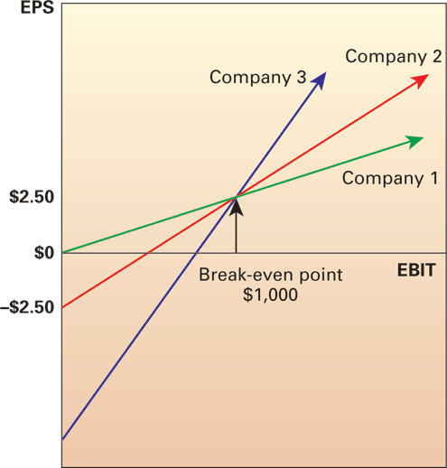
16.3 Break-Even Earnings for Different Capital Structures (continued)
3) Below an EBIT of $1000, e.g. $800: leverage hurts and vice-versa as shown in Figure 16.1.
Figure 16.1 Earnings per share and earnings for three different capital structures.

Slide 14
16.4 Pecking Order
The pecking order hypothesis is based on the notion that firms have a preferred order of raising capital.
Accordingly, it states that:
1. Firms prefer internal financing (retained earnings) first.
2. If external financing is required, firms will choose to issue the safest or cheapest security first, starting with debt financing and using equity as a last resort.

Slide 15
16.4 (A) Firms Prefer Internal Financing First
Why do firms prefer internal financing first?
It typically requires less effort,
Avoids transactions cost,
Avoids loss of secrecy.

Slide 16
16.4 (B) Firms Choose to Issue Cheapest Security First and Use Equity as a Last Resort
Retained earnings being limited, firms have to use other external sources such as debt and equity.
When they do tap the capital markets, firms tend to issue debt first, ➔ less costly, and leads to less loss of control, and equity last, ➔ too much debt can put the firm into a risk of bankruptcy.

Slide 17
16.4 (B) Firms Choose to Issue Cheapest Security First and Use Equity as a Last Resort (continued)
In summary, there are three implications of the pecking order hypothesis:
Profitable companies will borrow less ➔ they have more internal funds available ➔ and may have lower debt to equity ratios ➔ they have more debt capacity.
Less profitable companies will need more external funding and will first seek debt financing in an asymmetric world, avoiding the equity market.
As a last resort, firms will sell equity to fund investment opportunities.

Slide 18
16.5 Modigliani and Miller on Optimal Capital Structure
Franco Modigliani and Merton Miller (M&M), two Nobel laureates, ➔ developed a series of propositions around the question of whether or not there exists an optimal capital structure that firms can strive for.
The basic assumption underlying the various propositions is that investment decision of a firm is separate from its financing decision,
firms first decide which products and services to invest in and only then figure out what mix of financing sources they will use to finance the investment.

Slide 19
16.5 (A) Capital Structure in a World of No Taxes and No Bankruptcy
In 1956, M&M introduced their first theory which stated that in a world with no taxes and no bankruptcy risk, a firm’s debt-equity mix would be irrelevant.
M&M proposition I states that in a world with no taxes and no bankruptcy risk, the value of a leveraged firm (V_{L}) would equal that of an otherwise identical all-equity firm (V_{E}), i.e. the value of a firm does not depend on its capital structure.

Slide 20
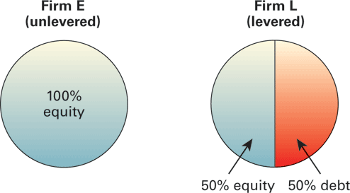
16.5 (A) Capital Structure in a World of No Taxes and No Bankruptcy (continued)
Figure 16.2 Value of firms according to Modigliani and Miller’s Proposition I in a world of no taxes.

Slide 21
16.5 (A) Capital Structure in a World of No Taxes and No Bankruptcy (continued)
M&M proposition II: states that the value of a firm depends on three things:
1. The required rate of return on the firm’s assets (which is the same for firms with identical assets or investment choices)
2. The cost of debt to the firm
3. The debt to equity ratio of the firm.
In a world with no bankruptcy risk and taxes, the value of a firm would simply be the present value of its cash flow assumed to be received in perpetuity,
V_{F} = Cash Flow
r
where r is the weighted average cost of capital of the firm (WACC) and can be calculated by using Equation 16.2.

Slide 22
16.5 (A) Capital Structure in a World of No Taxes and No Bankruptcy (continued)
Where E = the equity value;
D = the debt value;
V = the value of the firm = E+D
R_{e} = the cost of equity;
R_{d} = the cost of debt; and
T_{c} = the corporate tax rate

Slide 23
16.5 (A) Capital Structure in a World of No Taxes and No Bankruptcy (continued)
Since V=D+E, we can manipulate equation 16.3 to solve for the cost of equity (R_{e}) as shown in Equation 16.4:
➔R_{a} = [(E/V)* R_{e}] + [(D/V)R_{d}]➔[(E/V* R_{e}] = R_{a} - [(D/V*R_{d}]
➔R_{e} = R_{a}*V/E – D/E*R_{d}
Since V=D+E, we have
➔R_{e} = R_{a}*(D+E)/E – D/E*R_{d} ➔R_{e} = R_{a}*(1+D/E) – D/E*R_{d}
➔R_{e} = R_{a} + D/E*Ra – D/E*R_{d}➔R_{e} = R_{a} + D/E(R_{a} – R_{d})

Slide 24
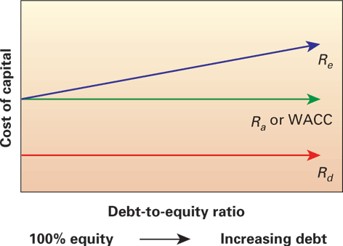
16.5 (A) Capital Structure in a World of No Taxes and No Bankruptcy (continued)
Figure 16.3 illustrates the trade-off between higher levels of debt and higher cost of equity, as implied in Equation 16.4
Figure 16.3 M&M Proposition II.

Slide 25
16.5 (A) Capital Structure in a World of No Taxes and No Bankruptcy (continued)
Example 2: Applying M&M’s Propositions I and II in a world with no taxes.
Firm A is an all-equity firm with a required return on its assets of 9%.
Firm B is a levered firm and can borrow in the debt market at 7%.
Both companies operate in an utopian world of no taxes and no bankruptcy (no risk).
If M&M proposition II holds, what is the cost of equity as firm B goes from (a) having 10% debt, to (b) 40% debt and finally to (c) 90% debt.
Which capital structure would be the best for this levered firm?

Slide 26
16.5 (A) Capital Structure in a World of No Taxes and No Bankruptcy (continued)
Example 2 Answer
To solve this problem we need to calculate the cost of equity and the WACC, of Firm B under the 3 different capital structures given.
With 10% debt➔Firm B’s debt-equity ratio is 10/90;
R_{a}=9%; R_{d}=7%; R_{e} = 9% + (9%-7%)*1/9 ➔9.22%
➔WACC = R_{a} = (.9*9.222%) + (.1*7%) ➔9%

Slide 27
16.5 (A) Capital Structure in a World of No Taxes and No Bankruptcy (continued)
Example 2 Answer (continued)
With 40% debt➔D/E = 40/60
R_{e} = 9% + (9%-7%)*.667➔10.334%
WACC = .6*10.334%+.4*7% ➔9%
With 90% debt➔D/E = 90/10
R_{e} = 9% + (9%-7%)*9 ➔27%
WACC = .1*27% + .9*7% ➔9%
Since the WACC of the levered firm is the same as that of the all-equity firm (9%) in all three scenarios, we can say that debt does not matter.

Slide 28
16.5 (B) Capital Structure in a World of Corporate Taxes and No Bankruptcy
Once M&M injected some reality into their capital structure discussion, i.e. that taxes are a way of life, their Propositions I and II got turned around.
With interest being tax-deductible, the levered firm pays less tax on its income than an all-equity firm, and the equity holders enjoy more in residual profits as portrayed in Figure 16.4

Slide 29
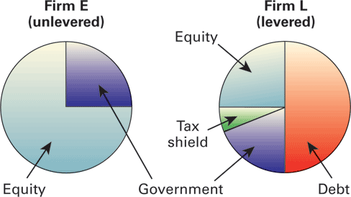
16.5 (B) Capital Structure in a World of Corporate Taxes and No Bankruptcy (continued)
Figure 16.4 Value of firms in a world of corporate taxes.
As the firm issues more debt, its tax shield increases,
and the government’s share of the pie decreases, increasing
the value of the equity-holders.
The new Propositions I and II are as follows:
Proposition I, with taxes: All debt financing is optimal.
Proposition II, with taxes: The WACC of the firm falls as more
debt is added.

Slide 30
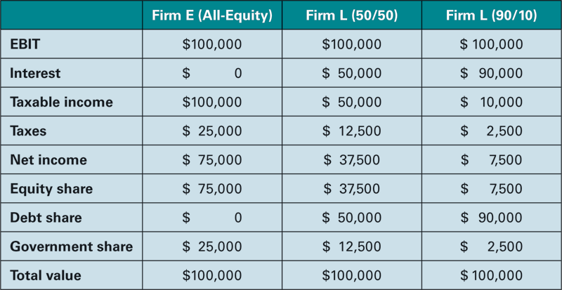
16.5 (C) Debt and the Tax Shield
Table 16.5 EBIT Distribution to Claimants under Different Funding Structures
Table 16.5 shows the effect of increasing debt levels on the distribution of a firm’s EBIT.
As the firm’s debt level goes from 0% to 90%, with EBIT staying constant at $100,000, government’s share of EBIT (taxes) dwindles from $25,000 to $2,500, thereby increasing the share of debt and equity holders from $75,000 to $97,500

Slide 31
16.5 (C) Debt and the Tax Shield (continued)
Equation 16.5 sums up M&Ms Proposition I in a world with corporate taxes as follows:
It shows that the value of a levered firm is greater than the value of an unlevered firm by the amount of the tax shield from selling debt, i.e. D*T_{c}.
The WACC equation (with T_{c}>0) shows that the cost of capital is reduced as the firm gets more levered.

Slide 32
16.5 (C) Debt and the Tax Shield (continued)
Example 3: An all-equity firm has a value of $8 million dollars and is currently being taxed 34% on its EBIT. The WACC for the company is currently at 16%. The current CEO who has just learned about M&Ms capital structure theory wants to sell $4 million worth of debt to take advantage of the tax shield on interest and accordingly increase the value of the firm for the equity holders. Is he justified in doing so? Please explain.
Answer
All-Equity Firm 50/50 Firm
Firm Value $8,000,000 $8,000,000
Debt holders’ share 0 $4,000,000
Government share (34%) $2,720,000 $1,360,000
Equity holders’ share $5,280,000 $8,640,000
Yes, the equity holder’s wealth has increased from $5,280,000 to $8,640,000

Slide 33
16.6 The Static Theory of Capital Structure
So if increasing debt levels leads to increasing firm values, why do firms not attempt to go for maximum debt?
➔➔➔bankruptcy risk.

Slide 34
16.6 (A) Bankruptcy
Risk of losing the firm ➔inability of a firm to pay its debt and other obligations. At bankruptcy, the value of equity is equal to zero, and the value of the firm’s assets is equal to or probably less than its liabilities.
Bankruptcy entails both direct and indirect costs.
Direct costs include the legal and administrative fees necessary to settle the claims of creditors etc.
Indirect costs of bankruptcy, called financial distress costs—include lost sales, loss of valuable employees, loss of consumer confidence, and loss of profitable opportunities while facing bankruptcy.
The greater the amount of debt carried by a firm ➔ greater chance of bankruptcy ➔ higher the financial distress costs.

Slide 35
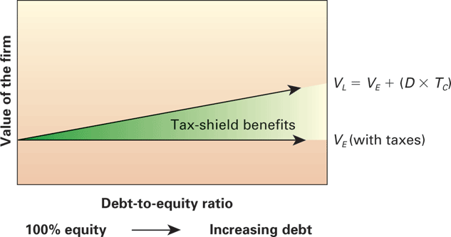
16.6 (B) Static Theory of Capital Structure
Figure 16.5 M&M Proposition II with taxes, where VE represents the value
of an unlevered or 100% equity-financed firm and VL represents the value of the levered firm.
The optimal capital structure (i.e. D/E)* comes at the point where the additional tax-shield benefit of adding one more dollar of debt financing is equal to the direct and indirect cost of bankruptcy from that extra dollar of debt.

Slide 36
16.6 (B) Static Theory of Capital Structure (continued)
3 scenarios discussed in this chapter lead to the following conclusions:
No taxes, no bankruptcy. Debt is irrelevant, since the values of leveraged firms and otherwise identical unleveraged firm are equal across all potential debt-equity ratios and the cost of capital is constant.
Taxes, no bankruptcy. The value of a firm increases by the amount of the tax shield due to debt. The value of the firm is greatest with 100% debt financing and its cost of capital is the lowest.
Taxes, bankruptcy. The value of a firm is maximized and its cost of capital is minimized at the point where the marginal benefit of financial leverage (the tax shield) equals the marginal cost of bankruptcy (financial distress costs).

Slide 37
Additional Problems with Answers Problem 1
Different Loan Rates – Diversified Holdings has three subsidiaries, each of which borrows funds from the parent company and has a different success rate with the projects it undertakes.
Subsidiary A is successful with its projects 80% of the time,
Subsidiary B gets it right 93% of the time,
Subsidiary C 75% of the time, and
Subsidiary D 85% of the time.
What loan rates should Diversified Holdings charge each subsidiary for loans?

Slide 38
Additional Problems with Answers Problem 1 (Answer)
Subsidiary A: To breakeven with an 80% success rate the firm will need to recoup, $1/.80= $1.25. It should charge a return greater then ($1.25)-1 = 25%
Subsidiary B: To breakeven with a 93% success rate Sub. B will need to recoup, $1/.93= $1.075268. He should charge a return greater then ($1.075268/$1.00)-1 = 7.526%
Subsidiary C: To breakeven with a 75% success rate Sub. B will need to recoup, $1/.75= $1.333. He should charge a return greater then ($1.3333/$1.00)-1 =33.33%
Subsidiary D: To breakeven with an 85% success rate Sub. D will need to recoup, $1/.85= $1.17647. He should charge a return greater then ($1.17647/$1.00)-1 =17.747%.

Slide 39
Additional Problems with Answers Problem 2
Benefits of Borrowing – Loyola Turbo Engines is looking at expanding its operations by adding another manufacturing location. If successful, the company will make $750,000, but if it fails, the company will lose $300,000. Loyola can borrow the required capital of 300,000 at 16%.
If all their projections point to an 85% probability of success, should they borrow the money and go ahead with the expansion?
Above what minimum probability of success will the project be acceptable with a discount rate of 16%?

Slide 40
Additional Problems with Answers Problem 2 (Answer)
(a) Accept when expected payout exceeds cost of loan
Exp. ret. = .85($750,000) + .15(-$300,000) = $592,500
Cost = $300,000(1+.16) <$348,000>
Expected Profit $244,500
(b) X%($750,000)+(1-X%)(-300,000) = 348,000
1,050,000X%=648,000➔ X=648000/1050000➔ 61.71%
With a discount rate of 16%, the project would be acceptable as long as its probability of success was at least 61.71%.

Slide 41
Additional Problems with Answers Problem 3
Break-even EBIT: The Fast-Track Co. has thus far only used equity to finance its operations and currently has 1,000,000 shares outstanding with an EBIT of $1,500,000.
The newly-hired CFO firmly believes that the firm would benefit its shareholders a great deal by issuing $10,000,000 of debt at the rate of 10% per year and buying back 400,000 shares.
If interest is tax-deductible, the firm is being charged a rate of 10% interest on borrowed funds, and the firm is in a 35% tax bracket, is the new CEO correct? Assume that the firm’s operating income will remain the same irrespective of its capital structure.

Slide 42
Additional Problems with Answers Problem 3 (Answer)
Interest on $10,000,000 of debt would be➔.1*$10,000,000 = $1,000,000
Indifference EBIT =[EBIT*(1-.35)]/1,000,000 = (EBIT-1,000,000) *(1-.35)
600,000
➔ 600,000*(.65EBIT)=1000000*(.65EBIT-650,000)
➔390,000EBIT=650,000EBIT-650000*1000000
➔EBIT =$2,500,000
So, since the firm is currently earning an operating income that is below
2,500,000 it would be better off not issuing debt.
Check:
.65*1,500,000/1,000,000 = $0.975 ➔EPS (no debt)
($1,500,000-$1,000,000)*(.65)/600,000=$0.54167➔EPS (with debt)

Slide 43
Additional Problems with Answers Problem 4
M&M: With and without taxes – McRonald’s, which is currently valued at $10,000,000, is looking at changing its capital structure from an all-equity firm to a leveraged firm with 50% debt and 50% equity. Since McRonald’s is a not-for-profit company it pays no taxes.
If the required rate on the assets of McRonald’s is 16% (R_{A}), what is the current required cost of equity and what is the new required cost of equity if the cost of debt is 11%?
If McRonald’s loses its tax-exempt status and will be taxed at 35%, how will its value change under the new leveraged capital structure?
Assume that its after-tax value is $10,000,000 as an unleveraged firm.

Slide 44
Additional Problems with Answers Problem 4 (Answer)
(A) Under tax-exempt status:
R_{E} = R_{A +} (R_{A-} R_{D}) x (D/E)
Current required cost of equity:
➔ .16 + (.16-.11) (0) = .16 or 16%
New required cost of equity:
➔ .16 + (.16- .11) (.5/.5) = .21 or 21%

Slide 45
Additional Problems with Answers Problem 4 (Answer) (continued)
(B) If McRonald’s loses its tax-exempt status:
$10,000,000 after tax value,
➔$10,000,000/.65= $15,384,615.38 ➔implied before tax value
At 50% debt amount of new bond issues = $15,384,615.38 x (.5) = $7,692,307.70
Equity value after tax with new structure = $7,692,307.70x (1-.35) = $5,000,000
New equity wealth after tax
= $5,000,000 + $7,692,307.7 = $12,692,307.7

Slide 46
Additional Problems with Answers Problem 4 (Answer) (continued)
Or this problem can be solved by adding the current equity wealth unlevered to the tax shield
➔V_{L =} V_{E} + (D x T_{C})
$10,000,000 + ($7,692,307.70 x .35)
➔ $12,692,307.7

Slide 47
Additional Problems with Answers Problem 5
Equity Value in a Levered Firm – Sea Crest Corporation, which is an all-equity firm has an annual EBIT of $2,540,000, and a WACC of 15%. The current tax rate is 35%. Sea Crest Corp. will have the same EBIT forever. If the company sells debt worth $3,250,000 with a cost of debt of 10%,
What is the value of equity in the unlevered and levered firm?
What is the value of debt in the levered firm?
What is the government’s value in the unlevered and levered firm?

Slide 48
Additional Problems with Answers Problem 5 (Answer)
Present Value of Cash Flow = (2,540,000/.15) = $16,933,333.33
V_{E} = $16,933,333.33(1-.35) = $11,006,666.67
V_{L} = V_{E} + (D x T_{C})
➔$11,006,666.67 + ($3,250,000 x .35)
= $12,144,166.67
Government’s value:
Unlevered: $16,933,333.33 x .35 ➔ $5,926,666.67
Levered: ($16,933,333.33 - $3,250,000) x 0.35
➔ $4,789,166.67

Slide 49
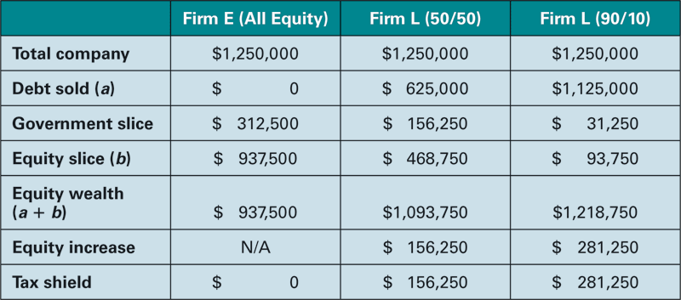
TABLE 16.6 Total Equity Wealth

Slide 50
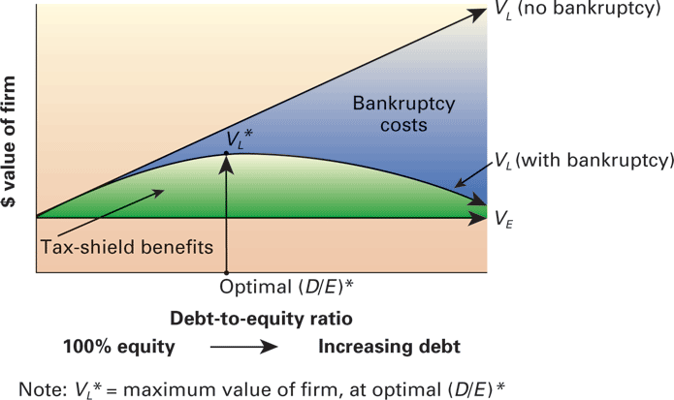
Figure 16.6 The static theory of capital structure.

Slide 51
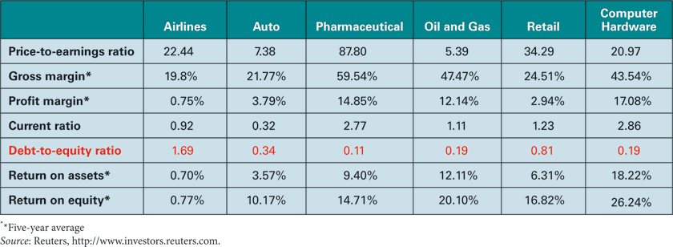
TABLE 16.7 Financial Ratios: Industry Averages

