Slide 1
Chapter 15
Raising Capital

Slide 2
Learning Objectives
Describe the life cycle of a business.
Understand the different sources of capital available to a start-up business and a growing business.
Explain the funding available to a stable or mature business.
Explain how companies sell bonds in a capital market.
Explain how companies sell stocks in a capital market.
Examine some special forms of financing: commercial paper and bankers’ acceptance.
Describe the options and regulations for closing a business.

Slide 3
15.1 The Business Life Cycle
A firm typically goes through 5 stages in its life cycle: start-up, growth, maturity, decline, and closing.
Each stage presents unique problems, opportunities, and funding requirements.
Business life cycles vary considerably. Some firms go through the early stages fairly rapidly and then settle into maturity for a long time, while others skip to the closing stage in a few years.
The US Census Bureau’s Business Information Tracking System estimates that roughly 60% of businesses that employ others besides the owners will close within their first 6 years.
The life cycle approach is a useful way to discuss financing opportunities and sources for businesses.
Figure 15.1 The business life cycle.

Slide 4
15.2 Borrowing for a Start-up and Growing Business
5 sources of capital can generally be used to start and grow a business:
Personal funds
Borrowed funds from family and friends
Commercial bank loans
Borrowed funds through business start-up programs like the U.S. Small Business Administration (SBA)
Angel financing or venture capital

Slide 5
15.2 (A) Personal Funds and Family Loans
Limited in scope, but often good starting points for most entrepreneurs and sole proprietorships.
Professional lenders like commercial banks and venture capitalists view funding by family and friends as a sign that the business has potential.
After all, if you can’t convince your family and friends that you have a good business idea, how can you convince a stranger?

Slide 6
15.2 (B) Commercial Bank Loans
Constitute the first source that people often seek after they have run out of friends and in-laws to ask.
Banks tend to be very conservative lenders often requiring substantial collateral, income history and evidence of stability.
Start-ups are rarely directly funded by commercial banks.

Slide 7
15.2 (C) Commercial Bank Loans through the Small Business Administration
Available to qualified small business applicants via a variety of loan programs, the most common of which is the 7(a) Loan Guaranty Program.
The 7(a) Loan Guaranty Program administers business loans to individuals or businesses that might not be eligible for a loan through the normal lending agencies.
Loan proceeds can be used for working capital and fixed assets, with repayment schedules extending up to 25 years.
These loans are delivered through commercial lenders and guaranteed by the SBA.
The interest rates tend to be quite competitive but the major advantage of this program accrues to the banks since the loans are backed by the SBA.

Slide 8
15.2 (D) Angel Financing and Venture Capital
Generally sought by entrepreneurs and businesses that would not qualify for commercial bank or SBA-backed financing.
Angel investors are wealthy individuals and groups that are interested in providing initial funding for high-risk ideas. They typically have very short loan investment horizons (less than 10 years) and upside limits of about $2 million.
Venture capitalist firms or funds are also willing to fund high-risk projects, but have longer time horizons and higher funding limits. They generally provide the funding in stages.

Slide 9
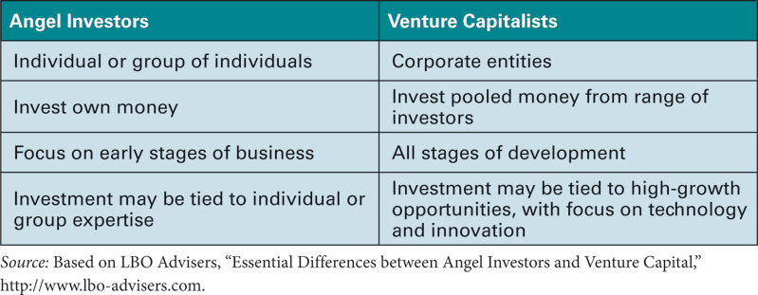
15.2 (D) Angel Financing and Venture Capital (continued)
Table 15.1 Differences between Angel Investors and Venture Capitalists

Slide 10
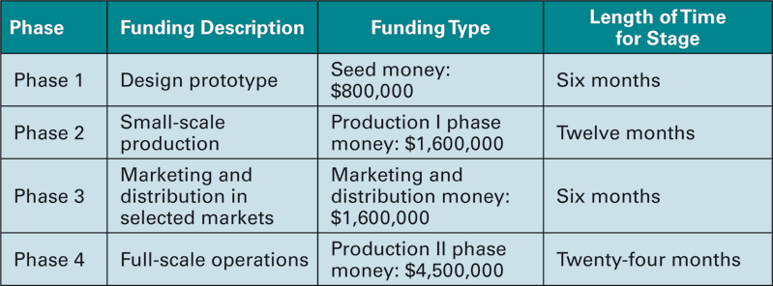
15.2 (D) Angel Financing and Venture Capital (continued)
Table 15.2 Mobile Medical Device Targets and Funding Amounts
Entrepreneurs with strong, promising ideas could be in a position to choose from a group of angel investors and venture capitalists.

Slide 11
15.2 (D) Angel Financing and Venture Capital (continued)
Factors to look for when picking a financier or group of financiers include:
Financial strength i.e. Will the financier have the necessary funding ability to back the project until its completion?
Contacts: i.e. Can the financier provide valuable contacts to help the entrepreneur reach his or her goal?
Exit strategy: i.e. how much equity is the investor looking to acquire as a condition of providing the funding and how much of control is the entrepreneur willing to give up?
Given that there is a high probability of failure among start-ups, angel investors and financiers commonly look for 60% - 100% potential annual rates of return on their successful ventures in order to provide funding.

Slide 12
15.2 (D) Angel Financing and Venture Capital (continued)
Example 1: Expected rate of return for a venture capitalist.
The Quick Start Funding Group is looking to fund only those projects which have the potential to return $10 million dollars for every $1 million that they have invested within a 5-year period.
Calculate the firm’s expected rate of return on its investment.
Answer
FV = $10 million; PV = 1 million; N=5; CPT I% ➔58.49% per year is the firm’s annual expected rate of return on investment.

Slide 13
15.3 Borrowing for a Stable and Mature Business: Bank Loans
Commercial banks provide much of the short-term financing required for the operating needs of a business via
straight loans,
discount loans, and
lines of credit with or without compensating balances.

Slide 14
15.3 (A) Straight loans
Represent the simplest of all types of bank loans
Offered with a quoted APR and pre-set payment amounts and intervals.

Slide 15
15.3 (A) Straight loans (continued)
Example 2: Calculating payments and EAR of a straight loan. The Timken Company wants to borrow $2,000,000 from its local bank. The bank quotes them a rate of 8.25% (APR) on a 5-year loan with payments due monthly. How much will their monthly payment be and what is their EAR?
Answer
PV = 2,000,000; FV = 0; N=60; i=8.25; P/Y=12;C/Y=12; PMT➔40,792.5
EAR = (1 + (.0825/12)¹² – 1➔8.569%

Slide 16
15.3 (B) Discount Loans
Offered to firms with the interest amount being already subtracted at the start.
The difference between the amount the firm can use and the amount that has to be paid back at the end is the bank’s interest or discount earned.
The loan amount is the amount due at maturity

Slide 17
15.3 (B) Discount Loans (continued)
Example 3: Discount loan. Let’s say that a firm needs $2,000,000 to fund the operations of its new expansion. It approaches a commercial bank, which offers it a discount loan at 9.5% per year which will have to be paid back in full in one payment at the end of twelve months. How much will the face value of the loan have to be set at and what rate of interest is the company effectively paying?
Answer
Loan amount (face value) = Amount needed/(1-discount rate) ➔$2m/(1-.095) ➔$2,209,000. Amount used = $2,000,000
Effective rate = discount paid/Amount used
➔ = 209,000/2,000,000 ➔10.45%

Slide 18
15.3 (C) Letter of Credit or Line of Credit
Line of credit is a preapproved borrowing amount that works much like a credit card.
The company can borrow money at a preset rate from bank at any time without seeking additional approval of the loan each time it needs funds.
The bank, however, is compensated based on the outstanding balance of the loan. The compensation can be a fixed interest rate, but often is a floating interest rate tied to a benchmark interest rate.
This borrowing style has changing balances and changing interest rates, so it is difficult to state the effective rate on the loan.

Slide 19
15.3 (D) Compensating Balance
These loans work like lines of credit except that a portion of the loan is not available to the borrower, even though interest is paid on the full face value of the loan.
For example, if a firm takes a loan of $100,000 at a rate of 7.5% per year and a compensating balance requirement of 15%, it will be able to use only $85,000 and be charge $7,500 in interest for the year. The effective rate of interest will therefore be:
Effective rate = Interest paid/Amount used
➔ $7,500/$85,000 ➔8.82%

Slide 20
15.4 Borrowing for a Stable and Mature Business: Selling Bonds
Corporate bonds ➔a major source of long-term financing for established companies.
Typically sold in $1000 units, and publicly auctioned or privately placed.
Public issue--regulated by the SEC ➔involves the following 5 steps
Company selects an investment bank.
Register the bond with the SEC
The bond is rated by an agency such as Standard & Poor’s or Moody’s
The investment bank markets the bond to prospective buyers
An auction is conducted to sell the bond.

Slide 21
15.4 Borrowing for a Stable and Mature Business: Selling Bonds (continued)
2 key documents ➔required during the bond issuance process:
prospectus
indenture agreement.
The prospectus ➔much of the information filed in the registration and is used to inform potential buyers about the bond.
The indenture agreement ➔formal contract for the bond between the issuing company and the eventual buyer.
It includes vital information about the bond such as the
coupon rate, payment schedule, maturity date, and par value
other restrictive covenants ➔restrict the activities of the issuing firm to increase the safety of the bond in the eyes of potential buyers.

Slide 22
15.4 Borrowing for a Stable and Mature Business: Selling Bonds (continued)
Firms that issue coupon bonds have to make periodic coupon payments and a large lump sum payment at maturity.
Sinking funds or reserve accounts ➔ set up by bond issuers to put away funds every year so as to have the necessary funds available to retire the bond when it matures.

Slide 23
15.4 Borrowing for a Stable and Mature Business: Selling Bonds (continued)
Example 4: Bond proceeds.
The Golden Corral Corporation is in the process of issuing a 30-year, 8% coupon (paid semi-annually) AA1-rated corporate bond with $1000 par value.
If by the time the bonds receive SEC clearance, the market yield on this bond goes to 8.35%,
and the company sells 3000 of these bonds with the help of an investment banker who charges them a commission rate of 3% on the proceeds,
what will the total proceeds be for the issuing company, and
what is the cost of these bonds to the firm in terms of the cost of capital?
What are the firm’s future cash obligations?

Slide 24
15.4 Borrowing for a Stable and Mature Business: Selling Bonds (continued)
Example 4 Answer
P/Y=2;C/Y=2;N=60;PMT=40;FV=1000;I=8.35 PV➔$961.686
Gross proceeds from sale of bonds = 3000*$962=$2,885,058
Investment banker’s commission = .03*$2,885,058= $86,552 (rounded)
Total proceeds received by the issuing company = $2,798, 506
Net proceeds per bond = $961.686*(1-.03) = $932.84

Slide 25
15.4 Borrowing for a Stable and Mature Business: Selling Bonds (continued)
Example 4 Answer (continued)
Cost of debt to Golden Corral based on net price:
P/Y=2; C/Y=2; PV=-932.84; N=60; PMT=40; FV=1000;I ➔8.629%
Future cash obligations:
Annual Coupon payments = $40*2*3000 = $240,000
Principal payment at maturity= $1000*3000 = $3,000,000

Slide 26
15.5 Borrowing for a Stable and Mature Business: Selling Stock
Common stock ➔the other major source of capital for a firm to avail of
Equity holders get voting rights as part owners and share in the residual profits of the firm.
initial public offerings (IPOs) when the firm first goes public and
seasoned offerings for subsequent issues.

Slide 27
15.5 (A) Initial Public Offerings and Underwriting
Firms sell stock to the public with the help of investment banking firms, who perform due diligence and are experts in marketing the issue.
Investment banks partner with issuing firms in exchange for compensation that can be set up on a best-efforts basis or on a fixed-commitment basis.
Under a best-efforts arrangement the investment bank pledges to use its best efforts to sell all the authorized shares and takes a cut on each individual share sold, but provides no guarantee as to how many shares will be sold. The more shares sold, the higher the payoff to the investment bank.
Under a fixed-commitment arrangement, also known as an underwriting arrangement, the investment banker guarantees a fixed amount of proceeds to the issuer. The investment banker makes up/keeps the difference between the actual selling price and the guaranteed price.

Slide 28
15.5 (A) Initial Public Offerings and Underwriting (continued)
Example 5: Best efforts versus fixed commitment underwriting:
The Wed Link Inc. wants to raise capital by issuing common stock. They contact a few investment bankers and the one with the best offer has presented them with 2 options:
A fixed commitment offer of $8,500,000
A best efforts arrangement in which the investment banker will receive $1.50 per share for every share of stock sold up to $$1,500,000 for the 1,000.000 shares to be offered to the public at $11 per share.
If 100% of the shares are sold, what are Wed Link’s proceeds? What is the payment to the investment banking firm under each method of issuing securities?
What if 85% of the shares are sold? At what percentage of shares sold are the proceeds to you the same under the two compensation arrangements?
At what percentage is the payment to the investment banking firm the same?

Slide 29
15.5 (A) Initial Public Offerings and Underwriting (continued)
Example 5 Answer
If 100% of the shares are sold i.e. 1,000,000 shares at $11 per share, to the public, the proceeds are as follows:
1) With the firm commitment arrangement, the issuer gets $8,500,000
The investment banker gets $11,000,000 - $8,500,000
➔$2,500,000
2) With the best efforts arrangement, the issuer gets
($11-$1.50)*1,000,000➔$9,500,000
The investment banker gets $1.50*1,000,000 ➔ $1,500,000
So, if the issue is 100% sold, the issuer is better off with the best efforts arrangement, while the investment banker would be better off with the fixed commitment arrangement.

Slide 30
15.5 (A) Initial Public Offerings and Underwriting (continued)
Example 5 Answer (continued)
b) If 85% of the shares are sold, i.e. 850,000 shares at $11 per share, the proceeds are as follows:
1) With the firm commitment arrangement, the issuer gets $8,500,000
The investment banker gets $9,350,000 - $8,500,000 = $850,000
2) With the best efforts arrangement, the issuer gets
($11-$1.50)*850,000➔$8,075,000
The investment banker gets $1.5*850,000➔$1,275,000
So if the issue is only 85% sold, the issuer is better off with a firm commitment offer while the investment banker would be better off with the best efforts arrangement.

Slide 31
15.5 (A) Initial Public Offerings and Underwriting (continued)
Example 5 Answer (continued)
c) Firm commitment offer = best effort $ per share sold
$8,500,000 = $9.50*1,000,000 * X%
➔ X% = $8,500,000/$9,500,000 ➔89.47%
So, if 89.47% of the shares are sold, the payment to the investment banking firm will be the same under either arrangement.

Slide 32
15.5 (B) Registration, Prospectus, and Tombstone
All new issues of shares have to be registered with the SEC prior to being sold in the capital markets.
20 to 40 days (cool-off period.)
During the waiting period, the issuer can circulate a preliminary prospectus (red herring) informing potential investors of the issue.
No commitments can be obtained from buyers until after SEC approval.
If information is missing, the SEC issues a comment letter, requiring corrections and a new application to be filed.
Once re-filed, the cool-off period starts again.
During the waiting period the issuer and investment bank place large advertisements (tombstone ads.) in newspapers and magazines,
containing the name of the issuer,
some details about the issue,
a list of participating investment banks.

Slide 33
15.5 (B) Registration, Prospectus, and Tombstone (continued)
There are 2 exceptions to the usual SEC registration process requirement,
If the issue has a maturity of less than 270 days e.g. commercial paper issues.
If the issue is worth less than $5 million (Regulation A)

Slide 34
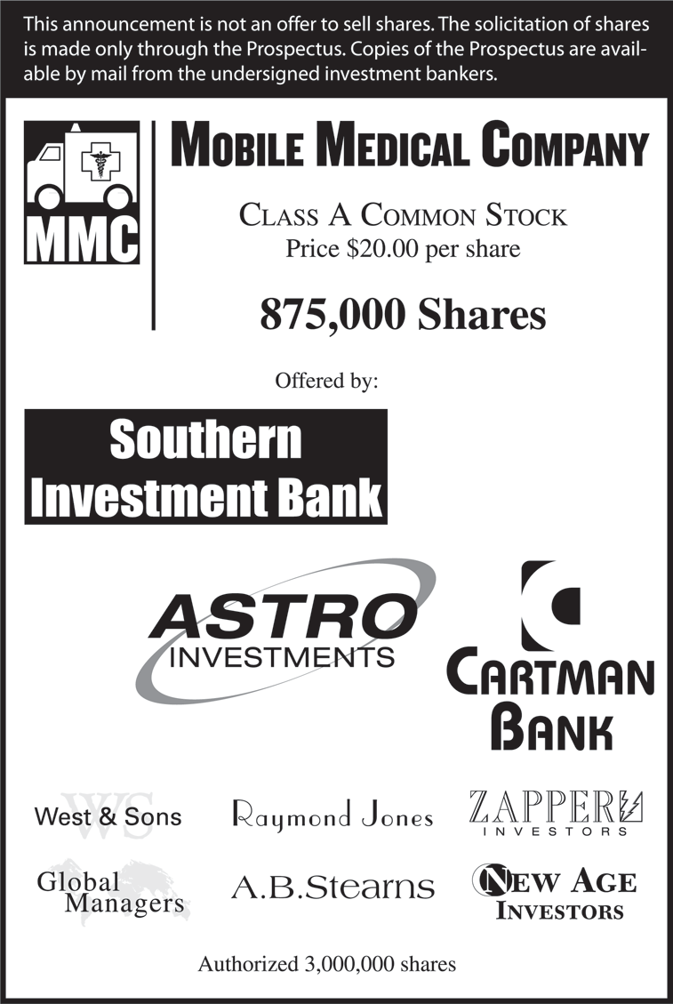
15.5 (B) Registration, Prospectus, and Tombstone (continued)
Figure 15.2 Tombstone for Mobile Medical Co.

Slide 35
15.5 (C) The Marketing Process: Road Show
Involves taking the issue on the road to attract interest among potential investors.
Process lasts about 2 weeks and enables the investment banker to get a feel for what the price should be set at.
After a successful road show and marketing campaign, a price is set and the issue proceeds forward to be auctioned off in the primary capital market.

Slide 36
15.5 (D) The Auction
Takes place on a single trading day,
➔ buyers submit their bids at pre-set prices.
➔ If over-subscribed, the bids are filled on a pro-rata basis until all the shares are sold.

Slide 37
15.5 (E) The Aftermarket: Dealer in the Shares
After completion of the auction the outstanding shares trade in the secondary market and the investment banker ➔ functions as a dealer in the stock for a minimum of 18 months, ➔ the “green-shoe provision.”
The green shoe provision allows the investment banker the right to purchase up to 15% of additional shares over a thirty-day period beyond that offered to the public during the auction ➔maintain inventory and fill any pent-up demand.
A lock-up agreement, ➔the original owners of the firm have to maintain their shares of stock for 180 days, ➔prevent dumping of stock and free-fall in its price due to profit-taking on part of the original owners.

Slide 38
15.6 Other Borrowing Options for a Mature Business
Commercial paper
Bankers’ acceptances
Commercial paper ➔ discounted note sold by a company directly to an investor with both principal and interest repaid within 270 days (just like a treasury bill).
Face value = $100,000,
Out of the reach of most small investors.
It is generally assumed institutions and sophisticated investors purchase commercial paper.
The reason firms issue commercial paper over other forms of borrowing:
➔lower rates than through commercial banks and
since they mature within 270 days, ➔short-form registration with the SEC.

Slide 39
15.6 Other Borrowing Options for a Mature Business (continued)
Example 6: The Large-Scale Industrial Corporation, a large well established company, is about to issue $6,000,000 worth of commercial paper.
The paper has a maturity of 9 months (270 days), and commands a price worth 97.5% of par value in the market.
The paper will be sold with a face or par value of $100,000.
How many commercial papers will be sold?
What is the cost of this borrowing to the firm?

Slide 40
15.6 Other Borrowing Options for a Mature Business (continued)
Example 6 Answer
Proceeds from the issue = Face Value *Discounted Value
= $6m*.975=$5.85m
Cost of this borrowing over 270 days =($6m-$5.85m)/$5.85m
=.02564
APR = .02564*365/270 = 0.03466➔3.47%
EAR = (1.02564)^{365/270} – 1➔3.48%
Number of commercial papers issued = Total Face Value
Par Value of 1
= $6,000,000/$100,000 = 60 papers

Slide 41
15.6 Other Borrowing Options for a Mature Business (continued)
A Bankers’ acceptance ➔short-term credit arrangement created by a firm and guaranteed by a bank,
and it is ordinarily used to finance inventories or other assets that will be self-liquidated over a relatively short period of time.
Its specific purpose is to promote trade.
It typically involves an importing firm having its invoice guaranteed (accepted) by a bank and sent over to the exporter as assurance of payment in the next few months (typically 60-90 days).
The exporter turns in the banker’s acceptance to his bank in exchange for a reduced payment and
in return the bank in the exporting country takes title to the exported goods until payment is received.
The importing firm is able to finance its purchases and releases funds as inventory is liquidated.

Slide 42
15.7 The Final Phase: Closing the Business
Sometimes, successful solvent firms decide to cease operations,
they sell off their assets,
pay off all outstanding debts and expenses,
and distribute the residual value to the stockholders.
When firms are unsuccessful, they may decide to cease operations,
declare bankruptcy, and liquidate their assets;
or they may decide to re-organize, attempt to re-establish themselves, and try to re-emerge as stronger firms.

Slide 43
15.7 (A) Straight Liquidation: Chapter 7
Chapter 7 of The Federal Bankruptcy Reform Act (1978)
➔ process that has to be followed when a firm decides to close its business and liquidate its assets.
Once a firm files for Chapter 7, the bankruptcy court judge appoints a trustee to oversee the process of liquidation, the order of which is as follows:

Slide 44
15.7 (A) Straight Liquidation: Chapter 7 (continued)
Proceeds from the sale of the collateralized assets or transfer of actual assets to secured creditors to settle their claims
The trustee’s expenses in administering the sale of assets and payment of claims
Payment to claimants whose claims result from activities after the filing of Chapter 7
Wage earners of the company for unpaid wages (there are limits for this class of claims)
Claims for unpaid portions of benefit plans for employees (again, there are limits for this class of claims)
Unsecured claims from customer deposits (up to a certain amount)
Federal, state, and local unpaid taxes
Unfunded pension plans
General unsecured creditors (unsecured bank loans, bondholders, and so forth)
Preferred stockholders up to the par value of their stock
Common stockholders (all remaining funds)
Note that common stockholders are last on the list and typically get little to nothing of the proceeds from the sale of the remaining assets.

Slide 45
15.7 (B) Reorganization: Chapter 11
Is what some firms file for if their managers feel that there is a chance that they could re-structure the firm and be worth more alive than dead. In a typical re-organization the process is as follows:
A petition for Chapter 11 is filed by either the company or by a creditor, and a bankruptcy court judge either accepts or denies the petition.
If accepted, a date is set by the judge for all claimants to show proof of their claims and
A reorganization plan is presented to the court and must be approved by a majority of the members of a claimant class.
If the claimants cannot agree on the reorganization plan, the judge may issue a ruling on all or parts of a plan and thus “decree” the reorganization plan.

Slide 46
15.7 (B) Reorganization: Chapter 11 (continued)
If a minority of classes does not agree to the plan, the judge may listen to their objections and alter the reorganization plan.
Often, the current managers continue to run the business while it operates under the reorganization plan, but the court may also appoint a trustee to oversee the operations and protect the rights of the claimants during this period of time.
The reorganization plan may allow the issuance of new securities and thus add another set of claimants to the firm.
Old debt may be restructured in terms of both maturity and rates.
The plan itself holds off claimants while the company tries to reorganize and come out of bankruptcy as a new operating firm.
If a firm fails to make the reorganization plan work, it will probably fall into Chapter 7 bankruptcy.

Slide 47
Additional Problems with Answers Problem 1
Venture Capital Required Rate of Return – Risk R Us Investors has a success ratio of 15% with its venture funding.
Their owners require a rate of return of 25% for their portfolio of lending,
and the average length on each loan is 4 years.
If you were to apply to Risk R Us for a $200,000 loan,
What is the annual percentage rate you would be required to pay for this loan?

Slide 48
Additional Problems with Answers Problem 1 (Answer)
First calculate how much $200,000 is 15% of?
i.e. $200,000/.15➔$1,333,333
➔for every $200,000 they are lending you they effectively would be looking to earn 25% on an investment of $1.33m to achieve their objective.
i.e. The venture capitalist will expect to earn a rate of 25% per year for 4 years on an investment if $1,333,333.
Calculate the FV of $1,333,333 @25% per year for 4 years.
N=4; I=25; PV=1333333; PMT = 0; CPT FV ➔$3,255,208.33
➔ expect the $200,000 investment in your venture to return $3,255,208.33.
Calculate the expected rate of return as follows:
N=4; PV = -200,000, FV = 3,255,208,33; PMT =0; CPT I = 100.86%➔APR

Slide 49
Additional Problems with Answers Problem 2
Discount loan versus straight loan: You want to borrow $250,000 for 1 year from your bank and are given the following 2 options:
Pay $21,900 per month for 12 months starting at the end of the 1st month.
Take a discount loan at the rate of 8% per year and pay the entire face value of the loan at the end of 12 months.
Which one is better?

Slide 50
Additional Problems with Answers Problem 2 (Answer)
Calculate the EAR under each option
Option 1 is a straight loan with PV = $250,000; N=12; PMT = -21,900; FV=0; i➔9.32% ➔APR; EAR➔(1 + (.0932/12))¹² – 1 = 9.73% (rounded at 2 decimals)
Option 2 is an 8% discounted loan, so to have $250,000 we would have to take on a loan with a face value of $250,000/0.92 = $271, 739.13 which is what we would owe at the end of 12 months.
So our APR = Interest paid/Amount used ➔$21,739.13/$250,000 ➔8.695% ➔ which is also our EAR
Option 2 is better! Lower EAR!

Slide 51
Additional Problems with Answers Problem 3
Bond proceeds: The Fire-Keepers Casino is in the process of issuing a 25-year, 9% coupon (paid semi-annually) AA2-rated corporate bond with $1000 par value.
If by the time the bonds receive SEC clearance, the market yield on this bond goes to 9.35%,
and the company sells 25000 of these bonds with the help of an investment banker who charges them a commission rate of 2.5% on the proceeds,
What will the total proceeds be for the issuing company,
What is the cost of these bonds to the firm in terms of the cost of capital?
What are the firm’s future cash obligations?

Slide 52
Additional Problems with Answers Problem 3 (Answer)
P/Y=2;C/Y=2;N=50;PMT=45;FV=1000;I=9.35; PV➔$966.38
Gross proceeds from sale of bonds = 2500*$966.38 =$2,415,9468.13
Investment banker’s commission = .025*$2,415,943.13 = $60,398.65
Total proceeds received by the issuing company
= $2,355,547.47
Net proceeds per bond = $966.38*(1-.025) = $942.22
Cost of debt to Golden Corral based on net price:
P/Y=2; C/Y=2; PV=-942.22; N=50;PMT=45;FV=1000;I ➔9.61%
Future cash obligations:
Annual Coupon payments = $45*2*25=00 = $225,000
Principal payment at maturity= $1000*2500 = $2,500,000

Slide 53
Additional Problems with Answers Problem 4
Firm Commitment vs. Best Efforts – Big Apple Investment Bankers offers Northern Diagnostics the following options on its initial public sale of equity:
(1) a best-efforts arrangement whereby Big Apple will keep 2 % of the retail sales or
(2) a firm-commitment arrangement of $6,000,000.
Lunar plans on offering 1,000,000 shares at $7.50 per share to the public.
If 100% of the shares are sold, which is the better choice for Northern Diagnostics?
Which is the better choice for Big Apple Investment Bankers?
What is the break-even sales percentage for Northern Diagnostics (point of indifference) and
What will each party receive at the break-even sales percentage?

Slide 54
Additional Problems with Answers Problem 4 (Answer)
Proceeds for Northern Diagnostics under each type of sales agreement:
Best Efforts 1,000,000 x $7.5 x (1 – 0.02) = $7,350,000
Firm Commitment $6,000,000
Best choice for Northern Diagnostics is Best Efforts
Proceeds for Big Apple Investments under each type of sales agreement:
Best Efforts 1,000,000 x $7.50 x (0.02) = $150,000
Firm Commitment 1,000,000 x $7.50 - $6,000,000 =$1,500,000
Best choice for Big Apple Investments is Firm Commitment

Slide 55
Additional Problems with Answers Problem 4 (Answer) (continued)
To calculate break-even Sales:
Sales Units x $7.50 (1 – 0.02) = $6,000,000
Sales Units = $6,000,000 / $7.35 = 816,327 shares
Best Efforts at 816,327 shares
To Northern Diagnostics: 816,327 x $7.50 x (1 – 0.02) = $6,000,000
To Big Apple Investment: 816,327 x ($7.5-$7.35) = $122,450
Firm Commitment at 816,327 sales:
To Northern Diagnostics: $6,000,000
To Big Apple Investments: 816,327 x $7.5 - $6,000,000 = $122,450

Slide 56
Additional Problems with Answers Problem 5
Commercial Paper – Cereal City Instruments will issue commercial paper for a short-term cash inflow.
The paper is for 182 days,
has a face value of $50,000,
and is anticipated to sell at 94% of par value.
Cereal City wants to raise $5,000,000, so what is the cost of this borrowing (annual terms) and how many “papers” will be sold?

Slide 57
Additional Problems with Answers Problem 5 (Answer)
Selling price is 0.94 x $50,000 = $47,000
The cost of this borrowing is:
182-day interest rate = ($50,000 - $47,000) / $47,000 = 0.06383
Stated annually we have:
Annual Percentage Rate = 0.06383 x 365/182 = 12.801%
Effective Annual Rate = (1 + 0.06383)^{365/182} – 1 = 13.21%
The total number of “papers” sold will be:
Number issued = $5,000,000 / $47,000 = 107
(must sell in whole units)

