Slide 1
Chapter 13
Working Capital Management

Slide 2
Learning Objectives
1. Model the cash conversion cycle and explain its components.
2. Understand why the timing of accounts receivable is important and explain the components of credit policy.
3. Understand the concept of float and its effect on cash flow and explain how to speed up receivables and slow down disbursements.
4. Explain inventory management techniques and calculate the economic order quantity (EOQ).
5. Account for working capital changes in capital budgeting decisions.

Slide 3
13.1 The Cash Conversion Cycle
In order to manage working capital efficiently, a firm has to be aware of how long it takes them, on average, to convert their goods and services into cash. This length of time is formally known as the cash conversion cycle.
The cash conversion cycle is made up of 3 separate cycles:
The production cycle: i.e. the time it takes to build and sell the product
The collection cycle: i.e. the time it takes to collect from customers (i.e. collecting accounts receivable) and
The payment cycle: i.e. the time it takes to pay for supplies and labor, i.e. paying accounts payable).

Slide 4
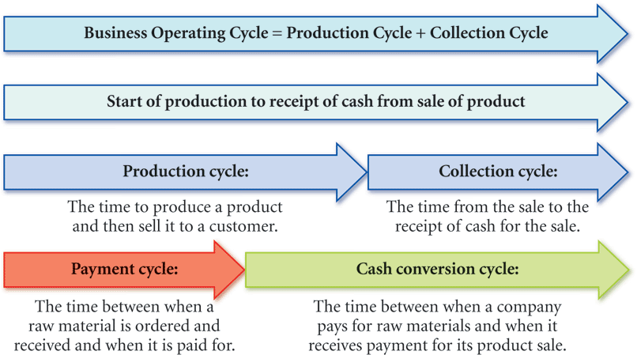
13.1 The Cash Conversion Cycle (continued)
The production cycle and the collection cycle together make up the operating cycle, so the cash conversion cycle can also be calculated as follows:
Cash conversion cycle = Operating cycle – Payment cycle.
Figure 13.1 The cash conversion cycle.

Slide 5
13.1 The Cash Conversion Cycle (continued)
The production cycle begins when a customer places an order and ends when the product is shipped out.
The collection cycle begins when the order is filled and ends when payment is received.
The payment cycle begins when labor is hired or raw materials are received to start production and ends when the firm pays for purchases, raw materials and other production costs.
Firms typically have to pay for production costs before they receive payment from their customers, a longer cash conversion cycle would tie up their finances and vice-versa.
Must keep track of these various cycles and try to shorten the cash conversion cycle so as to free up much needed funds.

Slide 6
13.1 (A) Average production cycle
Calculated in 3 steps.
First calculate average inventory as shown in Equation 13.2
Next, calculate the inventory turnover rate as follows:
Lastly, calculate the average production cycle as follows:

Slide 7
13.1 (B) Average collection cycle
Makes up the other leg of the operations cycle. It measures the number of days taken by a firm, on average, to collect its accounts receivables.
To measure it we first calculate the average accounts receivable, i.e.
Then we measure the accounts receivable turnover rate as follows:
Finally, we calculate the average collection cycle, i.e.
Average collection cycle = 365/A/R turnover rate.

Slide 8
13.1 (C) Average payment cycle
Also calculated with the same three steps
Except that we use the average accounts payable and accounts payable turnover to do it.

Slide 9
13.1 (D) Putting It All together: The Cash Conversion Cycle
Production cycle + Accounts receivable cycle – Payment cycle = Cash conversion cycle i.e. the number of days between when a firm incurs an outflow to start production until it receives payment on a credit sale.
So if a firm can shorten its production cycle or its collection cycle, or both, while keeping its payment cycle constant or lengthened, it can shorten the number of days that it would typically have to finance its operations for, thereby reducing its financing costs and increasing its profits.
Thus, shortening the cash conversion cycle essentially requires the efficient management of receivables (credit policy), inventory, and payables.

Slide 10
13.1 (D) Putting It All together: The Cash Conversion Cycle (continued)
Example 1: Measuring Cash Conversion Cycle.
Mark is has just been appointed as the chief financial officer of a mid-sized manufacturing company and is keen to measure the firm’s cash conversion cycle, operating cycle, production cycle, collection cycle, and payment cycle, so as to see if any changes are warranted. He collects the necessary information for the most recent fiscal year, and puts together the table below:
Cash sales $200,000
Credit sales $600,000
Total sales $800,000
Cost of goods sold $640,000
Ending Balance Beginning Balance
Accounts receivable $40,000 $36,000
Inventory $10,000 $6,000
Accounts payable $ 9,000 $ 5,000

Slide 11
13.1 (D) Putting It All together: The Cash Conversion Cycle (continued)
Example 1 Answer
First, we calculate the average values of the 3 accounts:
Average A/R ➔ ($36,000 + $40,000)/2 = $38,000
Average inventory ➔ $(10000+6000)/2 = $8,000
Average A/P ➔($9 000 + $5,000)/2 = $7,000
Next, we calculate the turnover rates of each:
A/R Turnover = Credit Sales/Avg. A/R ➔$600,000/$38,000 ➔15.7895
Inventory Turnover = Cost of Goods Sold/Avg. Inv➔ $640,000/$8,000 = 80
A/P Turnover = Cost of Goods Sold/Avg. A/P = $640,000/$7,000 = 91.43
Finally we calculate the collections cycle, the production cycle, and the payment cycle by dividing each of the turnover rates into 365 days, respectively.

Slide 12
13.1 (D) Putting It All together: The Cash Conversion Cycle (continued)
Example 1 Answer (continued)
Collection cycle= 365/A/R Turnover➔365/15.7895 ➔23.12 days
Production cycle = 365/Inv. Turnover➔365/80 ➔4.56 days
Payment cycle = 365/A/P Turnover➔365/91.43 ➔3.99 days
So the firm’s operation cycle = Collection cycle + Production cycle
= 23.12+4.56 = 27.68 days
Cash conversion cycle = Operating cycle – Payment cycle
= 27.68-3.99 ➔23.69 days.
So on average, the firm has to finance its credit sales for about 24 days.

Slide 13
13.2 Managing Accounts Receivable and Setting Credit Policy
The efficient management of accounts receivable ➔ critical step in shortening the cash conversion cycle.
Lax credit policy ➔ defaults
Strict credit policy➔ Lost sales
Firms have to establish well-balanced credit and collection policies to efficiently manage working capital.

Slide 14
13.2 (A) Collecting Accounts Receivable
The timing of collecting payments from customers is hardly uniform.
A certain percentage of customers always pay on time, while a small percentage is always late.
Firms have to analyze their historical collection patterns and accordingly plan for the future.

Slide 15
13.2 (B) Credit : A Two-Sided Coin
One firm’s accounts receivable is another firm’s accounts payable.
The cash conversion cycle decreases with a shortening of the collection cycle but increases with a lengthening of the payment cycle,
If a firms shortens it collection cycle by tightening its credit policy, its suppliers could do the same, which would negate the effectiveness of the strategy.
Firms must establish good credit policies regarding screening, payment terms, and collecting of over-due bills.

Slide 16
13.2 (C) Qualifying for credit
Often depends on the customer’s background, business potential, and competitive pressures.
There is usually a trade-off between paying the high screening costs and the lost cash flow due to defaults resulting from poor screening.

Slide 17
13.2 (C) Qualifying for Credit (continued)
Example 2: Evaluating credit screening cost. Go-Green Golf Carts Inc. has developed an environmentally friendly golf cart, which costs $2500 to produce and will sell for $4,000.
Market analysis shows that the firm will be able to sell 2000 carts per year, if it allows credit sales. However, there is a chance that 1% of the customers may default.
If the firm does not offer credit terms, 40% of the sales will be lost.
It has also been determined that if the firm offers credit only to credit-worthy customers by screening the buyers, the default rate will be zero, i.e. the 20 potential defaulters will be screened in advance.
Should the firm proceed with credit sales and if so, should it screen the clients and at what cost?

Slide 18
13.2 (C) Qualifying for Credit (continued)
Example 2 Answer
Profit earned on all-cash sales= .6*2000*($1500) ➔$1,800,000
Profit earned on credit sales (no screen)
= ( .99*2000*1500) - (20*2500)➔$2,920,000
i.e 99% of 2000 customers will pay and provide a $1500 profit, while 1% of 2000 or 20 customers will default causing a loss of $2500 each
Additional profit generated by granting no-screen credit
➔2,920,000-$1,800,000= $1,120,000

Slide 19
13.2 (C) Qualifying for Credit (continued)
Example 2 Answer (continued)
Benefits of screening = 20 *$2500 = $50,000
Maximum cost per customer for screen = $50,000/2000 = $25
Let’s say the firm proceeds with the credit terms and successfully screens out the 20 bad credit clients at a cost of $25 per screen
Profit = (1980*$1500) - $25*2000=$2,920,000➔the amount it would earn if all 2000 sales were on credit and 20 customers defaulted.
If the credit screen costs more than $25 it would be better for them to merely grant credit and hope that the default rate is not >1%!!

Slide 20
13.2 (D) Setting Payment Policy
An important part of credit policy is to determine how many days of free credit to grant customers and whether or not to offer discounts for paying early, and if so, how much of a discount?
Discounts, if high enough, tend to be mutually beneficial, since the seller frees up cash and the buyer pays less.

Slide 21
13.2 (D) Setting Payment Policy (continued)
Example 3: Cost of foregoing cash discounts.
Let’s say that a firm grants it customers credit on terms of 1/10, net 45. You are one of the customers who have an invoice due of $10,000. You have a line of credit with your bank that is at the rate of 9% per year on outstanding balances. Should you avail of the discount and pay on day 11 or wait until the 45th day and make the full $10,000 payment?

Slide 22
13.2 (D) Setting Payment Policy (continued)
Example 3 Answer
If you pay by Day 11, you will owe $10,000*(.99)= $9900
If you pay by Day 45, you will owe $10,000
You benefit by $100 for a 35 day period.
If you could invest $9900 over a 35 day period and end up with more than $10,000, you would be better off holding off the payment and investing the money rather than taking the discount.
The holding period return = $100/$9900 = 1.01% over a 35 day period
The APR = HPR * 365/35= 1.01*10.428% ➔10.53%
The EAR = (1+HPR)^{365/n} -1 = (1.0101)^{365/35}-1 =11.05%
Since you can borrow at 9% per year, it would be better to borrow the money, pay on Day 10, and take advantage of the discount.

Slide 23
13.2 (D) Setting Payment Policy (continued)
Example 3 Answer (continued)
Alternate method:
Calculate the APR and EAR implied by the discount being offered using Equations 13.12 and 13.13 as follows:
APR = (1%/(1-1%)) * (365/days between payment days)
= (.01/.99)* (365/(45-10) ➔.0101*10.428
➔.1053 or 10.53%
EAR = (1+ (.01/.99)^{365/35} -1 = (1.0101)^{10.428} – 1 = 11.05%

Slide 24
13.2 (E) Collecting Overdue Debt
A firm’s collection policy, involves sending collection notices, taking court action, and eventually writing off bad debts.
The cost to the firm escalates at each step
➔ Firms should carefully establish and monitor their credit policy involving:
screening,
payment terms, and
collection procedures
so as to maximize benefits while minimizing costs.

Slide 25
13.3 The Float
“Float,” ➔the time it takes for a check to clear, is of two types:
Disbursement float is the time lag between when a buyer writes a check to when the money leaves his or her account.
Collection float is the time lag between when a seller deposits the check to when the funds are received in the account.
Note: The collection float is part of the disbursement float, so if the seller or his bank can speed up collection it will automatically shorten the disbursement float.

Slide 26
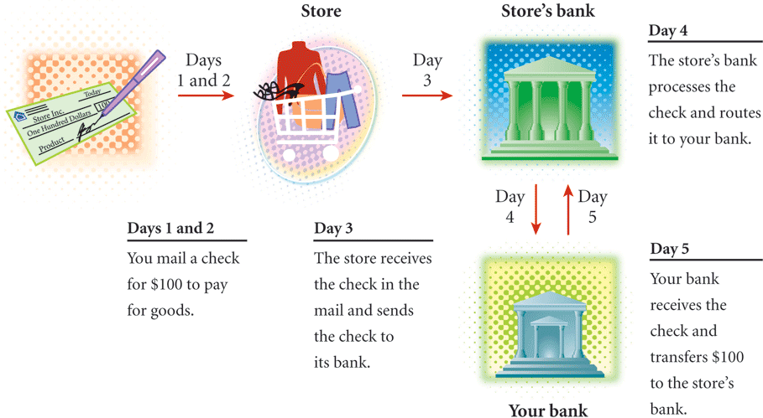
13.3 The Float (continued)
Figure 13.5 Disbursement and collection float.

Slide 27
13.3 (A) Speeding Up the Collection (Shortening the Lag Time)
Firms attempt to speed up collections in a variety of ways including:
Lock boxes, which are post office boxes set up at convenient locations to allow for quick pick up and deposit of checks by the firm’s bank.
Electronic fund transfers (EFT) which occur directly from the buyer’s account. For example by accepting debit cards.

Slide 28
13.3 (B) Slowing Down Payment (Lengthening the Lag Time)
Getting more difficult with the advent of Check 21 (electronic clearing of checks between banks) and acceptance of debit cards.
One method that continues to be popular, though, is the wide-spread use of credit cards which allows for a month long float.

Slide 29
13.4 Inventory Management: Carrying Costs and Ordering Costs
Managing inventory essentially involves the balancing of carrying costs (i.e. storage costs, handling costs, financing costs and costs due to spoilage and obsolescence) against ordering costs (i.e. delivery charges), which tend to offset each other.
To keep carrying costs down requires more frequent orders of smaller sizes, but could result in lost sales due to stock-outs.
Fewer, larger orders, lowers ordering costs, but requires carrying larger amounts of inventory.
There are 4 cost-minimizing methods that firms can use to manage inventories efficiently:
The ABC inventory management model;
Stocking redundant inventory;
the Economic Order Quantity method; and
the Just in Time approach.

Slide 30
13.4 (A) ABC Inventory Management
Involves categorizing inventory into 3 types:
Large dollar or critical items (A-type);
Moderate dollar or essential items (B-type),
Small-dollar or non-essential items (C-type).
Each type is monitored differently with respect to the frequency of taking stock and re-ordering.
Table 13.1 Inventory Categories for Corporate Seasonings

Slide 31
13.4 (B) Redundant Inventory Items
Involves maintaining back-up inventory of items that are currently not needed frequently, but could be used in emergencies.
Avoid higher costs due to stoppages.

Slide 32
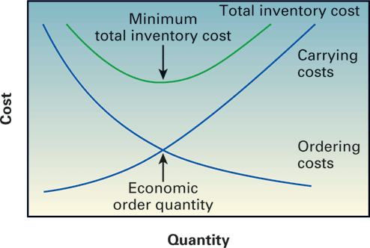
13.4 (C) Economic Order Quantity
Method to determine the optimal size of each order by balancing ordering costs with carrying costs so as to minimize the total cost of inventory.
The Trade-off between Ordering Costs and Carrying Costs: occurs because with larger order sizes, fewer orders are needed, reducing delivery costs, and the costs resulting from lost sales due to shortages. However, higher levels of inventory are held, thereby increasing costs associated with storage, handling, spoilage and obsolescence.
Figure 13.7 Inventory costs.

Slide 33
13.4 (C-2) Measuring Ordering Costs
Involves multiplying the number of orders placed per period by the cost of each order and delivery, i.e.
Where OC = cost per order; S=annual sales; and Q = order size.

Slide 34
13.4 (C-2) Measuring Ordering Costs (continued)
Example 4: Measuring ordering cost.
Nigel Enterprises sells 1,000,000 copies per year. Each order it places costs $40 for shipping and handling. How will the total annual ordering cost change if the order size changes from 1000 copies per order to 10000 copies per order.
Answer
At 1000 copies per order:
Total annual ordering cost = $40 X 1,000,000/1000 ➔$40,000
At 10,000 copies per order:
Total annual ordering cost = $40 X 1,000,000/10,000 ➔$4000
As order size increases, ordering costs decline due to fewer orders

Slide 35
13.4 (C-3) Measuring Carrying Costs
Involves multiplying the carrying cost by the half the order quantity, i.e.
The model assumes that inventory is used up at a constant rate each period so when it is at its half way point a new order is received, meaning that on average we are holding about half the inventory each period.

Slide 36
13.4 (C-3) Measuring Carrying Costs (continued)
Example 5: Measuring carrying cost.
Nigel Enterprises has determined that it costs them $0.10 to hold one copy in inventory each period. How much will the total carrying cost amount to with 1000 copies versus 10,000 copies being held in inventory.
Answer
With 1000 copies in inventory
Total annual carrying cost = $0.10* 1000/2 = $50
With 10,000 copies in inventory
Total annual carrying cost = $0.10*10,000/2 = $500
As order size increases carrying costs go up proportionately.

Slide 37
13.4 (C-3) Measuring Carrying Costs (continued)
To arrive at the optimal order quantity, we can use Equation 13.17

Slide 38
13.4 (C-3) Measuring Carrying Costs (continued)
Example 6: Calculating EOQ.
With annual sales of 1,000,000 copies, carrying costs amounting to $0.10 per copy held and order costs amounting to $40 per order. What is Nigel Enterprises’ optimal order size? Please verify that your answer is correct.
Answer
S = 1,000,000; OC = $40; CC = $0.10
EOQ = [(2*1000000*$40)/0.1]^{1/2}= 28, 285
(rounded to nearest whole number)
With order size = 28,285,
Total order cost = (1,000,000/28285)*$40 = $1,414.2
Total carrying cost = 28,285/2*0.1= $1414.2
Total inventory cost = $2,828.4

Slide 39
13.4 (C-3) Measuring Carrying Costs (continued)
Example 6 Answer (continued)
Verification:
With Q = 28,000 ➔OC = (1,000,000/28,000)*$40 ➔$1428.6
➔CC➔28000/2*.1➔1400
Total cost ➔2828.6>$2828.4
With Q = 29,000 ➔OC= 1,000,000/29,000)*40 ➔1379.31
➔CC➔1450
Total cost = $2,829.31>$2,828.4

Slide 40
13.4 (C-4) Reorder Point and Safety Stock
Inventory gets used up every day➔ lead time necessary for additional supplies ➔ firms must determine a reorder point ➔ to avoid a stock-out.
The reorder point = daily usage * days of lead time
Once the inventory hits the re-order point, the next order is placed so that by time it is delivered, the firm would be just about out of inventory.
An additional protection measure is to build in some safety stock or buffer so as to be covered in case of delivery delays as follows:
Average inventory = EOQ/2 + safety stock

Slide 41
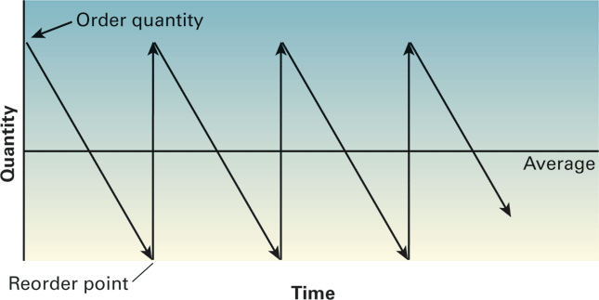
13.4 (C-4) Reorder Point and Safety Stock (continued)
Figure 13.6 Inventory flow.

Slide 42
13.4 (C-4) Reorder Point and Safety Stock (continued)
Example 7: Measuring re-order point and safety stock.
Calculate Nigel Enterprises’ re-order point and safety stock assuming that deliveries take 4 days on average with a possibility of 2 day delays sometimes.
Answer
EOQ = 28,285; daily usage rate = 1,000,000/365➔2740
Reorder point = 4*2740 = 10,960 (without safety stock)
With safety stock built in we calculate average inventory as➔
Average inventory = EOQ/2 + safety stock
Safety stock = 2 days usage = 2*2740 = 5480
So Nigel Enterprises should reorder when the inventory drops to
10,960 + 5480 ➔16,440 copies.

Slide 43
13.4 (C-5) Just in Time
An inventory management system which tries to keep inventory at a minimum by following lean manufacturing practices, i.e. producing only what is required, when it is required and keeping finished goods in storage for as little time as possible.
JIT inventory management, if practiced successfully would eliminate waste and improve productivity significantly

Slide 44
13.5 The Effect of Working Capital on Capital Budgeting
Inventories and Daily Operations: For capital budgeting ➔the initial investment required for working capital i.e. inventory and accounts receivable, as part of cash outflow at time 0.
Also, need to account for:
Periodic fluctuations in working capital, and
Cash inflow from recovery of working capital at the end of a project’s useful life i.e. drawing down on the inventory and collecting the receivables

Slide 45
Additional Problems with Answers Problem 1
Measuring Cash Conversion Cycle.
John Gray is really concerned that his company’s working capital is not being managed efficiently. He decides to take a look at the firm’s operating and cash conversion cycles to see what’s going on. Using the data provided below, help John measure his firm’s collection, production, payment, operating, and cash conversion cycles respectively.
Cash sales $350,000
Credit sales $600,000
Total sales $950,000
Cost of goods sold $600,000
Ending Balance Beginning Balance
Accounts receivable $45,000 $32,000
Inventory $22,000 $9,000
Accounts payable $6,000 $5,000

Slide 46
Additional Problems with Answers Problem 1 (Answer)
First, we calculate the average values of the 3 accounts:
Average A/R➔ ($45,000 + $32,000)/2 = $38,500
Average inventory➔$(22,000+9000)/2 = $15,500
Average A/P ➔($6,000 + $5,000)/2 = $5,500
Next, we calculate the turnover rates of each
A/R Turnover = Credit Sales/Avg. A/R ➔$600,000/$38,500 ➔15.58
Inventory Turnover = Cost of Goods Sold/Avg. Inv ➔ $600,000/$15,500 = 38.71
A/P Turnover = Cost of Goods Sold/Avg. A/P = $600,000/$5,500 = 109.09
Finally we calculate the collections cycle, the production cycle, and the payment cycle by dividing each of the turnover rates into 365 days, respectively.

Slide 47
Additional Problems with Answers Problem 1 (Answer) (continued)
Collection cycle = 365/A/R Turnover➔ 365/15.58 ➔23.43 days
Production cycle = 365/Inv. Turnover➔365/38.71 ➔9.43 days
Payment cycle = 365/A/P➔Turnover➔365 / ``````````````````````````109.09➔3.35 days
So the firm’s operation cycle = Collection cycle + Production cycle =23.43+9.43 = 32.86 days
Cash conversion cycle = Operating cycle – payment cycle = 32.86-3.35 ➔29.51 days. So on average, the firm has to finance its credit sales for about 30 days.

Slide 48
Additional Problems with Answers Problem 2
Credit screening cost-benefit analysis:
Mid-West Marine Products currently sells its light-weight boat lifts for $3,500 each. The unit cost of each lift is $2,600.
On average, the firm sells 2000 lifts a year on a cash basis. Consumer Credit Check is offering Mid-West a credit screening system at the rate of $25 per screen, and assures them that the system will be at least 99% accurate. Mid-West’s research indicates that if they offer credit terms, it will boost their sales by 40% per year. They have also learned that the typical default rate in their industry is around 3%.
Should Mid-West start offering credit terms?
If they do offer credit, should they do so with or without CCC’s credit screening services? Please explain.

Slide 49
Additional Problems with Answers Problem 2 (Answer)
Current profit (all-cash sales) = 2,000*($3,500-$2,600) = $1,800,000
With credit terms…Unit sales = 2,000*(1.4) = 2800 lifts
Profit (with credit and no screening)
= $900*2,800*.95 - .03 * 2,800* ($2,600)
➔$2,394,000-218,400=$2,175,600
Profit (with credit screening) = ($900*2,800*.99)-(.01*2800*($2,600))
=$2,494,800-$72,800➔$2,422,000
Increase in profit from screen = $2,422,000 - $2,175,600 = $246,400
Maximum cost of screening per customer = $246,600/$2,800 = $88
At $35 per screen, it is definitely worthwhile to offer credit terms with screening service provided by Consumer Credit Check.

Slide 50
Additional Problems with Answers Problem 3
Cost of foregoing cash discounts: Your raw material supplier has been accepting payments on 30 day terms with no interest penalty.
Recently, you received an invoice which stated that the supplier would offer terms of 1/10, net 30.
You have a line of credit with your bank at an EAR of 14.5% per year on outstanding loans.
Should you accept the discount offer? Please explain why or why not.

Slide 51
Additional Problems with Answers Problem 3 (Answer)
At terms of 1/10, net 30 you will get 1% off and be allowed to pay in 10 days, otherwise the full amount is due in 30 days
HPR = .01/.99 = 1.0101%
EAR = (1+HPR)^{365/20} – 1
= (1.0101)^{18.25} -1
= 20.129%
Since you are able to borrow at 14.5%, you are better off taking the cash discount and effectively earning an EAR of 20.129%

Slide 52
Additional Problems with Answers Problem 4
Economic order quantity (EOQ). The Always- Stocked Party Store wants to stay true to its name, especially since the “Out-to-Get-You” Party store is opening up very close by. One of their main sellers, the Mega-Keg, costs $2 to stock and accounts for sales of 3600 kegs per year.
Each order for kegs cost roughly $200 and takes on average 5 days to be delivered, with the possibility of 2 day delays.
What is the optimal order size for Mega-Kegs?
At what point should the kegs be re-ordered to assure that the store never runs out?

Slide 53
Additional Problems with Answers Problem 4 (Answer)
EOQ = [2 x 3600 x $200 / $2]^{1/2} = 849
EOQ = 849; daily usage rate = 3600/365➔10
Reorder point = 5*10 = 50 (without safety stock)
Safety stock = 2 days usage = 2*10 = 20
So the store should reorder when the inventory drops to 50+20 ➔70 kegs.

Slide 54
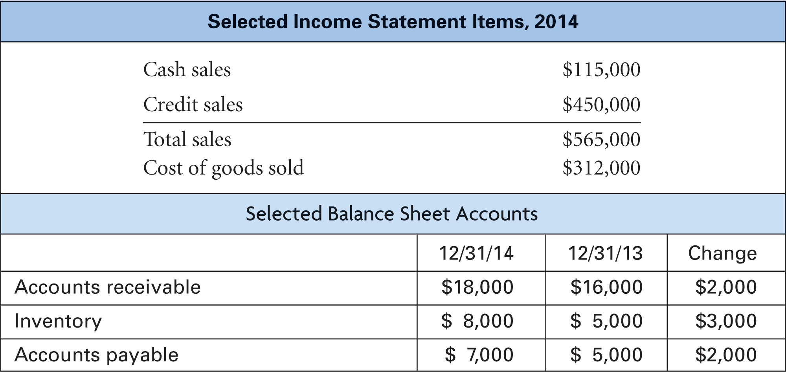
Figure 13.2

Slide 55
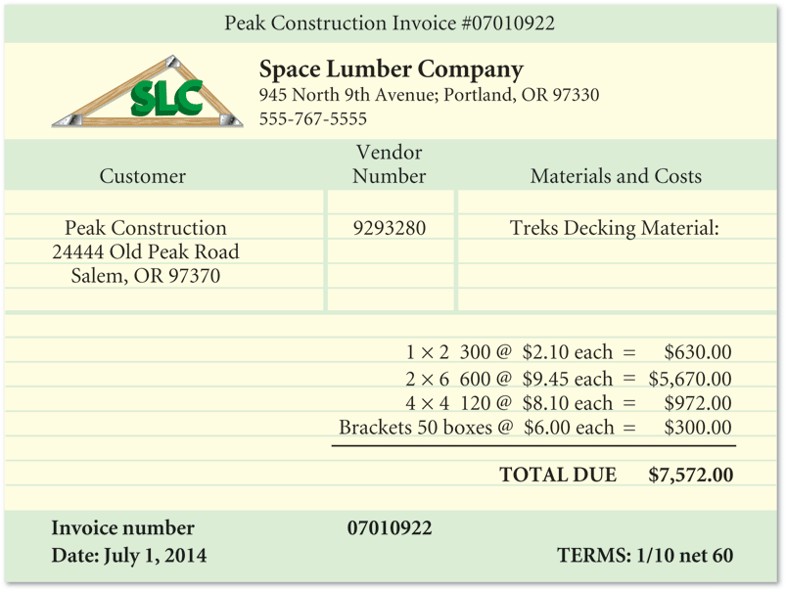
Figure 13.3

Slide 56
FIGURE 13.4 Invoice payment options, amounts, and dates for Peak Construction’s bill from Space Lumber Company

