Slide 1
Chapter 11
The Cost of Capital

Slide 2
Learning Objectives
Understand the different kinds of financing available to a company: debt financing, equity financing, and hybrid equity financing.
Understand the debt and equity components of the weighted average cost of capital (WACC) and explain the tax implications on debt financing and the adjustment to the WACC.
Calculate the weights of the components using book values or market values.
4. Explain how the capital budgeting models use WACC.
Determine the beta of a project and its implications in capital budgeting problems.
Select optimal project combinations for a company’s portfolio of acceptable potential projects.

Slide 3
11.1 The Cost of Capital: A Starting Point
3 broad sources of financing available or raising capital: debt, common stock (equity), and preferred stock (hybrid equity).
Each has its own risk and return profile and therefore its own rate of return required by investors to provide funds to the firm.
Figure 11.1 Component sources of capital.

Slide 4
11.1 The Cost of Capital: A Starting Point (continued)
The weighted average cost of capital (WACC) is estimated by multiplying each component weight by the component cost and summing up the products.
The WACC is essentially the minimum acceptable rate of return that the firm should earn on its investments of average risk, in order to be profitable.
WACC ➔discount rate for computing NPV
➔ IRR > WACC for acceptance of project.

Slide 5
11.1 The Cost of Capital: A Starting Point (continued)
Example 1: Measuring weighted average cost of a mortgage
Jim wants to refinance his home by taking out a single mortgage and paying off all the other sub-prime and prime mortgages that he took on while the going was good. Listed below are the balances and rates owed on each of his outstanding home-equity loans and mortgages:
Lender Balance Rate
First Cut-Throat Bank $ 150,000 7.5%
Second Considerate Bank $ 35,000 8.5%
Third Pawn Mortgage Co. $ 15,000 9.5%
Below what rate would it make sense for Jim to consolidate all these loans and refinance the whole amount?

Slide 6
11.1 The Cost of Capital: A Starting Point (continued)
Example 1 Answer
Jim’s weighted average cost of borrowing
= Proportion of each loan * Rate
➔(150,000/200,000)*.075+(35,000/200,000) *.085+(15,000/200,000)*.095
➔(.75*.075) + (.175*.085) (+.075*.095)
= .07825 or 7.825%
Jim’s average cost of financing his home is 7.825%. Any rate below 7.825% would be beneficial.

Slide 7
11.2 Components of the Weighted Average Cost of Capital
To determine a firm’s WACC we need to know how to calculate:
the relative weights and
costs of the debt, preferred stock, and common stock of a firm.

Slide 8
11.2 (A) Debt Component
The cost of debt (R_{d}) is the rate that firms have to pay when they borrow money from banks, finance companies, and other lenders.
It is essentially measured by calculating the yield to maturity (YTM) on a firm’s outstanding bonds, as covered in Chapter 6.
Although best solved for by using a financial calculator or spreadsheet, the YTM can also be figured out as follows:

Slide 9
11.2 (A) Debt Component (continued)
YTM on outstanding bonds, indicates what investors require for lending the firm their money in current market conditions.
However, new debt would also require payment of transactions costs to investment bankers reducing the net proceeds to the issuer and raising the cost of debt.
➔ We must adjust the market price by the amount of commissions that would have to be paid when issuing new debt, and then calculate the YTM.

Slide 10
11.2 (A) Debt Component (continued)
Example 2: Calculating the cost of debt
Kellogg’s wants to raise an additional $3,000,000 of debt as part of the capital that would be needed to expand their operations into the Morning Foods sector.
They were informed by their investment banking consultant that they would have to pay a commission of 3.5% of the selling price on new issues.
Their CFO is in the process of estimating the corporation’s cost of debt for inclusion into the WACC equation.
The company currently has an 8%, AA-rated, non-callable bond issue outstanding, which pays interest semi-annually, will mature in 17 years, has a $1000 face value, and is currently trading at $1075.
Calculate the appropriate cost of debt for the firm.

Slide 11
11.2 (A) Debt Component (continued)
Example 2 Answer
First determine the net proceeds on each bond
= Selling price –Commission
=$1075-(.035*1075) = $1037.38
Using a financial calculator we enter:
P/Y = C/Y = 2
Input 34 ? -1037.38 40 1000
Key N I/Y PV PMT FV
Output 7.60%
The appropriate cost of debt for Kellogg’s is 7.6%

Slide 12
11.2 (B) Preferred Stock Component
Preferred stock holders receive a constant dividend with no maturity point;
The cost of preferred (R_{p})can be estimated by dividing the annual dividend by the net proceeds (after floatation cost) per share of preferred stock:
R_{p} = D_{p}/Net price

Slide 13
11.2 (B) Preferred Stock Component (continued)
Example 3: Cost of Preferred Stock
Kellogg’s will also be issuing new preferred stock worth $1 million. They will pay a dividend of $4 per share which has a market price of $40. The floatation cost on preferred will amount to $2 per share. What is their cost of preferred stock?
Answer
Net price on preferred stock = $38;
Dividend on preferred = $4
Cost of preferred = R_{p} = $4/$38 = 10.53%

Slide 14
11.2 (C) Equity Component
The cost of equity (R_{e}) is essentially the rate of return that investors are demanding or expecting to make on money invested in a company’s common stock.
The cost of equity can be estimated by using either the SML approach (covered in Chapter 8) or the Dividend Growth Model (covered in Chapter 7).

Slide 15
11.2 (C) Equity Component (continued)
The Security Market Line Approach: calculates the cost of equity as a function of the risk-free rate (r_{f}) the market risk-premium [E(r_{m})-r_{f}], and beta (β_{i}).
That is,

Slide 16
11.2 (C) Equity Component (continued)
Example 4: Calculating Cost of Equity with the SML equation
Remember Kellogg’s from the earlier 2 examples? Well, to reach their desired capital structure their CEO has decided to utilize all of their expected retained earnings in the coming quarter. Kellogg’s beta is estimated at 0.65 by Value Line. The risk-free rate is currently 4%, and the expected return on the market is 15%. How much should the CEO put down as one estimate of the company’s cost of equity?
Answer
R_{e} = r_{f} + [E(r_{m})-r_{f}]β_{i}
R_{e}=4%+[15%-4%]0.65
R_{e=} 4%+7.15% = 11.15%

Slide 17
11.2 (C) Equity Component (continued)
The Dividend Growth Approach to R_{e:} The Gordon Model, introduced in Chapter 7, is used to calculate the price of a constant growth stock.
However, with some algebraic manipulation it can be transformed into Equation 11.6, which calculates the cost of equity, as shown below:
where Div₀ = last paid dividend per share;
P_{o} = Current market price per share; and
g = constant growth rate of dividend.

Slide 18
11.2 (C) Equity Component (continued)
For newly issued common stock, the price must be adjusted for floatation cost (commission paid to investment banker) as shown in Equation 11.7 below:
where F is the floatation cost in percent.

Slide 19
11.2 (C) Equity Component (continued)
Example 5: Applying the Dividend Growth Model to calculate R_{e}
Kellogg’s common stock is trading at $45.57 and its dividends are expected to grow at a constant rate of 6%.
The company paid a dividend last year of $2.27.
If the company issues stock they will have to pay a floatation cost per share equal to 5% of selling price.
Calculate Kellogg’s cost of equity with and without floatation costs.

Slide 20
11.2 (C) Equity Component (continued) Example 5 Answer
Cost of equity without floatation cost:
R_{e} = (Div₀*(1+g)/P_{o}) + g
➔ ($2.27*(1.06)/$45.57)+.06➔11.28%
Cost of equity with floatation cost:
R_{e} = [$2.27*(1.06)/(45.57*(1-.05)]+.06 ➔11.56%

Slide 21
11.2 (C) Equity Component (continued)
Depending on the availability of data, either of the two models, or both, can be used to estimate R_{e}.
With two values, the average can be used as the cost of equity.
For example, in Kellogg’s case we have (11.15%+11.28%)/2➔11.22% (without floatation costs)
or (11.15%+11.56%) /2➔11.36%(with floatation costs)

Slide 22
11.2 (D) Retained Earnings
Retained earnings does have a cost, i.e. the opportunity cost for the shareholders not being able to invest the money themselves.
The cost of retained earnings can be calculated by using either of the above two approaches, without including floatation cost.
Also, since interest expenses are tax deductible, the cost of debt, must be adjusted for taxes, as shown below, prior to including it in the WACC calculation:
After-tax cost of debt = R_{d}*(1-T_{c})
So if the YTM (with floatation cost) = 7.6%,
and the company’s marginal tax rate is 30%,
the after-tax cost of debt➔7.6%*(1-0.3)➔5.32%

Slide 23
11.3 Weighting the Components: Book Value or Market Value?
To calculate the WACC of a firm, each component’s cost is multiplied by its proportion in the capital mix and then summed up.
There are two ways to determine the proportion or weights of each capital component, using book value, or using market values.

Slide 24
11.3 (A) Book Value
Book value weights can be determined by taking the balance sheet values for debt, preferred stock, and common stock, adding them up, and dividing each by the total.
These weights, however, do not indicate the current proportion of each component.

Slide 25
11.3 (B) Adjusted Weighted Average Cost of Capital
Equation 11.9 can be used to combine all the weights and component costs into a single average cost which can be used as the firm’s discount or hurdle rate:

Slide 26
11.3 (B) Adjusted Weighted Average Cost of Capital (continued)
Example 6: Calculating Adjusted WACC
Using the market value weights and the component costs determined earlier, calculate Kellogg’s adjusted WACC.
Capital Component Weight After-tax Cost%
Debt .38 7.6%*(1-.3) =5.32% ➔R_{d} (1-Tc)
Preferred Stock .14 10.53% ➔R_{p}
Common Stock .48 11.36%* ➔R_{e}
*using average of SML and Div. Growth Model (with floatation cost)
Answer
WACC = .38*5.32% + .14*10.53%+.48*11.36%
=2.02%+1.47%+5.45%=8.94%

Slide 27
11.3 (C) Market Value
Market value weights are determined by taking the current market prices of the firm’s outstanding securities and multiplying them by the number outstanding, to get the total value; and then dividing each by the total market value to get the proportion or weight of each
If possible, market value weights should be used since they are a better representation of a company’s current capital structure, which would be relevant for raising new capital.

Slide 28
11.3 (C) Market Value (continued)
Example 7: Calculating capital component weights:
Kellogg’s CFO is in the process of determining the firm’s WACC and needs to figure out the weights of the various types of capital sources. Accordingly, he starts by collecting information from the balance sheet and the capital markets, and makes up the Table shown below:
What should he do next?

Slide 29
11.3 (C) Market Value (continued) Example 7 Answer
Calculate the total book value and total market value of the capital
Divide each component’s book value and market value by their respective totals.
➔Total Book Value = $375,000,000;
➔Total Market Value = $426,315,000
➔Book Value Weights: ➔Market Value Weights:
Debt = $150m/$375m=40%; Debt = $161.25m/$426.32m=38%
P/ S=$45m/$375m=12%; P/S = $60m/$426.32=14%
C/S = $180m/$375m=48%; C/S= $205.07m/$426.32m=48%
(Rounded to nearest whole number)
He should use the market value weights as they represent a more current picture of the firm’s capital structure.

Slide 30
11.4 Using the Weighted Average Cost of Capital in a Budgeting Decision
Once a firm’s WACC has been determined, it can be used either as the discount rate to calculate the NPV of the project’s expected cash flow or as the hurdle rate which must be exceeded by the project’s IRR.
Table 11.1 presents the incremental cash flow of a $5 million project being considered by a firm whose WACC is 12%.
Table 11.1 Incremental Cash Flow of a $5 Million Project

Slide 31
11.4 Using the Weighted Average Cost of Capital in a Budgeting Decision (continued)
Using a discount rate of 12%, the project’s NPV would be determined as follows:
Since the NPV > 0 this would be an acceptable project.
Alternatively, the IRR could be determined using a financial calculator➔14.85%
Again, since IRR>12%, this would be an acceptable project.

Slide 32
11.4 (A) Individual Weighted Average Cost of Capital for Individual Projects
Using the WACC for evaluating projects assumes that the project is of average risk.
If projects have varying risk levels, using the same discount rate could lead to incorrect decisions.

Slide 33
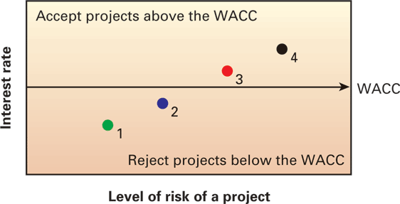
11.4 (A) Individual Weighted Average Cost of Capital for Individual Projects
Figure 11.3 Capital project decision model without
considering risk.
4 projects, whose IRRs range from 8% to 11%, but the risk levels also go from low→moderate→high→very high
With a WACC of 9.5%, only Projects 3 and 4, with IRRs of 10% and 11% respectively would be accepted.
However, Projects 1 and 2 could have been profitable lower risk projects that are being rejected in favor of higher risk projects, merely because the risk levels have not been adequately adjusted for.

Slide 34
11.4 (A) Individual Weighted Average Cost of Capital for Individual Projects
To adjust for risk, we would need to get individual project discount rates based on each project’s beta.
Using a risk-free rate of 3%; a market risk premium of 9%; a before-tax cost of 10%, a tax rate of 30%; equally-weighted debt and equity levels, and varying project betas we can compute each project’s hurdle rate as follows:

Slide 35
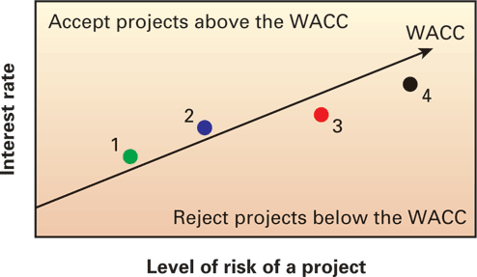
11.4 (A) Individual Weighted Average Cost of Capital for Individual Projects
Under the risk-adjusted approach, Project 1 (IRR=8%>7.7%) and Project 2 (IRR=9%>8.6%) should be accepted, while Project 3 (IRR=10%<10.4%) and Project 4 (IRR=11%<13.1%) should be rejected.
Figure 11.4 Capital project
decision model with risk.

Slide 36
11.5 Selecting Appropriate Betas for Projects
It is important to adjust the discount rate used when evaluating projects of varying risk, based on their individual betas.
However, since project betas are not easily available, it is more of an art than a science.
There are two approaches generally used:
Pure play betas: i.e. matching the project with a company that has a similar single focus, and using that company’s beta.
Subjective modification of the company’s average beta: i.e. adjusting the beta up or down to reflect different levels of risk.

Slide 37
11.6 Constraints on Borrowing and Selecting Projects for the Portfolio
Capital constraints prevent firms from funding all potentially profitable projects that come their way.
Capital rationing -- select projects based on their costs and expected profitability, within capital constraints.
Rank order projects (descending order) based on NPV or IRRs along with their costs ➔choose the combination which has the highest combined return or NPV ➔while using up as much of the limited capital budget.

Slide 38
11.6 Constraints on Borrowing and Selecting Projects for the Portfolio (continued)
Example 8: Selecting Projects with Capital Constraints.
The XYZ Company’s managers are reviewing various projects that are being presented by unit managers for possible funding.
They have an upper limit of $5,750,000 for this forthcoming year.
The cost and NPV of each project has been estimated and is presented below.
Which combination of projects would be best for them to invest in?

Slide 39
11.6 Constraints on Borrowing and Selecting Projects for the Portfolio (continued) Example 8 Answer
1) Form combinations of projects by adding the costs to sum up as close to the $5,750,000 limit as possible. Sum up the NPVs as well.
Comb. Total Cost NPV
1,2,4,5 2m+2.25m+.75m+0.5m=$5.5m 1.5m
1,3,4,5 2m+1.75m+.75m+.5m=$5m 0.95m
2,3,4,5 2.25m+1.75m+.75m+.5m=$5.25m 0.85m
Select the combination which has the highest NPV i.e. Combination 1 including projects 1,2,4, and 5 with a total NPV of $1.5m.

Slide 40
Additional Problems with Answers Problem 1
Cost of debt for a firm: You have been assigned the task of estimating the after-tax cost of debt for a firm as part of the process in determining the firm’s cost of capital.
After doing some checking, you find out that the firm’s original 20-year 9.5% coupon bonds (paid semi-annually), currently have 14 years until they mature and are selling at a price of $1,100 each.
You are also told that the investment bankers charge a commission of $25 per bond when new bonds are sold.
If these bonds are the only debt outstanding for the firm, what is the after-tax cost of debt for this firm if the marginal tax rate for the firm is 34 percent?

Slide 41
Additional Problems with Answers Problem 1 (Answer)
Calculate the YTM on the currently outstanding bonds, after adjusting the price for the $25 commission.
i.e. Net Proceeds = $1100-$25 ➔$1075
Set P/Y=2 and C/Y = 2
Input 28 ? -1075 47.5 1000
Key N I/Y PV PMT FV
Output 8.57%
After-tax cost of debt = 8.57%(1-.34) ➔5.66%

Slide 42
Additional Problems with Answers Problem 2
Cost of Equity for a firm: R.K. Boats Inc. is in the process of making some major investments for growth and is interested in calculating their cost of equity so as to be able to correctly estimate their adjusted WACC.
The firm’s common stock is currently trading for $43.25 and their annual dividend, which was paid last year, was $2.25, and should continue to grow at 6% per year.
Moreover, the company’s beta is 1.35, the risk-free rate is at 3%, and the market risk premium is 9%. Calculate a realistic estimate of RKBIs cost of equity. (Ignore floatation costs.)

Slide 43
Additional Problems with Answers Problem 2 (Answer)
Using the SML Approach:
Rf =3%; Rm-Rf = 9%; β = 1.35; Re=3%+(9%)*1.35 ➔15.15%
Using the Dividend Growth Model (constant growth)
P0 = $43.25; Do=$2.25; g=6%; ➔($2.25*(1.06)/$43.25)+.06➔11.51%
A realistic estimate of RKBIs cost of equity = Average of the 2 estimates
➔(15.15%+11.51%)/2➔13.33%

Slide 44
Additional Problems with Answers Problem 3
Calculating capital component weights: T.J. Enterprises is trying to determine the weights to be used in estimating their cost of capital.
The firm’s current balance sheet and market information regarding the price and number of securities outstanding are listed below.
TJ Enterprises
Balance Sheet
(in thousands)
Current Assets: $50,000 Current Liabilities: $ 0
Long-Term Assets: $60,000 Long-Term Liabilities
Bonds Payable $48,000
Owner’s Equity
Preferred Stock $15,000
Common Stock $47,000
Total Assets: $110,000 Total L & OE $110,000

Slide 45
Additional Problems with Answers Problem 3 (continued)
Market Information
Debt Preferred Stock Common Stock
Outstanding 48,000 102,000 1,300,000
Market Price $850 $95.40 $40
Calculate the firm’s capital component weights using book values as well as market values.

Slide 46
Additional Problems with Answers Problem 3 (Answer)
Based on book values: (in $ ‘000s)
Weight of Debt = $48,000/$110,000 ➔43.64%
Weight of P/S= $15,000/$110,000 ➔13.64%
Weight of C/S = $47,000/$110,000➔42.72%
Based on market value:
Market value of Debt =$40,800,000 ➔$850*48,000
Market Value of P/S= $9,730,800 ➔ $95.4*102,000
Market Value of C/S= $52,000,000 ➔ $40 * 1,300,000
Total Market Value= $102,530,000
Weight of Debt = $40,800/$102,530 ➔39.79%
Weight of P/S= $9,730.8/$102,530 ➔9.49%
Weight of C/S = $52,000/$102,530➔50.72%

Slide 47
Additional Problems with Answers Problem 4
Computing WACC: New Ideas Inc. currently has 30,000 of its 9% semi-annual coupon bonds outstanding (Par value =1000).
The bonds will mature in 15 years and are currently priced at $1,340 per bond.
The firm also has an issue of 1 million preferred shares outstanding with a market price of $11.00. The preferred shares offer an annual dividend of $1.20.
New Ideas Inc. also has 2 million shares of common stock outstanding with a price of $30.00 per share. The firm is expected to pay a$3.20 common dividend one year from today, and that dividend is expected to increase by 7 percent per year forever.
The firm typically pays floatation costs of 2% of the price on all newly issued securities.
If the firm is subject to a 35 percent marginal tax rate, then what is the firm’s weighted average cost of capital?

Slide 48
Additional Problems with Answers Problem 4 (Answer)
1) Determine the component costs
Cost of Debt:
P=$1340; F=2%; Net proceeds=P(1-F)
Net proceeds = $1340*(1-.02)=$1273
Set P/Y=2 and C/Y = 2
Input 30 ? -1273 45 1000
Key N I/Y PV PMT FV
Output 6.18%
Before-tax R_{d} ➔6.18%

Slide 49
Additional Problems with Answers Problem 4 (Answer) (continued)
Cost of preferred stock:
D_{p}=$1.20; P_{p}=$11; F=2%
R_{p} = D_{p}/P_{p}(1-F) → $1.20/($11(.98)➔1.20/10.78➔11.13%
Cost of common stock:
Pc=$30; D1=$3.2; g=7%; F=2%
Using the constant dividend growth model:
R_{e} = [D₁/(P(1-F])+g➔[3.2/$30(.98)]+.07➔17.88%

Slide 50
Additional Problems with Answers Problem 4 (Answer) (continued)
2) Determine the market value weights of the components:
Market value of bonds = $1340*30,000➔ $40,200,000
Market value of P/S = $11*1,000,000➔ $11,000,000
Market value of C/S=$30*2,000,000➔ $60,000,000
Total Market value➔ $111,200,000
Weight of debt = 40.2m/111.2m ➔36.15%
Weight of P/S = 11m/111.2m ➔ 9.89%
Weight of C/S = 60m/111.2m ➔53.96%

Slide 51
Additional Problems with Answers Problem 4 (Answer) (continued)
3) Calculate the adjusted WACC
WACC = .5396*17.88% + .0989*11.13% +.3615*6.18%*(1-.35)
=9.65 +1.10%+1.45% ➔ 12.2%

Slide 52
Additional Problems with Answers Problem 5
Capital Rationing: Quick Start Ventures, Incorporated is has received 6 excellent funding proposals, but is only able to fund up to $2,500,000
Project A: Cost $700,000, NPV $50,000
Project B: Cost $800,000, NPV $60,000
Project C: Cost $500,000, NPV $40,000
Project D: Cost $600,000, NPV $50,000
Project E: Cost $700,000, NPV $60,000
Project F: Cost $300,000, NPV $30,000
Which projects should Quick Start select?

Slide 53
Additional Problems with Answers Problem 5 (Answer)
1) Compute the Profitability Index of the projects and rank order from highest to lowest PI:
PI = (NPV + Cost)/Cost

Slide 54
Additional Problems with Answers Problem 5 (Answer) (continued)

Slide 55
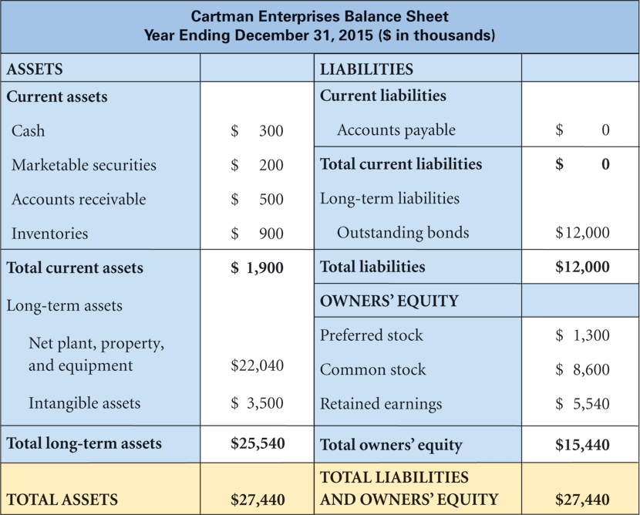
Figure 11.2

Slide 56
TABLE 11.2 Decision on Projects with and without Risk

