Slide 1
Chapter 10
Cash Flow Estimation

Slide 2
Learning Objectives
Understand the importance of cash flow and the distinction between cash flow and profits.
Identify incremental cash flow.
Calculate depreciation and cost recovery.
Understand the cash flow associated with the disposal of depreciable assets.
Estimate incremental cash flow for capital budgeting decisions.

Slide 3
10.1 The Importance of Cash Flow
Cash flow measures the actual inflow and outflow of cash, while profits represent merely an accounting measure of periodic performance.
A firm can spend its operating cash flow but not its net income.
Some firms have net losses (due to high depreciation write-offs) and yet can pay dividends from cash balances, while others show profits and may not have the cash available.
Thus, cash flow is broader than net income.

Slide 4
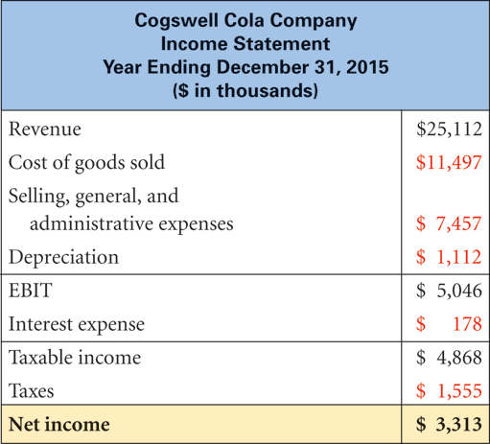
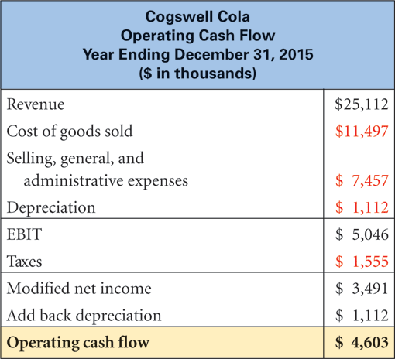
10.1 The Importance of Cash Flow (continued)
Figure 10.1
Figure 10.2
Figure 10.2 -- modified income -- it only considers the cash flow arising from operations. Interest expense (which is a financing cash flow) is not included, and depreciation (which had been deducted in Figure 10.1 mainly for tax purposes) is added back.
➔OCF = EBIT –Taxes +Depreciation=Net Income + Interest +Depreciation
$4,603 =$5,046 - $1,555 + $1,112 = $3313+$178+$1,112

Slide 5
10.2 Estimating Cash Flow for Projects: Incremental Cash Flow
For expansion, replacement or new project analysis, incremental effects on revenues and expenses must be considered.
Careful estimation and evaluation of the timing and magnitude of incremental cash flows is very important.
7 important issues to be kept track of:
sunk costs,
opportunity cost,
erosion,
synergy gains,
working capital,
capital expenditures, and
depreciation or cost recovery of assets.

Slide 6
10.2 (A) Sunk costs
Expenses that have already been incurred, or that will be incurred, regardless of the decision to accept or reject a project.
For example, a marketing research study exploring business possibilities in a region would be a sunk cost, since its expenditure has been done prior to undertaking the project and will have to be paid whether or not the project is taken on.
These costs although part of the income statement, should not be considered as part of the relevant cash flows when evaluating a capital budgeting proposal.

Slide 7
10.2 (B) Opportunity costs
Costs that may not be directly observable or obvious, but result from benefits being lost as a result of taking on a project.
For example, if a firm decides to use an idle piece of equipment as part of a new business, the value of the equipment that could be realized by either selling or leasing it would be a relevant opportunity cost.
These costs should be included.

Slide 8
10.2 (C) Erosion costs
Costs that arise when a new product or service competes with revenue generated by a current product or service offered by a firm.
For example, if a store offers two types of photo-copying services, a newer, more expensive choice and an older economical one.
Some of the revenues from the older repeat customers will be lost and should therefore be accounted for in the incremental cash flows.

Slide 9
10.2 (C) Erosion costs (continued)
Example 1: Erosion costs.
Frosty Desserts currently sell 100,000 of its Strawberry-Shortcake Delight each year for $3.50 per serving.
Its cost per serving is $1.75.
Its chef has come up with a newer, richer concoction, “Extra-Creamy Strawberry Wonder,” which costs $2.00 per serving, will retail for $4.50 and should bring in 130,000 customers.
It is estimated that after the launch the sales for the original variety will drop by 15%.
Estimate the erosion cost associated with this venture.

Slide 10
10.2 (C) Erosion costs (continued)
Example 1 Answer
To calculate the erosion cost we must consider the amount of lost contribution margin i.e.
(Selling price – unit cost) from SSD’s drop in sales.
Erosion cost = (Unit sales of SSD before launch) –(Unit sales after launch)
X(Selling Price – Unit Cost)
➔Erosion cost = (100,000 – 85,000)
X($3.50-$1.75)
= $26,250

Slide 11
10.2 (C) Erosion costs (continued)
Alternative way to measure erosion: Example 1 Answer
Margin contributed by ESW = ($4.50-$2.00)*130,000
= $325,000
Margin prior to new launch=100,000*($3.50 - $1.75)
= $175,000
Margin after launch = ($3.50 - $1.75)*85,000+$325,000
= $473,750
Net change in margin = $473, 750 - $175,000
= $298,750
Erosion cost = ESW’s contribution margin – net change in margin
= $325,000 - $298,750 = $26,250

Slide 12
10.2 (D) Synergy gains
The impulse purchases or sales increases for other existing products related to the introduction of a new product.
For example, if a gas station with a convenience store attached, adds a line of fresh donuts and bagels, the sales of coffee and milk, would result in synergy gains.

Slide 13
10.2 (E) Working capital
Additional cash flows arising from changes in current assets such as inventory and receivables (uses) and current liabilities such as accounts payables (sources) that occur as a result of a new project.
Generally, at the end of the project, these additional cash flows are recovered and must be accordingly shown as cash inflows.
Even though the net cash outflows -- due to increase in net working capital at the start -- may equal the net cash inflow arising from the liquidation of the assets at the end, the time value of money effects make these costs relevant.

Slide 14
10.3 Capital Spending and Depreciation
Capital expenditures are allowed to be expensed on an annual basis and can be used as tax shields.
The portion written off in the income statement, each year, is called the depreciation expense; and the accumulated total kept track of in the Balance sheet is known as Accumulated Depreciation.
Thus, the book value of an asset equals its original cost less its accumulated depreciation.

Slide 15
10.3 Capital Spending and Depreciation (continued)
The two reasons we need to deal with depreciation when doing capital budgeting problems are:
the tax flow implications from the operating cash flow and
the gain or loss at disposal of a capital asset.
Firms have a choice of using either straight line depreciation rates, or modified accelerated cost recovery system (MACRS) rates for allocating the annual depreciation expense, arising from an asset acquisition.

Slide 16
10.3 (A) Straight-Line depreciation
The annual depreciation expense is calculated by dividing the initial cost plus installation minus the expected residual value (at termination) equally over the expected productive life of the asset.
The annual depreciation expenses are the same for each year.

Slide 17
10.3 (B) Modified Accelerated Cost Recovery System
MACRS rates are established by the federal government, since 1981, as a way to allow for firms to accelerate the depreciation write-off in early years of the asset’s life.
These rates are set up based on various asset categories (class-lives).

Slide 18
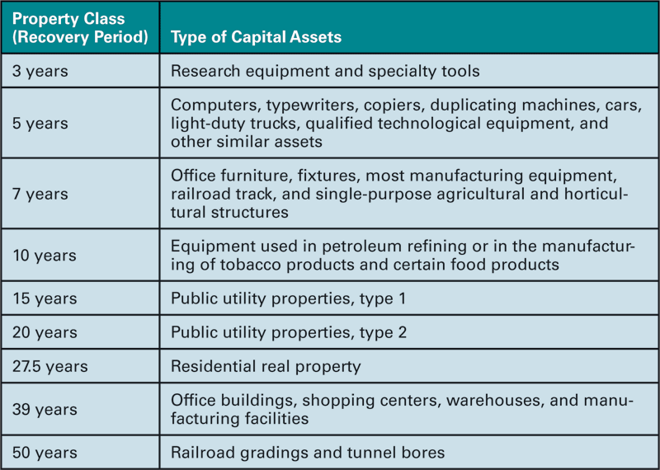
10.3 (B) MACRS (continued)
Table 10.3 Property Classes under MACRS

Slide 19
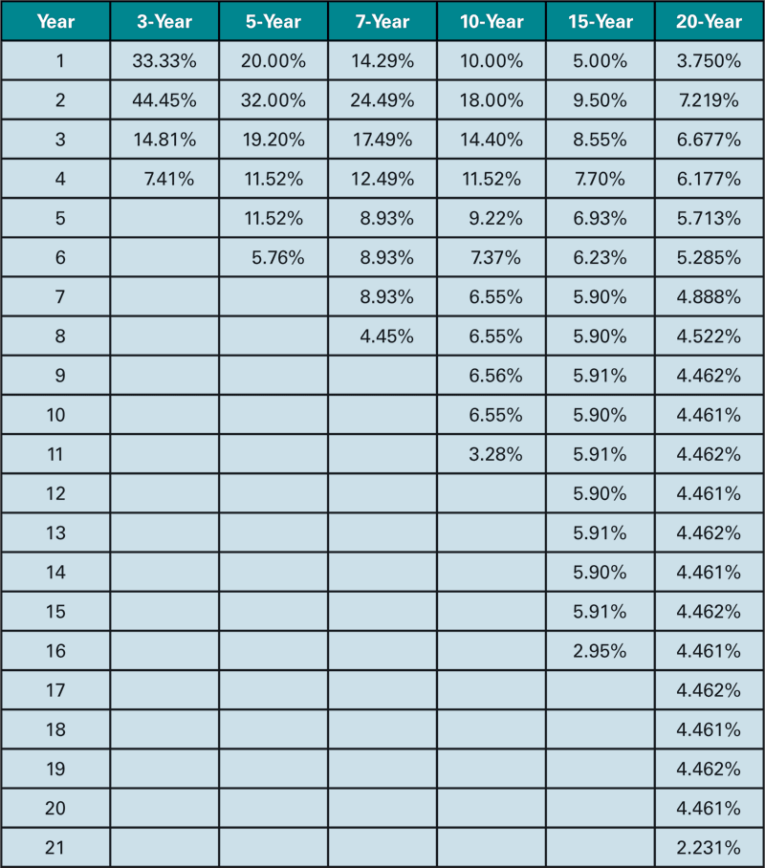
10.3 (B) MACRS (continued)
Table 10.4 MACRS Fixed Annual Expense Percentages by Recovery Class

Slide 20
10.3 (B) MACRS (continued)
Each class life, has one additional year of depreciation than the class-life states, e.g. a 3-year class life asset is depreciated over 4 years.
This is because the government assumes that the asset is put into use for only half a year at the start (half-year convention), and thereby allowed ½ depreciation, with the last year (Year 4) being allowed the balance required to reach 100% (which amounts to ½ the prior year’s percentage.
The depreciation rates in each column add up to 100%, i.e. no need to deduct residual value, with higher rates being allowed in earlier years and less in later years.
With higher depreciation rates allowed in earlier years, the tax savings are higher due to the time value of money.

Slide 21
10.3 (B) MACRS (continued)
Example 2: MACRS depreciation
The Grand Junction Furniture Company has just bought some specialty tools to be used in the manufacture of high-end furniture.
The cost of the equipment is $400,000 with an additional $30,000 for installation.
If the company has a marginal tax rate of 30%, compare its annual tax savings that would be realized from using MACRS depreciation rates.

Slide 22
10.3 (B) MACRS (continued)
Example 2 Answer
According to Table 10.3, specialty tools falls under a 3-year class asset with rates in Years 1-4 of 33.33%, 44.45%, 14.81%, and 7.41% respectively.
Depreciable basis = Cost + Installation = $400,000 + $30,000 = $430,000
The annual depreciation expenses (i.e. annual rate*Dep. Basis) are shown below:

Slide 23
10.4 Cash Flow and the Disposal of Capital Equipment
When a depreciable asset is sold, the cash inflow that results can be higher than, equal to, or lower than the actual selling price of the asset, depending on whether it was sold above (taxable gain), at (zero-gain) or below (tax credit) book value.
If the sale results in a taxable gain, then the cash inflow is reduced by the amount of the taxes
i.e. (Tax rate*(Selling Price –Book Value).
If the selling price is exactly equal to book value the cash inflow equals the sale price.

Slide 24
10.4 Cash Flow and the Disposal of Capital Equipment (continued)
If the asset is sold below its book value, a loss results, and can be written off taxes for the year, resulting effectively in an addition to cash inflows equal to
(Book Value-Selling Price)*Tax rate.
Thus, the cash flow resulting from after-tax salvage value of a depreciable asset is calculated as follows:
After-tax Salvage Value = Selling Price – Tax rate * (Selling price – Book Value)
OR
Selling Price + Tax rate * (Book Value – Selling Price)

Slide 25
10.4 Cash Flow and the Disposal of Capital Equipment (continued)
Example 3: Tax effects from disposal cash flow
Let’s say that the manager of the Grand Junction Furniture Company decides to dispose of the specialty tools, acquired 2 years ago at a cost of $430,000 (including installation), to another firm for $125,000.
How much of an after-tax cash flow will result, assuming that the tools were being depreciated based on the 3-year MACRS rates and the company’s marginal tax rate is 35%?

Slide 26
10.4 Cash Flow and the Disposal of Capital Equipment (continued)
Example 3 Answer
Depreciable basis = $430,000
Year 1 depreciation rate = 33.33%
Year 2 depreciation rate = 44.45%
Total depreciation taken so far = $430,000 * (33.33% + 44.45%)
= $334, 454
Book Value = Depreciable basis – Accumulated depreciation
Book Value = $430,000 - $334,454 = $95,546
Selling price = $125,000 > Book Value ➔ Taxable gain on the sale
➔ Taxable gain = $125,000-$95,546 = $29,454
After-tax Salvage Value= Selling Price – (Tax rate*Taxable gain )
=$125,000 - .35*($29,454) =$125,000-$10,308.9
=$114,691.1

Slide 27
10.5 Projected Cash Flow for a New Project
4 steps are typically involved:
1. Determination of the initial capital investment for the project
Purchase cost
+ Installation
+Initial Increase in net working capital
-After-tax salvage value from disposal of old asset (if any)

Slide 28
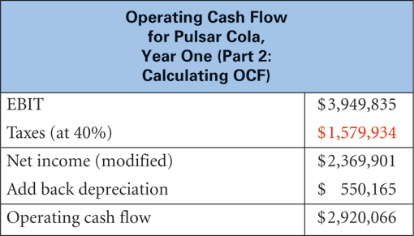
10.5 Projected Cash Flow for a New Project (continued)
Figure 10.4

Slide 29
10.5 Projected Cash Flow for a New Project (continued)
2. Estimation of the annual operating cash flows (incremental) generated by the project, ignoring sunk costs and including erosion costs and side-effects.
OCF = EBIT – Taxes + Depreciation
In the terminal year, besides the usual OCF we have to account for any salvage value that is received, which requires the calculation of Book value and taxes (or tax credits) on sale of the asset.
Terminal Year Cash flow = OCF + After-tax Salvage Value

Slide 30
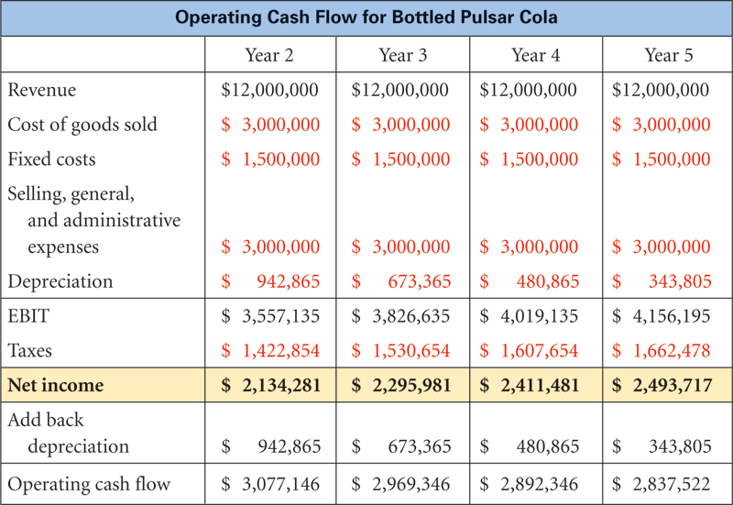
10.5 Projected Cash Flow for a New Project (continued)
Figure 10.5

Slide 31
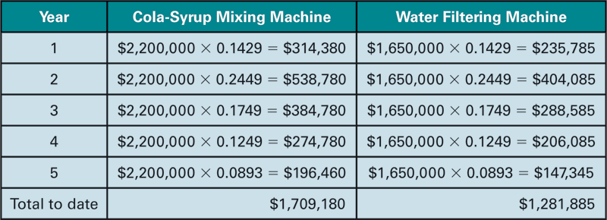
10.5 Projected Cash Flow for a New Project (continued)
Table 10.6 Depreciation of Equipment for Cogswell Cola

Slide 32
10.5 Projected Cash Flow for a New Project (continued)
3. Determination of the change in net working capital which is usually an increase (outflow) at the beginning and a reduction (inflow) at the end.
4. Evaluation of the proposed project using an appropriate discount or hurdle rate and either the NPV or IRR approach.

Slide 33
10.5 Projected Cash Flow for a New Project (continued)
Table 10.7 Incremental Cash Flow of Pulsar Cola

Slide 34
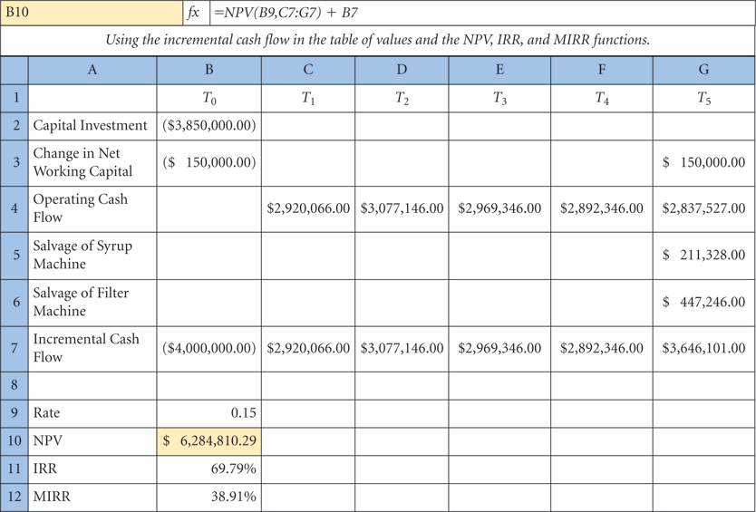
10.5 Projected Cash Flow for a New Project (continued)
Figure 10.6 Spreadsheet application for Pulsar Cola: Calculating NPV, IRR, and MIRR.

Slide 35
Additional Problems with Answers Problem 1
Erosion cost: Volvo is looking to introduce a new “hybrid” car in the US. Their analysts
estimate that they will sell 20,000 of these new cars per year.
The unit cost per car is $18,000 and they plan on selling the vehicle for $22,000.
If the current sales of Volvo ‘s sedan, which costs $15,000 to produce and sells for $20,000, go down from 25,000 units per year to 18,000 units, is this a worthwhile move for Volvo?
Calculate the amount of the erosion cost and the incremental cash flow that will result if they go ahead with the launch.

Slide 36
Additional Problems with Answers Problem 1 (Answer)
OLD SEDAN
Current EBIT = # of cars sold *(Price – Cost)
= 25,000*($20,000-$15,000)
= $125,000,000
EBIT (after launch) = 18,000 *($5000) = $90,000,000
Lost EBIT = $125,000,000 - $90,000,000
= $35,000,000= Erosion Cost
HYBRID
EBIT = 20,000 * ($22,000-$18,000) = $80,000,000
COMBINED EBIT
= $80,000,000 + $90,000,000 = $170,000,000
Since the Combined EBIT is higher than the current EBIT by $45,000, 000 it would be a worthwhile move for Volvo.

Slide 37
Additional Problems with Answers Problem 2
Depreciation rates: R.K. Boats Inc. has just installed a new hydraulic lift system which is being categorized as a 5-year class-life asset under MACRS.
The total purchase cost plus installation amounted to $750,000.
RKB has always used straight-line depreciation in the past, but their accountant is pushing the owner to use the MACRS rates this time around.
The owner seems to think that it really doesn’t matter since the total depreciation under each method will still sum up to $750,000 and be spread over 6 years with the application of the “half-year” convention.
Do you agree with the owner? Please explain by making the appropriate calculations. RKB’s hurdle rate is 10% and its marginal tax rate is 30%.

Slide 38
Additional Problems with Answers Problem 2 (Answer)
Under straight-line depreciation:
Annual dep.exp. = Cost + Installation / Life = $750,000/5 = $150,000
Using “half-year” convention the comparison of yearly depreciation under the 2 methods is as follows:
So clearly, with the tax advantages coming in earlier i.e. in the first two years, the
time value of money advantages makes it a positive NPV move.

Slide 39
Additional Problems with Answers Problem 3
Disposal Cash Flow:
Reddy Laboratories had purchased some manufacturing equipment five years ago for a total cost of $3,000,000, and has been depreciating it using the MACRS – 7 year class-life rates.
Currently, newer, more efficient equipment is available and Reddy has found a buyer who is willing to pay $$500,000 for the old equipment.
If the firm, which has a marginal tax rate of 35%, disposes of the system to the buyer, how much will the after-tax cash flows add up to?

Slide 40
Additional Problems with Answers Problem 3 (Answer)
After 5 years, the book value would be (0893+.0893+.0445)*$3,000,000
Book value = 0.2231*$3,000,000 = $669, 300
Loss on sale = Selling Price – Book value = $500,000 - $669,30
= -$169,300
Tax credit = Tax rate * Loss = 0.35*$169,300 = $59,255
After-tax cash inflow = Selling price + Tax credit
= $500,000 + $59,255 = $559,255

Slide 41
Additional Problems with Answers Problem 4
Operating cash flow (growing each year; MACRS). Balik Ventures is looking at a project with the following forecasted sales: first-year sales quantity of 20,000 with an annual growth rate of 4% over the next 5 years.
the sales price per unit is $35.00 and will grow at 5% per year.
The production costs are expected to be 45% of the current year’s sales price.
The manufacturing equipment to aid this project will have a total cost (including installation) of $2,200,000.
It will be depreciated using MACRS and has a five-year MACRS life classification.
Fixed costs are $285,000 per year. The firm has a tax rate of 35%.
What is the operating cash flow for this project over these 5 years?
Hint: Use a spreadsheet and round units to the nearest whole number.

Slide 42
Additional Problems with Answers Problem 4 (Answer)

Slide 43
Additional Problems with Answers Problem 4 (Answer) (continued)

Slide 44
Additional Problems with Answers Problem 5
Let’s say that Balik Ventures has forecasted the operating cash flows over the 5 year project life as shown in Problem 4 above.
The project will entail an investment of 10% of the first year’s forecasted production costs for working capital, which will be recovered at the end of the 5-year life.
In addition, the equipment will be sold for 20% of its initial cost when the project is terminated.
If the firm uses a hurdle rate of 14% for similar risk projects, should they go ahead with this venture? Why or why not?

Slide 45
Additional Problems with Answers Problem 5 (Answer)
In addition to the operating cash flow for years 1-5, we need to calculate the initial year and terminal year cash flow and add them in.
Initial Year Cash Flow (Year 0)
Cost of Equipment = $2,200,000
Increase in NWC = .10*(Year 1 production cost) = 0.1*$472,500 = $47,250
Total cost at start up = -2,247,250

Slide 46
Additional Problems with Answers Problem 5 (Answer) (continued)
Terminal Year Cash Flow
Recovery of NWC = +$47, 250
After-tax Salvage Value of Equipment = Selling Price –Tax on Gain
Where; Tax on gain = Tax rate * (Selling Price – Book Value)
Selling Price = 20% of Cost = .2*(2,200,000) = $440,000
Book Value = Year 6 MACRS Dep. Rate * Dep. Basis
= .0576*2200000 = $126,720
Tax on Gain = 0.35*($440,000-$126.720) = $109,648
After-tax Salvage Value = $440,000-$109,648= $330,352
Total Terminal Year Cash Flow (not including OCF)
= 47,250 + 330,352 = 377,602

Slide 47
Additional Problems with Answers Problem 5 (Answer) (continued)
Year CashFlow
0 -$2,247,250
1 $344,125
2 $471,060
3 $410,211
4 $392,256
5 $437,226+377,602=$814,828
NPV @10% = -$463,045.5
REJECT THE PROJECT!

Slide 48
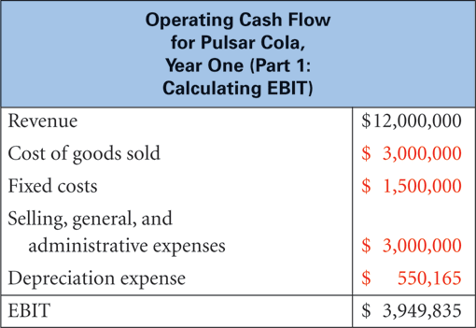
Figure 10.3

Slide 49
TABLE 10.1 Annual Incremental Cash Revenues

Slide 50
TABLE 10.2 Annual Cash Revenues After Competitor Introduces Flavored Cola

Slide 51
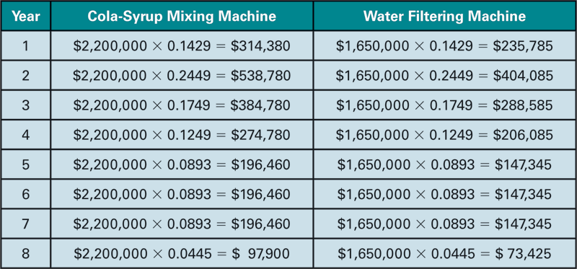
TABLE 10.5 Annual Depreciation Expense of Equipment for Cogswell Cola

