Slide 1
Chapter 9
Capital Budgeting Decision Models

Slide 2
Learning Objectives
Explain capital budgeting and differentiate between short-term and long-term budgeting decisions.
Explain the payback model and its two significant weaknesses and how the discounted payback period model addresses one of the problems.
Understand the net present value (NPV) decision model and appreciate why it is the preferred criterion for evaluating proposed investments.
Calculate the most popular capital budgeting alternative to the NPV, the internal rate of return (IRR); and explain how the modified internal rate of return (MIRR) model attempts to address the IRR’s problems.
Understand the profitability index (PI) as a modification of the NPV model.
Compare and contrast the strengths and weaknesses of each decision model in a holistic way.

Slide 3
9.1 Short-Term and Long-Term Decisions
Long-term decisions vs. short-term decisions
longer time horizons,
cost larger sums of money, and
require a lot more information to be collected as part of their analysis, than short-term decisions.
Capital budgeting meets all 3 criteria

Slide 4
9.1 Short-Term and Long-Term Decisions (continued)
Three keys things to remember about capital
budgeting decisions include:
1. Typically a go or no-go decision on a product, service, facility, or activity of the firm.
2. Requires sound estimates of the timing and amount of cash flow for the proposal.
3. The capital budgeting model has a predetermined accept or reject criterion.

Slide 5
9.2 Payback Period
The length of time in which an investment pays back its original cost.
Payback period ← the cutoff period➔ and vice-versa.
Thus, its main focus is on cost recovery or liquidity.
The method assumes that all cash outflows occur right at the beginning of the project’s life followed by a stream of inflows
Also assumes that that cash inflows occur uniformly over the year.
Thus if Cost = $40,000; CF = $15,000 per year for 3 years; PP = 2 .67 yrs.

Slide 6
9.2 Payback Period (continued)
Example 1 Payback period of a new machine
Let’s say that the owner of Perfect Images Salon is considering the purchase of a new tanning bed.
It costs $10,000 and is likely to bring in after-tax cash inflows of $4,000 in the first year, $4,500 in the second year, $10,000 in the 3rd year, and $8,000 in the 4th year.
The firm has a policy of buying equipment only if the payback period is 2 years or less.
Calculate the payback period of the tanning bed and state whether the owner would buy it or not.

Slide 7
9.2 Payback Period (continued) Example 1 Answer

Slide 8
9.2 Payback Period (continued)
The payback period method has three major flaws:
1. It ignores all cash flow after the initial
cash outflow has been recovered.
2. It ignores the time value of money.
3. It ignores the riskiness of the cash flows.

Slide 9
9.2 (A) Discounted Payback Period
Calculates the time it takes to recover the initial investment in current or discounted dollars.
Incorporates time value of money by adding up the discounted cash inflows at time 0, using the appropriate hurdle or discount rate, and then measuring the payback period.
It is still flawed in that cash flows after the payback are ignored.

Slide 10
9.2 (A) Discounted Payback Period (continued)
Example 2: Calculate Discounted Payback Period
Calculate the discounted payback period of the tanning bed, stated in Example 1 above, by using a discount rate of 10%.

Slide 11
9.2 (A) Discounted Payback Period (continued) Example 2 Answer

Slide 12
9.3 Net Present Value (NPV)
Discounts all the cash flows from a project back to time 0 using an appropriate discount rate, r:
A positive NPV implies that the project is adding value to the firm’s bottom line and therefore when comparing projects, the higher the NPV the better.

Slide 13
9.3 Net Present Value (NPV) (continued)
Example 3: Calculating NPV.
Using the cash flows for the tanning bed given in Example 2 above, calculate its NPV and indicate whether the investment should be undertaken or not.
Answer
NPV _{bed} = -$10,000 + $4,000/(1.10) + $4,500/(1.10)² + $10,000/(1.10)³ + $8,000/(1.10)⁴
=-$10,000 + $3,636.36 + $3719.01 + $7513.15 + $5,464.11
=$10,332.62
Since the NPV > 0, the tanning bed should be purchased.

Slide 14
9.3 (A) Mutually Exclusive versus Independent Projects
NPV approach useful for independent as well as mutually exclusive projects.
A choice between mutually exclusive projects arises when:
There is a need for only one project, and both projects can fulfill that need.
There is a scarce resource that both projects need, and by using it in one project, it is not available for the second.
NPV rule considers whether or not discounted cash inflows outweigh the cash outflows emanating from a project.
Higher positive NPVs would be preferred to lower or negative NPVs.
Decision is clear-cut.

Slide 15
9.3 (A) Mutually Exclusive versus Independent Projects (continued)
Example 4: Calculate NPV for choosing between mutually exclusive projects.
The owner of Perfect Images Salon has a dilemma. She wants to start offering tanning services and has to decide between purchasing a tanning bed and a tanning booth. In either case, she figures that the cost of capital will be 10%. The relevant annual cash flows with each option are listed below:
Year Tanning Bed Tanning Booth
0 -10,000 -12,500
1 4,000 4,400
2 4,500 4,800
3 10,000 11,000
4 8,000 9,500
Can you help her make the right decision?

Slide 16
9.3 (A) Mutually Exclusive versus Independent Projects (continued)
Example 4 Answer
Since these are mutually exclusive options, the one with the higher NPV would be the best choice.
NPV _{bed} = -$10,000 + $4,000/(1.10)+ $4,500/(1.10)² + $10,000/(1.10)³+$8,000/(1.10)⁴
=-$10,000 +$3636.36+$3719.01+$7513.15+$5464.11
=$10,332.62
NPV _{booth} = -$12,500 + $4,400/(1.10)+ $4,800/(1.10)² + $11,000/(1.10)³+$9,500/(1.10)⁴
=-$12,500 +$4,000+$3,966.94+$8,264.46+$6,488.63
=$10,220.03
Thus, the less expensive tanning bed with the higher NPV
(10,332.62>10,220.03) is the better option.

Slide 17
9.3 (B) Unequal Lives of Projects
Firms often have to decide between alternatives that are:
mutually exclusive,
cost different amounts,
have different useful lives, and
require replacement once their productive lives run out.
In such cases, using the traditional NPV (single life analysis) as the evaluation criterion can lead to incorrect decisions, since the cash flows will change once replacement occurs.

Slide 18
9.3 (B) Unequal Lives of Projects
Under the NPV approach, mutually exclusive projects with unequal lives can be analyzed by using one of the following two modified approaches:
Replacement Chain Method.
Equivalent annual annuity (EAA) Approach

Slide 19
9.3 (B) Unequal Lives of Projects (continued)
Example 5: Unequal lives.
Let’s say that there are two tanning beds available, one lasts for 3 years while the other for 4 years.
The owner realizes that she will have to replace either of these two beds with new ones when they are at the end of their productive life, as she plans on being in the business for a long time.
Using the cash flows listed below, and a cost of capital is 10%, help the owner decide which of the two tanning beds she should choose.

Slide 20
9.3 (B) Unequal Lives of Projects (continued)
Example 5 (continued)

Slide 21
9.3 (B) Unequal Lives of Projects (continued) Example 5 Answer
Using the Replacement Chain method:
1. Calculate the NPV of each tanning bed for a single life
NPV_{bed a} = -$10,000 + $4,000/(1.10)+ $4,500/(1.10)² + $10,000/(1.10)³+$8,000/(1.10)⁴
=-$10,000 + $3636.36 + $3719.01 + $7513.15+ $5464.11
= $10,332.62
NPV_{bed b}= -$-5,750 + $4,000/(1.10)+ $4,500/(1.10)² + $9,000/(1.10)³
= -$5,750 +$3636.36+$3719.01+$6761.83
= $8,367.21
Next, calculate the Total NPV of each bed using 3 repetitions for A and 4 for B, i.e. We assume the Bed A will be replaced at the end of Years 4, and 8; lasting 12 years, while Bed B will be replaced in Years 3, 6, and 9, also lasting for 12 years in total.

Slide 22
9.3 (B) Unequal Lives of Projects (continued)
Example 5 Answer (continued)
We assume that the annual cash flows are the same for each replication.
Total NPV _{bed} _{a} = $10, 332.62 + $10,332.62/(1.10) ⁴+ $10,332.62/(1.1)⁸
Total NPV _{bed} _{a} = $10,332.62+$7,057.32+$4,820.24
=$22,210.18
Total NPV _{bed} _{b} = $8,367.21 + $8,367.21/(1.10)³ + $8,367.21/(1.1)⁶ + $8,367.21/(1.1)⁹
Total NPV _{bed} _{b} = $8,367.21+$6,286.41+$4723.07+$3,548.51 = $22,925.20
Decision: Bed B with its higher Total NPV should be chosen.

Slide 23
9.3 (B) Unequal Lives of Projects (continued)
Example 5 Answer (continued)
Using the EAA Method.
EAA _{bed a} = NPV_{A}/(PVIFA,10%,4) = $10,332.62/(3.1698) = $3259.56
EAA _{bed b} = NPV B/(PVIFA,10%,3) = $8,367.21/(2.48685) = $3364.58
Decision: Bed B’s EAA = $3,364.58 > Bed A’s EAA = $3,259.56➔Accept Bed B

Slide 24
9.3 (C) Net Present Value Example: Equation and Calculator Function
2 ways to solve for NPV given a series of cash flows
We can use equation 9.1, manually solve for the present values of the cash flows, and sum them up as shown in the examples above; or
We can use a financial calculator such as the Texas Instruments Business Analyst II or TI-83 and input the necessary values using either the CF key (BA-II) or the NPV function (TI-83).

Slide 25
9.3 (C) Net Present Value Example: Equation and Calculator Function (continued)
Example 6: Solving NPV using equation/calculator
A company is considering a project which costs $750,000 to start and is expected to generate after-tax cash flows as follows:
If the cost of capital is 12%, calculate its NPV.

Slide 26
9.3 (C) Net Present Value Example: Equation and Calculator Function (continued) Example 6 Answer

Slide 27
9.3 (C) Net Present Value Example: Equation and Calculator Function (continued) Example 6 Answer (continued)

Slide 28
9.3 (C) Net Present Value Example: Equation and Calculator Function (continued)
Example 6 Answer (continued)
TI-83 Method:
We use the NPV function (available under the FINANCE mode) as follows:
NPV(discount rate, CF₀, {CF₁,CF₂,…CF_{n}} and press the ENTER key
NPV(12, -750000, {125000, 175000, 200000, 225000, 250000} ENTER
Output = -71,679.597
Note: The discount rate is entered as a whole number i.e .12 for 12% and a comma should separate each of the inputs, with a { } bracket used for cash flows 1 through n.

Slide 29
9.4 Internal Rate of Return
The Internal Rate of Return (IRR) is the discount rate which forces the sum of all the discounted cash flows from a project to equal 0, as shown below:
The decision rule that would be applied is as follows:
IRR > discount rate ➔ NPV > 0 ➔ Accept project
The IRR is measured as a percent while the NPV is measured in dollars.

Slide 30
9.4 Internal Rate of Return
Example 7. Calculating IRR with a financial calculator.
Using the cash flows for the tanning bed given in Example 1 above calculate its IRR and state your decision.
CF₀ =-$10,000; CF₁ = $4,000; CF₂=$4,500; CF₃ = $10,000; CF₄ = $8,000
I or discount rate = 10%

Slide 31
9.4 Internal Rate of Return (calculator) Example 7 Answer
TI-83 inputs are as follows:
Using the Finance mode, select IRR( function and enter the inputs as follows:
IRR(-CF₀,{CF₁,CF₂,CF₃,CF₄} ENTER
IRR(-10000, {4000, 4500, 10000, 8000} ENTER
➔44.932% = IRR > 10% ➔Accept it!

Slide 32
9.4 (A) Appropriate Discount Rate or Hurdle Rate
Discount rate or hurdle rate is the minimum acceptable rate of return that should be earned on a project given its riskiness.
For a firm, it would typically be its weighted average cost of capital (covered in later chapters).
Sometimes, it helps to draw an NPV profile
i.e. A graph plotting various NPVs for a range of incremental discount rates, showing at which discount rates the project would be acceptable and at which rates it would not.

Slide 33
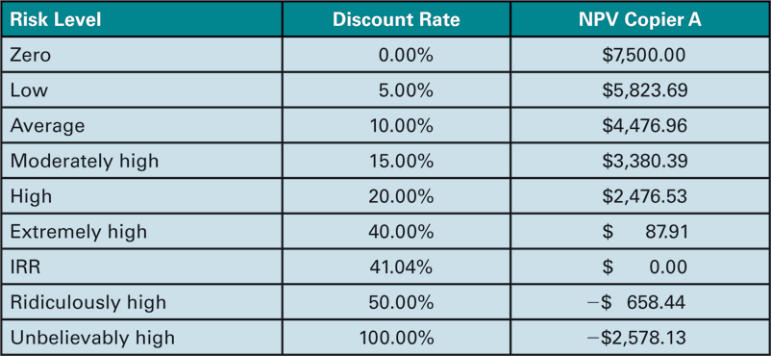
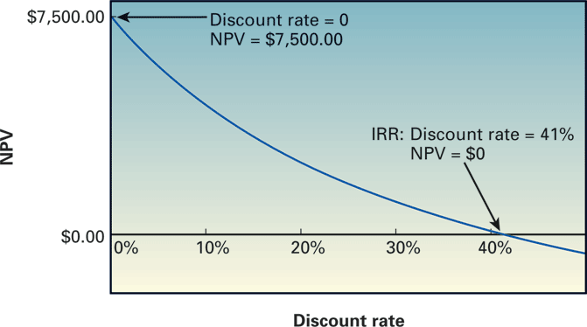
9.4 (A) Appropriate Discount Rate or Hurdle Rate (continued)
TABLE 9.2 NPVs for Copier A with Varying Risk Levels
The point where the NPV line cuts the X-axis is the IRR of the project i.e. the discount rate at which the NPV = 0. Thus, at rates below the IRR, the project would have a positive NPV and would be acceptable and vice-versa.
Figure 9.3 Net present value profile of copier A.

Slide 34
9.4 (B) Problems with the Internal Rate of Return
In most cases, NPV decision = IRR decision
That is, if a project has a positive NPV, its IRR will exceed its hurdle rate, making it acceptable. Similarly, the highest NPV project will also generally have the highest IRR.
However, there are some cases when the IRR method leads to ambiguous decisions or is problematic. In particular, we can have 2 problems with the IRR approach:
1. Multiple IRRs; and
2. An unrealistic reinvestment rate assumption.

Slide 35
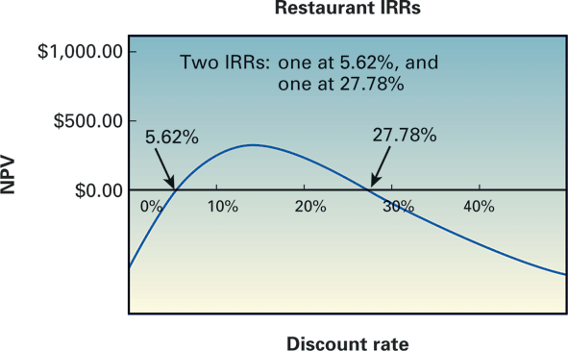
9.4 (C) Multiple Internal Rates of Return
Projects which have non-normal cash flows (as shown below) i.e. multiple sign changes during their lives often end up with multiple IRRs.
Figure 9.4 Pay Me Later Franchise Company multiple internal rates
of return.

Slide 36
9.4 (C) Multiple Internal Rates of Return (continued)
Typically happens when a project has non-normal cash flows, i.e. the cash inflows and outflows are not all clustered together i.e. all negative cash flows in early years followed by all positive cash flows later, or vice-versa.
If the cash flows have multiple sign changes during the project’s life, it leads to multiple IRRs and therefore ambiguity as to which one is correct.
In such cases, the best thing to do is to draw an NPV profile and select the project if it has a positive NPV at our required discount rate and vice-versa.

Slide 37
9.4 (D) Reinvestment & Crossover Rates
Another problem with the IRR approach is that it inherently assumes that the cash flows are being reinvested at the IRR, which if unusually high, can be highly unrealistic.
In other words, if the IRR was calculated to be 40%, this would mean that we are implying that the cash inflows from a project are being reinvested at a rate of return of 40%, for the IRR to materialize.

Slide 38
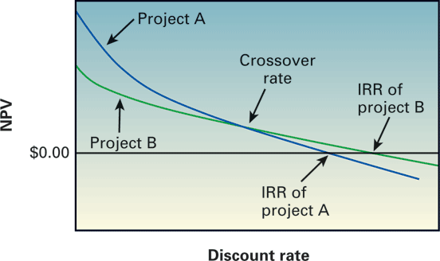
9.4 (D) Reinvestment & Crossover Rates (continued)
A related problem arises when in the case of mutually exclusive projects we have either significant cost differences, and/or significant timing differences, leading to the NPV profiles crossing over.
Figure 9.5 Mutually exclusive projects and their crossover rates.
Notice that Project B’s IRR is higher than Project A’s IRR, making it the preferred choice based on the IRR approach.
However, at discount rates lower than the crossover rate, Project A has a higher NPV than Project B, making it more acceptable since it is adding more value

Slide 39
9.4 (D) Reinvestment & Crossover Rates (continued)
If the discount rate is exactly equal to the crossover rate both projects would have the same NPV.
To the right of the crossover point, both methods would select Project B.
The fact that at certain discount rates, we have conflicting decisions being provided by the IRR method vis-à-vis the NPV method is the problem.
So, when in doubt go with the project with the highest NPV, it will always be correct.

Slide 40
9.4 (D) Reinvestment & Crossover Rates (continued)
Example 8: Calculating the crossover rate of two projects
Listed below are the cash flows associated with two mutually exclusive projects, A and B. Calculate their crossover rate.
First calculate the yearly differences in the cash flows i.e. (A-B)
Next, calculate the IRR of the cash flows in each column, e.g. For IRR_{(A-B)}

Slide 41
9.4 (D) Reinvestment & Crossover Rates (continued) Example 8 Answer
➔IRR(10, {-3000, -4000, 2000, 7000} ➔12.04%
➔IRR_{A} = 42.98% ; IRR_{B} = 77.79%; IRR_{(A-B)} = 12.04%
Now, to check this calculate the NPVs of the two projects at:
0%, 10%, 12.04%, 15%, 42.98%, and 77.79%.
From 0% to 12.04%, NPV_{A} > NPV_{B}
For I >12.04%, NPV_{B} > NPV_{A}
NPV profiles cross-over at 12.04%

Slide 42
9.4 (E) Modified Internal Rate of Return (MIRR)
Despite several shortcomings, managers like to use IRR since it is expressed as a% rather than in dollars.
The MIRR was developed to get around the unrealistic reinvestment rate criticism of the traditional IRR
Under the MIRR, all cash outflows are assumed to be reinvested at the firm’s cost of capital or hurdle rate, which makes it more realistic.
We calculate the future value of all positive cash flows at the terminal year of the project, the present value of the cash outflows at time 0; using the firm’s hurdle rate; and then solve for the relevant rate of return that would be implied using the following equation:

Slide 43
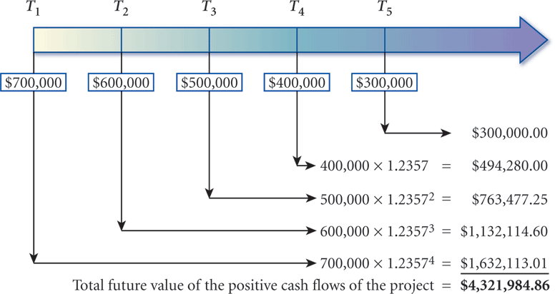
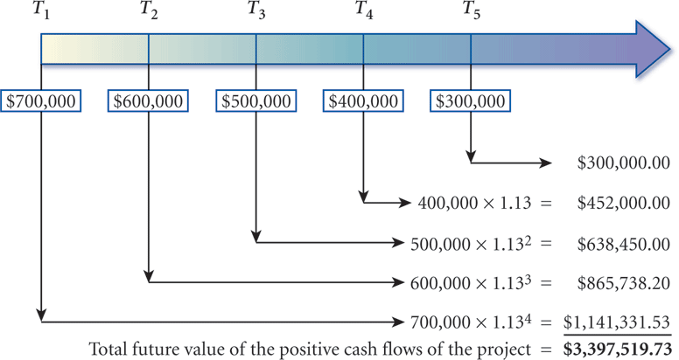
9.4 (E) Modified Internal Rate of Return (MIRR) (continued)
Figure 9.7 Future value of cash inflows reinvested at the internal rate
of return.
Figure 9.8 Future value of cash inflows reinvested at 13%.

Slide 44
9.4 (E) Modified Internal Rate of Return (MIRR) (continued)
Example 9: Calculating MIRR.
Using the cash flows given in Example 8 above, and a discount rate of 10%; calculate the MIRRs for Projects A and B. Which project should be accepted? Why?

Slide 45
9.4 (E) Modified Internal Rate of Return (MIRR) (continued)
Example 9 Answer
Project A:
PV of cash outflows at time 0 = $10,000
FV of cash inflows at year 3, @10% = 5,000*(1.1)² + $7,000*(1.1)¹ + $9,000
➔$6,050+$7,700+$9,000=$22,750
MIRR_{A} = (22750/10000)^{1/3} – 1 = 31.52%
Project B:
PV of cash outflows at time 0 = $7,000
FV of cash inflows at year 3, @10% = $9,000*(1.1)² + $5,000*(1.1)¹ + $2,000
➔$10,890+$5,500+$2,000=$18,390
MIRR_{B} = (18390/7000)^{1/3} – 1 = 37.98%
So, accept Project B since its MIRR is higher.

Slide 46
9.5 Profitability Index
If faced with a constrained budget choose projects that give us the best “bang for our buck.”
The Profitability Index can be used to calculate the ratio of the PV of benefits (inflows) to the PV of the cost of a project as follows:
In essence, it tells us how many dollars we are getting per dollar invested.

Slide 47
9.5 Profitability Index (continued)
Example 10: PI calculation.
Using the cash flows listed in Example 8, and a discount rate of 10%, calculate the PI of each project Which one should be accepted, if they are mutually exclusive? Why?
Answer
PI_{A}= (NPV + Cost)/Cost = ($17,092.41/$10,000) = $1.71
PI_{B} = (NPV + Cost)/Cost = ($13,816.68/$7,000) = $1.97
PROJECT B, HIGHER PI

Slide 48
9.6 Overview of Six Decision Models
Payback period
simple and fast, but economically unsound.
ignores all cash flow after the cutoff date
ignores the time value of money and riskiness of cashflows.
Discounted payback period
incorporates the time value of money
still ignores cash flow after the cutoff date.
3. Net present value (NPV)
economically sound
properly ranks projects across various sizes, time horizons, and levels of risk, without exception for all independent projects.

Slide 49
9.6 Overview of Six Decision Models (continued)
Internal rate of return (IRR)
provides a single measure (return),
has the potential for errors in ranking projects.
can also lead to an incorrect selection when there are two mutually exclusive projects or incorrect acceptance or rejection of a project with more than a single IRR.
5. Modified internal rate of return (MIRR)
corrects for most of, but not all, the problems of IRR and gives the solution in terms of a return.
the reinvestment rate may or may not be appropriate for the future cash flows, however.
6. Profitability index (PI)
incorporates risk and return,
but the benefits-to-cost ratio is actually just another way of expressing the NPV.

Slide 50
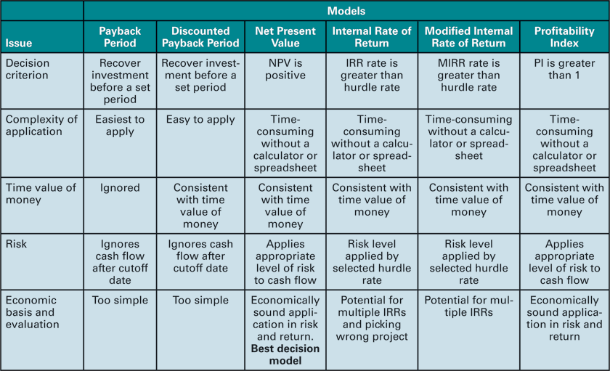
9.6 Overview of Six Decision Models (continued)
Table 9.4 Summary of Six Decision Models

Slide 51
9.6 (A) Capital Budgeting Using a Spreadsheet
NPV, MIRR, and IRR can be easily solved once data is entered into a spreadsheet.
For NPV we enter the following ➔ NPV(rate, CF₁:CF_{n}) + CF₀
Note: for the NPV we have to add in the Cash outflow in Year 0 (CF₀), at the end, i.e.to the PV of CF₁…CF_{n}
For IRR we enter the following ➔ IRR(CF₀:CF_{n})
For MIRR ➔MIRR(CF0:CFn,discount rate, reinvestment rate); where the discount rate and the reinvestment rate would typically be the same i.e. the cost of capital of the firm.

Slide 52
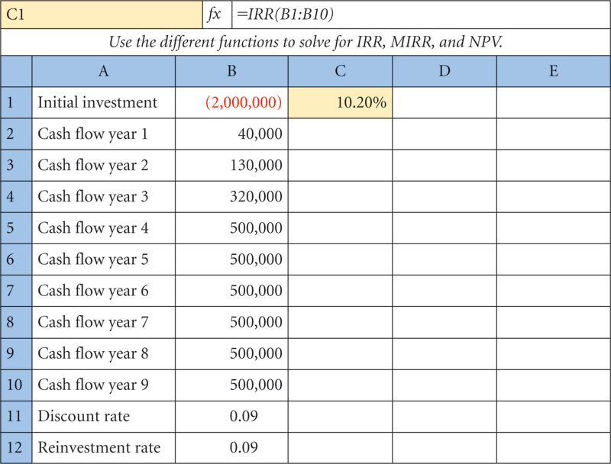
9.6 (A) Capital Budgeting Using a Spreadsheet (continued)

Slide 53
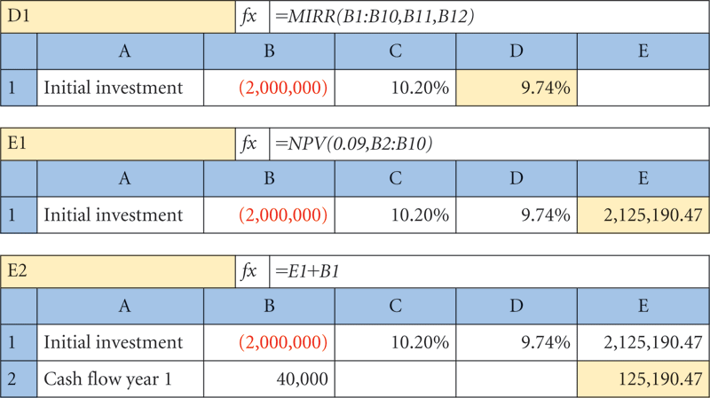
9.6 (A) Capital Budgeting Using a Spreadsheet (continued)

Slide 54
Additional Problems with Answers Problem 1
Computing Payback Period and Discounted Payback Period.
Regions Bank is debating between two the purchase of two software systems; the initial costs and annual savings of which are listed below. Most of the directors are convinced that given the short lifespan of software technology, the best way to decide between the two options is on the basis of a payback period of 2 years or less.
Compute the payback period of each option and state which one should be purchased.
One of the directors states, “I object! Given our hurdle rate of 10%, we should be using a discounted payback period of 2 years or less.” Accordingly, evaluate the projects on the basis of the DPP and state your decision.

Slide 55
Additional Problems with Answers Problem 1 (Answer)
Payback period of Option A = 1 year + (1,875,000-1,050,000)/900,000 = 1.92 years
Payback period of Option B = 1year + (2,000,000-1,250,000)/800,000 = 1.9375 years.
Based on the Payback Period, Option A should be chosen.

Slide 56
Additional Problems with Answers Problem 1 (Answer) (continued)
For the discounted payback period, we first discount the cash flows at 10% for the respective number of years and then add them up to see when we recover the investment.
DPP _{A} = -1,875,000 + 954,545.45+743,801.65=-176652.9
➔ still to be recovered in Year 3
➔ DPP _{A} = 2 + (176652.9/338091.66) = 2.52 years
DPP _{B} = -2,000,000+1, 136,363.64+661157.02 = -202479.34 ➔still to be recovered in Year 3
DPP_{B} = 2 + (202479.34/450788.88) = 2.45 years.
Based on the Discounted Payback Period and a 2 year cutoff, neither option is acceptable.

Slide 57
Additional Problems with Answers Problem 2
Computing Net Present Value – Independent projects:
Locey Hardware Products is expanding its product line and its production capacity. The costs and expected cash flows of the two projects are given below. The firm typically uses a discount rate of 15.4 percent.
What are the NPVs of the two projects?
Which of the two projects should be accepted (if any) and why?

Slide 58
Additional Problems with Answers Problem 2 (Answer)
NPV @15.4% = $86,572.61 $20,736.91
Decision: Both NPVs are positive, and the projects are independent, so assuming that Locey Hardware has the required capital, both projects are acceptable.

Slide 59
Additional Problems with Answers Problem 3
KLS Excavating needs a new crane. It has received two proposals from suppliers.
Proposal A costs $ 900,000 and generates cost savings of $325,000 per year for 3 years, followed by savings of $200,000 for an additional 2 years.
Proposal B costs $1,500,000 and generates cost savings of $400,000 for 5 years.
If KLS has a discount rate of 12%, and prefers using the IRR criterion to make investment decisions, which proposal should it accept?

Slide 60
Additional Problems with Answers Problem 3 (Answer)

Slide 61
Additional Problems with Answers Problem 4
Using MIRR.
The New Performance Studio is looking to put on a new opera.
They figure that the set-up and publicity will cost $400,000.
The show will go on for 3 years and bring in after-tax net cash flows of $200,000 in Year 1; $350,000 in Year 2; -$50,000 in Year 3.
If the firm has a required rate of return of 9% on its investments, evaluate whether the show should go on using the MIRR approach.

Slide 62
Additional Problems with Answers Problem 4 (Answer)
The forecasted after-tax net cash flows are as follows:
Year After-tax cash flow
0 -$400,000
1 200,000
2 350,000
3 -$50,000
The formula for MIRR is as follows:
Where :FV = Compounded value of cash inflows at end of project’s life
(Year 3)using realistic reinvestment rate (9%);
PV = Discounted value of all cash outflows at Year 0;
N = number of years until the end of the project’s life= 3.

Slide 63
Additional Problems with Answers Problem 4 (Answer) (continued)
FV₃ = $200,000*(1.09)² + $350,000*(1.09)¹
= $237,620 + $381,500 = $619,120
PV₀ = $400,000 + $50,000/(1.09)³
=$438,609.17
MIRR = (619,120/$438,609.17)^{1/3} – 1
= (1.411552)^{1/3} -1 = 12.18%
The show must go on, since the MIRR = 12.18% > Hurdle rate = 9%

Slide 64
Additional Problems with Answers Problem 5

Slide 65
Additional Problems with Answers Problem 5 (Answer)
To get some idea of the range of discount rates we should include in the NPV profile, it is a good idea to first compute each project’s IRR and the crossover rate, i.e. , the IRR of the cash flows of Project B-A as shown below:

Slide 66
Additional Problems with Answers Problem 5 (Answer) (continued)
So, it’s clear that the NPV profiles will cross-over at a discount rate of 5.2%.
Project A has a higher IRR than Project B, so at discount rates higher than 5.2%, it would be the better investment, and vice-versa (higher NPV and IRR), but if the firm can raise funds at a rate lower than 5.2%, then Project B will be better, since its NPV would be higher.
To check this let’s compute the NPVs of the 2 projects at 0%, 3%, 5.24%, 8%, 10.2%, and 11.6%...

Slide 67
Additional Problems with Answers Problem 5 (Answer) (continued)
Note that the two projects have equal NPVs at the cross-over rate of 5.24%. At rates below 5.24%, Project B’s NPVs are higher; whereas at rates higher than 5.24%, Project A has the higher NPV.

Slide 68
FIGURE 9.1 Initial cash outflow and future cash inflow of Copiers A and B.

Slide 69
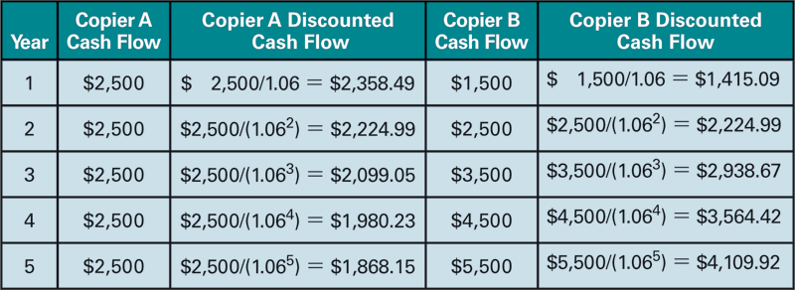
TABLE 9.1 Discounted Cash Flow of Copiers A and B

Slide 70
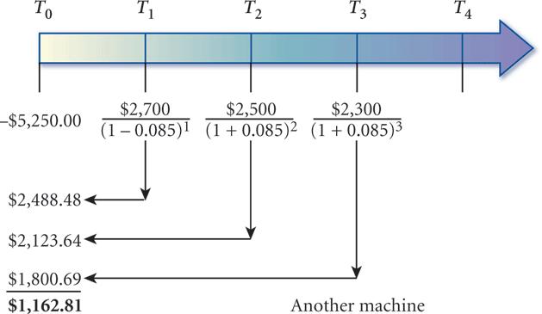
FIGURE 9.2 Net present value of a low-tech packaging machine.

Slide 71
TABLE 9.3 Project Rankings Based on the Internal Rate of Return and the Net Present Value

Slide 72
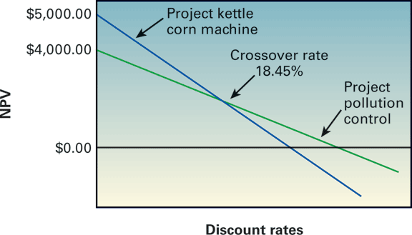
FIGURE 9.6 Crossover rate for two projects.

Slide 73
TABLE 9.5 Corporate Use of Different Decision Models: What Capital Budgeting Decision Models Do You Use?

