Slide 1
Boolean Algebra

Slide 2
Boolean Functions
In Boolean algebra we work with the set {0,1}, where:
0 ≡ F (False) & 1 ≡ T (True).
The 3 Operations used in Boolean Algebra are:
Complementation ( ^{-ــــــــ} , ¬).
Boolean sum (+; OR, V).
Boolean product(. ; AND, Λ).
Where (¬, V, Λ) are the Logical Operations.

Slide 3
The Operations In Boolean Algebra
The complementation of an element, denoted with a bar “^{-ــــــــ}” is defined by:
The sum (+; OR):
1+1=1; 1+0=1; 0+1=1; 0+0=0.
3. Boolean product(. ; AND).
1.1=1, 1.0=0, 0.1=0, 0.0=0

Slide 4
Example1:
Find the value of
Solution:
Using the definition of operations in Boolean algebra, it follows that:

Slide 5
Translation into a Logical Equivalence
0 ≡ F,
1 ≡ T ,
. ≡ Λ,
+ ≡ V,
^{ــــــــ} ≡ ¬

Slide 6
Example 2:
Solution:
0 ≡ F,
1 ≡ T ,
. ≡ Λ,
+ ≡ V,
^{ــــــــ} ≡ ¬

Slide 7
Example 3:
Solution:
0 ≡ F,
1 ≡ T ,
. ≡ Λ,
+ ≡ V,
^{ــــــــ} ≡ ¬

Slide 8
Boolean Expressions and Boolean Functions
Let B= {0,1} . Then B^{n}={(x₁, x₂ , • • • , x_{n})/x_{i}ϵB for 1 ≤ i ≤n} is the set of all possible n -tuples of Os and 1s. The variable x is called a Boolean variable if it assumes values only from B , that is, if its only possible values are 0 and 1 . A function from B^{n} to B is called a Boolean
function of degree n.

Slide 9
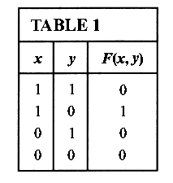
EXAMPLE 4
The function from the set of ordered pairs of Boolean variables to the set {0,1}
is a Boolean function of degree 2 with
F ( 1,1)=0, F (1,0) = 1 , F (0,1) = 0, and F(0, 0) = 0.
We display these values of F in Table 1 .
0 ≡ F,
1 ≡ T ,
. ≡ Λ,
+ ≡ V,
^{ــــــــ} ≡ ¬

Slide 10
Boolean Expressions
Boolean functions can be represented using expressions made up from variables and Boolean operations (., +, ^{ــــــــ} ).
The Boolean expressions in the variables x₁ , x₂ , • • • , x_{n} are defined recursively as
0, 1 , x₁ , x₂ , • • • , x_{n} are Boolean expressions;
if E₁ and E₂ are Boolean expressions, then , (E₁.E₂), and (E₁+E₂) are Boolean expressions.

Slide 11
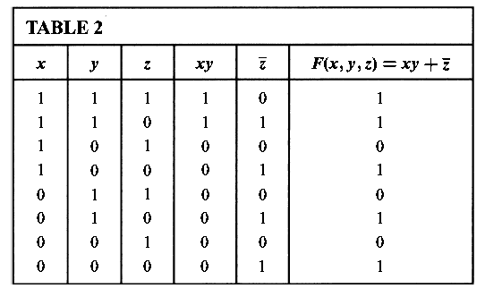
EXAMPLE 5
Find the values of the Boolean function represented by
Solution:
The values of this function are displayed in Table 2.

Slide 12
Equality of Boolean Functios

Slide 13
EXAMPLE 7
How many different Boolean functions of degree n are there?
Solution: From the product rule for counting, it follows that there are 2^{n} different n-tuples of
Os and 1 s.
Because a Boolean function is an assignment of 0 or 1 to each of these 2^{n} different n-tuples, the product rule shows that there are different Boolean functions of degree n.

Slide 14
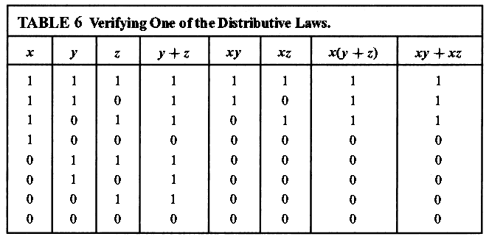
Identities of Boolean Algebra
EXAMPLE 8
Show that the distributive law x(y+z)=xy+xz is valid.
Solution:. The identity holds because the last two columns of the table agree.

Slide 15
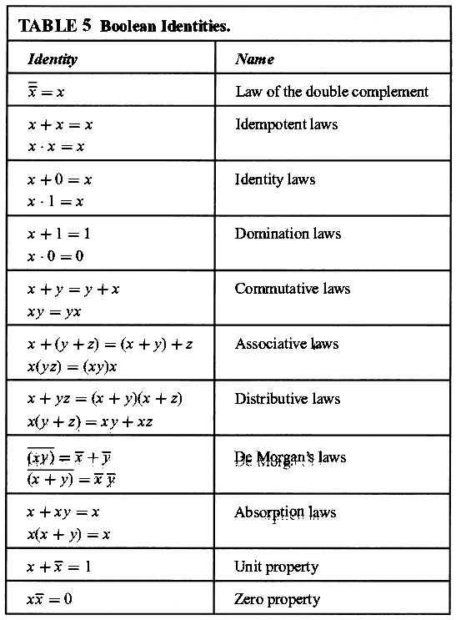

Slide 16
EXAMPLE 9
Translate the distributive law x+yz=(x+y)(x+z) in Table 5 into a logical equivalence.
Solution:
Put x≡p, y≡q, & z≡r, and use the translation of Boolean operations
This transforms the Boolean identity into the logical equivalence
pV(qΛr)≡(pVq)Λ(p Vr).
0 ≡ F,
1 ≡ T ,
. ≡ Λ,
+ ≡ V,
^{ــــــــ} ≡ ¬

Slide 17
EXAMPLE 10
Prove the absorption law x(x+y)=x using the other identities of Boolean algebra shown in
Table 5
Solution:
The steps used to derive this identity and the law used in each step follow:
x(x+y)=(x+0)(x+y) Identity law for the Boolean sum
= x+0.y Distributive law of the Boolean sum over the
Boolean product
= x +Y.0 Commutative law for the Boolean product
=x+0 Domination law for the Boolean product
= x Identity law for the Boolean sum

Slide 18
Duality
The dual of a Boolean expression is obtained by interchanging Boolean sums and Boolean products and interchanging Os and 1 s.
Duality of a Boolean function F is denoted by F^{d}
Duality
0 interchanged to 1,
1 interchanged to 0,
+ interchanged to . ,
. interchanged to +

Slide 19
EXAMPLE 11
Solution:
Duality
0 interchanged to 1,
1 interchanged to 0,
+ interchanged to . ,
. interchanged to +

Slide 20
Duality Principle
An identity between functions represented
by Boolean expressions remains valid when the duals of both sides of the identity are taken.
This result, called the duality principle, is useful
for obtaining new identities.

Slide 21
EXAMPLE 12
Construct an identity from the absorption law x(x+y)=x by taking duals.
Solution:
Taking the duals of both sides of this identity produces the identity x+xy = x, which
is also called an absorption law and is shown in Table 5 .
Duality
0 interchanged to 1,
1 interchanged to 0,
+ interchanged to . ,
. interchanged to +

Slide 22
Homework
Page 756
1(a),
4(a,b),
5(a),
11,
28(a,d).

