Slide 1
Bonds
Premium/Discount + Amortization

Slide 2
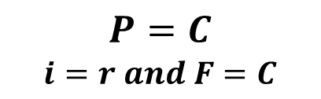
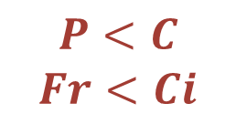


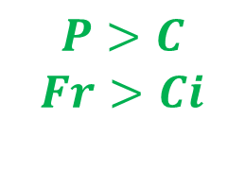
Bonds
Premium/Discount
$$P<C$$
$$Fr<Ci$$
$$P=C$$
$$i=r and F=C$$
$$P>C$$
$$Fr>Ci$$
Priced at Par
Bought at
Discount
Bought at
Premium
$$Discount = C−P$$
$$Premium=P−C$$

Slide 3

Example
$$A four year 1000 par value bond$$
Coupon Rate | Yield Rate | Ci | Fr | Price | Amount of Discount/Premium
4% | 4%
5% | 4%
2.5% | 4%

Slide 4
Example
$$A four year 1000 par value bond$$
Coupon Rate | Yield Rate | Ci | Fr | Price | Amount of Discount/Premium
4% | 4% | 40 | 40 | 1000 | Priced at Par
5% | 4% | 40 | 50 | 1036.30 | 36.3
2.5% | 4% | 40 | 25 | 945.55 | 54.45

Slide 5
Bonds
Amortization
Loans
Outstanding Balance
Loan Payment
Principal
Bonds
Book Value
Coupon
Write (Up/Down)

Slide 6
Bonds – Amortization
Write-Down Example
$$Four year 1000 par value bond i=4\% and r=5\% , P=\text{1036}\text{.}\text{30}$$
Year | Coupon | Interest | Write-Down
0 |  |  |  | 1036.30
1 | 50
2 | 50
3 | 50
4 | 50 |  |  | 1000

Slide 7
Bonds – Amortization
Example
$$Four year 1000 par value bond i=4\% and r=5\% , P=\text{1036}\text{.}\text{30}$$
Year | Coupon | Interest | Write-Down
0 |  |  |  | 1036.30
1 | 50 | 41.45 | 8.55 | 1027.75
2 | 50 | 41.11 | 8.89 | 1018.86
3 | 50 | 40.75 | 9.25 | 1009.61
4 | 50 | 40.39 | 9.61 | 1000

Slide 8
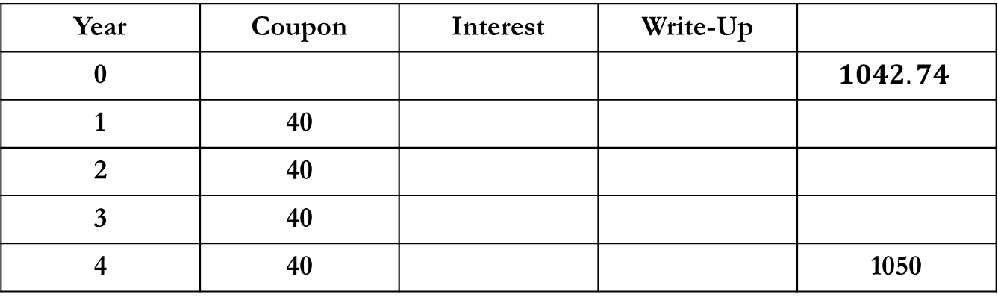
Bonds – Amortization
Write-Up Example
$$Four year 1000 par value bond redeemable at 1050 i=4\% and r=4\% , P=1042.74$$
Year | Coupon | Interest | Write-Up
0 |  |  |  | $$1042.74$$
1 | 40
2 | 40
3 | 40
4 | 40 |  |  | 1050

Slide 9
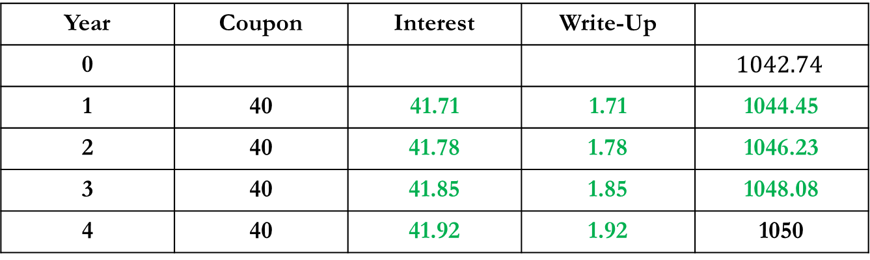
Bonds – Amortization
Write-Up Example
$$Four year 1000 par value bond redeemable at 1050 i=4\% and r=4\% , P=1042.74$$
Year | Coupon | Interest | Write-Up
0 |  |  |  | $$1042.74$$
1 | 40 | 41.71 | 1.71 | 1044.45
2 | 40 | 41.78 | 1.78 | 1046.23
3 | 40 | 41.85 | 1.85 | 1048.08
4 | 40 | 41.92 | 1.92 | 1050

Slide 10

Bonds – Amortization
Formulas
$$Four year 1000 par value bond redeemable at 1050 i=4\% and r=4\% , P=1042.74$$
$$BV_{2} ?$$
$$I_{3} ?$$
$$P_{3} ?$$

Slide 11
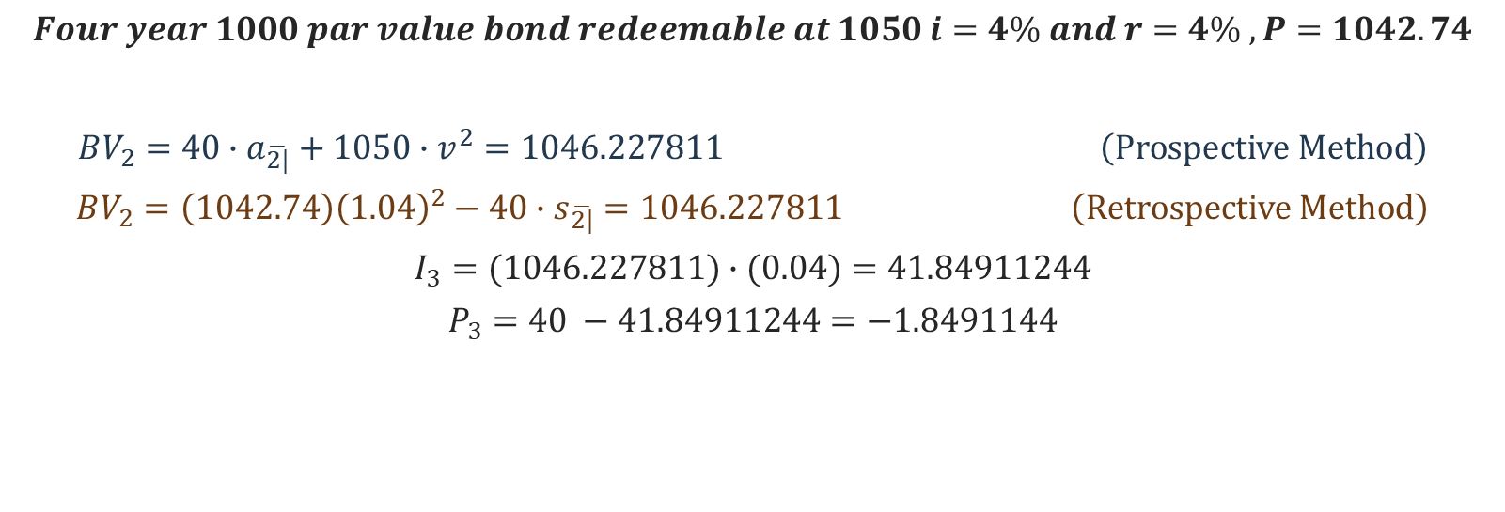
Bonds – Amortization
Formulas
$$Four year 1000 par value bond redeemable at 1050 i=4\% and r=4\% , P=1042.74$$
$$BV_{2}=40∙a_{\overline{2|}}+1050∙v^{2}=1046.227811 \left(Prospective Method\right)$$
$$BV_{2}=\left(1042.74\right){\left(1.04\right)}^{2}−40∙s_{\overline{2|}}=1046.227811 \left(Retrospective Method\right)$$
$$I_{3}=(1046.227811)∙(0.04)=41.84911244$$
$$P_{3}=40 −41.84911244=−1.8491144$$

Slide 12
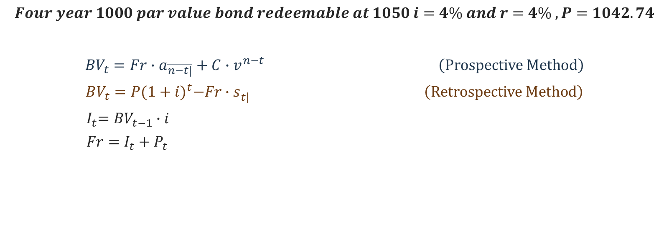
Bonds – Amortization
Formulas
$$Four year 1000 par value bond redeemable at 1050 i=4\% and r=4\% , P=1042.74$$
$$BV_{t}=Fr∙a_{\overline{n−t|}}+C∙v^{n−t} \left(Prospective Method\right)$$
$$BV_{t}=P{(1+i)}^{t}−Fr∙s_{\overline{t|}} \left(Retrospective Method\right)$$
$${ I}_{t}=BV_{t−1}∙i$$
$$Fr=I_{t}+P_{t}$$

