Slide 1
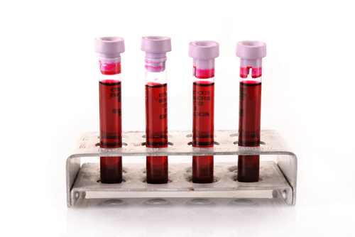
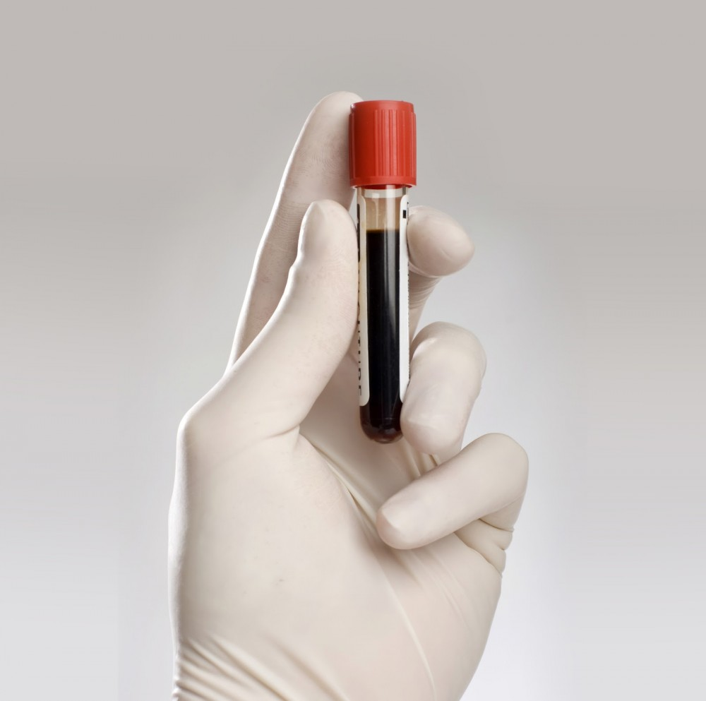
Introduction and Separation of Plasma and Serum from Whole Blood
471 BCH

Slide 2
Blood
The blood is a vitally important fluid for the body It is thicker than water, and feels a bit sticky.
Is very important in transporting oxygen and nutrients to organs
Blood tests are often used in health care to determine physiological and biochemical states, such as disease, mineral content, pharmaceutical drug effectiveness, and organ function.

Slide 3
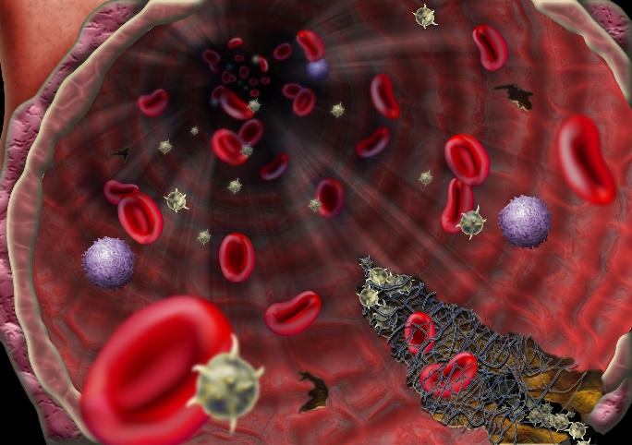
Blood Functions
1.Transportation:
Transports oxygen from the lungs to the cells of the body, where it is needed for metabolism.
2.Regulation:
For instance, it makes sure that the right body temperature is maintained.
3.Protection
blood clot together very quickly and make sure that a scrape, for instance, stops bleeding.
The carbon dioxide produced during metabolism is carried back to the lungs by the blood, where it is then exhaled.
Blood also provides the cells with nutrients, transports hormones and removes waste products, which the liver, the kidneys or the intestine, for example, then get rid of.
White blood cells and other messenger substances also play an important role in the immune system.

Slide 4
Blood contents

Slide 5
Formed Elements (BLOOD CELLS)
Red blood cells (erythrocytes)
White blood cells (leukocytes)
Platelets (thrombocytes)
The cells are produced primarily by bone marrow and account for blood “solids”.
Blood cells are classified as:
The size of Blood cells : • white cells are the largest, red cells fall into the middle, and platelets are the smallest.

Slide 6
Red blood cell
Red blood cells contain hemoglobin, a complex iron-containing protein that carries oxygen throughout the body and gives blood its red color.
Red blood cells have no nucleus
look like discs with indentations on top and on the bottom.
They can bend easily to “squeeze through” narrow blood vessels.
They live for approximately 120 days in the circulatory system and are eventually removed by the spleen.

Slide 7
WHITE BLOOD CELLS (WBC)
They are responsible for protecting the body from invasion by foreign substances such as bacteria, fungi, and viruses.
Types of WBC
Granulocytes:
Agranulocytes
Neutrophils
Eosinophils
Basophils
Monocytes
Lymphocytes
They are classified according to how their nucleus is shaped and what the inside of the cell looks like under a microscope.

Slide 8
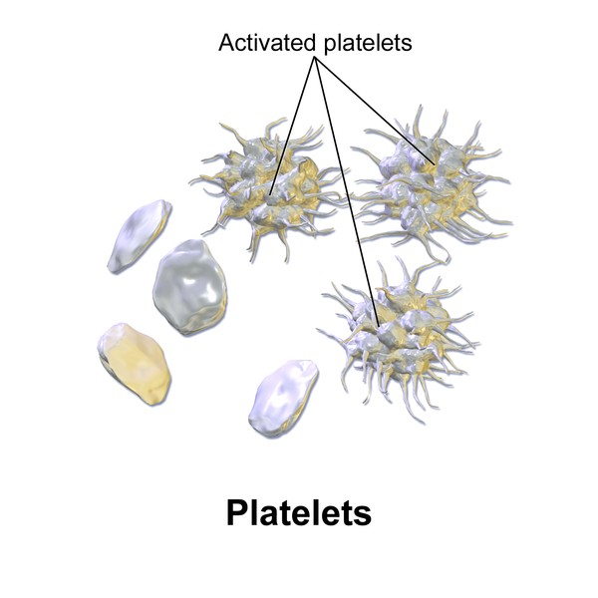
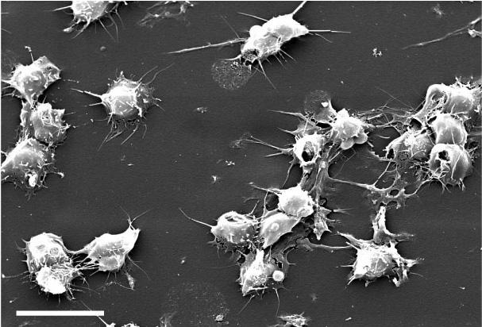
PLATELETS
They are very small cellular components of blood that help the clotting process by sticking to the lining of blood vessels.
They survive in the circulatory system for an average of 9-10 days before being removed from the body by the spleen.
They help prevent massive blood loss resulting from trauma, as well as blood vessel leakage.

Slide 9
The Liquid Phase of Blood
Plasma is the liquid portion of blood
It constitutes about 55 % of blood volume.
90% of plasma is water
It contains 7% proteins:
Albumin (the chief protein constituent)
Globulins (including antibodies).
Fibrinogen (responsible, in part, for the clotting of blood)
•Serum :It resembles plasma in composition but lacks the coagulation factors.
(Serum = Plasma – clotting factors)

Slide 10
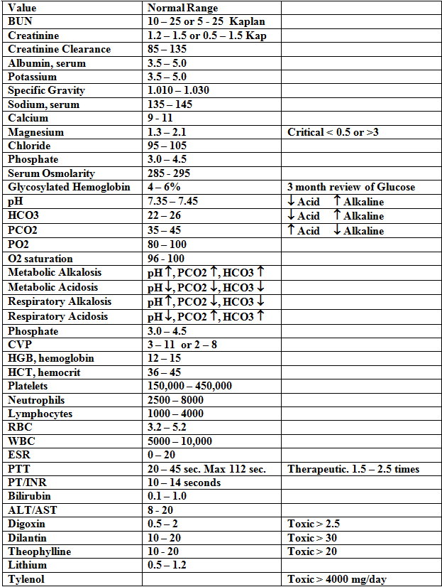
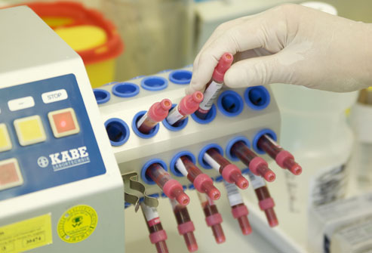
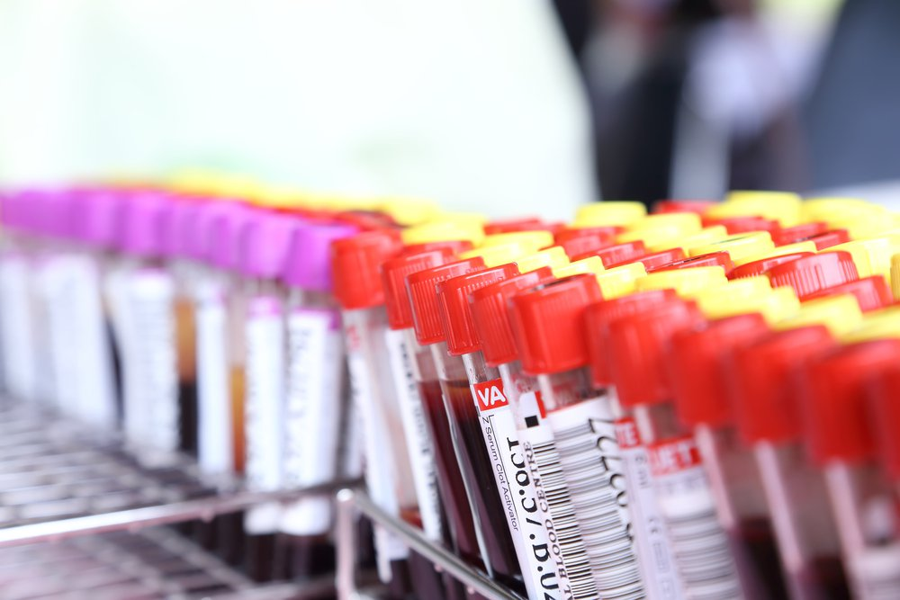
Blood for diagnosis
Blood tests are often used in health care to determine physiological and biochemical states, such as disease, mineral content, pharmaceutical drug effectiveness, and organ function.

Slide 11
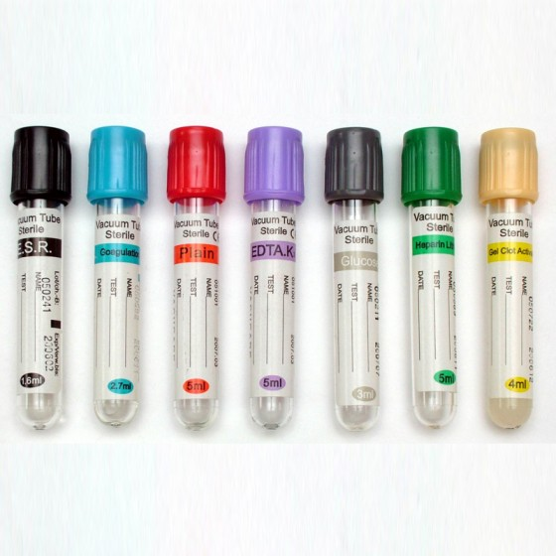
COLLECTION OF BLOOD SPECIMENS
In order to do blood tests, the first thing to do is to collect the blood sample correctly it is a very important step !!
Blood tests could be performed on serum, plasma, or whole blood depending on the type of the test.
Different anticoagulants interfere with different tests; using serum means the same sample can be used for many tests. Some tests require serum, others plasma, while some can be carried out on either or whole blood

Slide 12
Collection of Blood Specimens
If whole blood or plasma is desired, an anticoagulant must be added to the specimen immediately after it is drawn or placed into the tube into which the blood is collected.
Types of Anticoagulants
Heparin
It is the most satisfactory anticoagulant since it does not produce a change in red cell volume or interfere with subsequent determinations.
It inhibits the formation of thrombin from prothrombin and thus preventing the formation of fibrin from fibrinogen.

Slide 13
EDTA
It is a chelating agent, drives its anticoagulant activity from the fact that it binds calcium, which is essential for the clotting mechanism.
Potassium Oxalate
It inhibits blood coagulation by forming insoluble complexes with calcium ions, which is necessary for coagulation.
Sodium Citrate
It does not precipitate the calcium, but converts it into a non-ionized form, and hence prevent clotting of blood.
Sodium Fluoride
It acts as a weak anticoagulant.
It has been used chiefly as a preservative since it inhibits red cell metabolism and bacterial action.

Slide 14
Collection of Blood Specimens
If Serum desired It is obtained by
letting a blood specimen clot prior to centrifugation usually in a red top tube with no additives or anticoagulant.
Or by centrifugation of plasma to precipitate fibrinogen.
Serum is preferred for many tests (e.g. determination of lactate dehydrogenase) as the anticoagulants in plasma can sometimes interfere with the results.

Slide 15
Changes in Blood on Keeping
Loss of carbon dioxide.
Conversion of glucose to lactic acid (glycolysis).
Increase in plasma inorganic phosphate.
Formation of ammonia from nitrogenous substances.
Passage of substances through the red cell envelope.
Conversion of pyruvate into lactate.

Slide 16
Objective
To know how to separate plasma and serum from whole blood.

Slide 17
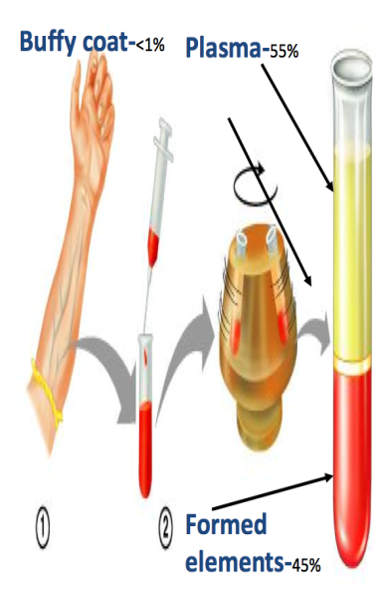
Separate plasma and serum from whole blood.
If blood is treated to prevent clotting and permitted to stand or centrifuged in a container:
The RBCs, which weigh more than the other components, will settle to the bottom;
The plasma will stay on top; and
The WBCs and platelets will remain suspended between the plasma and the RBCs.
Serum: could be obtained by ethier:
Collecting the blood by a tube that do not contain any anticoagulant(red cap) then centrifuge the blood
Or by centrifuginging the plasma at 5000 rpm

Slide 18
Materials
Whole blood
Centrifuge (up to 5000 rpm)
Centrifuge tubes suitable for the rotor of the centrifuge (preferably plastic and capped).
Disposable gloves
Disposable Pasteur pipette.
Measuring cylinder 10 ml.

Slide 19
Method
Into dry clean centrifuge tube, pipette 15 ml of whole blood (V1).
Place the centrifuge tube in the centrifuge machine and run it at 3000 rpm for 10 minutes. Centrifugation of whole blood separates the solid from the supernatant plasma.
Remove the tube, withdraw the liquid layer (plasma) by pasture pipette and measure its volume using small measuring cylinder (V2). Determine the volume of blood cells too V3 (equal to V1 – V2).
Transfer the supernatant (plasma) in another centrifuge tube and make further centrifugation at 3000 rpm. This will precipitate fibrinogen and the supernatant will be SERUM. Measure its Volume (V4).

Slide 20
Result
Record your results in the following table:
 | Component | Total Volume | Percentage (%)
1 | Whole Blood | V1=
2 | Plasma | V2=
3 | RBCs | V3=
4 | Serum | V4=

