Slide 1
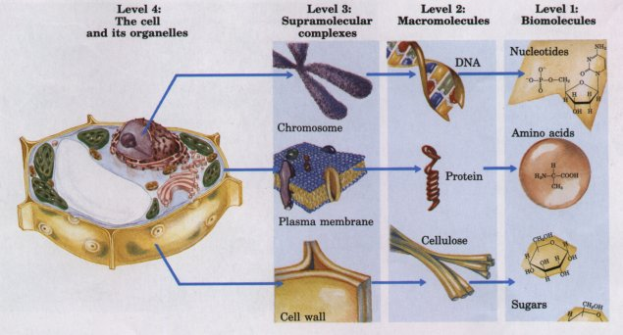
Bimolecular hierarchy

Slide 2
Biomolecules
Biomolecules:
molecules found in living things.
-made up of C, H, O, N, ………etc.
-form macromolecules (proteins, fat, carbohydrates,
nucleic acids).

Slide 3
The biomolecules of living organisms are ordered into a hierarchy of increasing molecular complexity:
All organic biomolecules are derived from
simple low Mwt precursors obtained
from the environment
(e.g CO2, water, and atmospheric nitrogen)
These precursors are converted
by living matter via sequence
of metabolic intermediates into
building-block biomolecules
(e.g amino acids, nucleotides, glucose, fatty acids)

Slide 4
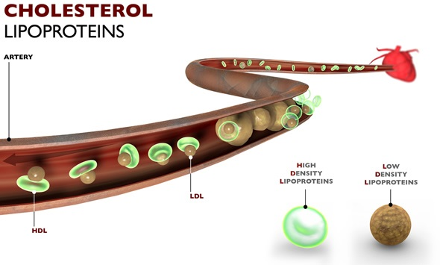
These building block molecules
are then linked to each other
covalently to form the macromolecules
of the cell.
macromolecules
(e.g proteins, nucleic acids, polysaccharides, lipids)
macromolecules of different classes
associate with each other non-covalently
to form supramolecular complex
supramolecular complex
(e.g lipoproteins)

Slide 5
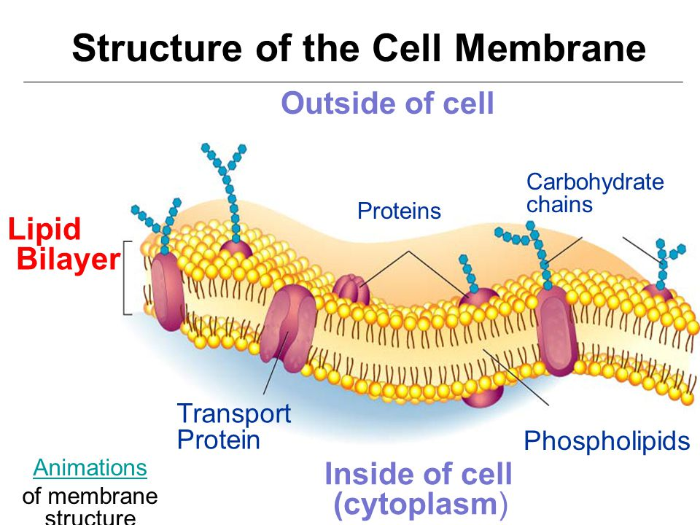
Finally, at the highest level of organization in
the hierarchy of cell structure, various
supramolecular complexes are further
assembled into cell organelles.
Cell organelles
(e.g nuclei, mitochondria, and chloroplast)

Slide 6
It is clear that the dimension, shape and physical properties of the simple building block biomolecules must determine the dimension and properties of macromolecules whose shape must in turn determine how they fit together to form supramolecular structure, which in turn determine the structure of cell organelles and ultimately of the cell itself.

Slide 7
Cells
-Cells are the structural and functional units of all living
organisms.
-The smallest organisms consist of single cells, whereas larger organisms are multicellular.
-Multicellular organisms contain many different types of cells, which vary in size, shape and specialized function.
Cells of all kinds share certain structural feature:
1) The plasma membrane
2) Cytoplasm
3) Ribosomes
4) either nucleus or nucleoid

Slide 8
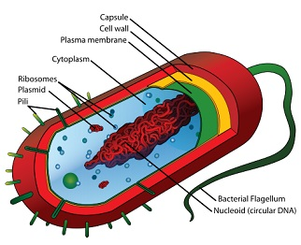
Classes of cells:
1) Prokaryotes:
-Cells without nuclear envelopes.
-Lack both a true nucleus and organelles.
e.g bacterial cells, blue green algae
2) Eukaryotes:
-Cells with nuclear envelope
-Have a true nucleus and organelles
e.g animal, plants,

Slide 9
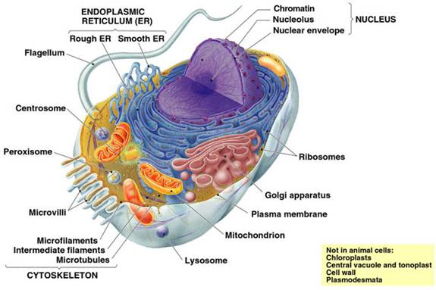

Slide 10
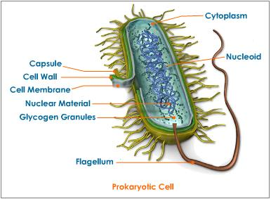

Slide 11
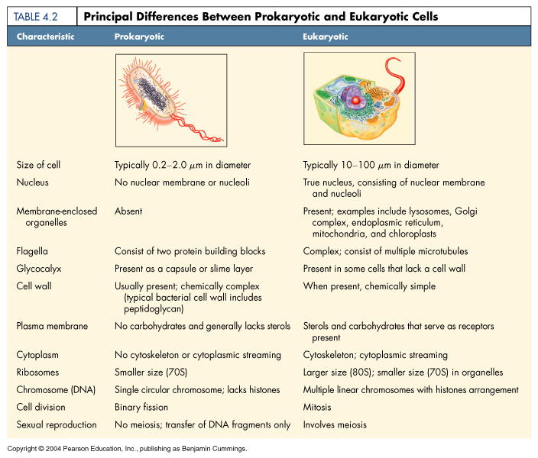

Slide 12
Eukaryotic cells have a variety of membranous organelles:
The organelles in eukaryotic cells:
1) nucleus
2) Endoplasmic reticulum
3) Golgi apparatus
4) mitochondria
5) chloroplast in plants
5) lysosome
6) peroxisome

Slide 13
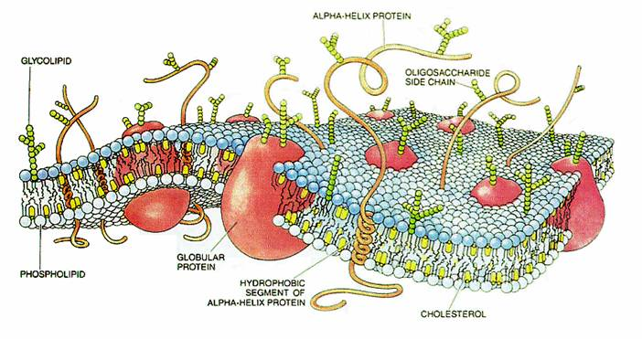

Slide 14
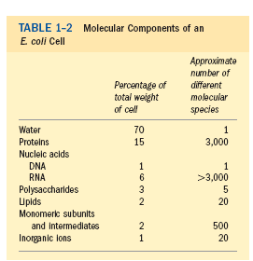
Macromolecules are the major
constituents of cells:
-Many biological molecules are macromolecules.
Example:
major classes of biomolecules in E.coli cell:

Slide 15
-The proteins are the first most abundant macromolecules in the cell, making up over 50% of the dry weight.
-The second most abundant set of macromolecules are nucleic acids.
- followed by carbohydrates and lipids.
-All living cells contain about the same proportion of the major classes of biomolecules as shown in E.coli

Slide 16
The major classes of biomolecules:
1) proteins
2) Carbohydrates
3) Lipids
4) Nucleic acids
https://www.youtube.com/watch?v=RQ-SMCmWB1s
https://www.youtube.com/watch?v=KF7Ve8eM_xk

