Slide 1
Introduction To Number Systems
Binary System

Slide 2
Binary System
The binary system is a different number system.
The coefficients of the binary numbers system have only two possible values: 0 or 1.
Each coefficient d is multiplied by 2^{n}.
For example, the decimal equivalent of the binary number 11010.11 is 26.75, as shown from the multiplication of the coefficients by powers of 2:
1x2⁴ + 1x2³ + 0x2² + 1x2¹ + 0x2⁰ + 1x2⁻¹ + 1x2⁻² = 26.75
the digits in a binary number are called bits.

Slide 3
Binary to Decimal Conversion
A binary number can be converted to decimal by forming the sum of powers of 2 of those coefficients whose value is 1.
Example 2
Convert the binary number (1101001)₂ to decimal.
Solution:
(1101001)₂ =

Slide 4
Binary Fractions
Example3:
Convert the (110.001)₂ to decimal.
Solution:
(110.001)₂ =
------------------------------------------
Example 4
Convert (0.11101)₂ to decimal.
Solution:
(0.11101)₂ =
=
=

Slide 5
Decimal to Binary Conversion
Algorithm 1
To convert from a base-10 integer numeral to its base-2 (binary) equivalent,
the number is divided by two, and the remainder is the least-significant bit.
The (integer) result is again divided by two, its remainder is the next least significant bit.
This process repeats until the quotient becomes zero.

Slide 6
Decimal to Binary Conversion
Example 5
Convert 23₁₀ to binary number.
Solution:
The answer is found by reading "up" from the bottom. Therefore, 23₁₀ =
 |  | Quotient |  | Remainder
1. | 23 ÷ 2 =
2. | 11 ÷ 2 =
3. | 5 ÷ 2 =
4. | 2 ÷ 2 =
5. | 1 ÷ 2 =
6. | 0 ÷ 2 =
7. | 0 ÷ 2 =
 | sign bit

Slide 7
Decimal to Binary Conversion
Example 6:
Convert 46 ₁₀ to base 2.
Solution:
Therefore, 46₁₀ =
 |  | Quotient |  | Remainder
1. | 46 ÷ 2 =
2. | 23 ÷ 2 =
3. | 11 ÷ 2 =
4. | 5 ÷ 2 =
5. | 2 ÷ 2 =
6. | 1 ÷ 2 =
7. | 0 ÷ 2 =
 | sign bit

Slide 8
Decimal Fractions to Binary Fractions Conversions
To convert the fractional part successive multiplications are done instead of divisions. In each case the remaining fractional part is used in the succeeding multiplication

Slide 9
Decimal Fractions to Binary Fractions Conversions
Example 7
Convert the decimal fraction 0.59375₁₀ to binary fraction.
Solution:
To convert the fractional part (0.59375)₁₀, successive multiplications are done instead of divisions. In each case the remaining fractional part is used in the succeeding multiplication
Therefore 0.59375₁₀ =
 |  | Integer |  | Fraction
1. | 0.59375 x 2 =
2. | 0.1875 x 2 =
3. | 0.375 x 2 =
4. | 0.75 x 2 =
5. | 0.5 x 2 =

Slide 10
Decimal to Binary Conversion
Example 8
Convert 46.59375₁₀ to base 2.
Solution:
First, convert the whole number (46) using the previous method.
46₁₀ = 0010 1110₂
Next, convert the fractional part (0.59375), also use the previous method.
0.59375₁₀ = 0.10011₂
Therefore, 46.59375₁₀ = 0010 1110.10011 ₂

Slide 11
Arithmetic in the Binary System

Slide 12
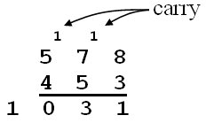
Binary Addition
The process for adding binary numbers is the same in any number system, except that you must be aware of when (and what) to “carry”.
In the decimal system, a carry occurs when the sum of 2 digits is 10 or more. For example,
In binary, a carry occurs when the sum of 2 binary digits is 2 or more. This leaves only four possibilities:
0 + 0 = 0₂ 0 + 1 = 1₂ 1 + 1 = 10₂ (therefore, 0 with a carry) 1 + 1 + 1 = 11₂ (therefore, 1 with a carry)

Slide 13
Example9:
Add the binary numbers
0011 0010₂ + 0011 0111₂:
Solution:
Addition table
+ | 0 | 1
0 | 0 | 1
1 | 1 | 10

Slide 14
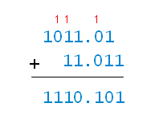
Example10:
Add the binary numbers
1011.01₂+11.011₂
Solution:
Addition table
+ | 0 | 1
0 | 0 | 1
1 | 1 | 10

Slide 15
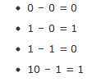
Binary Subtraction
For binary subtraction, there are four facts instead of one hundred:

Slide 16
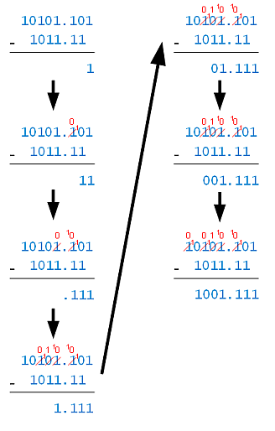
Example 11:
Subtract: 10101.101_1011.11
Solution:
Step 1: 1 – 0 = 1.
Step 5: 1 – 1 = 0.
Step2: Borrow to make 10 – 1 = 1.
Step 6: 0 – 0 = 0.
Step3: Borrow to make 10 – 1 = 1.
Step7: Borrow to make 10 – 1 = 1.
Step 4: Cascaded borrow to make 10 – 1 = 1.

Slide 17
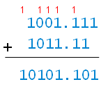
Checking the Answer
You can check the answer in a few ways. One way is to add the result (1001.111) to the subtrahend (1011.11), and check that that answer matches the minuend (10101.101):

Slide 18
Binary Multiplication
Binary multiplication uses the same algorithm as in decimal, but uses just three order-independent facts:
0 x 0 = 0,
1 x 0 = 0,
1 x 1 = 1

Slide 19
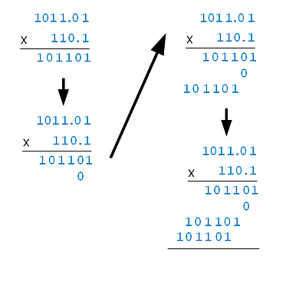
Binary Multiplication
Example 12:
Multiply 1011.01 x 110.1
Solution:
1 1 1
1 10
1
1001001.001

Slide 20
Homework
All Exercises Page 10

