Slide 1
Bacteriology
Basic features of bacteria
Bacteria form a large group of parasitic, saprophytic, and free-living microorganism
1. Bacterial cell wall (protects against osmotic damage)
Bacterial cell is prokaryotic. Contains high concentration of inorganic ions and requires as strong cell wall to prevent fluid being drawn into and lysing the cell. The cell wall is strengthen by mucopeptide polymer (peptidoglycan)
Chemically: the rigid part of cell wall is peptidoglycan: this is a mucopeptide composed of a strand of alternating N-acetylglucosamine and N-acetylmucramic acid molecules
Protects the cell from mechanical disruption
Osmotic protection
Provides a barrier against certain toxic chemical and biological agent
Being rigid responsible for the shape of the cell
Antigenic determinant (a site on an antigen at which an antibody can bind, the molecular arrangement of the site determining the specific combining antibody. ) of the cell surface

Slide 2
A century ago by the Danish microbiologist Hans Christian Gram, * gram stain
Most bacteria surround themselves with a peptidoglycan (PG) exoskeleton synthesized by polysaccharide polymerases called penicillin-binding proteins (PBPs) (Paradis-bleau, Catherine).
Differences in the composition of bacterial cell walls, lead to differences in the staining of bacteria. The most important staining procedure is the gram staining, by this the organism is classified as gram positive (purple in color) or gram negative (red in color) depending on whether they retain the stain crystal violet (gram positive) or are decolorized and take up the red counter stain (gram negative).
He main differences between the cell walls of gram positive and gram-negative bacteria are as follows

Slide 3
 | Gram positive bacteria (G+) | Gram negative bacteria (G-)
Cell wall | Large amount of peptidoglycan and teichoic acid | Small amount of peptidoglycan
 | Additional carbohydrate and proteins according to species | Outer layer of cell wall contains lipo-polysaccharide molecules (endotoxine) (LPS) and phospholipids

Slide 4
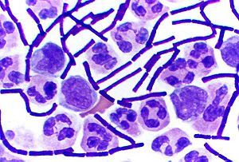
Gram-positive bacteria are so called because they take up the violet stain used in the Gram staining method. Gram-positive bacteria are able to retain the crystal violet stain due to their thick peptidoglycan layer in their cell wall. This layer is superficial to the cell membrane. Cell walls provide structural support, protection and rigidity to the cell.
These features distinguishes Gram-positive bacteria from the other large group of bacteria, the Gram-negative bacteria, which cannot retain the crystal violet stain. Instead they take up the counterstain (safranin or fuchsine) and appear red or pink. This is because, in Gram-negative bacteria, this peptidoglycan layer is much thinner and is located between two cell membranes: an inner cell membrane and a bacterial outer membrane.
showing gram-positive anthrax baccilli (purple rods).
http://en.wikipedia.org/wiki/Gram-positive_bacteria

Slide 5
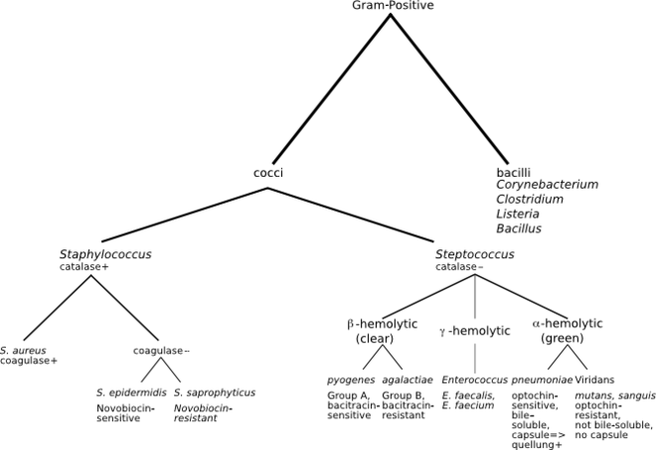

Slide 6
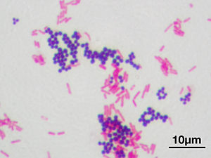
Gram negative
Highly complex, multilayer structure. The cytoplasm membrane (called inner membrane) in gram negative bacteria is surrounded by single planner sheet of peptidoglycan to which h is anchored a complex layer called outer membrane
The space between the inner and outer is called periplasmic space; the membrane of the gram-negative bacteria is rich in lipids.
The outer-membrane of the gram-negative cell wall is anchored to underlying peptidoglycan Braun’s lipoprotein. The membrane is bilayered structure consisting mainly of phospholipids, proteins and lipopolysacharides; the lipopolysacharieds has toxic properties and is known as endotoxines. It is occurs in outer layer of membrane and its composed three covalently linked parts
Lipid A firmly embedded in the membrane
Core polysaccharides located at the membrane surface
antigen extend like whiskers from the membrane
Stained gram-positive cocci and lighter gram-negative rod-shaped bacteria
http://en.wikipedia.org/wiki/Gram-positive_bacteria

Slide 7
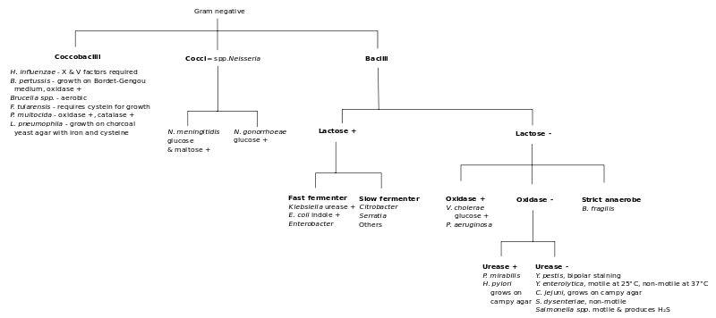

Slide 8
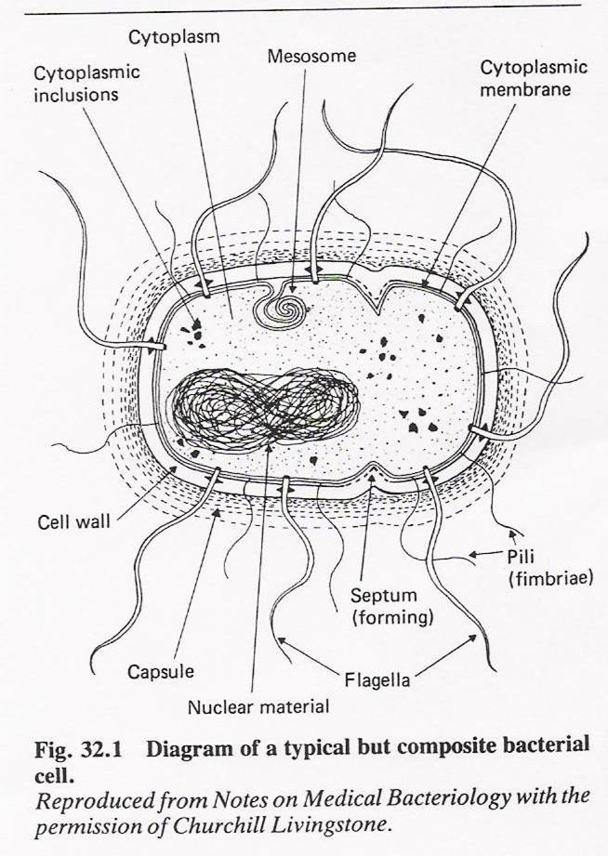

Slide 9
Gram +
Gram -

Slide 10
2. protoplast, spheroplast, L-form
protoplast
a bacterium is referred to as a protoplast when it is without cell wall. The cell wall is lost due to the action of lysozome enzymes that destroy peptidoglycan or blocking the synthesis of peptidoglycan with an antibiotic such as Penicillin.
Spheroplast
Bacteria with damaged cell wall. The damage is cause by the action of toxic chemical or an antibiotic such as Penicillin can changed to there regular fore if grown on a culture media
L-form
Mutant bacteria without cell wall
Bacterial capsule
Many bacteria secrete around themselves a polysaccharide substances often referred to as slim layer.
*India ink preparation
* Pathogenicity (not phagocyte and destroyed by host cell)

Slide 11
4. flagella and pili
Flagella are third like structure composed of proteins
they are the organ of locomotion
made up of proteins (flageline)
they are highly antigenic (H antigen)
Three types of arrangement
monotrichous: single polar flagellum
lophotrichous multiple polar flagellum
peritrichous flagella distributed over the entire cell
Pili (fimbriae) (short hair like structure)
many gram-negative bacteria possess rigid surface called pili, they are shorter and fine than flagella like flagella composed of structural proteins subunits know as pilins
Enable the organism to adhere to host tissues and to one another
Virulence factors
certain enteric bacteria are able to form a specialized pili called F pili (Sex pili) which enable DNA material to be transferred from one bacterium to another (conjugation), *antibiotic resistance

Slide 12
F pili also possess receptors to which viruses become attached (bacteriphage) to transfer genetic characteristic from one bacterial strain to another b means of bacteriophage.
Cytoplasmic membrane
It is also called? *
Structure
It has composed of phospholibids and proteins, the membrane of prokaryotes distinguished from eukaryotes bye the absence of sterols
Mesosomes
There are two types
Spetal mesosomes which involve in the cell division (forming cross wall)
Lateral mesosomes the (bacterial DA is attached to spetal mesosomes)
Amino acid and number of granules

Slide 13
Single piece of double stranded DNA
Ribosome’s
Water
Inorganic ions
Mitochondrial granules
Certain bacteria contains the plasmid (extra pieces of chromosome material DNA that can exchange between bacterial cells through the specializes sex pili
This is one of the antibiotic resistances*
Function of the cell membrane
Selective permeability and transports of solutes
Electron transports and oxidative phosphorylation in aerobic species
Excretion of hydrolytic exoenzymes
Bearing the enzymes and carrier molecules that function in the biosynthesis of DNA, cell polymers and membrane lipids
Bearing the receptors and other proteins of the chemtactic and other sensor transduction system

Slide 14
Spores formation
When conditions for vegetative growth are not favorable, especially when carbon and nitrogen become unavailable,
e.g. Bacillus and Clostridium
sproulation:
the sporulation process begin when neutritonal conditions become unfavorable
sporulation process beings with formation of an axial filament, the process continues with an enfolding of the membrane to produce a double membrane structure
the grow pints move progressively toward the pole of the cell so as to engulf the developing spore
the two spores membrane now engage in the active synthesis of special layer that will form the cell envlope the spore wall and the cortex, lying between the facing membrane And the coat and exosporium lying outside the facing membrane

Slide 15
properties of endospores
Core spore protplast it contains a complete nucleus (chromosome)
Spore wall inner most layer surrounding inner spore membrane
Cortex the thicker layer of the spore envelope
Coat compose of a keratin like protein
Exosporium is lipoprotein membrane containing some carbohydrate
Germination process occurs in three stages
activation
most endospore cannot germinate immediately after they formed after several days can germinator activated by using rich medium
Initiation
Once activated spore will germinate if environmental conditions are favorable
outgrowth
degradation of the cortex and outer layer resulting in the emergence of new vegetative cell consisting of the spore protoplast with its surrounding wall

Slide 16
Aerobic and anaerobic bacteria
Many bacteria obtain there energy from oxidation or fermentation of simple carbohydrates. These metabolic reaction are brought about by the different enzyme systems found in bacterial cells
Depending on the atmospheric requirements, an organism can be described as:
Obligatory (strict) aerobe: e.g. Pseudomonas aeruginosa
Microaerophilic organism: e.g. Compylobacter jejuni
Obligatory (strict) anaerobic: Clostridium tetani
Facultative anaerobe: e.g. Streptococcus pyogenes
Carboxyphilic e.g. Neisseria meningitidis
Reproduction of fungi
Bacteria multiply by simple cell division know as binary fission (splitting into two). the single piece of double strand DNA reproduces its self exactly.
Mutation: transmissible variation through changes in morphology and physiology of bacteria (temporary).

Slide 17
Taxonomy and classification
Classification: the division of organism into ordered groups
Nomenclature : the labeling of the groups and of individual members within groups or is naming the organism by international rules according to its characteristic
Identification refers to practical use of classification
isolate and distinguish desirable organism
verifying special properties
isolate and identify the causative agent of a disease
Antigenic differentiation
The arrangement of organisms into taxonomic group (taxa) based on similarities or relationship

Slide 18
Criteria for classification of bacteria
Cell shape
Presence or absence of specialized structures
Staining procedures Gram staining
Production of some pigments
Certain enzymes (extra cellular)….haemolysis
Immunological cross-reaction
Molecular biology*
http://www.youtube.com/watch?v=yYIZgS-L5Sc#
Genetic instability* e.g. antibiotic resistance
Genome instability (also “genetic instability” or “genomic instability”) refers to a high frequency of mutations within the genome of a cellular lineage. These mutations can include changes in nucleic acid sequences, chromosomal rearrangements or aneuploidy. Genome instability is central to carcinogenesis
Ewing classification
Depends on phenotypic properties and classified into eight trips seven of them are humming beings the rest are plant pathogen. Those formed of different genre which as some biochemical and diagnostic criteria
Berge’s manual system
Based on DNA relation, classified into fourteen genre and there are 6 additiona (Ohgew Kweon, 2008)
CDC central disease control
Based on DNA classification and phenotypic characteristic
Description of the major categories and groups of bacteria

Slide 19
There are two different groups
Eubacteria
Archaebacteria
Eubacteria contains the more common bacteria
The other doesn’t produce the peptidoglycan , and they live in extreme environment and carry unusual metabolic reaction
3. Antigenic differentiation
serotypes a single bacterial strains or type, defined by antigenic structure
sero-groupe a group of serologically related organism
Classification according to morphological characteristic
Cocci ,,,,coccus
Rods bacilli,,,, bacillus
Vibrios ,,,vibrio
Spirilla,,, spirillum
Spirochaetes

Slide 20
Cocci :
Round oval bacteria measuring about 0.5-1 um in diameter, when multiply they form pairs, chains, or groups
Cocci in pairs called diplococi.g. Meningococcal
Cocci in chain called streptococci for e.g. Staphylococcus pyogenes
Cocci in irregular group (clusters) called staphylococci
e.g. staphylococcus aureus
Gram reaction staphylococci and streptococci are gram positive, where diplococcic are can be gram negative or positive
Rods (bacilli)
theses are stick like bacteria with rounds tapered (fusiform) square or swollen ends they measures 1-0 um in length , the short roads with rounded ends called coccobacilli , when multiply they don’t attach to each other
chain e.g. streptobacillus species
Branching chain e.g. lactobacilli
Mass together. Mycobacterium leprae
remain attached at various angles resemble Chinese letters e.g. Corynebacteriaum diphtheriae

Slide 21
Bacillus genus and clostridium are able to form resistant spores
Many roads having flagella
Gram reaction
Many roads are gram negative such as large group of enterobacteracae
Gram-positive roads include clostridium, Corynebacterium
And bacillus sp, Lesteria moncytogenes
Coccobacilli such as yersinia
Vibrios
Curved roads measuring 3 -4 um in width
Most of vibrio is motile with a single flagellum at one end
Showing darting motility e.g. vibrio cholera
Gram reaction vibrio is gram negative
Bacillus genus and clostridium are able to form resistant spores
Many roads having flagella

Slide 22
Gram reaction
Many roads are gram negative such as large group of enterobacteracae
Gram-positive roads include clostridium, Corynebacterium
And bacillus sp, Lesteria moncytogenes
Coccobacilli such as yersinia
Vibrios
Curved roads measuring 3 -4 um in width
Most of vibrio is motile with a single flagellum at one end
Showing darting motility e.g. vibrio cholera
Gram reaction vibrio is gram negative
Spirochaetes
These are flexible, coiled, motile organism they progress by rapid body movement most are not easily stained by gram method
Spirocheates divided into three main groups
Treponems, thin delicate spirocheates with regular tight coils e.g. Treponema pallidum
Borreliae, large spirochetes irregular open coils m e.g. Borrelia duttoni
Leptospires thin spitocheates many tightly packed coils that are difficult to distinguish

Slide 23
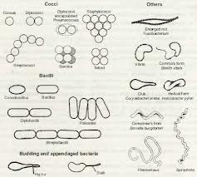
https://www.google.com.sa/search?safe=active&q=morphology%20of%20bacterial%20cells&um=1&ie=UTF-8&hl=en&tbm=isch&source=og&sa=N&tab=wi&ei=uaUJU5abFM2M0wW3-4HIBQ

