Slide 1
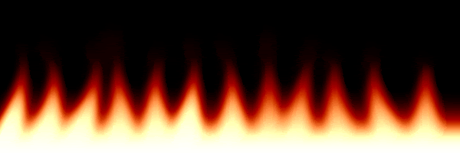
Pain
Analgesic
Lab #3
LAB # 3

Slide 2
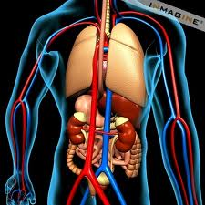
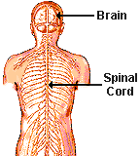
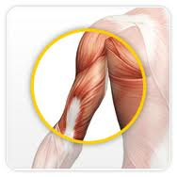
Consists :
A- nerves
B- ganglia
smooth muscle, cardiac muscle, and glands
The Nervous System
CNS
PNS
Sensory division (afferent)
Motor division (efferent)
Brain
Spinal cord
Somatic nervous system (voluntary)
Autonomic nervous system (involuntary)
Sympathetic
Parasympathetic
The main function is to connect CNS to the limbs and organs.
Outside of the CNS
From CNS to PNS
From PNS to CNS
Skeletal muscle

Slide 3
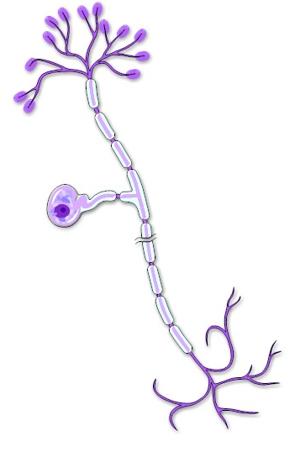
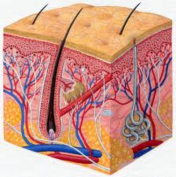
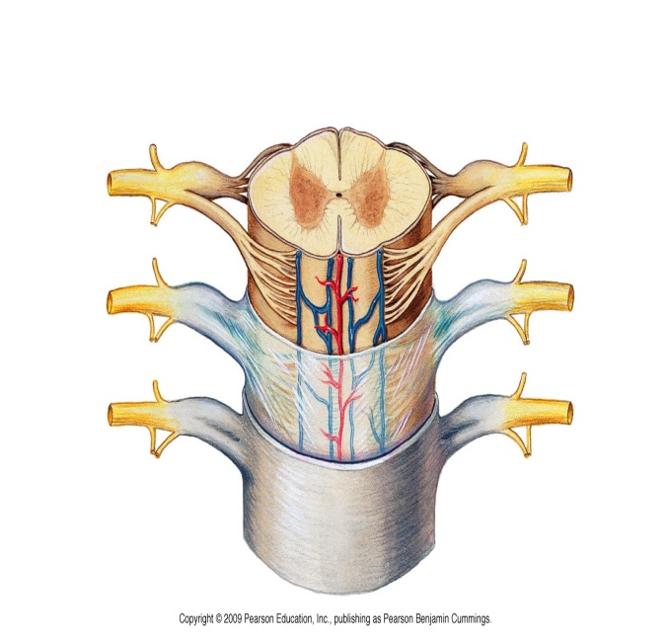
Sensory or afferent neurons
Neurons carrying impulses (AP) from sensory receptor (at PNS) to the CNS
Unipolar neuron
Cell body
carrying impulses
AP
Spinal cord
Notes:
afferent ( literally means to go toward )

Slide 4
Sensory or Afferent Type
C fibers
Non- myelinated
Low conducting velocity
Cause a dull burning and non-localized pain
Aδ fibers
Myelinated
High conduction velocity
Cause a sharp and localized pain
When an injury occurs, one first senses sharp “fast pain”(Aδ fibers) before felling the dull “slow pain” ( C fiber)
Pain receptor
(Nociceptors)
are cells nerve ending that initiate the sensation of pain
Sensory Receptor
Can be activated by :
Chemical stimuli
Thermal stimuli
Mechanical stimuli
This process, called nociception
Noxious Stimuli
An actually or potentially tissue damaging event

Slide 5
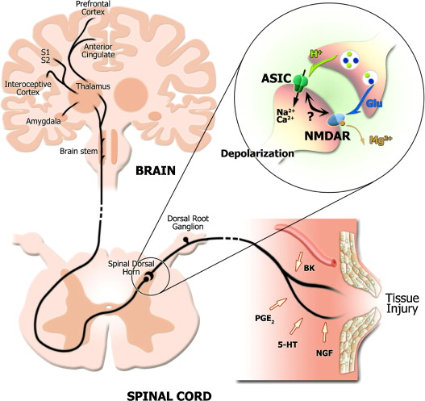
cell membrane phospholipids
phospholipases A₂
Arachidonic acid
Noxious Stimuli
COX-2
Prostaglandin E2 (PGE2)
Sensitizes nociceptors to bradykinin (BK) , ((the most potent pain producing chemical)) and other pain mediators like substance P histamine, 5-HT…etc.
Release of endogenous opioid peptide ( endorphin) which cause inhibiting of nociceptive impulse( Modulation )
-
Then transmission the impulse to spinal cord and cortex (perception)
For stimulation nociceptors, and lead to production of AP

Slide 6
Pain
‘’ An unpleasant sensory and emotional experience associated with actual or potential tissue damage, or described in terms of such damage’’
Sensation
Quick sharp pain
Localization
General
Duration
Chronic
Source
Somatic
Specific area
Slow pain
Acute
Visceral
Referred pain
pain
Notes:
Referred pain. Occurs when the painful sensation is felt in a site other than the one where it is actually occurring, depending upon how the brain interprets information it receives from the body.

Slide 7
Analgesia
Without
Pain
Pain killer
Analgesics
Are medicines or drugs that relieve pain (analgesia).
Analgesic
Opioid agent
Non-opioid agent
NSAID
Other agent e.g. Acetaminophen Local anesthetics
They reduce moderate to severe pain without loss of consciousness.
They reduce mild to moderate pain
Notes:
Analgesia : The absence of the sense of pain while remaining conscious.

Slide 8
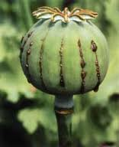
Opioid Analgesics
Contains many alkaloids
Opium
morphine
Opiate : A drug derived from alkaloids of the opium
Interaction with opioid receptor
Opioid : the class of drugs that includes opiate, and all synthetic and semisynthetic drugs that mimic the action of opiate
Mixed agonist- antagonists
e.g. nalbuphine
Antagonists
e.g. Naloxone
Agonists
Strong: morphine
Moderate : codeine
weak: propoxyphene

Slide 9
opioid receptor
It’s G protein-coupled receptor.
Mainly located in brain and spinal cord , and may be on peripheral sensory nerve endings
Three types
1- μ (mu)
Most of the analgesic opioids are μ-receptor agonists
Responsible for some major unwanted effects (e.g. respiratory depression, euphoria, sedation and dependence)
2- κ (kappa)
3- δ (delta)
MOA
1- they close voltage-gated Ca+2 channels on presynaptic nerve terminal thereby reduce transmitter release.
2- they hyperpolarize and thus inhibit postsynaptic neuron by opening K+ channel.

Slide 10
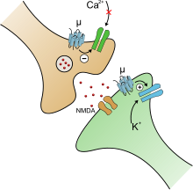
Close voltage-gated Ca+2 channels
Presynaptic nerve terminal
reduce transmitter release
opening K+ channel
hyperpolarization
postsynaptic neuron

Slide 11
Non Opioid Analgesics
NSAIDs
Non- Steroidal
Anti-Inflammatory
Drugs
Arachidonic acid
NSAID
-
-
COX-1
COX-2
NSAID
Thromboxane
Prostacyclin
Prostaglandins

Slide 12
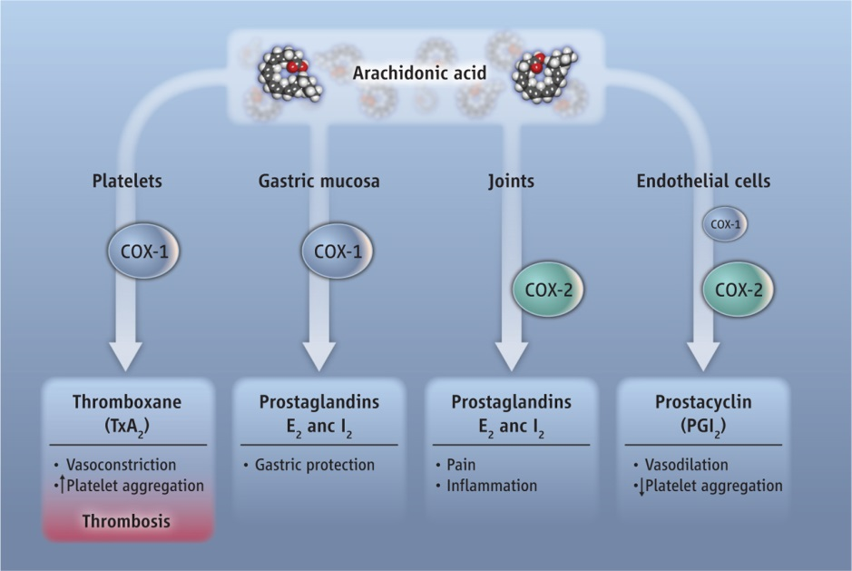
Decreased lead to ulcer

Slide 13
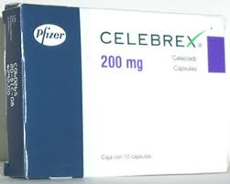
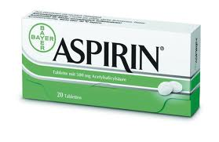
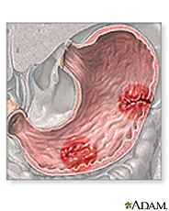
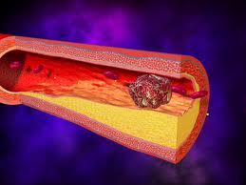
Cox-2 selective inhibitor
(coxib)
Cox non-selective inhibitors
Example
Celecoxib
Example :
Aspirin,
Ibuprofen,
Diclofenac…etc
Thrombosis
GI ulcer

Slide 14
LAB WORK
Objective :
To show the analgesic effects of different analgesics using different methods.
Writhing test.
Hot plate method.

Slide 15
Writhing test
Principle:
Pain is induced by injection of noxious chemical as Acetic acid 0.1% at volume 0.3 ml.
Writhing means stretching behavior of the abdominal and at least one hind limb.

Slide 16
Procedure:
1.First inject the mouse with acetic acid and calculate the number of writhing/20 minutes and this will be control test.
2.Inject the second animal with aspirin and inject the third one with morphine.
3.After 5 minutes inject the animals with acetic acid then calculate the number of writhing/20 minutes.

Slide 17
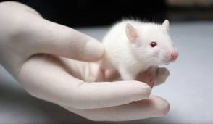
Control mouse
Inj. Morphine
Inj. Aspirin
Inj. Acetic acid
Wait 5 minutes
calculate the number of writhing/20 minutes
Inj. Acetic acid
Inj. Acetic acid
calculate the number of writhing/20 minutes
calculate the number of writhing/20 minutes

Slide 18
 | Drug | No. of writhing/20 minutes
Control | Acetic cid
Test 1 | Morphine acetic acid
Test 2 | Aspirin acetic acid
5 min’s
5 min’s

Slide 19
Procedure:
4.Compare the number of writhing for each drug and comment on the results:
A drug has …………… number of writhing that has more potency as analgesic.
Less
More

Slide 20
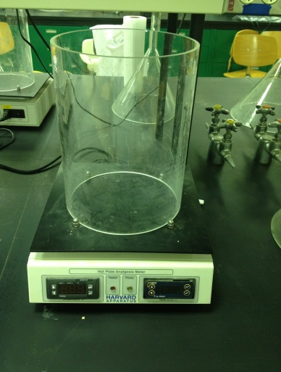
Hot plate method
principle:
The paws of the mouse are very sensitive to heat at temperature which are not damaging the skin .
At temperature of 55 C the mouse will jump and licking the paws.
The time till these response occur is calculated and is prolonged after administration of analgesics.
Hot Plate Analgesia Meter

Slide 21
Procedure:
Put the mouse on the hot plate and record the time taken in order to jump or licking the fore paws.
Record the time in seconds this is the control time.
Weight the animal and calculate the dose of Morphine and Aspirin
At 5 min’s interval ( for 30 min’s ) place the animal on the hot plate and record the time to see the response .
Compare the time need to see the response the drug with longer time is more potent as analgesic.

Slide 22
Drug | Time interval
 | zero | 5 | 10 | 15 | 20 | 25 | 30
Morphine
aspirin

Slide 23
 | Conc (g%) | Dose mg/Kg
Morphine | 0.2% | 20
aspirin | 3% | 300

