Slide 1
Age and Sex structure

Slide 2
The age and sex structure of a population is the distribution of the population by age and sex.
For summarizing and graphing statistics on age, we use five year age groups.
Age group 20 – 24, for example is a five year age group referring to everyone 20 years and over who has

Slide 3
not has their 25th birthday.
Age misreporting:
Take two basic forms:
a- Heaping:
People report ages ending with 0 or 5 while relatively few gives ages ending in 9, 1, 4 or 6.
b- Shifting:
People tend not to report their exact

Slide 4
ages. For example:
Young men may understate or overstate their ages to avoid military service.
Young mothers may exaggerate their age, while older, unmarried women may understate their age.
Population censuses are the main source of statistics on the age – sex composition of populations.

Slide 5
Age structure visualization:
1- Numerical:
1- Sex ratio:
Is the ratio of males to females in the population.
Expressed as the number of males per 100 females.
Sex ratio at birth is around 105

Slide 6
males per 100 females. That is, for every 205 births, on average 100 are female.
In other words, the proportion who are female is thus (100/205) = 0.488.
Sex differences in mortality and migration cause the sex ratio to vary between ages.
Female mortality is lower than male mortality at all ages.

Slide 7
males per 100 females. Women live longer, on average, than men. Thus the sex ration tends to decline with age.

Slide 8
Dependency ratio (DR):
Is the ratio of economically inactive to economically active persons in a population.
Usually defined as the sum of Children (0 – 14 years) and old ages (65 years and over ) related to working age (15 – 64 years).

Slide 9
Children + elderly
DR =
x 100
Working ages
Example:
Let
the numbers of aged 0 – 14 = 734
Numbers aged 15 – 64 = 2521
Numbers aged 65+ = 457
Then, the dependency ratio is:

Slide 10
DR = ((734 + 457)/ 2521) x 100 = 47.2
Interpretation:
How many dependents are to be supported by 100 people of working age.
The ratio can be used to compare dependency burdens in different countries.

Slide 11
Disadvantages of dependency ratio:
1- Age groups are extremely broad.
2- Assume all children and above 65 years to be dependent.
3- Assume all people in the working age are economically active.

Slide 12
Child Dependency Ratio (CDR):
Is defined as the number Children (0 – 14 years) and related to people of working age (15 – 64 years).
Children (0 – 14)
CDR =
x 100
Working ages 15 - 64

Slide 13
Aging Index (AI):
Is defined as the number aged 65+ related to the number of children aged (0 – 14 years).
number aged (65+)
AI =
x 100
Children aged (0 – 14)

Slide 14
Example:
Let
the numbers of aged 0 – 14 = 734
Numbers aged 15 – 64 = 2521
Numbers aged 65+ = 457
Then, the dependency ratio is:
734
X 100 = 29.1%
CDR =
2521

Slide 15
457
x 100
= 62.3
AI =
734

Slide 16
Determinants of age structure
1- Change in the level of fertility:
Affect the youngest age groups. Only over many years will it work through to affect older age.
A decline in fertility has the effect of narrowing the base of the pyramid as the number of births falls.

Slide 17
1- Change in the level of mortality:
Affect the youngest age groups. Only over many years will it work through to affect older age.
A change in adult mortality has much less impact on the shape of the age distribution, because it is not concentrated on one age group but is spread over all adult ages.

Slide 18
In developing countries high mortality due to epidemics and wars affects age groups disproportionately.
3- Migration can cause big distortion in age structure because it is normally concentrated among young adults, and it is sometimes also sex selective:

Slide 19
Areas from which substantial number have emigrated will, in extreme cases, have top high proportion of the population in older age groups, few young adults, and few children.

Slide 20
Conversely, areas where substantial numbers of immigrants have settled will have a young age structure, with many children and very few elderly.

Slide 21
Demographic Transition Theory
There are a series of stages during which the population moves from a situation where both fertility and mortality are high, to a position where both fertility and mortality are low.

Slide 22
Both before and after the transition population growth is very slow.
In between, during the transition, population growth is very rapid. This is because the decline in mortality tends to occur before the decline in fertility.

Slide 23
This can be divided into four stages:
Stage 1 - High Fluctuating
Birth Rate and Death rate are both high.
Population growth is slow and fluctuating.

Slide 24
Reasons:
Birth Rate is high as a result of:
Lack of family planning
High Infant Mortality Rate
Need for workers in agriculture
Religious beliefs
Children as economic assets

Slide 25
Death Rate is high because of:
High levels of disease
Famine
Lack of clean water and sanitation
Lack of health care
War
Competition for food from predators such as rats.
Lack of education

Slide 26
Stage 2 - Early Expanding
Birth Rate remains high.
Death Rate is falling.
Population begins to rise steadily.

Slide 27
Reasons:
Death Rate is falling as a result of:
Improved health care (e.g. Smallpox Vaccine)
Improved Hygiene (Water for drinking boiled)
Improved sanitation
Improved food production and storage
Improved transport for food
Decreased Infant Mortality Rates

Slide 28
Stage 3 - Late Expanding
Birth Rate starts to fall.
Death Rate continues to fall.
Population rising.

Slide 29
Reasons:
Family planning available
Lower Infant Mortality Rate
Increased mechanization reduces need for workers
Increased standard of living
Changing status of women

Slide 30
Stage 4 - Low Fluctuating
Low birth Rate
Low death Rate both low.
Population steady.
Typical of USA; Sweden; Japan; Britain

Slide 31
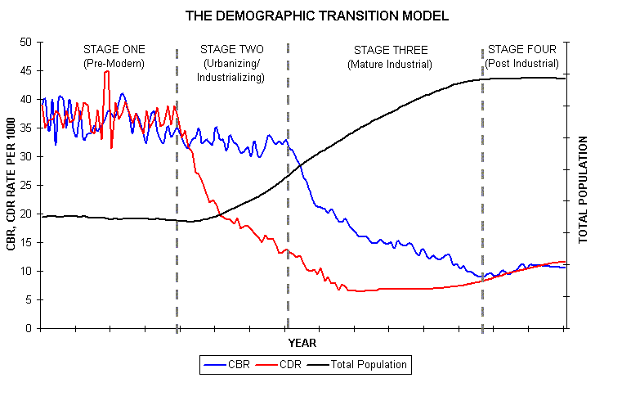

Slide 32
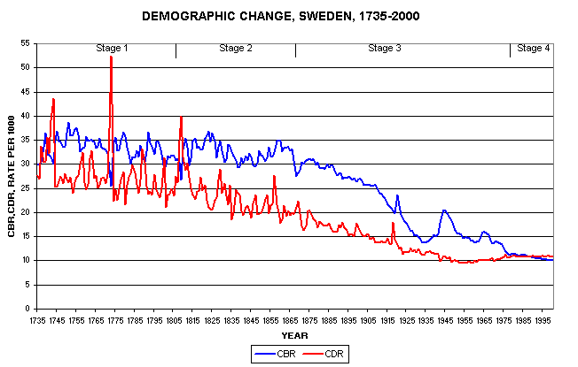

Slide 33
Population Pyramids

Slide 34
What is a population pyramid?
Are useful way of presenting an age and sex distribution graphically.
A pyramid looks like two histograms placed on their sides and back to back.
Pyramids are always drawn showing the male population on the left hand side and the female population on the right.

Slide 35
The young are always at the bottom and the old at the top.
Population pyramids may be drawn using absolute numbers or percentages, and the horizontal scale should be labeled accordingly.

Slide 36
When using percentages, the base for the percentages is the total population for both sexes combined.
Pyramids drawn using percentages are useful for comparing age and sex distributions, provided that the horizontal and vertical scales used in all the pyramids are the same.

Slide 37
How to interpret population pyramids
There main types of pyramids
  Rapid growth
  Slow growth
  Negative growth
Shape of rapid
growth
Shape of
Slow growth
Shape of negative
growth

Slide 38
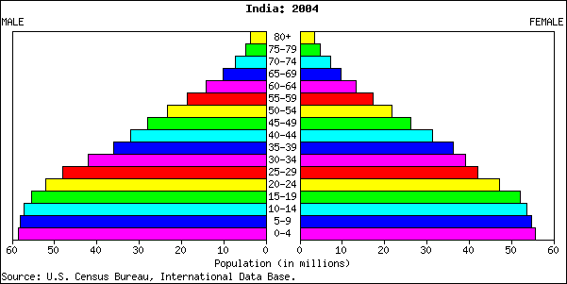
Rapid growth

Slide 39
Rapid growth pyramids
Have a large base to show high birth rates
Amount of people decreases as the ages goes up indicating a lower standard of living
Associated with developing countries like Brazil, Uganda, China

Slide 40
Slow growth pyramids
Take on a more rectangular shape
Indicates population is remaining fairly steady
Birth rates and death rates are similar
Associated with developed countries like the UK, Germany, Canada.

Slide 41
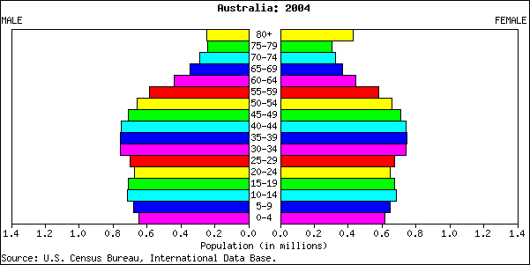
Slow Growth

Slide 42
Negative growth pyramids
Looks like a reverse pyramid
Indicates the population of the country is decreasing
Death rates are higher than birth rates
Associated with developed countries like Austria, Japan, Italy

Slide 43
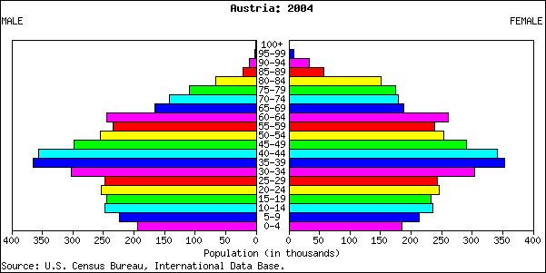
Negative growth

Slide 44
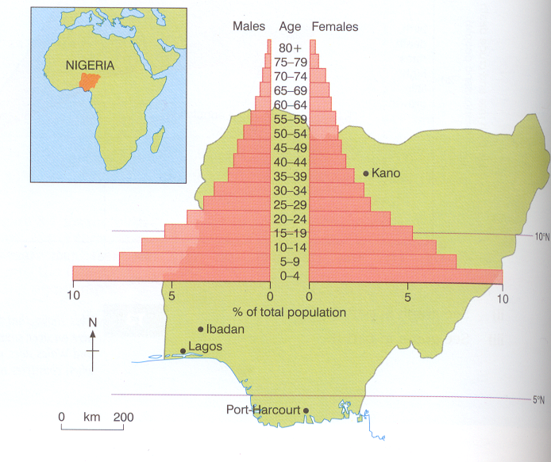
Population pyramid of less developed
Population Pyramid of Nigeria (1995)

Slide 45
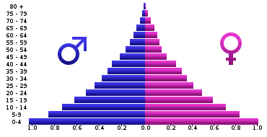
Population pyramid of Angola 2005

Slide 46
Importance of Population Pyramids
A broad based population pyramid :
increase food production.
build more homes & schools
plan for more job opportunities for the young in future
implement birth control program/ campaigns.

Slide 47
Usually agricultural with problems of overpopulation.
Many Dependents.

Slide 48
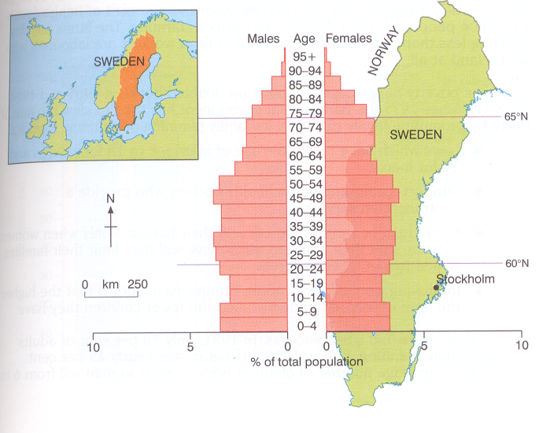
Population pyramid of a developed nation
Population Pyramid of Sweden (1995)

Slide 49
A narrow based population pyramid Means:
Birth rate and Death rate low
Work out incentives to encourage more births
hiring foreign labor
proper medical services & health care for the aged.

Slide 50
 | _{Saudi} _{Arabia} | _{Kuwait} | _{Oman} | _{Iraq} | _{Bahrain} | _{Qatar}
₀ ₋ ₁₄ | 27.6 | 30.4 | _{36.7} | _{19.7} | _{12.5} | _{20.7}
₁₅ ₋ ₂₄ | 19.3 | 19.9 | _{19.6} | _{15.9} | _{13.4} | _{13.7}
₂₅ ₋ ₅₄ | 45.4 | 42.6 | _{36.3} | _{56.2} | _{69.9} | _{61.5}
₅₅ ₋ ₆₄ | 4.5 | 3.9 | _{4.2} | _{5.5} | _{3.4} | _{3.1}
₆₅₊ | 3.2 | 3.3 | _{3.2} | _{2.7} | _{0.9} | ₁

Slide 51
Comparison between the Pyramids of developing & developed Countries
Developing countries | Developed countries
Wide (high BR) | Narrow ( Low BR) | Base
Sloping. (high mortality) | Not sloping (Straight ). (low mortality ) | Side
Short (Low life expectancy) | Tall (high life expectancy). | Height
Narrow (few people survive to old age) | Wide (large numbers of people > 60. | Apex
Low ( High births) | High (low birth) | Median Age
Low | High | Old dependency ratio
High | Low | Young dependency ratio

Slide 52
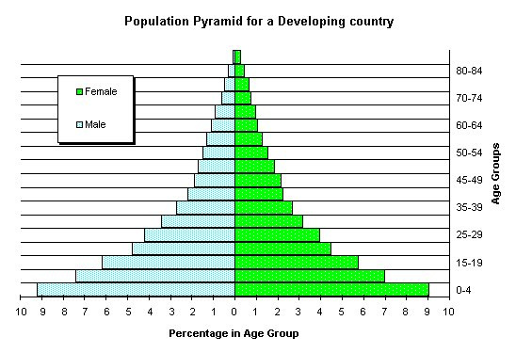

Slide 53
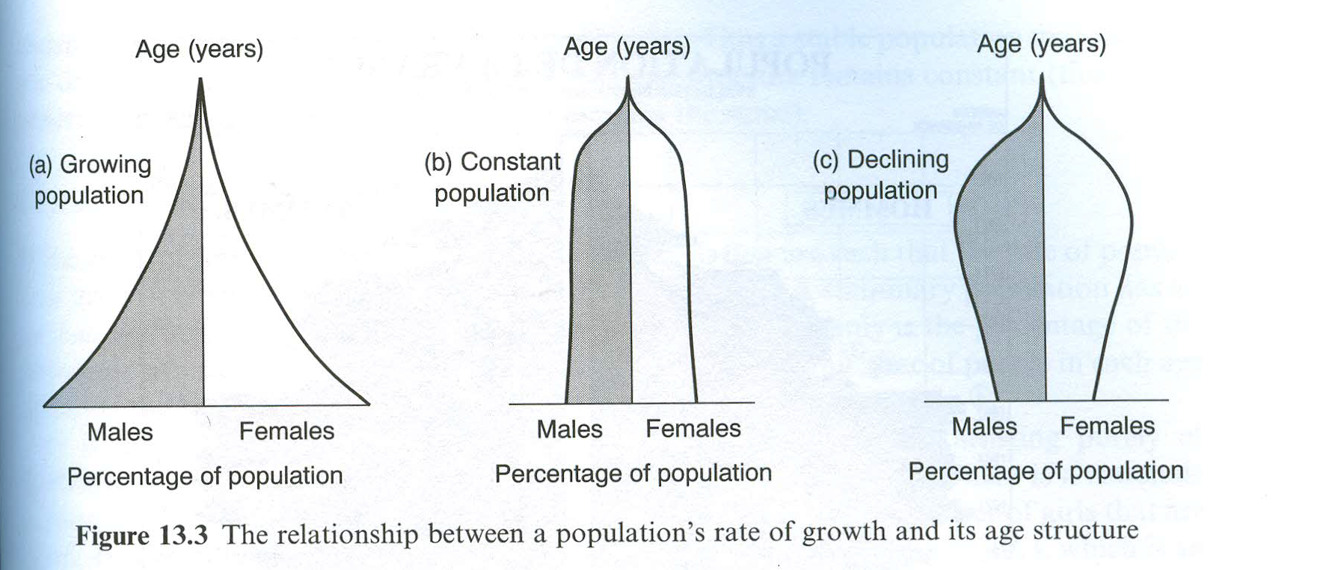

Slide 54
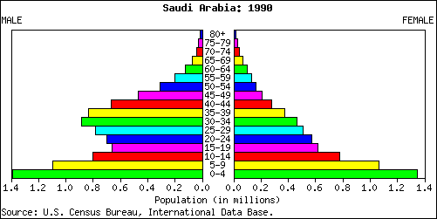
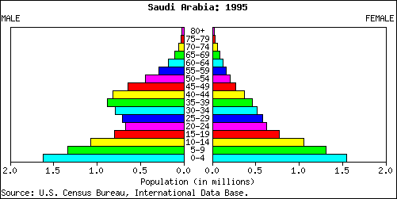

Slide 55
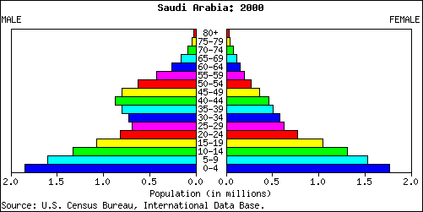
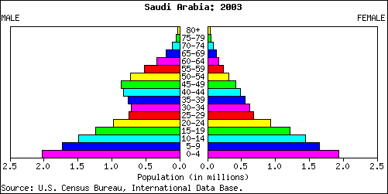

Slide 56
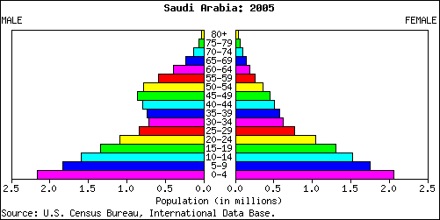
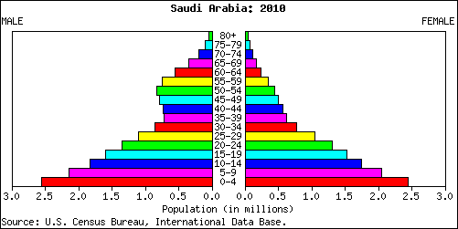

Slide 57
