Slide 1
Adjective Clauses

Slide 2
Adjective Clauses
An adjective (or relative) clause is a dependent clause that functions as an adjective in a sentence. It modifies nouns, pronouns, or a whole sentence. It begins with a relative pronoun. It comes immediately after the words that it modifies. In some cases, a prepositional phrase may come in between.

Slide 3
Adjective Clause Pronouns Used as the Subject
I thanked the woman.
She helped me.
↓
(a) I thanked the woman who helped me.
(b) I thanked the woman that helped me.
In (a): I thanked the woman = a main clause;
who helped me = an adjective clause.*
An adjective clause modifies a noun.
In (a): the adjective clause modifies woman.

Slide 4
In (a): who is the subject of the adjective clause.
In (b): that is the subject of the adjective clause.
NOTE: (a) and (b) have the same meaning; (c) and (d) have the same meaning.
The book is mine.
It is on the table.
↓
(c) The book which is on the table is mine.
(d) The book that is on the table is mine.

Slide 5
Who = used for people
Which = used for things
That = used for both people and things
(e) CORRECT: The book that is on the table is mine.
(f) INCORRECT: The book is mine that is on the table.
An adjective clause closely follows the noun it modifies.

Slide 6
Exercise 3, p. 271.
2. The girl who/that won the race is happy.
3. The student who/that sits next to me is from China.
4. The students who/that sit in the front row are from China.
5. We are studying sentences that/which contain adjective clauses.
6. I am using a sentence that/which contains an adjective clause

Slide 7
Adjective Clause Pronouns Used as the Object of a Verb
The man was Mr. Jones.
I saw him.
↓
The man who(m) I saw was Mr. Jones.
The man that I saw was Mr. Jones.
The man Ø I saw was Mr. Jones.
Notice in the examples: The adjective clause pronouns are placed at the beginning of the clause.
In (a): who is usually used instead of whom, especially in speaking. Whom is generally used only in very formal English.

Slide 8
The movie wasn’t very good.
We saw it last night.
↓
(d) The movie which we saw last night wasn’t very good.
(e) The movie that we saw last night wasn’t very good.
(f) The movie Ø we saw last night wasn't very good.
In (c) and (f): An object pronoun is often omitted (Ø) from an adjective clause. (A subject pronoun, however, may not be omitted.)

Slide 9
who(m) = used for people
which = used for things
that = used for both people and things
(g) INCORRECT:
The man who(m) I saw him was Mr. Jones.
The man that I saw him was Mr. Jones.
The man I saw him was Mr. Jones.
In (g): The pronoun him must be removed. It is unnecessary because who(m), that, or Ø functions as the object of the verb saw.

Slide 10
Exercise 8, p. 273.
2. I liked the woman who/that/whom/Ø I met at the party last night.
3. I liked the composition that/which/Ø you wrote.
4. The people who/that/whom/Ø we visited yesterday were very nice.
5. The man who/that/whom/Ø Ann brought to the party is standing over there.

Slide 11
Adjective Clause Pronouns Used as the Object of a Preposition
She is the woman.
I told you about her.
↓
a) She is the woman about whom I told you.
b) She is the woman who(m) I told you about.
c) She is the woman that I told you about.
d) She is the woman Ø I told you about.
In very formal English, the preposition comes at the beginning of the adjective clause, as in (a) and (e). Usually, however, in everyday usage, the preposition comes after the subject and verb of the adjective clause, as in the other examples.

Slide 12
The music was good.
We listened to it last night.
↓
e) The music to which we listened last night was good.
f) The music which we listened to last night was good.
g) The music that we listened to last night was good.
h) The music Ø we listened to last night was good.

Slide 13
NOTE: If the preposition comes at the beginning of the adjective clause, only whom or which may be used. A preposition is never immediately followed by that or who.
INCORRECT: She is the woman about who I told you.
INCORRECT : The music to that we listened last night was good.

Slide 14
Exercise 11, p. 274.
1. The man who I was telling you about is standing over there.
The man whom I was telling 5'ou about is standing over there.
The man that I was telling you about is standing over there.
The man I was telling you about is standing over there.
The man about whom I was telling you is standing over there.
2. I must thank the people who I got a present from.
I must thank the people whom I got a present from.
I must thank the people that I got a present from.
I must thank the people I got a present from.
I must thank the people from whom I got a present.
3. The meeting that Omar went to was interesting.
The meeting which Omar went to was interesting.
The meeting Omar went to was interesting.
The meeting to which Omar went was interesting.

Slide 15
Exercise 13, p. 275.
2. which I had borrowed from my roommate
that I had borrowed from my roommate
I had borrowed from my roommate
3. I hadn’t seen for years
who I hadn’t seen for years
whom I hadn’t seen for years
that I hadn’t seen for years
4. she knew very little about
which she knew very little about
that she knew very little about
about which she knew very little
5. who keeps chickens in his apartment
that keeps chickens in his apartment

Slide 16
Exercise 14, p. 275.
1. In our village, there were many people who/that didn’t have much money.
2. I enjoyed the book that you told me to read.
3. I still remember the man who taught me to play the guitar when I was a boy.
4. I showed my father a picture of the car I am going to buy as soon as I save enough money.
5. The woman about whom I was talking suddenly walked into the room, or The woman whom I was talking about suddenly walked into the room. I hope she didn’t hear me.
6. The people who/that appear in the play are amateur actors.
7. I don’t like to spend time with people who/that lose their temper easily.
8. While the boy was at the airport, he took pictures of people who/that were waiting for their planes.
9. People who work in the hunger program estimate that 45,000 people worldwide die from starvation and malnutrition-related diseases every single day of the year.
10. In one corner of the marketplace, an old man was playing a violin.

Slide 17
Subject vs. Object Relative Pronouns
If the relative pronoun is followed by a verb, it is a subject pronoun. In this case, the relative pronoun must be used. For example: I ate the apple which is lying on the table.
If the relative pronoun is not followed by a verb (i.e., by a noun or a pronoun), it is an object pronoun. In restrictive relative clauses, it may be omitted. For example:
I ate the apple which Sara put on the table OR
I ate the apple Sara put on the table.

Slide 18
Using Whose
I know the man.
His bicycle was stolen.
↓
I know the man whose bicycle was stolen.
The student writes well.
I read her composition.
↓
(b) The student whose composition I read writes well.

Slide 19
Whose is used to show possession. It carries the same meaning as other possessive pronouns used as adjectives: his, her, its, and their.
Like his, her, its, and their, whose is connected to a noun:
his bicycle —> whose bicycle
her composition --> whose composition
Both whose and the noun it is connected to are placed at the beginning of the adjective clause.
Whose cannot be omitted.

Slide 20
(c) I worked at a company whose employees wanted to form a union.
Whose usually modifies people, but it may also be used to modify things, as in (c).

Slide 21
(d) That's the boy whose parents you met.
(e) That’s the boy who’s in my math class.
( f ) That’s the boy who’s been living at our house since his mother was arrested.*
Whose and who’s have the same pronunciation.
Who's can mean who is, as in (e), or who has, as in (f).
*When has is a helping verb in the present perfect, it is usually contracted with who in speaking and sometimes in informal writing, as in ( f ) i.e. who’s.
When has is a main verb, it is not contracted with who: I know a man who has a cook.

Slide 22
Exercise 18, p. 278.
2. Mrs. North teaches a class for students whose native language is not English.
3. The people whose house we visited were nice.
4. I live in a dormitory whose residents come from many countries.
5. I have to call the man whose umbrella I accidentally picked up after the meeting.
6. The man whose beard caught on fire when he lit a cigarette poured a glass of water on his face.

Slide 23
Using Where in Adjective Clauses
The building is very old.
He lives there (in that building).
(a) The building where he lives is very old.
(b) The building in which he lives is very old.
The building which he lives in is very old.
The building that he lives in is very old.
The building Ø he lives in is very old.

Slide 24
Where is used in an adjective clause to modify a place (city, country, room, house, etc.).
If where is used, a preposition is NOT included in the adjective clause, as in (a).
If where is not used, the preposition must be included, as in (b).

Slide 25
Exercise 24, p. 280.
1. The city where we spent our vacation was beautiful.
The city in which we spent our vacation was beautiful.
The city which/that/Ø we spent our vacation in was beautiful.
2. That is the restaurant where I will meet you.
That is the restaurant at which I will meet you.
That is the restaurant which/that/Ø I will meet you at.
3. The office where I work is busy.
The office in which I work is busy.
The office which/that/Ø I work in is busy.
4. That is the drawer where I keep my jewelry.
That is the drawer in which I keep my jewelry.
That is the drawer which/that/Ø I keep my jewelry in.

Slide 26
Using When in Adjective Clauses
I’ll never forget the day.
I met you then (on that day).
↓
(a) I’ll never forget the day when I met you.
(b) I'll never forget the day on which I met you.
(c) I’ll never forget the day that I met you.
(d) I’ll never forget the day Ø I met you.

Slide 27
When is used in an adjective clause to modify a noun of time (year, day, time, century, etc.).
The use of a preposition in an adjective clause that modifies a noun of time is somewhat different from that in other adjective clauses: a preposition is used preceding which, as in (b); otherwise, the preposition is omitted.

Slide 28
Exercise 26, p. 280.
1. Monday is the day when they will come.
Monday is the day on which they will come.
Monday is the day that/Ø they will come.
2. 7:05 is the time when my plane arrives.
7:05 is the time at which my plane arrives.
7:05 is the time that/Ø my plane arrives.
3. 1960 is the year when the revolution took place.
1960 is the year in which the revolution took place.
1960 is the year that/Ø the revolution took place.
4. July is the month when the weather is usually the hottest.
July is the month in which the weather is usually the hottest.
July is the month that/Ø the weather is usually the hottest.

Slide 29
Exercise 27, p. 281.
3. A cafe is a small restaurant where people can get a light meal.
4. Every neighborhood in Brussels has small cafes where customers drink coffee and eat pastries.
5. There was a time when dinosaurs dominated the earth.
6. The house where I was born and grew up was destroyed in an earthquake ten years ago.
7. The miser hid his money in a place where it was safe from robbers.
8. There came a time when the miser had to spend his money.

Slide 30
Using Adjective Clauses to Modify Pronouns
(a) There is someone I want you to meet.
(b) Everything he said was pure nonsense.
(c) Anybody who wants to come is welcome.
Adjective clauses can modify indefinite pronouns (e.g., someone, everybody).
Object pronouns (e.g., who(m), that, which) are usually omitted in the adjective clause, as in (a) and (b).

Slide 31
(d) Paula was the only one I knew at the party.
(e) Scholarships are available for those who need financial assistance.
Adjective clauses can modify the one(s) and those*
*An adjective clause with which can also be used to modify the demonstrative pronoun that:
We sometimes fear that which we do not understand.
The bread my mother makes is much better than that which you can buy at a store.

Slide 32
(f) INCORRECT: I who am a student at this school come from a country in Asia.
Adjective clauses are almost never used to modify personal pronouns. Native English speakers would not write the sentence in (f).

Slide 33
(g) It is I who am responsible.
(h) He who laughs last laughs best.
Example (g) is possible, but very formal and uncommon.
Example (h) is a well-known saying in which he is used as an indefinite pronoun (meaning “anyone” or “any person”).

Slide 34
Punctuating Adjective Clauses
General guidelines for the punctuation of adjective clauses:
Do not use commas if the adjective clause is necessary to identify the noun it modifies.*
*Adjective clauses that do not require commas are called essential or restrictive or identifying.
Use commas if the adjective clause simply gives additional information and is not necessary to identify the noun it modifies.**
**Adjective clauses that require commas are called nonessential or nonrestrictive or nonidentifying. NOTE: Nonessential adjective clauses are more common in writing than in speaking.

Slide 35
(a) The professor who teaches Chemistry 101 is an excellent lecturer.
(b) Professor Wilson, who teaches Chemistry 101, is an excellent lecturer.
In (a): No commas are used. The adjective clause is necessary to identify which professor is meant.
In (b): Commas are used. The adjective clause is not necessary to identify Professor Wilson. We already know who he is: he has a name. The adjective clause simply gives additional information.

Slide 36
(c) Hawaii, which consists of eight principal islands, is a favorite vacation spot.
(d) Mrs. Smith, who is a retired teacher, does volunteer work at the hospital.
GUIDELINE: Use commas, as in (b), (c), and (d), if an adjective clause modifies a proper noun. (A proper noun begins with a capital letter.)
NOTE: A comma reflects a pause in speech.

Slide 37
Who(m)
(e) The man that / met teaches chemistry.
Ø
(f) Mr. Lee, whom I met yesterday, teaches chemistry.
In (e): If no commas are used, any possible pronoun may be used in the adjective clause. Object pronouns may be omitted.
In (f): When commas are necessary, the pronoun that may not be used (only who, whom, which, whose, where, and when may be used), and object pronouns cannot be omitted.

Slide 38
COMPARE THE MEANING:
(g) We took some children on a picnic. The children, who wanted to play soccer, ran to an open field as soon as we arrived at the park.
(h) We took some children on a picnic. The children who wanted to play soccer ran to an open field as soon as we arrived at the park. The others played a different game.
In (g): The use of commas means that all of the children wanted to play soccer and all of the children ran to an open field. The adjective clause is used only to give additional information about the children.
In (h): The lack of commas means that only some of the children wanted to play soccer. The adjective clause is used to identify which children ran to the open field.

Slide 39
Exercise 35, p. 286.
3. additional: Rice, which is grown in many countries, is a staple food throughout much of the world.
4. necessary: The rice which we had for dinner last night was very good.
5. necessary: The newspaper article was about a man who died two weeks ago of a rare tropical disease.
6. additional: Paul O’Grady, who died two weeks ago of a sudden heart attack, was a kind and loving man.
7. additional: I have fond memories of my hometown, which is situated in a valley.
8. necessary: I live in a town which is situated in a valley.
9. necessary: People who live in glass houses shouldn’t throw stones.
10. additional: In a children’s story, Little Red Riding Hood, who went out one day to visit her grandmother, found a wolf in her grandmother’s bed when she got there.

Slide 40
Exercise 37, p. 287.
3. The Mississippi River, which flows south from Minnesota to the Gulf of Mexico, is the major commercial river in the United States.
4. A river that is polluted is not safe for swimming. (no commas)
5. Mr. Trang, whose son won the spelling contest, is very proud of his son’s achievement. The man whose daughter won the science contest is also very pleased and proud.
6. Goats, which were first tamed more than 9,000 years ago in Asia, have provided people with milk, meat, and wool since prehistoric times.
7. She’s furious at the goat that got on the wrong side of the fence and is eating her flowers. (no commas)

Slide 41
Exercise 40, p. 288.
1. (no change)
2 . We enjoyed Mexico City, where we spent our vacation.
3. (no change)
4. One of the most useful materials in the world is glass, which is made chiefly from sand, soda, and lime.
5. You don’t need to take heavy clothes when you go to Bangkok, which has one of the highest average temperatures of any city in the world.
6. Child labor was a social problem in late eighteenth century England, where employment in factories became virtual slavery for children.
7. (no change)
8. (1st sentence: no change) The research scientist, who was wearing protective clothing before she stepped into the special chamber holding the bees, was not stung. (3rd sentence: no change)

Slide 42
Exercise 43, p. 290.
2. Last night the orchestra played three symphonies, one of which was Beethoven’s Seventh.
3. I tried on six pairs of shoes, none of which I liked.
4. The village has around 200 people, the majority of whom are farmers.
5. That company currently has five employees, all of whom are computer experts.
6. After the riot, over 100 people were taken to the hospital, many of whom had been innocent bystanders.

Slide 43
Using Expressions of Quantity in Adjective Clauses
In my class there are 20 students.
Most of them are from Asia.
(a) In my class there are 20 students, most of whom are from Asia.
(b) He gave several reasons, only a few of which were valid.
(c) The teachers discussed Jim, one of whose problems was poor study habits.
An adjective clause may contain an expression of quantity with of: some of, many of, most of, none of, two, of, half of, both of, etc.
The expression of quantity precedes the pronoun. Only whom, which, and whose are used in this pattern.
This pattern is more common in writing than speaking.
Commas are used.

Slide 44
Using Which to Modify a Whole Sentence
a) Tom was late. That surprised me.
(b) Tom was late, which surprised me.
(c) The elevator is out of order. This is too bad.
(d) The elevator is out of order, which is too bad.
The pronouns that and this can refer to the idea of a whole sentence which comes before.
In (a): The word that refers to the whole sentence Tom was late.
Similarly, an adjective clause with which may modify the idea of a whole sentence.
In (b): The word which refers to the whole sentence Tom was late.

Slide 45
Using which to modify a whole sentence is informal and occurs most frequently in spoken English. This structure is generally not appropriate in formal writing. Whenever it is written, however, it is preceded by a comma to reflect a pause in speech

Slide 46
Exercise 46, p. 292.
2. She usually came to work late, which upset her boss.
3. So her boss fired her, which made her angry.
4. She hadn’t saved any money, which was unfortunate.
5. So she had to borrow some money from me, which
I didn’t like.
6. She has found a new job, which is lucky.
7. So she has repaid the money she borrowed from me, which I appreciate.
8. She has promised herself to be on time to work every day, which is a good idea.

Slide 47
Exercise 47, p. 292.
2. The blue whale, which can grow to 100 feet and 150 tons, is considered the largest animal that has ever lived.
3. The plane was met by a crowd of 300 people, some of whom had been waiting for more than four hours.
4. In this paper, I will describe the basic process by which raw cotton becomes cotton thread.
5. The researchers are doing case studies of people whose families have a history of high blood pressure and heart disease to determine the importance of heredity in health and longevity.

Slide 48
6. At the end of this month, scientists at the institute will conclude their AIDS research, the results of which will be published within six months.
7. According to many education officials, “math phobia” (that is, fear of mathematics) is a widespread problem to which a solution can and must be found.
8. The art museum hopes to hire a new administrator under whose direction it will be able to purchase significant pieces of art.
9. The giant anteater, whose tongue is longer than 30 centimeters (12 inches'), licks up ants for its dinner.
10. The anteater’s tongue, which can go in and out of its mouth 160 times a minute, is sticky.

Slide 49
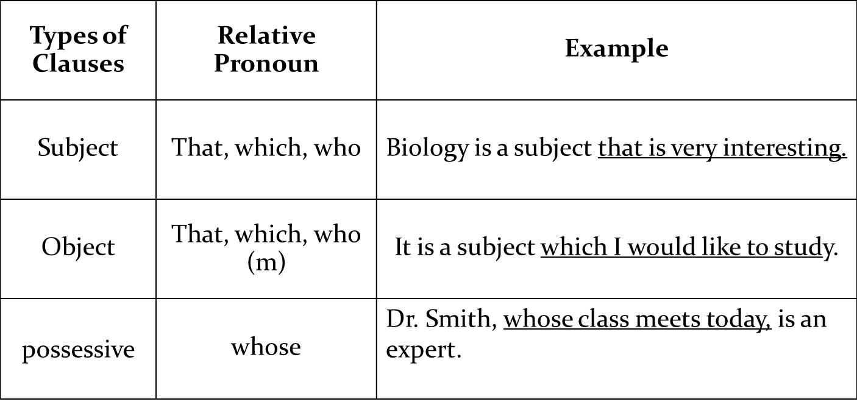
There are several types of adjective clauses:

Slide 50
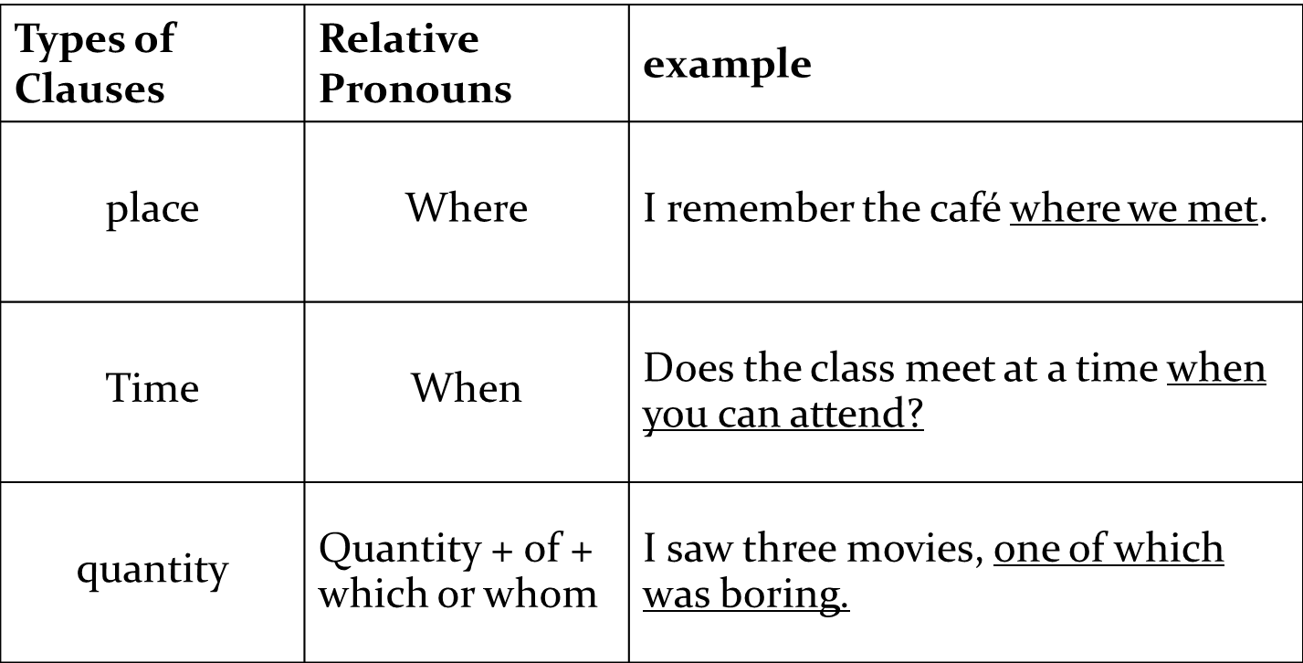

Slide 51
Reducing Adjective Clauses to Adjective Phrases
Clause: A clause is a group of related words that contains a subject and a verb.
Phrase: A phrase is is a group of related words that does not contain a subject and a verb.

Slide 52
(a) CLAUSE: The girl who is sitting next to me is Mai.
(b) PHRASE: The girl sitting next to me is Mai.
(c) CLAUSE: The girl (whom) I saw was Mai.
(d) PHRASE: [none)
An adjective phrase is a reduction of an adjective clause. It modifies a noun. It does not contain a subject and verb.
Examples (a) and (b) have the same meaning.
Only adjective clauses that have a subject pronoun — who, which, or that— are reduced to modifying adjective phrases. The adjective clause in (c) cannot be reduced to an adjective phrase.

Slide 53
(e) CLAUSE: The man who is talking to John is from Korea.
PHRASE: The man Ø Ø talking to John is from Korea.
(f) CLAUSE: The ideas which are presented in that book are good.
PHRASE: The ideas Ø Ø presented in that book are good.
(g) CLAUSE: Ann is the woman that is responsible for the error.
PHRASE: Ann is the woman Ø Ø responsible for the error.
There are two ways in which an adjective clause is changed to an adjective phrase.
If the adjective clause contains the be form of a verb, omit the subject pronoun and the be form, as in (e), (f), and (g).*

Slide 54
*If an adjective clause that contains be + a single adjective is changed, the adjective is moved to its normal position in front of the noun it modifies.
CLAUSE: Fruit that is fresh tastes better than old, soft, mushy fruit.
CORRECT PHRASE: Fresh Fruit tastes better than old, soft, mushy fruit.
INCORRECT PHRASE: Fruit fresh tastes better than old, soft, mushy fruit.

Slide 55
(h) CLAUSE: English has an alphabet that consists of 26 letters.
PHRASE: English has an alphabet Ø consisting of 26 letters.
(i) CLAUSE: Anyone who wants to come with us is welcome.
PHRASE: Anyone Ø wanting to come with us is welcome.
2. If there is no be form of a verb in the adjective clause, it is sometimes possible to omit the subject pronoun and change the verb to its -ing form, as in (h) and (i).

Slide 56
(j) Paris, which is the capital of France, is an exciting city.
(k) Paris, the capital of France, is an exciting city.
If the adjective clause requires commas, as in (j), the adjective phrase also requires commas, as in (k). An adjective phrase in which a noun follows another noun, as in (k), is called an appositive.

Slide 57
Exercise 51, p. 295.
2. The scientists researching the causes of cancer are making progress.
3. We have an apartment overlooking the park.
4. The photographs published in the newspaper were extraordinary.
5. The rules allowing public access to wilderness areas need to be reconsidered.
6. The psychologists studying the nature of sleep have made important discoveries.
7. Antarctica is covered by a huge ice cap containing 70 percent of the earth’s fresh water.
8. When I went to Alex’s house to drop off some paperwork, I met Jacob, his partner.
9. Many of the students hoping to enter this university will be disappointed because only one-tenth of those applying for admission will be accepted.
10. Kuala Lumpur, the capital of Malaysia, is a major trade center in Southeast Asia.

Slide 58
Exercise 53, p. 295.
2. Corn was one of the agricultural products that/which was introduced to the European settlers by the Indians. Some of the other products that/which were introduced by the Indians were potatoes, peanuts, and tobacco.
3. Mercury, which is the nearest planet to the sun, is also the smallest of the planets which/that orbit our sun.
4. The pyramids, which are the monumental tombs of ancient Egyptian pharaohs, were constructed more than 4,000 years ago.
5. Any student who/that doesn’t want to go on the trip should inform the office.
6. Be sure to follow the instructions that/which are given at the top of the page.

Slide 59
Exercise 54, p. 296.
(2) Walt Disney, the creator of Mickey Mouse and the founder of his own movie production company, once was fired by a newspaper editor because he had no good ideas.
(3) Thomas Edison, the inventor of the light bulb and the phonograph, was believed by his teachers to be too stupid to learn.
(4) Albert Einstein, one of the greatest scientists of all time, performed badly in almost all of his high school courses and failed his first college entrance exam.

Slide 60
Exercise 57, p. 298.
2. Disney World, an amusement park located in Orlando, Florida, covers a large area of land that includes lakes, golf courses, campsites, hotels, and a wildlife preserve.
3. Jamaica, the third largest island in the Caribbean Sea, is one of the world’s leading producers of bauxite, an ore from which aluminum is made.
4. Robert Ballard, an oceanographer, made headlines in 1985 when he discovered the remains of the Titanic, the “unsinkable” passenger ship that has rested on the floor of the Atlantic Ocean since 1912, when it struck an iceberg. (also possible: Oceanographer Robert Ballard made headlines . . . .)
5. The Republic of Yemen, located at the southwestern tip of the Arabian Peninsula, is an ancient land that has been host to many prosperous civilizations, including the Kingdom of Sheba and various Islamic empires.

Slide 61
Exercise 58, p. 299.
1. Baseball is the only sport in which I am interested.
OR Baseball is the only sport (which) I am interested in.
2. My favorite teacher, M r. Chu, was always willing to help me after class.
3. It is important to be polite to people who live in the same building.
4. My sister has two children, whose names are Ali and Talal.
5. He comes from Venezuela, (which is) a Spanish speaking country.
6. There are some people in the government (who are) trying to improve the lives of the poor.
7. My classroom is located on the second floor of
Carver Hall, which is a large brick building in the center of the campus.
8. A myth is a story expressing traditional beliefs, or
A myth is a story which /that expresses traditional beliefs.
9. There is an old legend (which/that is) told among people in my country about a man who lived in the seventeenth century and saved a village from destruction.

Slide 62
10. An old man fishing (OR who/that was fishing) next to me on the pier was muttering to himself.
11. The road that we took through the forest was narrow and steep.
12. There are ten universities in Thailand, seven of which are located in Bangkok, (which is) the capital city.
13. At the national park, there is a path leading to a spectacular waterfall, or At the national park, there is a path which /that leads to a spectacular waterfall.
14. At the airport, I was waiting for some relatives who /that/ whom / Ø I had never met before.
15. It is almost impossible to find two persons whose opinions are the same.
16. On the wall, there is a colorful poster which/that consists of / consisting of a group of young people (who are) dancing.
17. The sixth member of our household is Pietro, who is my sister’s son.
18. Before I came here, I didn’t have the opportunity to speak with people whose native tongue is English. OR . . . people for whom English is their native tongue.

