Slide 1
Adaptive Filter
A digital filter that automatically adjusts its coefficients to adapt input signal via an adaptive algorithm.
Applications:
Signal enhancement
Active noise control
Noise cancellation
Telephone echo cancellation
Text: Digital Signal Processing by Li Tan, Chapter 10

Slide 2
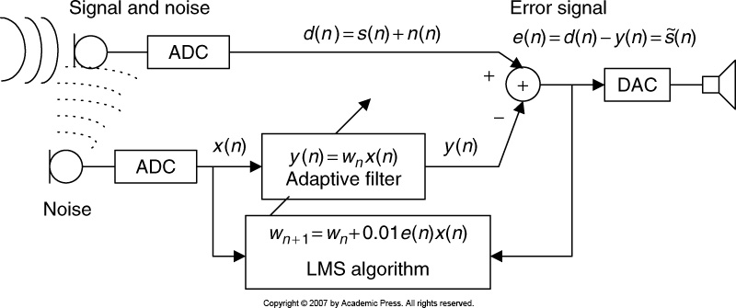
Simplest Noise Canceller
Controls speed of convergence
n(n) is a linear filtered (delayed) version of x(n).

Slide 3
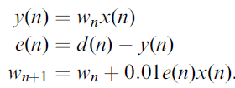
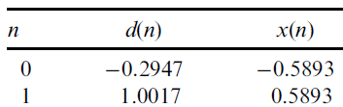
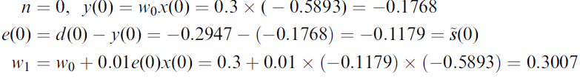
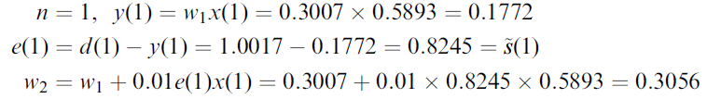
Simplest Noise Canceller – contd.
Initial coefficient
Measured

Slide 4
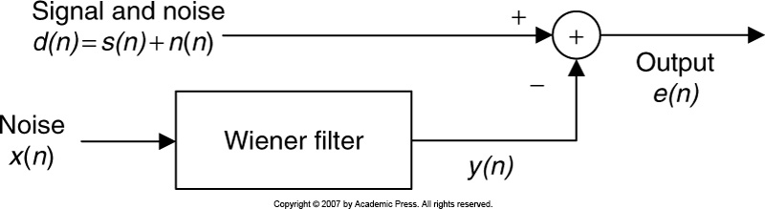


Wiener Filter & LMS Algorithm
Clean signal
Consider, single weight case,
Error signal,
Now we have to solve for the best weight w*

Slide 5
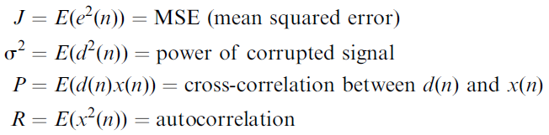
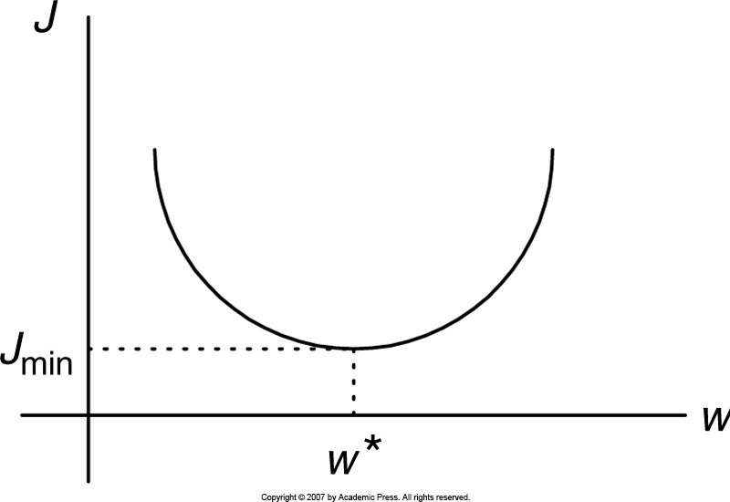



LMS Algorithm
Taking Expectation of squared error signal
For large N,
Optimal w* is found when minimum J is achieved

Slide 6


LMS Algorithm - Example
Given MSE function for the Wiener filter:
Solving for optimal, we get
Finally we get
large N
R⁻¹: Matrix inversion
Makes real-time implementation difficult

Slide 7

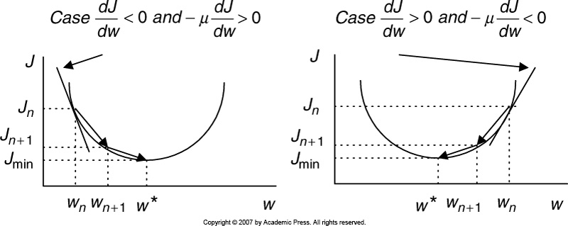
Steepest Decent Algorithm
μ = constant controlling the speed of convergence.

Slide 8




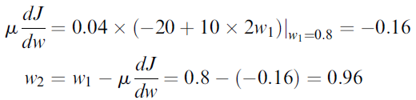


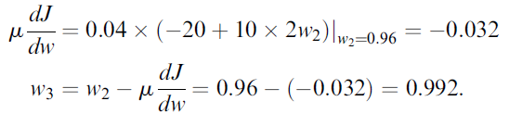

Steepest Decent Algorithm: Example
Solution:
Given:
Iteration three times
For n = 0,
Find optimal solution for w*
For n = 1,
For n = 2,

Slide 9
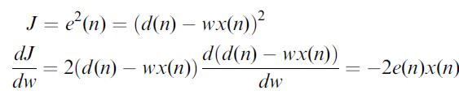

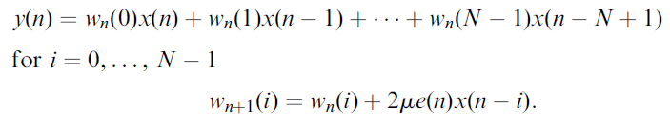

Steepest Decent Algorithm – contd1.
To make it sample-based processing, we need to take out estimation.
Updating weight
For multiple tap FIR filter:
Choose convergence constant as
P_{x} : maximum input power

Slide 10
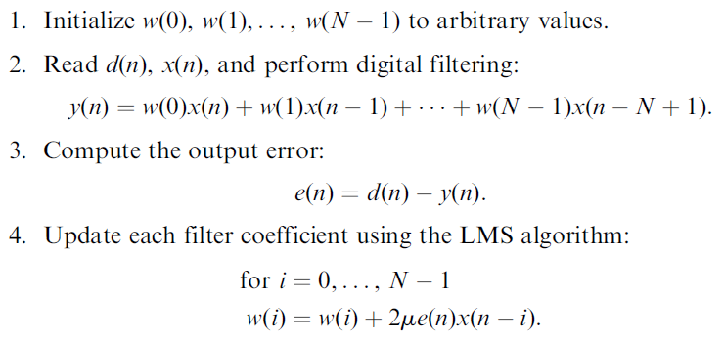
Steepest Decent Algorithm – contd2.
Steps:

Slide 11



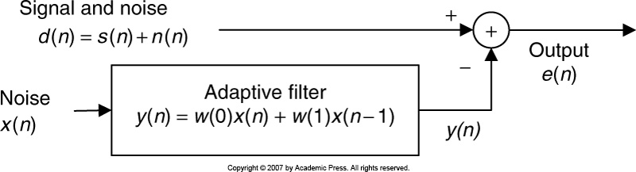


Noise Canceller Using Adaptive Filter-1
Perform adaptive filtering to obtain outputs
Given:
Initial weights:
Updating weights:
Solution:
Filtering:
Output:

Slide 12
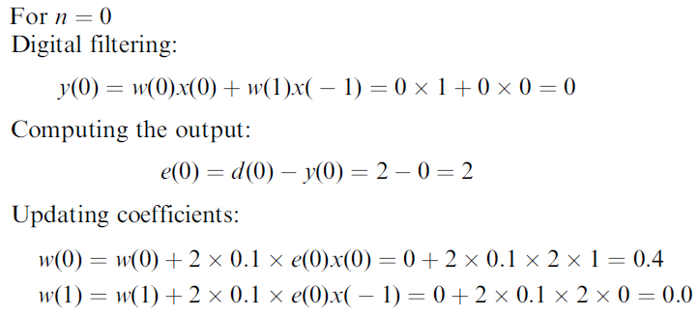
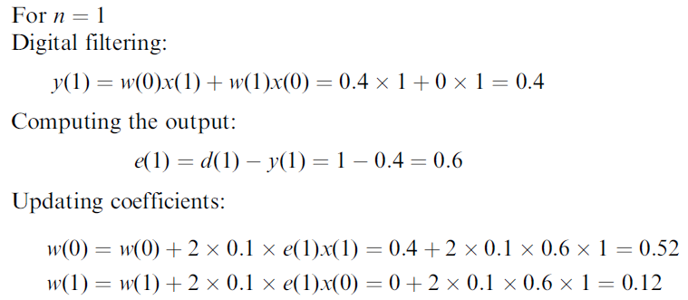
Noise Canceller Using Adaptive Filter-2

Slide 13
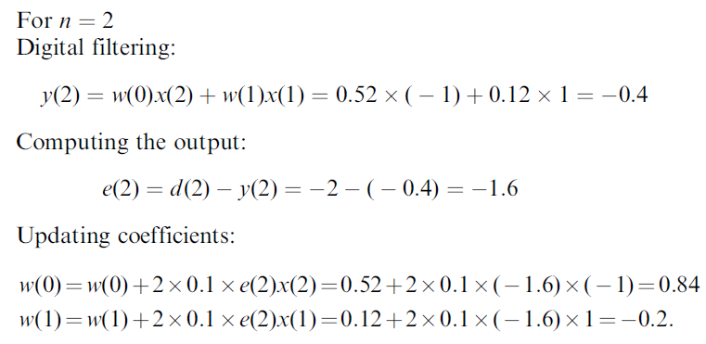

Noise Canceller Using Adaptive Filter-3
Output (noise-cleaned signal):
Practice: Textbook by Li Tan, Chapter 10.
10.3, 10.5, 10.7

Slide 14
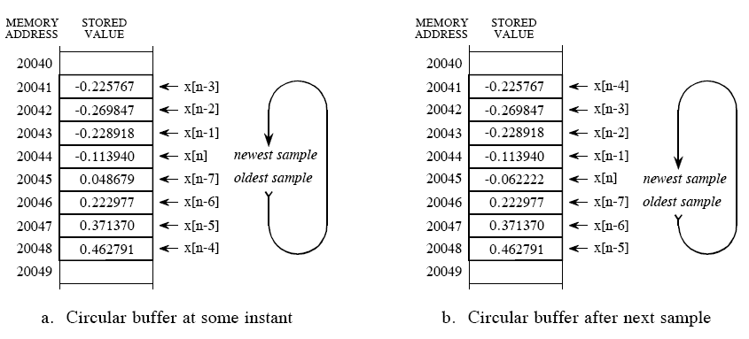
Digital Signal Processors - Introduction
Processors dedicated to DSP
Off-line processing: all the data needs to be in the memory at the same time. The output is produced after all the input data is in the memory.
On-line processing: the output is produced as the same time the input is coming. No delay or little delay.
Circular Buffer Operation:
Start Pointer
Pointer to most recent sample
Step size of memory = 1
End Pointer

Slide 15
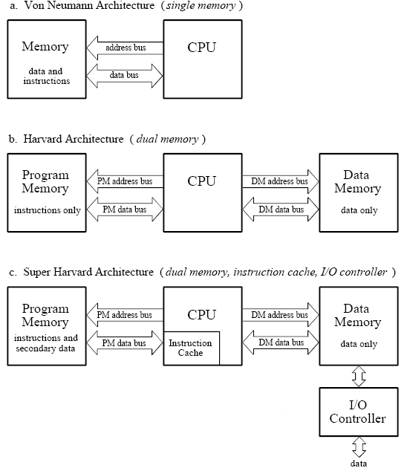
Microprocessors Architecture
Normal microprocessors
DSP uses these ideas
Most recent instructions

Slide 16
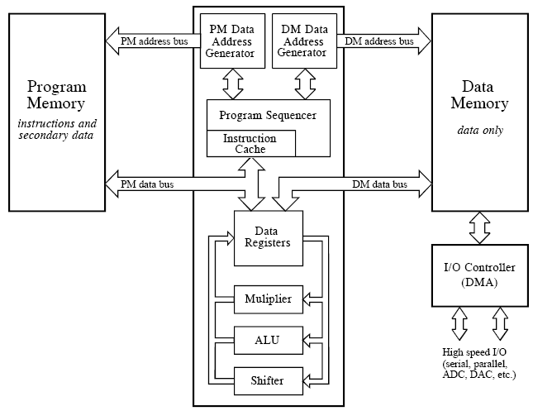
Typical DSP Architecture
For circular buffering
Operations are divided

Slide 17
Application of DSP in Image Processing: Basic Intensity Transfer Functions
Linear
Logarithmic
Power-law
Grey Image has intensity in the range [0 – 255] i.e. it uses 8 bits.
Intensity is transformed for better viewing.

Slide 18
Negative Transformation
Intensity level: [0, L - 1]
Original Image
Negative Image

Slide 19
Log Transformation
Compresses the dynamic range of images with large variations in pixel values.
Loss of details in low pixel values
Original Image (Fourier Spectrum)
Log Transformed Image

Slide 20
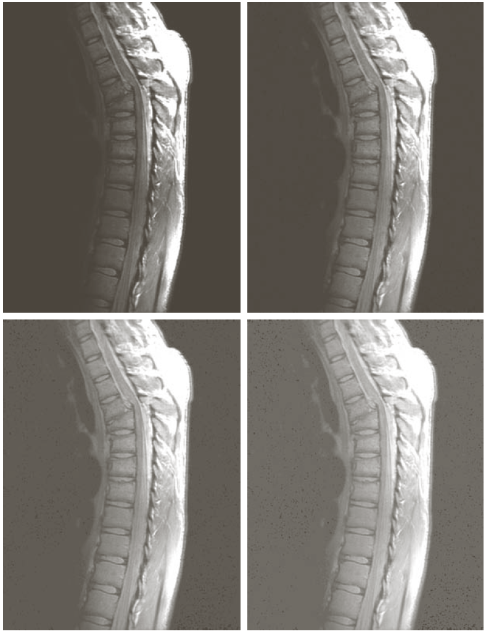
Contrast manipulation: Power-Law
MRI of a fractured spine.
Best contrast
Washed out

Slide 21
Filter Mask
Smoothing Filter (low pass) mask:
Normalization factor
Equal weight
Weighted average

Slide 22
Smoothing Effect
Original image
3 X 3 mask
Noise is less pronounced.
5 X 5 mask
35 X 35 mask
Completely blurred!

Slide 23
Median Filtering
Find the median in the neighborhood, then assign the center pixel value to that median.

Slide 24
Digital (Image) Watermarking
Inserting information (watermark) into images in such a way that the watermark is inseparable from the images.
Copyright identification.
User identification.
Authenticity determination.
Automated monitoring.
Copy protection.
Watermarked image
Original image
Watermark

Slide 25
Example of Watermarking - I
Visible
α= 0.3
Textbook: Digital Image Processing by Gonzalez and Woods

Slide 26

Example of Watermarking - II
Invisible
Watermark is inserted in image’s two LSBs.
By zeroing 6 MSB and scaling the remains to full intensity level,
we get
Sets two LSBs of image to 00.
Shifts two MSBs into two LSBs.

Slide 27
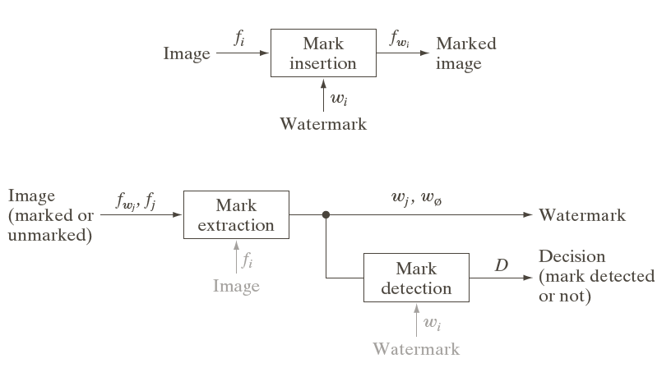
Image Watermarking System
Private / restricted key system: f_{i} and w_{i} are used.
Public / unrestricted key system: f_{i} and w_{i} are unused.

