Slide 1
Acne
Faris M. Al Ghulaiga

Slide 2
Acne
a disorder of the skin caused by inflammation of the skin glands and hair follicles resulting in pimples.

Slide 3
How acne develops
There are four basic events involved in the development of acne lesions.

Slide 4
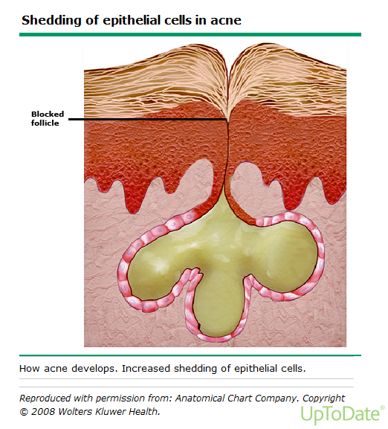

Slide 5
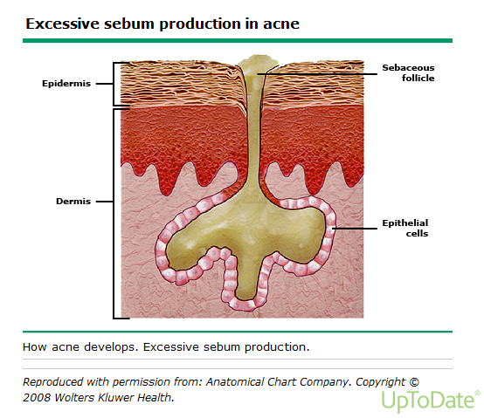

Slide 6
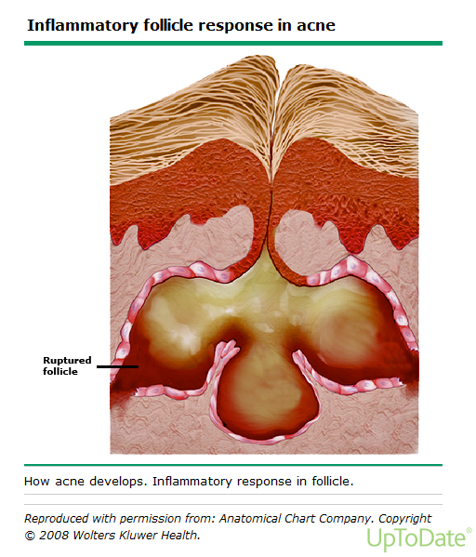

Slide 7
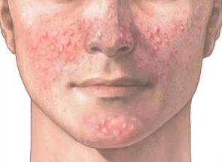
Types of acne:
- Acne vulgaris:
Increased sebum production
Propionibacterium acnes within the follicle
Inflammation

Slide 8
Types of acne:
- Acne mechanica:
after repetitive physical trauma to the skin such as rubbing, occurring from clothing or sports equipment.

Slide 9
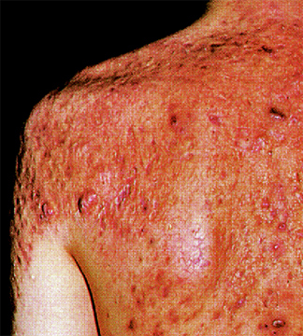
Types of acne:
- Acne conglobata:
It is a severe form of nodular acne that is most commonly seen in young males. Lesions are most prominent on the back, chest, and buttocks

Slide 10
Thank you

