Slide 1
Corneal melting after collagen cross-linking for keratoconus
Dr.Georgios Labiris
Journal of Medical Case Reports ,2011
By
Ibrahim almahuby

Slide 2
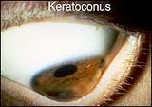
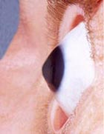
introduction
Keratoconus (KC) is a degenerative non-inflammatory corneal disease. It is usually bilateral and has an incidence of approximately one per 2000 in the general population.
In the majority of cases, KC starts at puberty and progresses at a variable rate.
KC eyes require penetrating keratoplasty.

Slide 3
Corneal collagen cross-linking (CXL)
It is a rather new therapeutic approach attempting to address KC progression.
By using riboflavin (Vitamin B2) and ultraviolet A (UVA, 365nm) radiation.
The primary objective of CXL is to stabilize the collagen fiber matrix in KC corneas.

Slide 4
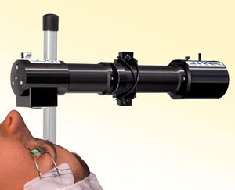
Corneal collagen cross-linking (CXL)

Slide 5
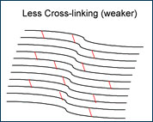
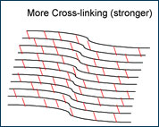
Corneal collagen cross-linking (CXL)
After surg-erery

Slide 6
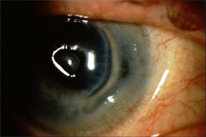
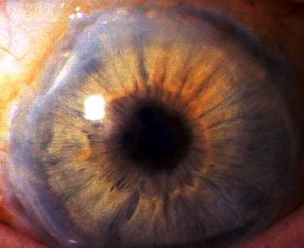
Corneal melting
Postoperative corneal melts may be associated with infectious, inflammatory, or trophic causes.
The most common causes of corneal melt are herpes simplex virus (HSV) keratitis , retained lenticular material and autoimmune disorders.

Slide 7
Case presentation
23-year-old Caucasian man.
He had progressive bilateral keratoconus.
He had no other ophthalmological problems. However, during the past year, he had developed contact lens intolerance.
UCVA : OD : 0.4 logMar
OS : 0.5 logMar
BCVA OD : 0.1 logMar (- 0.25 -2.50 X20)20/25
OS : 0.3 logMar (-0.50 – 3.0 X155)20/40

Slide 8
Central corneal pachymetry
OD = 462 μm
OS = 455 μm
keratometric readings
OD : K1= -43.1 , K2= -46.4
OS : K1= -43.2 , K2= -46.6
The thickness of the thinnest corneal point (TCT) in the left eye was 443 μm

Slide 9
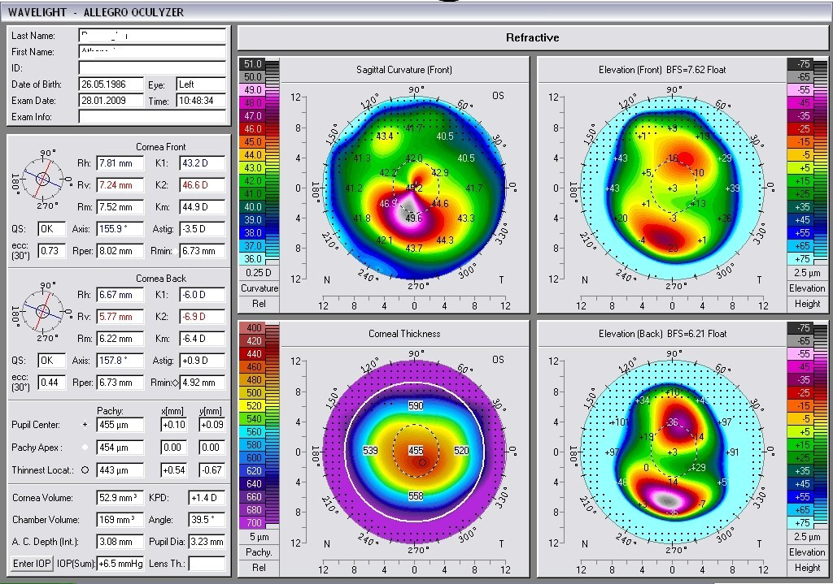

Slide 10
postoperative
during the first postoperative day the patient developed :
Intense photophobia.
Watering .
Non-specific ocular discomfort.

Slide 11
Slit lamp biomicroscopy
redness, especially at the limbal region,
severe corneal haze .
accompanied by non-specific endothelial
precipitates.
few inflammatory cells in the anterior
chamber.
patient’s visual acuity was limited to counting
fingers.
patient’s visual acuity was limited to counting fingers

Slide 12
Slit lamp biomicroscopic image showing severe corneal haze and endothelial precipitates due to the acute inflammatory response.

Slide 13
treatment
The patient's postoperative medication was modified to ofloxacin drops , Exocin, Optive and Zovirax.
The treatment change resulted in subjective improvement of ocular discomfort and disappearance of the inflammatory cells in the anterior chamber.
However, the cornea presented extremely slow re- epithelialization and progressive thinning, which resulted in descemetocele and finally perforation in the second month.

Slide 14
Discussion
Corneal CXL is a temporary block in the progression of keratoconus .
the technique has an excellent safety profile if:
1- De- epithelialization of the cornea to facilitate the absorption of riboflavin.
2- Use of riboflavin 0.1% for at least 30 min.
3- Homogeneous UV irradiation.
4- A minimal central corneal thickness of 400 μm.
( All of the criteria were met in our case )

Slide 15
corneal melting literature
An extensive literature search retrieved the following cases of CXL melting.
(Gokhale et al,2010) recently presented a case of acute corneal melting after CXL for keratoconus which was attributed to the hazardous impact of diclofenac on stromal keratocytes. Despite the fact that no apparent etiologic relationship between non-steroidal anti-inflammatory drugs (NSAIDs).

Slide 16
corneal melting literature
several investigators have attempted to associate keratolysis with postoperative NSAID therapy [Örnek K ,2008].
The potential impact of NSAIDs on keratocytes is well known to the authors, thus we did not use NSAIDs as standard postoperative treatment in CXL.
bilateral melting after CXL for keratoconus in a patient with Down syndrome; however, the required minimal stromal thickness of 400 μm was not met.[Faschinger C ,2010]

Slide 17
in our case
Neither the central corneal thickness nor the thinnest corneal thickness was below 400 μm.
No evidence of non-infective keratitis.
No indications of hypersensitivity to riboflavin could be identified.
because of the shielding effect of riboflavin, the standard CXL procedure seems to cause no damage to the endothelial cells.

Slide 18
Conclusion
The exact cause of corneal melting in our case remains unknown to us.
An immunohistochemical examination of the affected cornea could provide more data regarding its pathological mechanism.
Nevertheless, since all precautions for standard CXL treatment were met in our case,
Further research is necessary to address all safety issues associated with this procedure.

Slide 19
thanks

