Slide 1
المنهج الكامل

Slide 2
عدد فقرات الاختبار 20 فقرة , اختيار متعدد , خمس درجات
مدة الاختبار نصف ساعة
المتغيب عن الاختبار سوف يختبر اختبار مقالي

Slide 3
Introduction and CNS stimulants
Mohammed A. Alyami
Head Teaching Assistant
Department of Pharmacology & Toxicology
College of Pharmacy
KSU
E-mail : maalyami@ksu.edu.sa

Slide 4
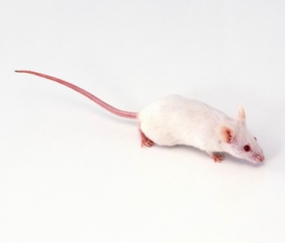
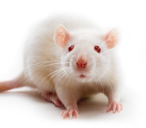
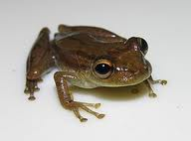
Lab Animals will be used in PHL 322, 326
Mouse
Rat
Frog

Slide 5
Restraint of mouse
Tail Restraint
Used for :
transferring animals from cage to cage.
B. Scruff Restraint
Used for :
Injections
blood withdrawal.
Injection
Intraperitoneal Injections ( IP )
- Restrain the mouse by the scruff method.

Slide 6
CNS stimulant drugs
Lab# 1

Slide 7
Neuron
They are the basic functional units of the nervous system.
- They contain three major parts
1- Cell Body | 2- Dendrites | 3- Axons
1
3
Axon terminal
Effector
2
Synapse
Is the site where the axon of a neuron communicates with effectors or other neurons.

Slide 8
Neurotransmitter
Neurotransmitter
Aspartic acid | Excitatory Neurotransmitter
Glutamic acid | Excitatory Neurotransmitter
GABA | inhibitory Neurotransmitter
Glycine | inhibitory Neurotransmitter
Notes:
Definition
noun, plural: chemical synapses
A specialized cell-to-cell junction where nerve impulse is transmitted in one direction, from one neuron to another or from a neuron to a non-neuronal cell.

Slide 9
CNS stimulants
Definition:
“Stimulants are substances which tend to increase behavioral activity when administered”
Signs and symptoms of CNS stimulation :
1- Elevate Mood.
2- Increase Motor Activity.
3- Increase Alertness.
4- Decrease need for Sleep.

Slide 10
1- Amphetamine
MOA:
Block the reuptake of Norepinephrine and Dopamine into the presynaptic neuron and increase the release of these Monoamines into the extraneuronal space.
Clinical use:
1. Narcolepsy.
2. Attention-deficit hyperactivity disorder (ADHD)
3. Simple obesity

Slide 11
Signs and Symptoms:
After injecting the mice with Amphetamine, you will notice:
1- Hair erection.
2- Licking, gnawing.
3- Stereotype.
4- Sniffing.

Slide 12
2- Picrotoxin
MOA:
Non-competitive antagonist of GABA receptors.
After injecting the mice with Picrotoxin, you will notice:
Clonic Convulsion characterized by :
1. Asymmetric
2. Intermittent
3. Spontaneous
4. Coordinated

Slide 13
3- Strychnine
MOA:
Competitive antagonist of the Glycine receptors.
After injecting the mice with Strychnine, you will notice:
Tonic convulsion characterized by :
1. Symmetric
2. Reflex in origin
3. Continuous
4. Uncoordinated.

Slide 14
Drug | MOA | Site of action | Signs and symptoms
Amphetamine | Blocking the neurotransmitters’ reuptake and Promoting the release of neurotransmitters | Cerebral Stimulants | 1- Hair erection. 2- Licking, gnawing. 3- Stereotype. 4- Sniffing.
Picrotoxin | antagonist of GABA receptors | Medullary Stimulants | Clonic Convulsion characterized by 1. Asymmetric 2. Intermittent 3. Spontaneous 4. Coordinated
Strychnine | Competitive antagonist of the Glycine receptors | Spinal Stimulants | Tonic convulsion characterized by : 1. Symmetric 2. Reflex in origin 3. Continuous 4. Uncoordinated

Slide 15
CNS depressants
LAB 2

Slide 16
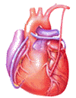
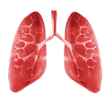
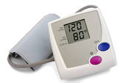
A stimulant is a drug that speeds up activities of the CNS
A depressant is a drug that slows brain and body reactions
Stimulants increase
Depressants decrease
Heart rate
Respiratory rate
Increase Motor Activity.
Increase Alertness.
Decrease need for Sleep
Relax muscle tension
Lower alertness
Cause drowsiness
Blood pressure

Slide 17
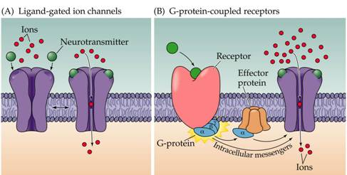
GABA
Is inhibitory neurotransmitter.
GABA Receptors
GABA A
GABA B
Ligand-gated ion channel
(ionotropic receptors)
Metabotropic receptors
Notes:
Which are typically released from local interneurons.

Slide 18
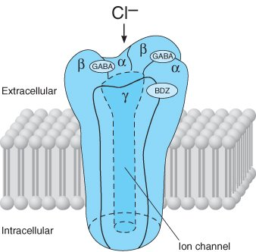
GABA A ( Chloride ion channel)
Ci -
Ci -
Ci -
Prevent action potential
Ci -
Ci -
Ci -
Ci -
Ci -
↑ Cl- conductance
Hyperpolarization of membrane

Slide 19
General Anesthesia
General anesthetics
Inhaled
IV
Gas
(nitrous oxide)
Volatile liquids
(halothane)
Barbiturates
(thiopental)
Benzodiazepines
(midazolam)
Opioids
(fentanyl)
Dissociative
(ketamine)
Miscellaneous
(etomidate, propofol)
MOA of Inhaled anesthetics, barbiturates, benzodiazepines, etomidate, and propofol are facilitate GABA-mediated inhibition at GABAA receptors.
Its antagonism of the action of glutamic acid on the NMDA receptor

Slide 20
Sedative-Hypnotic Drugs
Sedation : reduction of anxiety
Hypnosis : induction of sleep
Sedative = anxiolytic = antianxiety = minor tranquilizer : a drug that reduce anxiety
Increase the dose of sedative that will lead to hypnosis
Clinical use of Sedative-Hypnotic Drugs
Anxiety
Sleep disorder
Antiseizure
Anesthesia protocol

Slide 21
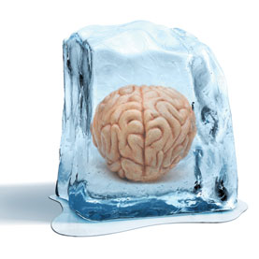
Sedative-hypnotics
Benzodiazepine
Barbiturates
Miscellaneous agent
Chloral hydrate
….etc.
Notes:
Ultrashort acting: ( 15 minutes) e.g. Thiopental.
Short acting: ( 2-4 hours) e.g. Pentobarbital .
Intermediate acting: (4-6 hours) e.g. Amobarbital.
Long acting: ( 6-8 hours): e.g. Phenobarbital.
Diazepam (Valium) and clorazepate (Tranxene) have fast onsets of action,
oxazepam (Serax) has a slow onset, and
lorazepam (Ativan), alprazolam (Xanax), and clonazepam (Klonopin) have intermediate onsets of action

Slide 22
Tranquilizer
Major tranquilizer = Antipsychotic
Example
Chlorpromazine (CPZ)
MOA : Work by blocking dopamine (D 2 )receptor.

Slide 23
Work lab
To demonstrate the effect of different types of CNS depressants as :
- Hypnotics. Phenobarbital
- Sedatives. Chloral hydrate (at sedative dose)
- Tranquilizers. CPZ
To learn how to distinguish between their signs if they are given as unknown drugs.

Slide 24
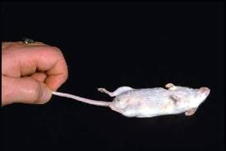
Righting reflex
righting reflex the ability of the mice to assume an optimal position when there has been a departure from it.
Is widely used to screen compounds with sedative properties
If it isn’t lost Righting reflex ------- +ve
If it’s lost Righting reflex ------- - ve
Notes:
Righting Reflex is a simple assay to assess motor coordination
onset of action = the start of loss in righting reflex
duration of drug effect = from the start of loss till the return of righting reflex

Slide 25
1- Phenobarbital
Hypnotic drug
After injection of Phenobarbital we can observe :
Loss of righting reflex ( -ve)
2- chloral hydrate
Sedative drug
When the dose increased they will induce sleep.
After injection of chloral hydrate we can observe :
NO loss righting reflex (+ve)

Slide 26
CPZ
After injection of CPZ we can observe signs such as:
No loss of righting reflex (+ ve)
Ataxic gait: loss of muscle coordination .
Catalepsy : rigid body
Creeping gait
Grasping test (CPZ):
When you trying to put the mice on the cord, the mice will fall down
Notes:
State of catalepsy → onset time
Symptoms of Catalepsy Symptoms of catalepsy include:
Extremely rigid body posture
Decreased sensitivity to pain
Limbs that stay in the same position when they are moved
Slower bodily functions, particularly breathing
Decreased muscle control, or complete loss of muscle control

Slide 27
Pain
Analgesic
Lab #3

Slide 28
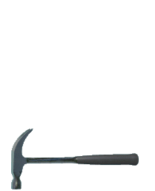
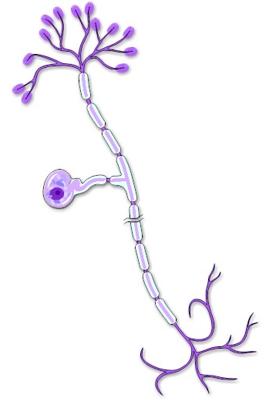
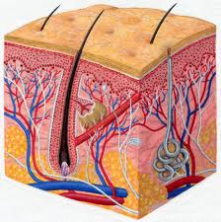
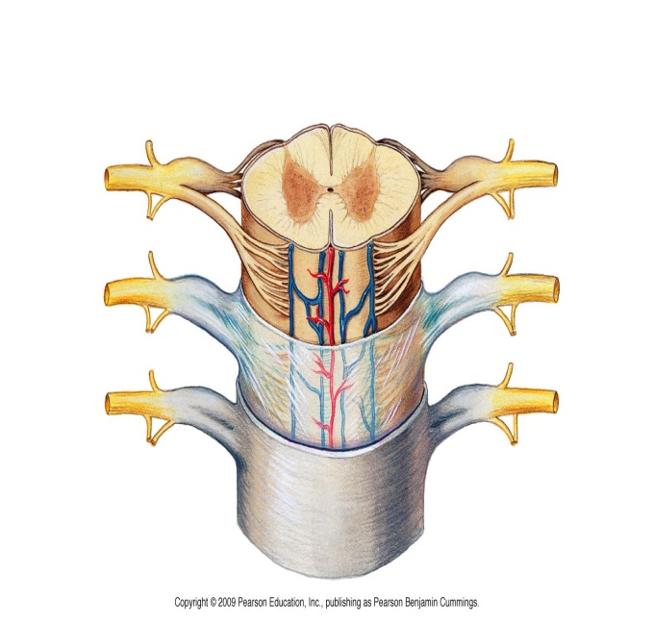
Sensory or afferent neurons
Neurons carrying impulses (AP) from sensory receptor (at PNS) to the CNS
Unipolar neuron
Cell body
carrying impulses
AP
Spinal cord
Notes:
afferent ( literally means to go toward )

Slide 29
Sensory or Afferent Type
C fibers
Non- myelinated
Low conducting velocity
Cause a dull burning pain
Cause non-localized pain
Aδ fibers
Myelinated
High conduction velocity
Cause a sharp pain
Cause localized pain
Pain receptor
(Nociceptors)
are cells nerve ending that initiate the sensation of pain
Sensory Receptor
Can be activated by :
Chemical stimuli
Thermal stimuli
Mechanical stimuli
This process, called nociception
Noxious Stimuli
An actually or potentially tissue damaging event

Slide 30
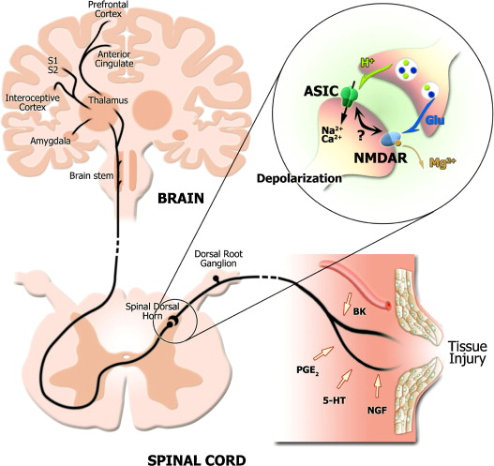
cell membrane phospholipids
phospholipases A₂
Arachidonic acid
Noxious Stimuli
COX-2
Prostaglandin E2 (PGE2)
Sensitizes nociceptors to bradykinin (BK) , ((the most potent pain producing chemical)) and other pain mediators like substance P histamine, 5-HT…etc.
Release of endogenous opioid peptide ( endorphin) which cause inhibiting of nociceptive impulse( Modulation )
-
Then transmission the impulse to spinal cord and cortex (perception)
For stimulation nociceptors, and lead to production of AP

Slide 31
Analgesia
Without
Pain
Pain killer
Analgesics
Are medicines or drugs that relieve pain (analgesia).
Analgesic
Opioid agent
Non-opioid agent
NSAID
Other agent e.g.
Local anesthetics
Notes:
Analgesia : The absence of the sense of pain while remaining conscious.

Slide 32
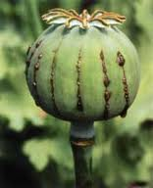
Opioid Analgesics
Contains many alkaloids
Opium
morphine
Opiate : A drug derived from alkaloids of the opium
Interaction with opioid receptor
Opioid : the class of drugs that includes opiate, and all synthetic and semisynthetic drugs that mimic the action of opiate
Mixed agonist- antagonists
e.g. nalbuphine
Antagonists
e.g. Naloxone
Agonists
Strong: morphine
Moderate : codeine
weak: propoxyphene

Slide 33
opioid receptor
It’s G protein-coupled receptor.
Three types
1- μ (mu)
Most of the analgesic opioids are μ-receptor agonists
Responsible for some major unwanted effects (e.g. respiratory depression, euphoria, sedation and dependence)
2- κ (kappa)
3- δ (delta)

Slide 34
Non Opioid Analgesics
NSAIDs
Non- Steroidal
Anti-Inflammatory
Drugs
Arachidonic acid
NSAID
-
-
COX-1
COX-2
NSAID
Thromboxane
Prostacyclin
Prostaglandins

Slide 35
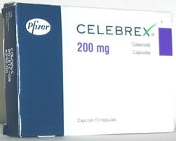
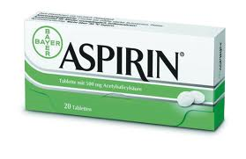
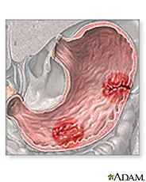
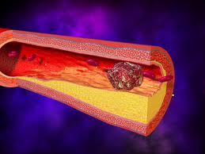
Cox-2 selective inhibitor
(coxib)
Cox non-selective inhibitors
Example
Celecoxib
Example :
Aspirin,
Ibuprofen,
Diclofenac…etc
Thrombosis
GI ulcer

Slide 36
LAB WORK
Objective :
To show the analgesic effects of different analgesics using different methods.
Writhing test.
Hot plate method.

Slide 37
Procedure:
4.Compare the number of writhing for each drug and comment on the results:
A drug has less number of writhing that has more potency as analgesic.
 | Drug | No. of writhing/20 minutes
Control | Acetic cid
Test 1 | Morphine acetic acid
Test 2 | Aspirin acetic acid
5 min’s
5 min’s

Slide 38
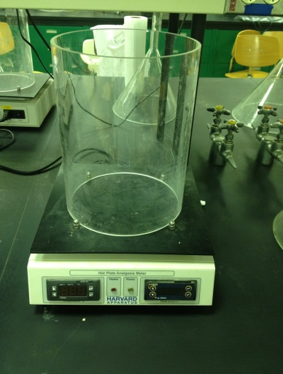
Hot plate method
principle:
The paws of the mouse are very sensitive to heat at temperature which are not damaging the skin .
At temperature of 55 C the mouse will jump and licking the paws.
The time till these response occur is calculated and is prolonged after administration of analgesics.
Hot Plate Analgesia Meter

Slide 39
It is a reaction of living tissue to an injury.
Inflammation
Types
Acute
Chronic
Rapid onset ,
Short duration
Gradual onset ,
long duration
Cardinal signs of acute inflammation:
Redness
Hotness
Swelling
Pain and tenderness

Slide 40
Inflammatory Mediators
Mediator | Main activity
Histamine | Vasodilation, increase permeability
Prostaglandins ( PGs ) | Vasodilation, pain, fever
Leukotrienes (LKs) | Increase permeability
Bradykinin | Vasodilation, increase permeability, pain

Slide 41
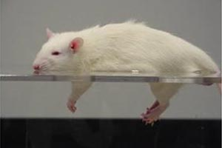
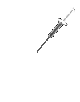
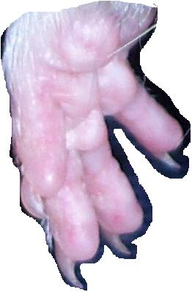
Inflammatory process (( vascular phase))
Tissues damage
Release inflammatory mediators
Histamine
PGE2
LKs
Bradykinin
Vasodilation (V.D.)
Increase blood flow
Increase vascular permeability lead to formation of fluid exudate((plasma protein))
Edema Formation

Slide 42
Inflammatory process
Cardinal signs of acute inflammation:
Redness: due to Vasodilation
Hotness: due to Vasodilation and increase blood flow
Swelling: due to vascular leakage
Pain and tenderness: due to irritation by chemical mediators and pressure of swelling
Aiming of the inflammation response
prevents the spread of damaging agents to nearby tissues,
disposes of cell debris and pathogens, and
sets the stage for repair.

Slide 43
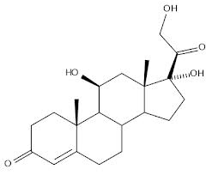
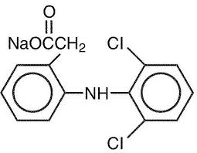
Anti-inflammatory drugs
Steroidal
Non-steroidal
Glucocorticoids
NSAIDs like
Aspirin
aspirin
Containing steroid moiety
don’t contain steroid moiety

Slide 44
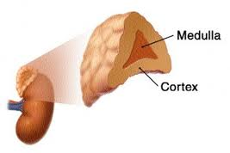
Adrenal gland
Secreted glucocorticoids from adrenal cortex
glucocorticoids : are steroids hormones which include cortisone and cortisol (also called hydrocortisone)
cortisol : is predominant glucocorticoids in human
Notes:
glucocorticoids : A corticosteroid hormone secreted by adrenal cortex that influences glucose metabolism and immune function
Corticosteroids : A family of steroids synthesized by and released from the adrenal cortex.
CRH= Corticotropin-releasing hormone
ACTH =Adrenocorticotropic hormone

Slide 45
Glucocorticoids
Clinical uses
A- adrenal disorders: like Addison's disease
B- Nonadrenal disorders :
Anti-inflammatory for treatment asthma as example
Immunosuppression: to prevent organ transplant rejection
…..etc.
Natural
Cortisol
Cortisone
Synthetics
Prednisone
Dexamethasone
One of the MOA
They act by indirect inhibition of the enzyme phospholipase A2 by induce synthesis of a protein “lipocortin-1” which has the inhibitory effect on phospholipase A2.
Some Adverse Effects
Hyperglycemia
Osteoporosis
Moon face, buffalo hump

Slide 46
NSAIDs
Non- Steroidal
Anti-Inflammatory
Drugs
Cox-2 selective inhibitor
(coxib)
Cox non-selective inhibitors
Example
Celecoxib ((has a FDA initiated “black box” warning concerning cardiovascular risk))
Example :
Aspirin,
Ibuprofen,
Diclofenac …etc
MOA
Inhibit synthesis of PGs through inhibition of COX

Slide 47
Compare between Glucocorticoids &NSAID
glucocorticoids | NSAID
Containing steroid moiety in their structure | They don’t contain steroid moiety
Powerful anti-inflammatory , immunosuppression, adrenal disorder | anti-inflammatory, analgesic, antipyretic anti-platelet ((only aspirin))
Prevent synthesis of LKs and PGs | Prevent synthesis of PGs
Treatment of asthma | Can be caused asthma

Slide 48
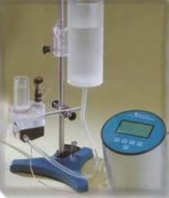
Measurement the activity of anti-inflammatory drugs
Method : Paw Oedema Method
Equipment : Plethysmometer
Principle : Induction a chemical inflammation by injecting an
irritant ( formalin ) into rat’s paw
Objective : Measure the anti-inflammatory activity of aspirin
and hydrocortisone (cortisol) with different doses
Notes:
Plethysmometer : Any instrument designed to measure small changes in volume, usually via the displacement of water

Slide 49
Procedure :
1- select 5 rats
2- inject each rat 1 ml urethane for anesthesia.
3- select one as control and inject the rest of them Intraperitoneal (IP)
rat 1 >>> control
rat 2 >>> 40 mg/kg aspirin
rat 3 >>> 80 mg/kg aspirin
rat 4 >>> 20 mg/kg hydrocortisone
rat 5 >>> 40 mg/kg hydrocortisone
4- after 1 hr. , inject 0.1 ml formalin in each rat into
their paws >>> to induce inflammation.
5- after 1 hr. , take the reading using the plethysmometer of each
rat paw ( right and left ).
6- calculate the inflammation and response % for each drug.

Slide 50
Response% | inflammation | RP | LP | Dose
---------- | C |  |  | control
 | T1 |  |  | 40 mg/kg asp.
 | T2 |  |  | 80 mg/kg asp.
 | T3 |  |  | 20 mg/kg hydro.
 | T4 |  |  | 40 mg/kg hydro.
Inflammation = LP - RP
Response % $=\frac{C − T }{C}× 100$

Slide 51
Response% | inflammation | RP | LP | Dose
--------- | 0.53 | 1.02 | 1.55 | control
37.74 | 0.33 | 1.2 | 1.53 | 40 mg/kg asp.
69.81 | 0.16 | 1.25 | 1.41 | 40 mg/kg hydro.
Inflammation for
Control ((C)) : 1.55-1.02 = 0.53
Asprirn : 1.53- 1.2 = 0.33
Hydrocortisone : 1.41-1.25 = 0.16
Inflammation = LP - RP
Response % of aspirin $=\frac{0.53 − 0.33 }{0.53}× 100 =37.74\%$
Response % $=\frac{C − T }{C}× 100$
Response % of hydro. $=\frac{0.53 − 0.16}{0.53}× 100 =69.81\%$
Response % Anti-inflammatory activity

Slide 52
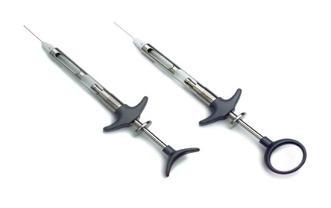
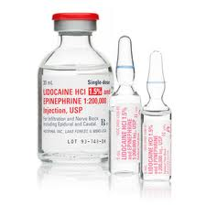
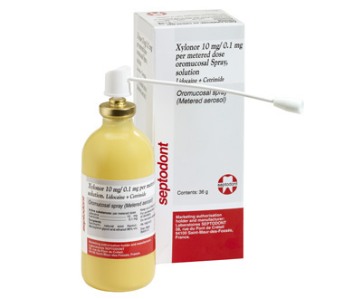
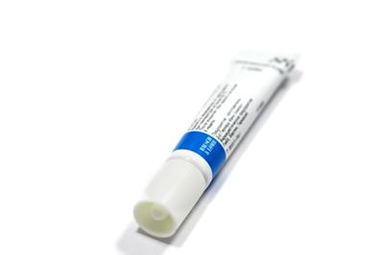
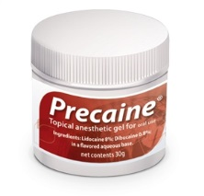
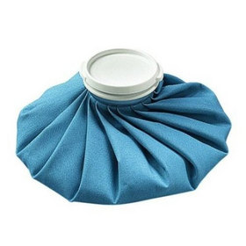
Lab# 5
Local Anesthetics
PHL 322
PHL 326

Slide 53
Is the condition that results when sensory transmission (action potential) from a local area of the body to the CNS is blockade
Local Anesthesia
Block nerve conduction of sensory impulse
Caused
Local Anesthetic
(LA)
Is a drug that causes reversible local anesthesia and a loss of nociception.

Slide 54
MOA
LAs block voltage-dependent sodium channels (at axon) and reduce the influx of sodium ions, thereby preventing depolarization of the membrane and blocking conduction of the action potential.

Slide 55
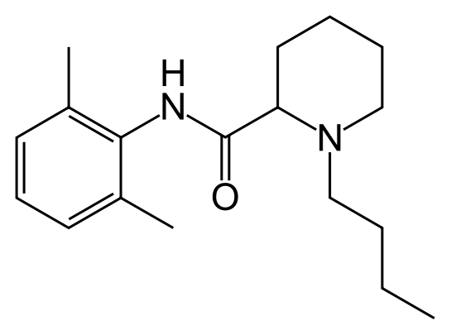
The commonly used LA are weak base with at least 1 ionizable amine function that can become charged through the gain of a proton.
+H⁺
Drug
Drug⁺
-H
Ionizable amine
+H⁺
-H
H⁺
the ionize (charged) form
The Nonionize ( uncharged) form
More lipid soluble
Once the drug has penetrated the lipid barrier and reach its site of action (receptor) it ionized and the ionized form is responsible for LA activity
It will facilitate its penetration through the cell membrane (bilayer phospholipid)

Slide 56
-H+
Na+ channel
Drug+
Drug
Outside
+H+
Membrane diffusion
Na+
Receptor
Membrane
Drug
Na+
Drug+
Inside
Drug
+H+
Drug+
-H+

Slide 57
PH
Charged forms
Acidosis
Acidosis such as caused by inflammation at a wound partly reduces the action of LAs. This is partly because most of the anesthetic is ionized and therefore unable to cross the cell membrane.

Slide 58
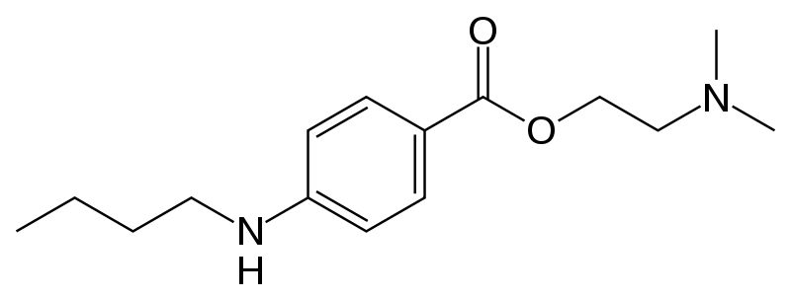
local anesthetics
Esters
long action (tetracaine)
short action (procaine)
Amides
long action (bupivacine, ropivacine)
medium action (lidocaine)
surface action (benzocaine, cocaine)

Slide 59
Pharmacologic effects
Nerve
Heart
Skeletal muscle
Local Anesthesia (including analgesia)
Antiarrthymia
(e.g. Lodicaine)
Paralysis
(no clinical application)
Clinical use

Slide 60
Method of administration
Definition | Method of adm.
application LA to the surface of the skin or mucosa | Surface anesthesia
Can be called “Topical anesthesia” : gel, spray, ointment
injected of LA into the epidural space where it acts primarily on the spinal nerve roots | epidural anesthesia
injected LA into the cerebrospinal fluid, usually at the lower back, where it acts on spinal nerve roots and part of the spinal cord. | Spinal anesthesia

Slide 61
Many shorter acting local anesthetics are readily absorbed into the blood from the injection site after administration.
Decrease of duration
Increase in systemic toxicity
This can be accomplished by administration of a vasoconstrictor (usually an agonist sympathomimetic like epinephrine ) with the local anesthetic agent.
blood flow to the area is reduced
Epinephrine decrease of rate of absorption in blood that leads to minimize of systemic toxicity and increase duration .
Notes:
Definition
noun
The property of a drug that produces partial agonist effect at the receptor similar to the cholinergic stimulation of the sympathetic nervous system.
Supplement
Intrinsic sympathomimetic activity or ISA is often used to describe the property of certain beta-blockers.
Beta-blockers with ISA are beta-blockers that exert a partial agonism at the adrenergic receptor while simultaneously blocking the endogenous catecholamines from binding to the receptor. Hence, they are less potent than catecholamines and other beta-agonists.

Slide 62
Treatment of toxicity
Severe toxicity is treated symptomatically; there are no antidotes. e.g. Convulsions are usually managed with intravenous diazepam or a short-acting barbiturate such as thiopental.

Slide 63
Frog’s plexus method
“Foot withdrawal reflex of frog”
Principle:
The skin of the frog is very sensitive to diluted HCL and will reflex by withdrawing its leg when immersed in HCL

Slide 64
Administer 1 ml of LA solution in the abdominal sac of the frog and observe the zero time.
Test the withdrawal reflex at 3 minutes interval and wash with tap water after each exposure to the acid, observe the time at which the absence of withdrawal reflex occurs
Onset time: is the time from adding LA until the acid fails to provoke withdrawal of the foot
Tabulate your results and determine which of LA is more rapid in its action than the other.
LA | The time interval
 | 3
 | 6
 | 9
 | 12
 | 15
 | 18
 | 21
Still withdrawal Reflex
Still withdrawal Reflex
Absence of withdrawal Reflex
the drug has activity and blocks sodium channels
((Onset time))

Slide 65
Lignocaine | Procaine | The time interval
- | - | 3
+ | - | 6
 | - | 9
 | - | 12
 | - | 15
 | + | 18
Negative (-)= means the presence of the withdrawal reflex (the drug has no activity).
Positive (+)= means the absence of the withdrawal reflex (the drug has activity and blocks sodium channels)
Conclusion:
From the table we conclude that lignocaine is more rapid in inducing local anesthesia (( rapid onset)) than procaine

