Slide 1
ZOO 103 Lab 8
Prepared by : Reem Aldossari

Slide 2
Ascaris
Kingdom: Animalia, Nematoda (Roundworms)
Class: Rhalditea
Order: Ascariida
Family: Ascariidae
Genus: Ascaris
Species: lumbricoides
Ascaris lumbricoides
External Features:
The body form, is cylindrical, long (length varies according to species .
sex being in A. vitulorum 15-26 cm in the male and 22-30 cm in the female) and tapering at both ends.
The sexes are separate ; the female is the larger, and has a straight posterior end, while the male is more slender and has its posterior end sharply curled ventrally.
Four longitudinal streaks run the entire length of the body, 2 thin white dorsal and ventral lines, and 2 broader and darker lateral lines.
The mouth lies at the anterior end of the body and is guarded by three finely papillated lips, one dorsal and two ventro¬lateral.

Slide 3
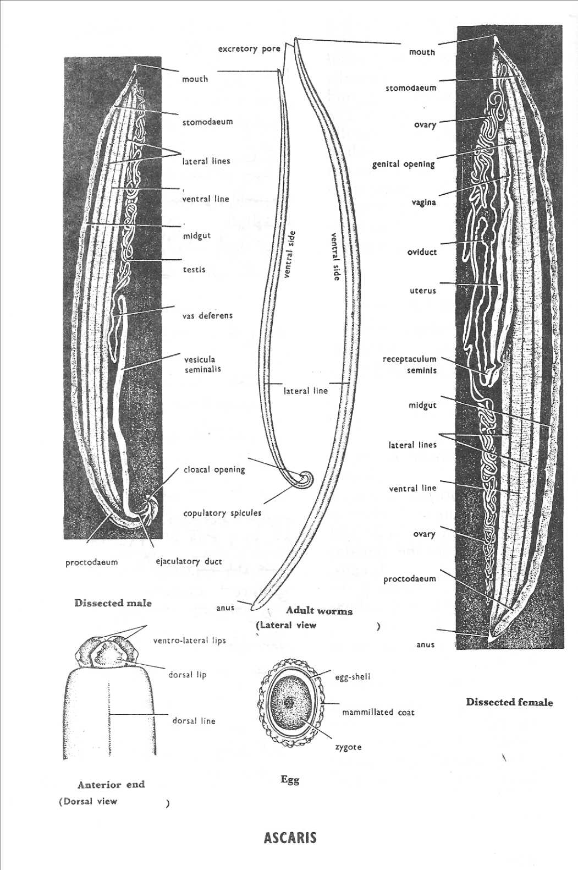
The minute excretory pore lies on the ventral side, 2 mm behind the mouth.
The genital aperture in the female is situated on the ventral side some distance from the anterior end (at about one third the length of the body in A. lumbricoides.
In the male, the genital duct joins the hind gut and both open by a common cloaca a short distance from the posterior end.
A pair of minute copula to ry spicules project from the latter aperture.
The female has a separate slit-like anus.

Slide 4
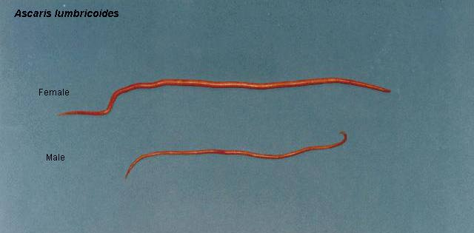

Slide 5
The Earthworm – Allolobophora:
Kingdom: Animalia
Phylum: Annelida
Class: Oligochaeta
Genus: Allolobophora (Earthworm)
1-Species: caliginosa
Allolobophora caliginosa
External Features:
The body form is cylindrical pointed anteriorly and dorso-ventrally flattened posteriorly.
The dorsal surface is somewhat darker in colour.
The mouth and anus open terminally at the anterior and posterior ends respectively.
The body is divided into a great number of segments, separated by conspicuous inter-segmental grooves.
The clitellum (secretes the cocoon) is the thickened skin of segments 26¬-34, and lies on the dorsal and lateral sides concealing the segments .

Slide 6
These, however, are distinct on the ventral side, where the edges of the clitellum are thick¬ened on segments 31-33 forming two puberty crests.
The head is composed of a peristomium (first segment) surrounding the mouth and a prostomium which is dorsal and forms an upper lip that extends in front of the mouth; the prostomium is not to be considered a segment.
The chaetae or setae are minute chitinous struc¬tures which can be felt by passing the finger from be-hind forwards on the ventral surface of the worm (preferably preserved).
Everybody segment, except the first and the last, carries four pairs of chaetae, two pairs on the ventral surface and one pair on each lateral side. Use a hand-lens to see that the chaetae are directed backwards.
The female open¬ings are two small open¬ings which lie ventro-laterally on segement 14.

Slide 7
The male openings are two slit-like apertures with thickened lips. They lie on the ventro-lateral sides of segemnt 15.
The spermathecal pores are two pairs of minute openings which lie on the ventral side in the inter-segmental grooves between segments 9/l0 and 10/11. They are surrounded by three pairs of copulatory papillae on segemnts 9, 10 and 11.
The dorsal pores are minute single pores which communicate the coelom with the outside.
They lie mid dorsally on the inter-segmental grooves starting with 8/9 to the posterior end.
The excretory pores or nephridiopores are the minute pores of the nephridia to the outside. They are ventral in position, two per segment, except the first three and the last segment where they are absent.

Slide 8
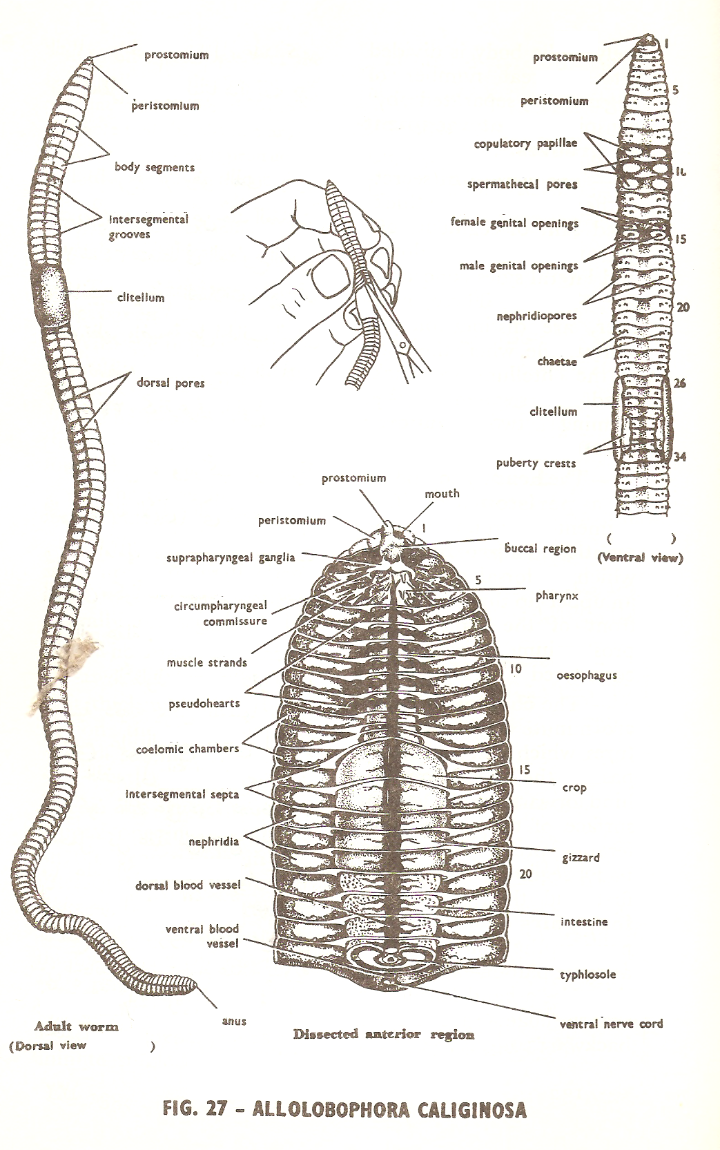

Slide 9
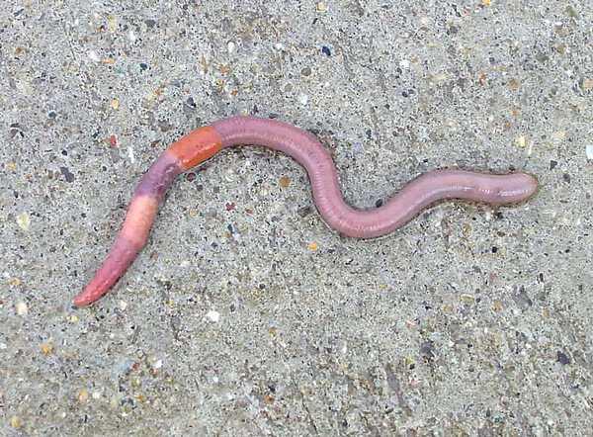

Slide 10
Hirudo
Kingdom: Animalia
Phylum: Annelida
Class: Hirudinea (leeches)
Genus: Hirudo
Species: medicinalis
Hirudo medicinalis.
External Features:
Body form and colour, dorsoventrally flattened (not rounded) with a greenish-brown colour, paler below than above.
The dorsal surface is marked with yellowish longitudinal bands spotted with black pigment, while the ventral surface is irregularly mot¬tled.
The suckers: a cup-shaped anterior sucker with the mouth opening in its middle, and a larger imperforated disc-like posterior sucker, both are ventrally directed.

Slide 11
External annulation:
The body is externally divided into a large number of rings or annuli which are actually more numerous than the true internal segments.
The animal has a fixed number of segments, only 33. Ever/ 5 annuli correspond to one true seg¬ment except at the anterior and hind ends where the number of annuli per segment is less.
The eyes are five pairs on the dorsal surface of the first 5 segments.

Slide 12
The nephridiopores are 17 pairs of minute openings on the ventral surface, one pair in each of the segments 7-23 inclusive, and located on the annulus immediately in front of the one bearing the papillae.
The male genital opening lies in the mid-ventral line on the 4th annulus of segment 11.
The female genital opening lies in the mid-ventral line on the 4th annulus of segment 12.
The anus opens mid-dorsally at the point of junction between segment 26 and the posterior sucker

Slide 13
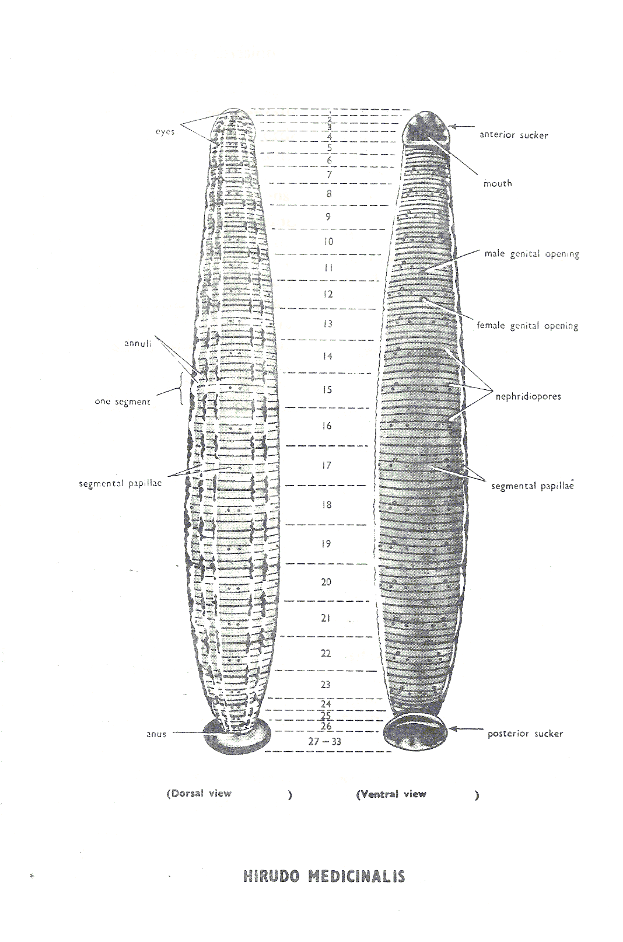

Slide 14
