Slide 1
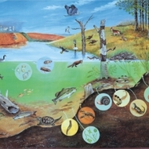
ZOO-573
Lab-1

Slide 7
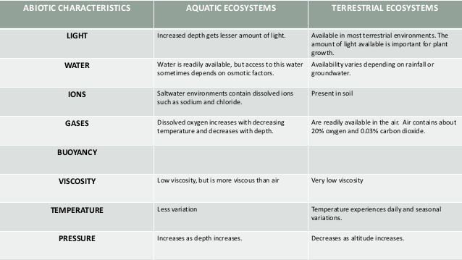

Slide 13
Questions
Make a list of terrestrial and aquatic organisms and state their trophic level in their respective ecosystem.
Draw an aquatic and terrestrial food web.

