Slide 1
Wrist & Hand Exam
Abdulaziz Alomar, MD, MSc FRCSC
Assistant Professor and consultant Orthopaedic surgeon. KKUH, KSU

Slide 2
Introduction
Very important for U/E use and ADLs, fine motor skills, hobbies, operating…
Wrist Articulations
DRUJ
Radiocarpal
Ulnocarpal / TFCC
Hand Articulations
Midcarpal, CMC, MCP, PIP, DIP, IP at thumb

Slide 3
DRUJ is uniaxial pivot with 1 degree freedom
Radius pivots around and ulna moves posteriorly in pronation, anteriorly in supination
Radiocarpal joint is biaxial ellipsoid, with articulations with scaphoid, lunate, ulna
Ulna articulates with the lunate and triquetrum with the TFCC between
TFCC is a disc-like cushion, with it 60% load on radius and 40% ulna, without 95% radius

Slide 4
Carpal stability is ligamentous
Palmar is stronger
Radioscapholunate one very important
CMC at thumb is free, sellar joint
MCP are condyloid joints with collaterals that are tight in flexion, lax in extension
IP joints are uniaxial hinge

Slide 5
Inspection & Palpation
SEADS
Disease specific findings (*many*)
Listed in later slides
Palpate all bony and soft tissue structures in an orderly fashion, volar and dorsal
Great one’s to name during an OSCE are scaphoid tubercle, lister’s tubercle, individual carpal bones, snuff box, tendon compartments, 1st CMC joint

Slide 6
Range Of Motion
Wrist
Flexion is 80 to 90 deg
60% radiocarpal, 40% intercarpal
Extension is 70 – 80 deg
66% radiocarpal, 33% intercarpal
Radial deviation 15 deg
Ulnar deviation 30 to 45 deg

Slide 7
Finger
MCP flexion 85-90 deg, extension 30-45
PIP flexion 100-115, zero extension
DIP 80-90 flexion, 20 extension
ABD 20-30, zero ADD

Slide 8
Thumb
CMC flexion 45-50 deg
MCP flexion 50-55, zero extension
IP flexion 85-90, extension 0-5
ABD 60-70, ADD 30
Opposition should be tip to tip

Slide 9
Special Signs & Tests
Signs
Cascade sign = finger convergence at scaphoid tubercle, when off, may have previous trauma
Contractures = previous lacerations, nerve injuries, compressions, instrinsic +/-, dupuytrens
Thenar wasting (median)
Hypothenar wasting (ulna)
Joint subluxations in DJD, RA, trauma, tumor

Slide 10
Vasomotor signs (hair loss, shiny, discolouration, sweat changes) in RSD, Raynauds, PVD, DM, etc
Bone hypertrophy – pagets, cancer, NF1
Nodes (Heberden’s DIP, Bouchard’s PIP)
Nail pathology (an even longer laundry list)
Swan neck = MCP and DIP flexion, PIP extension from intrinsic contracture or volar plate tear in trauma
Boutonnierres = extension of MCP and DIP, flexion of PIP, rupture central slip of extensor hood in trauma and RA

Slide 11
Ulnar drift = MCP ulnar deviation and sublixation in RA due to weak capsuloligamentous structures and bowstring effect of EDC
Trigger finger – flexor tendon thickening
Ape hand – thenar wasting allowing for thumb to line up with other digits
Benediction hand – hypothenar and intrinsic wasting on ulnar side due to compression or palsy showing flexion of 4th and 5th digits
Drop wrist – radial palsy

Slide 12
Intrinsic Plus Hand = over active lumbricals (intrinsic contractures) allowing MCP flexion and PIP extension position, due to trauma, ischemia, burns, extrinsic failure, stills dz, RA, CP, NM dz
Intrinsic Minus Hand = loss of intrinsic function and overactivity of extrinsics, MCP is hyper extended and PIP flexed, due to median/ulnar nerve palsies
Lumbrical Plus Finger = loss of FDP function, lumbrical extends PIP when desire finger flexion, often from avulsion of tendon, or rupture

Slide 13
Quadrigia – flexor lag of other digits when a shortened flexor tendon reaches it’s maximum, due to trauma, to short a repair, ischemia, the other digits will all lag behind like a roman chariot’s horses reigns
Extensor Plus – adhesions or shortening of extensor comminus before MCP, allowing MCP and PIP to flex individually, but not the same time
Mannerfelt Syndrome = FPL rupture
Vaughn-Jackson – EDM / EDC ulnar side rupture
Z thumb, MCP flexion, IP hyperextension, in RA

Slide 14
Tests for Ligaments
Finger varus/valgus testing
Thumb ulnar collateral, valgus with thumb in extension at MCP, > 30 deg + in ulnar sided tear, test again in flexion of 30 deg to isolate UCL, if +, then gamekeeper’s thumb
Reagan’s test = ballottement of lunotriquetal
Murphy’s sign = 3rd MCP at level of 2nd and 4th, should be longer, indicates lunate DL

Slide 15
Watson shift test – elbow on table, forearm pronated, fingers on wrist and thumb on volar scaphoid, bring the wrist from ulnar deviation and slight extension, to radial deviation and slight flexion, with pressure volarly, will sublux dorsally and clunk with SL tear / DISI
Piano Key = shuck of DRUJ, in pronation
Supination lift off test – try to lift against flat surface (table), pain on ulna is TFCC pathology

Slide 16
Pain with forced ulnar deviation is TFCC pathology
TILT is pain with wrist extension on the dorsal ulnar side
Grind test for MCP and CMC DJD of thumb or other joints, axial load and circumferential movements
Linscheid test – for 2nd and 3rd CMC, shucking
Bone Avulsion
Jersey finger = FDP avulsion
Mallet finger = Extensor avulsion

Slide 17
Musculotendinous Tests
Finkelstein – thumb in palm, close fist, ulnar deviation, for DeQuervains
Bunnell test – with MCP extended, examiner tries to flex PIP more, if possible, when MCP flexed, examiner should be able then to flex the PIP, cannot flex PIP when MCP extended, intrinsics are tight, when cannot in MCP flexion, capsule is tight, this is an intrinsic plus hand
FDS vs FDP individual testing

Slide 18
Neurovascular
See parts of Nerve Compression talk
Wrinkle / Shrivel test (also called… the Bernstein/Halloran test), dip in water 20 min, if no wrinkling, then it’s denervated
Allen test
2 point discrimination (2-4 mm, some say 6)
Individual muscles and myotomes
Dermatomes – C6 thumb, C7 middle, C8 pinky
Others – grip, pinch strength

Slide 19
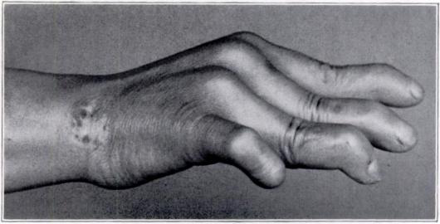
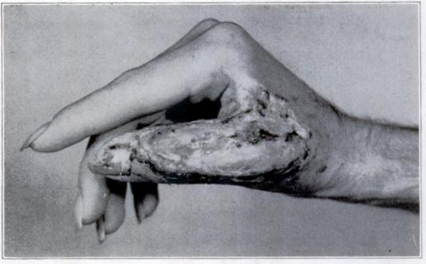
Intrinsic
Plus Hand
- leprosy
- trauma

Slide 20
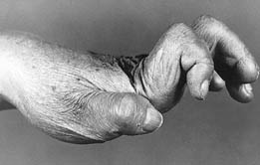
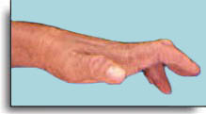
Intrinsic Minus
Hands

Slide 21
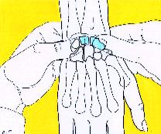
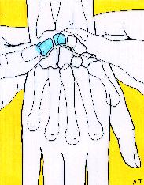
Ballottement
Scapholuate
Lunotriquetal (Reagan)

Slide 22
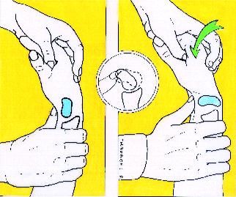
WATSON SHIFT TEST

Slide 23
Rheumatoid Hand
Ulnar drift at MCPs and dorsally subluxed ulna from DRUJ
Ulna sublux will lead to Vaughn-Jackson in RA

Slide 24
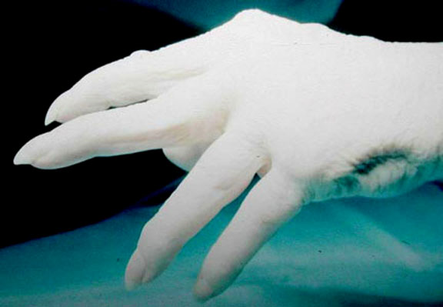
Vaughn Jackson is disruption of extensor digiti minimi (EDM) and ulnar sided EDC

Slide 25
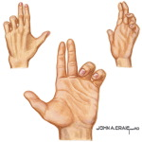
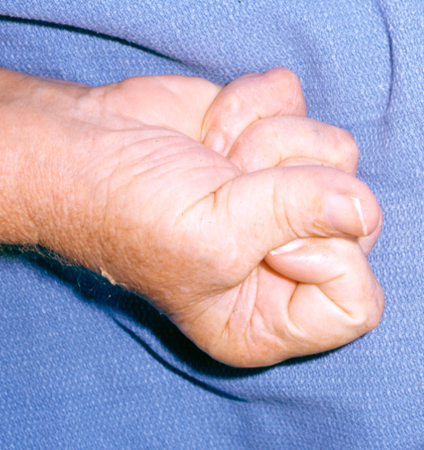
Benediction Hand
Mannerfelt Syndrome

Slide 26
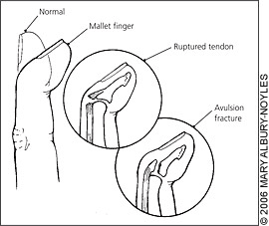
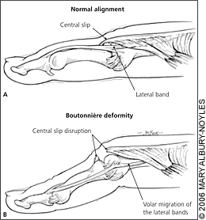
Mallet Finger
Boutonniere’s Deformity

Slide 27
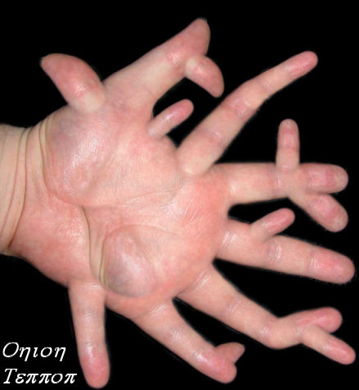
Diagnosis???????

