Slide 1
Welcome To The New Semester

Slide 2
Course Title: Pharmacology for Nursing
Course Code: NURS 226
Program: Bachelor of Science in Nursing
Department: Medical Surgical Nursing
Instructor: Prof. Nikhat Siddiqi
Office: Room 32; Building 12
Email: nikhat@ksu.edu.sa

Slide 3
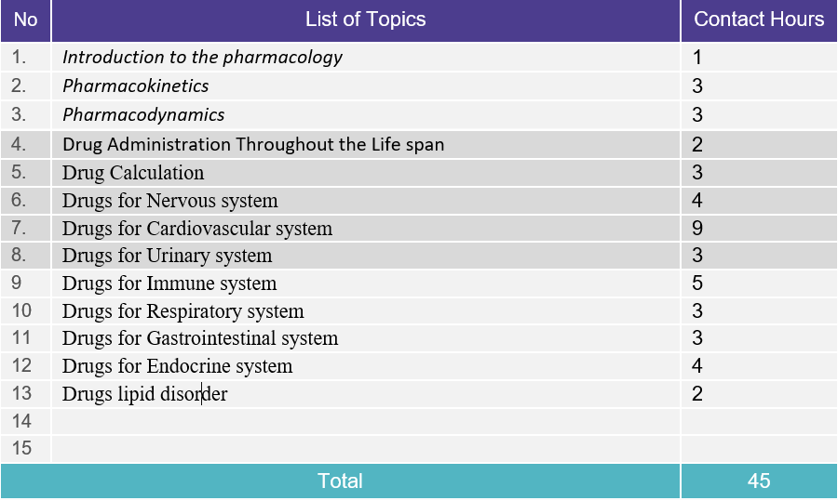

Slide 4
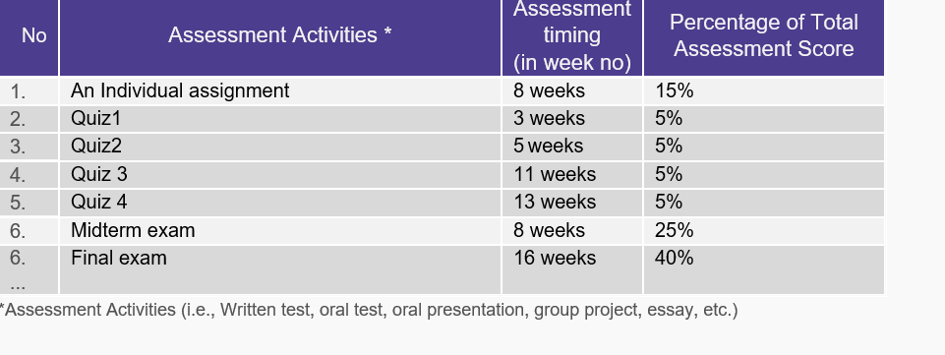
Students Assessment Activities

Slide 5
Time table for Exam and Quizzes
Quiz 1-29/30 January 2025
Quiz 2- 12/13 February 2025
Mid term 23-27 February 2025 (Submit assignment)
Quiz 3 – 12/13 March 2025
Quiz 4- 16/17 April 2025

Slide 6



Slide 7


