Slide 1
Web Hosting Domain names

Slide 2
Agenda
Objective is to have a practical understanding of web hosting.
Introduction
Web hosting basics
Customer experience
Summary

Slide 3
Introduction
Individuals or small businesses purchase web hosting because they do not have the funds or expertise to host their websites and applications on their own.
Web hosting is a service mainly for the purpose of:
Registering a domain name
Building a website
Using email addresses with a customer’s own domain name
Web hosting consists of the following:
Domain names
DNS
Web server space
E-mail service
Customer support
Everything else

Slide 4
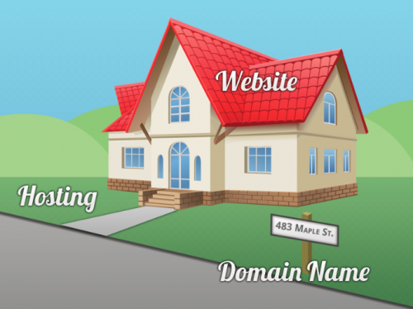
Are domain name and Web Hosting the Same?
Often, internet newbies cannot tell the difference between a domain name and web hosting.
Domain Name – The Address
Hosting – The Land
Website – The House
You get a domain name, then
you get hosting, then you build
a website/create email addresses

Slide 5
1. Getting a Domain Name
Once you decide for a name of your website, or a domain name for your email addresses to use, you need to ‘register’ that domain name with a company licensed to register domains. These kinds of companies are called ‘Registrars

Slide 6
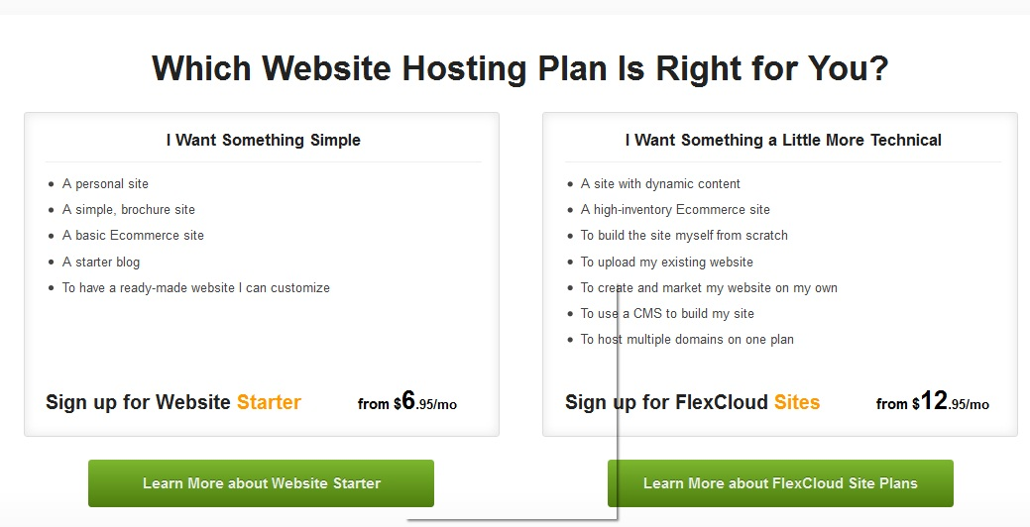
2. Getting Hosting for The Domain Name
After you register a domain, you can now buy a web hosting plan from a Hosting company like Hostway and can then put you website(house) and email to ‘live’ at the hosting company (land).

Slide 7
3. How do the Domain Name and Hosting Connect?
If I got the domain name and hosting plan from the same company they automatically connect. If they were purchased from different companies, I need to point the domain name to the web hosting company.
WHY?
Because my website and email is ‘HOSTED’ at the hosting company
How Do I Point My Domain Name to My Web Hosting?
After registering your domain name, if you choose to host with a different company, simply contact the Hosting company and ask for their hosting ‘Nameservers’. Then type that information and save it into where you registered your domain and they become automatically connected. Accommodating Changes of Nameserver requests from clients MUST include informing them that hosting with us is not cancelled.

Slide 8
Domain name registration
Absolute first web hosting requirement. How is anyone going to find the website without a domain name?
Domains names have a format of [name][dot][TLD] like “domain.com”
Numerous generic top-level domain (gTLDs) and country code top-level domain (ccTLDs)
.com .biz .us
.net .co .uk
.org .info .sa

Slide 9
DNS – Domain Name System
Question
Computers speak numbers. Humans speak words. Humans communicate with computers. How?
For example, when you type www.google.com in your browser, how does your computer know what that means?
Answer
The domain name www.google.com is translated into numbers.
DNS
Internet Users
Web server
www.google.com
216.185.130.30

Slide 10
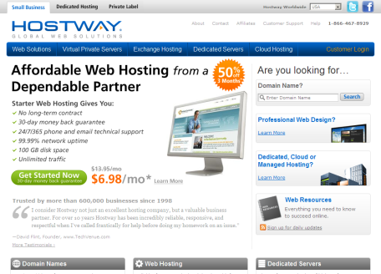
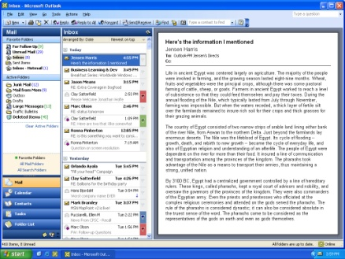
Web hosting
Web servers display (or serve) web
pages and any other file type
Email servers send and receive email
for customers using their domain
name
Servers are computers with special
software installed
Web server
Email server

Slide 11
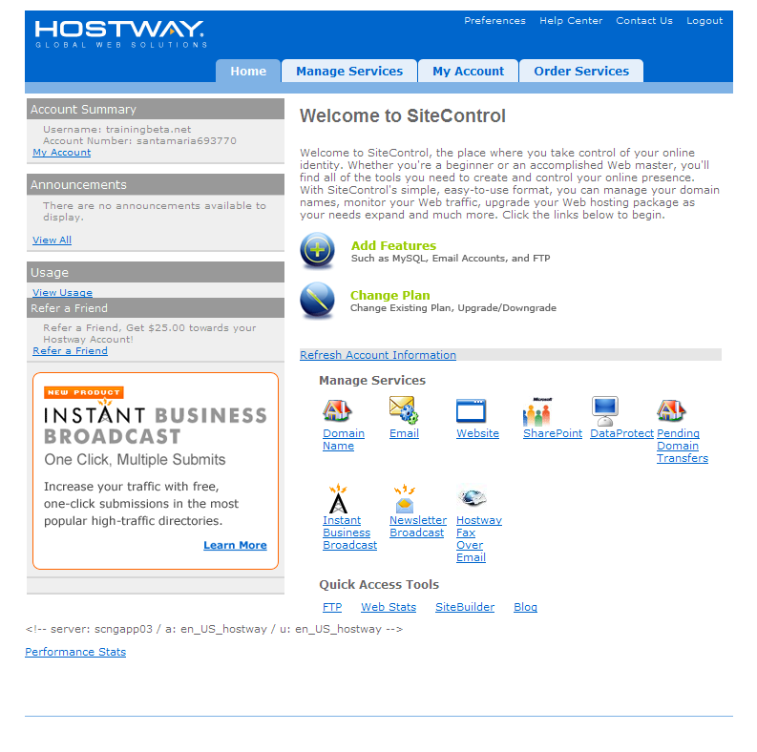
SiteControl
Customers manage products and billing
through SiteControl
Products included in customer’s web hosting
plan can be activated and optional add-ons
can be purchased through SiteControl
Majority of changes can be performed
in SiteControl rather than calling Billing or
Technical Support

Slide 12
Customer support
Control panel such as SiteControl and Cpanl are powerful tools to manage a web hosting account, but customers like to speak with humans. Strange, right?
Sales Team
Billing Team
Technical Support is available 24/7

Slide 13
Summary
Web hosting is a service that broadly consists of the following:
Domain name
DNS
Web hosting
E-mail
Customer support

Slide 14
What is the first step to getting a website online?
Getting a hosting plan from a hosting provider
Securing a domain name
Hiring a web designer, or learning HTML
That’s not it – a hosting plan without a domain name won’t do you much good
That’s correct – all the other webhosting components won’t work without a domain
Not true – people can build a website with no programming knowledge, but it’s not worth much if you don’t have a domain name
Next

Slide 15
What is the company licensed to sell domain names called?
A Registrar
A Web hoster
Domain broker
Correct!
That’s not it. Try again!
That’s not it. Try again!
Next

Slide 16
Can a person have their domain name registered with a given company and a hosting plan from another company?
YES
NO
In that case, how will the domain name and hosting plan connect?
Not true –
They will connect automatically over the Internet.
They will connect via the domain’s nameservers
They don’t need to connect as there can be only be 1 domain of a kind
That’s not it.
Correct!
That’s not it.
Next

Slide 17
When you type in a domain name in your browser, how does the browser know where exactly to go?
It doesn’t, but all computers have a large database of domains and IP addresses they point to.
The bowser works the domain name system and gets the domain name translated into an IP address.
Negative – it’s not possible to maintain, or distribute such a database to all computers around the world.
Correct – each browser and operating system are equipped with the tools necessary to do this.
End

