Slide 1

O₂
O₂
O₂
Haemoglobin

Slide 2
Oxygen O₂
98% travels in oxyhaemoglobin (in red blood cells)
2% is dissolved in plasma (compared to carbon dioxide, oxygen is relatively insoluble in plasma)
O₂ is not very soluble – thus needs a carrier !

Slide 3
Oxygen-Binding Proteins
Myoglobin, Haemoglobin, Cytochromes bind O₂
Oxygen is transported from lungs to various tissues via blood in association with haemoglobin
In muscle, haemoglobin gives up O₂ to myoglobin which has a higher affinity for O₂ than heamoglobin.
Cytochromes participate in redox reactions and are components of the electron transport chain

Slide 4
Haemoglobin
Haemoglobin (Hb or Hgb) is the primary constituent of RBCs
This molecule gives the characteristic red colour to erythrocytes and to the blood
The primary function of haemoglobin is to transport oxygen (O₂) from the lungs to the tissue cells of the body and to carry carbon dioxide (CO₂)

Slide 5
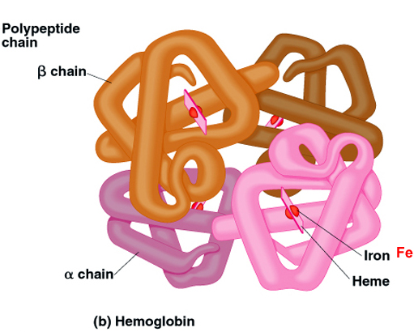
Structure of Hemoglobin
Hemoglobin (tetramer) is composed of the protein globin, made up of two alpha chains (141 a.a) and two beta chains (146 a.a), each bound to a heme group
Alpha and beta are similar but not identical in a.a. sequence
Each heme group bears an atom of iron, which can bind to one oxygen molecule
Each hemoglobin molecule can transport 4 molecules of oxygen

Slide 6
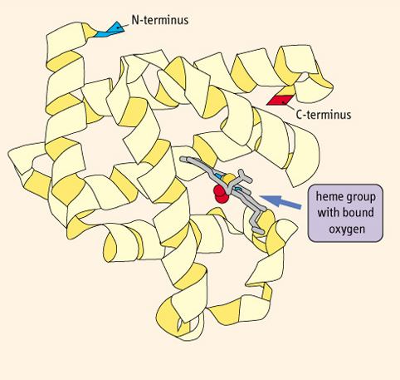
Myoglobin
Abundant in skeletal muscles
Consists of one heme and globin consists of single polypeptide chain (monomeric: 153 aa; 17,200 MW)

Slide 7
Normal haemoglobin types
1. Hb A:
    Makes up about 95%-98% of Hb found in adults;
    Contains two alpha (α) protein chains and two beta (β) protein chains
2. Hb A2:
    Makes up about 2%-3% of Hb;
    Has two alpha (α) and two delta (δ) protein chains

Slide 8
Normal haemoglobin types (cont.)
3. Hb F:
    Makes up to 2% of Hb found in adults;
    Has two alpha (α) and two gamma (γ) protein chains;
    The primary haemoglobin produced by the fetus during pregnancy, its production usually falls to a low level shortly after birth
    Foetal Hb has a higher affinity for oxygen than adult haemoglobin.
    This means that the fetus can receive oxygen from the mother across the placenta.

Slide 9
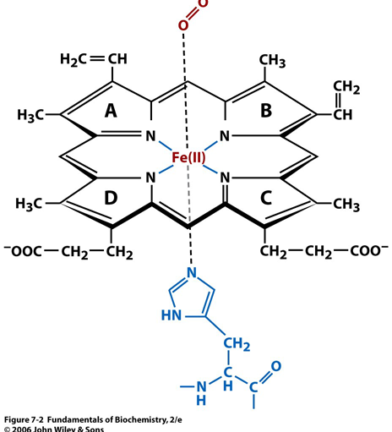
The Prosthetic Heme Group
Responsible for the O₂⁻binding capacity of Hb.
Consists of an iron (Fe) ion held in a heterocyclic ring, known as a porphyrin
The protoporphyrin made up of four pyrrole rings linked by methane bridges

Slide 10
The Prosthetic Heme Group (cont.)
A Fe atom in its ferrous state (Fe⁺²) is at the center of protoporphyrin.
Fe⁺² has 6 coordination bonds
  4 bonded to the 4 pyrrole N atoms (The nucleophilic N prevent oxidation of Fe⁺²)

Slide 11
The Prosthetic Heme Group (cont.)
The 2 additional binding sites are one on either side of the heme plane:
  One of these is occupied by the imidazole group of His
  The second site can be reversibly occupied by O₂

Slide 12
Different forms of Hemoglobin
When Hb is bound to O₂, it is called oxyHb. This is the relaxed (R ) state
The form with a vacant O₂ binding site is called deoxyHb and corresponds to the tense (T) state
If iron is in the oxidized state as Fe⁺³, it is unable to bind O₂

Slide 13
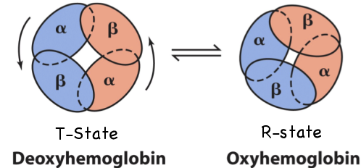
Different forms of Hemoglobin (cont.)
R state has a higher affinity for O₂
T state is more stable in the absence of O₂
Conformational change
The subunits slide and rotate making the central cavity smaller

Slide 14
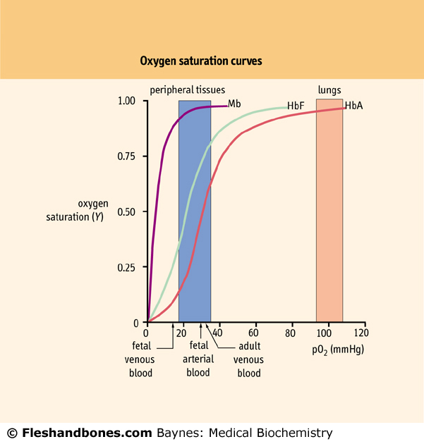
O₂-binding kinetics
O₂-binding curves show Hb saturation as a function of the partial pressure for O₂
4 subunits, so 4O₂-binding sites: If one heme group has a bound O₂, it increases the ability of the other heme groups to bind O₂ (last O₂ affinity is 300 times greater than its affinity for 1st O₂)
Cooperative binding
Segmoidal curve

Slide 15
O₂-binding kinetics (cont.)
Myoglobin has a higher O₂ affinity than Hb
Myoglobin O₂ dissociation curve is hyperbolic.

Slide 16
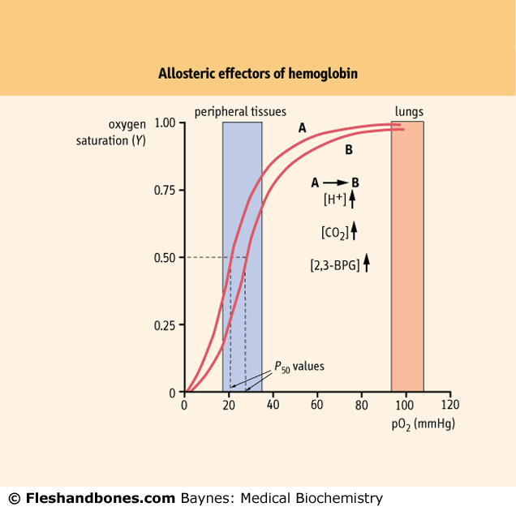
A number of factors reduce the affinity of Hb for O₂ so that more O₂ is released to tissues(****)
As the curve shifts from A to B (to right) the affinity for O₂ decreases.
H⁺, PCO₂, and BPG modify the structure of Hb and alter its affinity for oxygen:
  Increases of these factors:
  Decrease hemoglobin’s affinity for oxygen
  Enhance oxygen unloading from the blood
    Decreases act in the opposite manner.

Slide 17
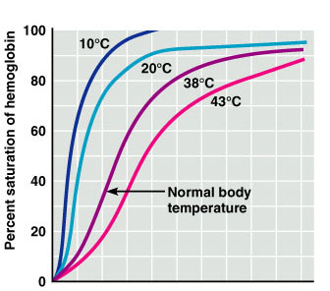
A number of factors reduce the affinity of Hb for O₂ so that more O₂ is released to tissues (cont.)
Increasing temperature also shift the curve to the right

Slide 18
Transport of CO₂
CO₂ in blood present in 3 forms:
                7% dissolved in plasma
                70% travels as HCO₃⁻ ions (hydrogencarbonate ions)
                23% travels as carboamino compounds
In red blood cells
CO₂ = waste product of cellular metabolism (the end-product)

Slide 19
CO₂ bound as carbamate
CO₂ reacts directly with Hb to form the carboaminoHb; reversible reaction
Small quantity of CO₂ reacts with plasma proteins - less significant (quantity of proteins 1/4th that of Hb)
H
H
R N
+ CO₂
R N
+ H⁺
H
COO⁻
Protein
Carboamino compound

Slide 20
CO₂ bound as HCO₃
Dissolved CO₂ in blood reacts with water to form Carbonic Acid.
CO₂ + H₂O ⇔ H₂CO₃ ⇔ H⁺ + HCO₃⁻
Carbonic Anhydrase present inside RBCs (but not plasma) catalyzes this reaction
Carbonic acid rapidly dissociates into ion H⁺ and bicarbonate ion.

Slide 21
Bohr Shift
The relationship between the binding of O₂, H⁺, CO₂ to hemoglobin (allosteric site), is knowing as Bohr effect
Tissues
With high level of activity
CO₂ enters the blood
H₂CO₃
HCO⁻₃
Leaves the red blood cell
acidification in the red blood cell
↓ Hb affinity with O₂
H⁺
Trapped in cytoplasm
Bohr Shift
Release of O₂

Slide 22
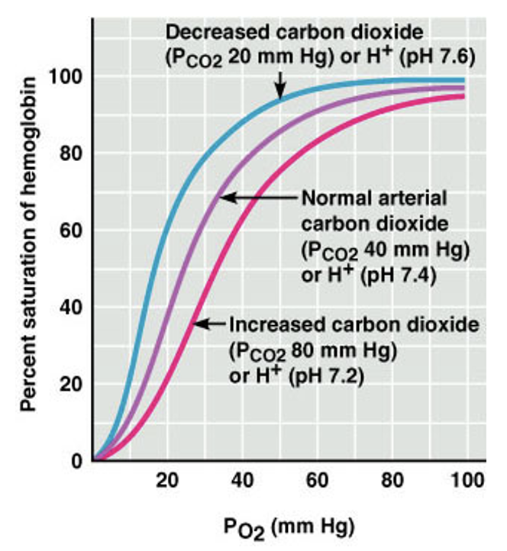
Bohr Effect or Bohr Shift
The dissociation curve moves to the right at higher concentration of carbon dioxide. This shows that carbon dioxide lowers the affinity of Hb for oxygen.
Hb tends to give up O₂ in area of high CO₂ such as the respiring tissues that need it most.

Slide 23
Chloride shift
The build up of hydrogen carbonate ions causes them to diffuse out of the RBC leaving the inside of the RBC positively charged
In order to balance this electric charge chloride ions diffuse into the RBCs from the plasma → this is known as the chloride shift

Slide 24
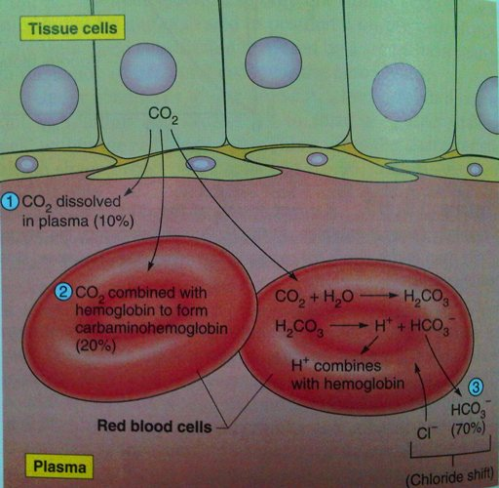
Carbon dioxide transport and the chloride shift

Slide 25
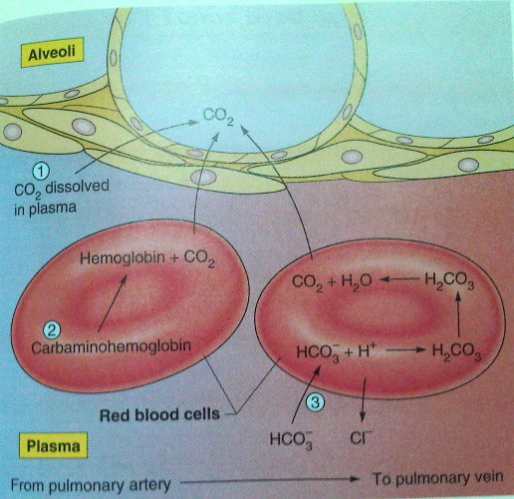
The reverse chloride shift in the lungs

Slide 26
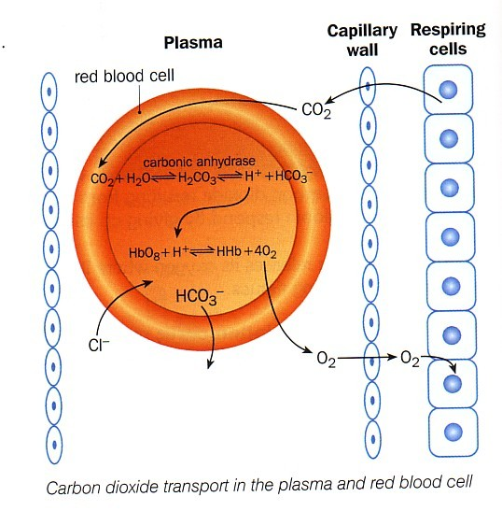
Chloride shift

Slide 27
When blood gets to the lungs, all the reactions are reversed
The hydrogen carbonate and hydrogen ions recombine releasing CO₂
The chloride shift is reversed
Carbamino-haemoglobin breaks down to release CO₂

Slide 28
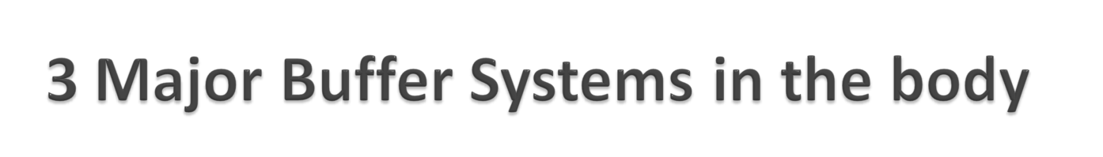
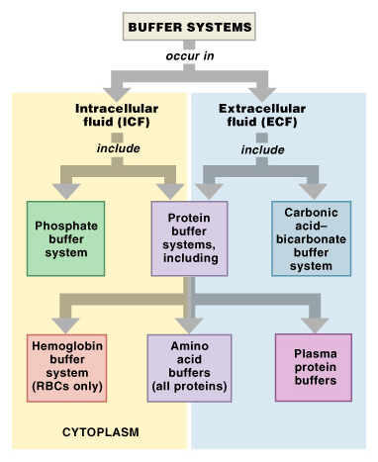
Figure 27–7

Slide 29
Hemoglobin as a buffer
Hemoglobin acts as a buffer in blood by picking up CO₂ or H⁺
In tissues:
Hemoglobin becomes more basic when it is deoxygenated, i.e. it binds H⁺ more tightly
In the lung:
Hemoglobin is oxygenated, becomes more acidic, (i.e. it is a more powerful H⁺ donor), and releases its H⁺

Slide 30
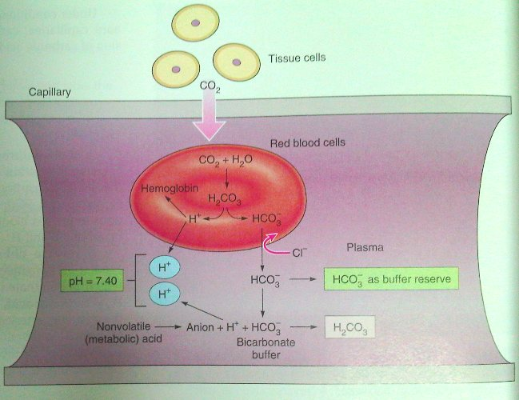
The effect of bicarbonate on blood pH

Slide 31
Catabolism of hemoglobin
Senescent
RBCs
Stercobilin
excreted in feces
Urobilin
excreted in urine
Hemoglobin
Globin
INTESTINE
Heme
Glucuronic acid is removed and bilirubin is converted to urobilinogen which is then oxidized by intestinal bacteria
KIDNEY
O₂
reabsorbed
into blood (Portion of urobilinogen)
Heme oxygenase
CO
Biliverdin
via bile duct to intestine
NADPH
Biliverdin
reductase
Bilirubin diglucuronide
(water-soluble)
NADP⁺
2 UDP-glucuronic acid
Bilirubin
(water-insoluble)
Bilirubin
(water-insoluble)
LIVER
via blood to the liver (complexed with albumin)

Slide 32
Conjugated vs unconjugated bilirubin
Why is this important?
Unconjugated bilirubin
Toxic to tissues
Not soluble in aqueous solutions
Tightly complexed to albumin
Cannot be excreted in the urine even when blood levels are high
Conjugated bilirubin
Water-soluble
Non-toxic
Loosely bound to albumin
Excreted in urine (bilirubinuria)

Slide 33

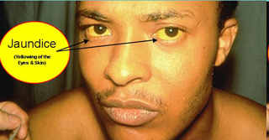
What is Jaundice?
Jaundice describes the yellowing of sclera, skin and mucosal membranes due to increased circulating bilirubin in the plasma
This becomes clinically evident when serum bilirubin reaches about 80-100 μmol/l.

Slide 34
Figure : Examples of hyperbilirubinemia
A. Hemolytic anemia
B. Hepatitis
C. Biliary duct stone
excess
hemolysis
⬆ unconjugated bilirubin
(in blood)
↑ conjugated bilirubin
(released to bile duct)
⬆ unconjugated bilirubin
(in blood)
⬇ conjugated bilirubin secreted by liver into bile
↑ unconjugated bilirubin
(in blood)
⬆ conjugated bilirubin
(in blood)
Hemolytic Jaundice
Hepatic jaundice
Obstructive jaundice

Slide 35
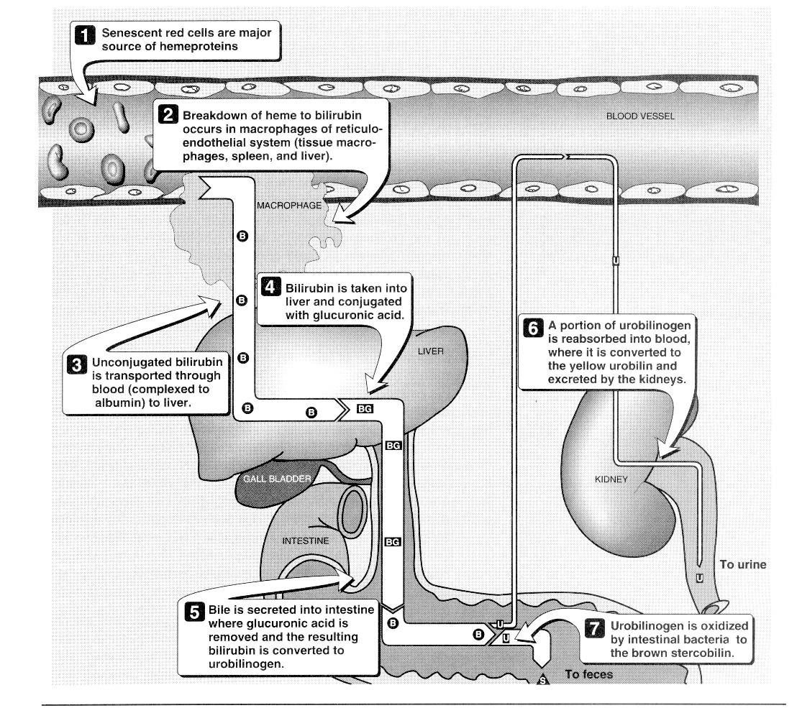

Slide 36
Once RBC’s are hemolysed
in liver, spleen, bone marrow
Hemoglobin
Globin
AAs
Reused again
Heme
Iron (Fe2+)
Stored and reused in biosynthesis
Protoporphyrin
Not reused
Biliverdin
NADPH
Biliverdin
reductase
NADP⁺
Bilirubin
(yellow water
-insoluble pigment)
Bilirubin-albumin
complex
liver

