Slide 1
Erythrocytes (RBC)

Slide 2
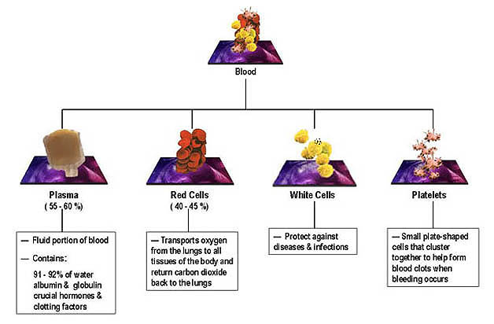
Two major components of blood: liquid phase and formed elements

Slide 3
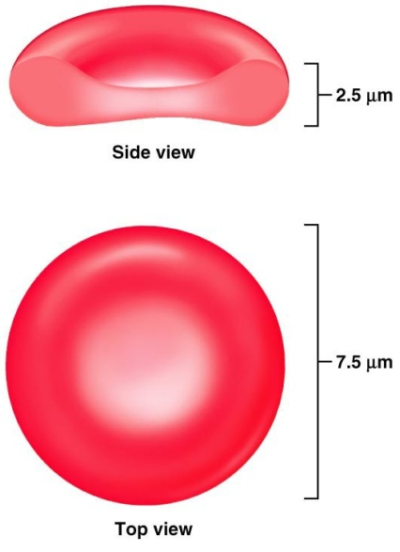
Erythrocyte Structure
RBCs are flattened biconcave discs
Flexible structure
Shape provides increased surface area for diffusion
7.5 mm diameter, 2.5 mm thick
Life cycle – 120 days
Lack a nucleus and other organelles.
33% of weight is hemoglobin molecules (Each RBC contains 280 million hemoglobins).
Other proteins include antioxidants and those to maintain RBC shape (spectrin)

Slide 4
Erythrocyte Function
Erythrocytes are dedicated to respiratory gas transport
(transport O₂ to tissues and CO₂ from tissues)
Hemoglobin reversibly binds with oxygen and most oxygen in the blood is bound to hemoglobin

Slide 5
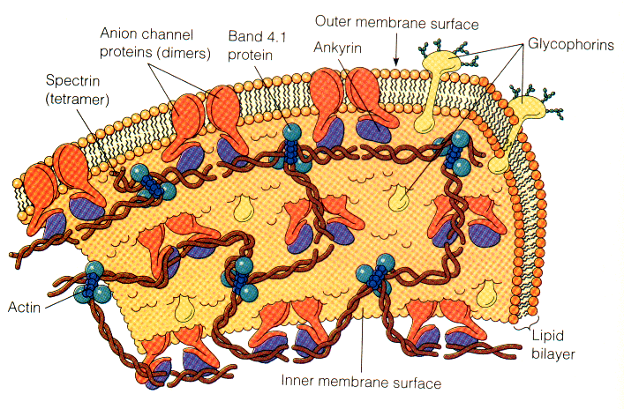
RBC’s Membrane

Slide 6
RBC’s Membrane characterizations
Is very elastic
Is a semi-permeable lipid bi-layer supported by a mesh-like cytoskeleton
Is a three-layer structure:
An outer hydrophilic portion: glycolipid, glycoprotein and protein
A central hydrophobic layer: protein, cholesterol and PL
An inner hydrophilic layer: containing protein

Slide 7
Components of RBC membrane
Protein 50%
Phospholipid 20%
Cholesterol 20%
Carbohydrate 10%

Slide 8
Components of RBC membrane (cont.)
Lipid bilayer
Integral membrane protein
Membrane cytoskeleton

Slide 9
Lipid bilayer
Components of RBC membrane (cont.)
Phospholipid
Cholesterol
Glycolipid
Integral protein
Peripheral protein.

Slide 10
Components of RBC membrane (cont.)
Several proteins are present in the RBC’s
Peripheral proteins:
Limited to cytoplasmic surface of membrane and forms the RBC cytoskeleton.
Integral membrane proteins:
Extend from outer surface and transverse entire membrane to inner surface

Slide 11
Components of RBC membrane (cont.)
Peripheral Proteins | Integral Proteins
Tropomyosin | Glycophorin
Spectrin | Band 3 Protein
Actin
Protein 4.1
Ankrynin
Protein 4.2

Slide 12
Peripheral Proteins
Names | Definition | Function
Spectrin | cytoskeletal protein that lines the intracellular side of the plasma membrane | Responsible for biconcave shape of RBC
Actin | Abundant protein in cell membrane | participates in more proteinprotein interactions
Ankyrin | are a family of adaptor protein | Interacts with band 3 protein and spectrin to achieve linkage between bilayer and skeleton.
Protein 4.1 | is a major structural element | Stabilises actin-spectrin interactions
Protein 4.2 | is an ATP-binding protein | regulate the association of protein 3 with ankyrin.
Trophomyosin | Heterodimeric protein | Stabilizing the actin filaments.

Slide 13
Integral Proteins
Names | Definition | Function
Glycophorin | Sialic acid rich glycoproteins. | imparts a negative charge to the cell, reducing interaction with another cells/ endothelium
Band 3 protein | Anion exchanger 1. | Exchanges bicarbonate for chloride (chlorine shift).

Slide 14
Components of RBC membrane (cont.)
Cytoskeleton:
Network of proteins on the inner surface of the plasma membrane, called the peripheral membrane proteins
Provides rigid support and stability to lipid bilayer
Responsible for maintaining shape and deformability of RBC .
(Go back to slide 5)

Slide 15
Peripheral Membrane Proteins
1. Spectrin :
The most abundant peripheral protein.
Flexible, rod like molecule composed of an alpha helix of two polypeptide chains.
Is an important factor in RBC membrane integrity because it binds with other peripheral proteins to form the skeletal network of microfilaments on the inner surface of RBC membrane.
Microfilaments strengthen membrane, protecting cell from being broken.
Controls biconcave shape and deformability of cell.

Slide 16
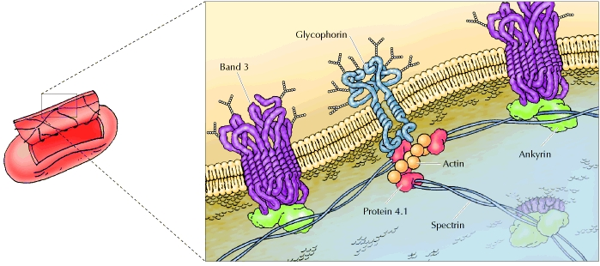
Peripheral Membrane Proteins

Slide 17
Peripheral Membrane Proteins
2. Ankyrin :
Primarily anchors lipid bilayer to membrane skeleton
3. Protein 4.1:
May link the cytoskeleton to the membrane by means of its associations with glycophorin
4. Actin:
Responsible for contraction and relaxation of membrane

Slide 18
Integral Membrane Proteins:
Glycophorin:
Is the principle RBC glycoprotein. Spans entire thickness of lipid bilayer and appears on external surface of RBC membrane
Three types of glycophorins identified: A, B, and C
All glycophorins carry RBC antigens and are receptors or transport proteins

Slide 19
Red Cell Membrane Lipids
Erythrocyte membrane lipid consists of bilayer of phospholipids intermingled with molecules of cholesterol in nearly equal amounts. Also, small amounts of free fatty acids and glycolipids.
Different types of phospholipids are found on the inside layer than on the outside layer.
Abnormalities in the PL may result in decreased deformability and decreased red cell survival.

Slide 20
Red Cell Membrane Lipids (cont.)
Most of glycolipids are located in outer half of lipid bilayer and interact with glycoproteins to form many of RBC antigens
Cholesterol equally distributed on both sides of lipid bilayer (25% of RBC membrane lipid content)
RBC membrane cholesterol is in continual exchange with plasma cholesterol

Slide 21
Red Cell Membrane Lipids (cont.)
Cholesterol plays important role in regulating membrane fluidity and permeability
Accumulation of cholesterol results in decreased deformability and may lead to hemolytic anemia

Slide 22
Red Cell Membrane Carbohydrates
They occur only on the external surface of the red cell
They occur as glycoproteins or glycolipids
The antigens of ABO blood groups are examples of carbohydrate membranes

Slide 23
Abnormalities of the RBC membrane
1-Hereditary Spherocytosis (HS):
The most common hereditary haemolytic anemia in north Europeans, autosomal dominant.
Defective or absent of Spectrin\Ankrin molecule which involved in the vertical interactions between the membrane skeleton and lipid bilayer of the red cell.
Leads to loss of RBC membrane, decreased deformability of cell, spherocytosis.
Increased osmotic fragility

Slide 24
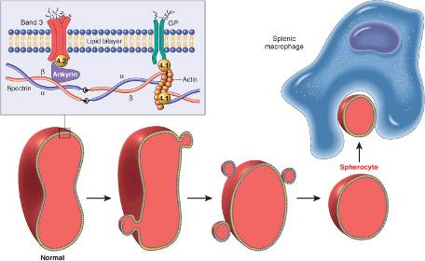
Hereditary Spherocytosis
Normal biconcave red cell loses membrane fragments
and adopts a spherical shape
Inflexible cells are trapped in the spleen cords, phagocytosed by macrophages

Slide 25
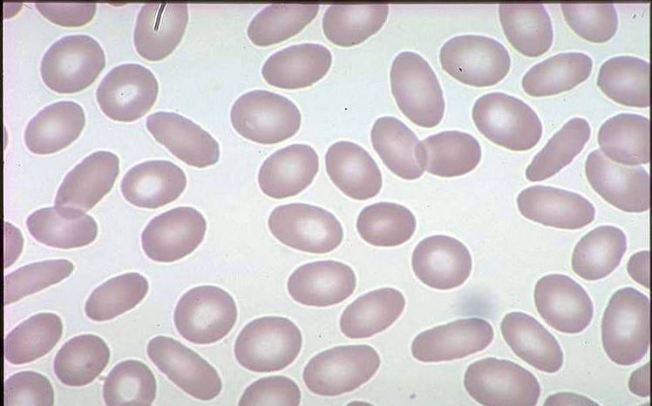
Abnormalties of the RBC’s membrane (cont)
2. Hereditary Elliptocytosis:
The most common hereditary haemolytic anemia in South-East Asian ovalocytosis.
Hereditary disorder of the RBCs (autosomal dominant trait)
RBCs assume an elliptical shape, rather than the typical round shape.

Slide 26
Abnormalties of the RBC’s membrane (cont)
2. Hereditary Elliptocytosis:
Spectrin abnormality or deficiency of protein 4.1
RBC hemolysis occurs in the spleen, thus splenectomy corrects the hemolysis, but not the RBC membrane defect

Slide 27
Erythrocyte Sedimentation Rate (ESR)
Nonspecific test for inflammatory process
Anticoagulated blood in calibrated tube; rate of sedimentation of RBCs in 1h
Normal: <15mm/h male;<20mm/h female; add 10 past age 60
X

Slide 28
Erythrocyte Sedimentation Rate (ESR)
Any condition that elevates fibrinogen should elevate ESR.
Dramatically ↑ with infection, malignancy, connective tissue disease. Also ↑ with pregnancy, inflammatory disease, and anemia.
A ↓ ESR is associated with blood diseases in which red blood cells have an irregular or smaller shape that causes slower settling ie: sickle cell anemia

Slide 29
Erythropoiesis
The term erythropoiesis (erythro = RBC, and poiesis = to make) is used to describe the process of RBC formation or production.
In humans, erythropoiesis occurs almost exclusively in the red bone marrow

Slide 30
Erythropoiesis
A hemocytoblast is transformed into a committed cell called the proerythroblast
Proerythroblasts develop into early erythroblasts
The developmental pathway consists of three phases
Phase 1: ribosome synthesis in early erythroblasts
Phase 2: hemoglobin accumulation in late erythroblasts and normoblasts
Phase 3: ejection of the nucleus from normoblasts and formation of reticulocytes
Reticulocytes then become mature erythrocytes

Slide 31
Role of B12 and Folic acid in the maturation of RBC
Essential for DNA synthesis
Deficiency leads to delay in maturation of nucleus

Slide 32
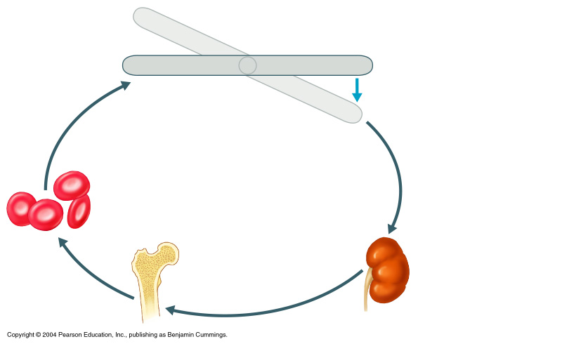
Erythropoietin Mechanism
Imbalance
Start:
Normal blood oxygen levels
Stimulus: Hypoxia /
decreased availability of O₂ to blood/or increased tissue demands for O₂
Imbalance
Increases O₂-carrying ability of blood
Reduces O₂ levels in blood
Enhanced erythropoiesis increases RBC count
Erythropoietin stimulates red bone marrow
Kidney (and liver to a smaller extent) releases erythropoietin

Slide 33
Formation of haemoglobin
Begins in proerythroblast.
Starting molecule: succinyl CoA with glycine forms a pyrrole.
Four pyrroles form protoporphyrin IX
Protoporphyrin IX combines with iron to form haem.
Each haem combines with globin to form haemoglobin.

Slide 34
Heme biosynthesis

Slide 35
Once RBCs are hemolyzed
in liver, spleen, bone marrow
Hemoglobin is phagocytosed by macrophages in spleen, liver and bone marrow
Globin
AAs
Reused again
Heme
Iron (Fe²⁺)
Is released into the blood, stored and reused in biosynthesis
Protoporphyrin
Not reused
Biliverdin
NADPH
Biliverdin
reductase
NADP⁺
Bilirubin
(yellow water
-insoluble pigment)
Bilirubin-albumin
complex
liver

Slide 36
What Is Hemolysis?
Hemolysis is the breakage of the RBC’s membrane, causing the release of the hemoglobin and other internal components into the surrounding fluid.
Hemolysis is visually detected by showing a pink to red tinge in serum or plasma (The Hb of the lysed cells dissolves in plasma and makes it red)
In-vivo hemolysis may be due to pathological conditions, such as autoimmune hemolytic anemia or transfusion, drugs and infections…

Slide 37
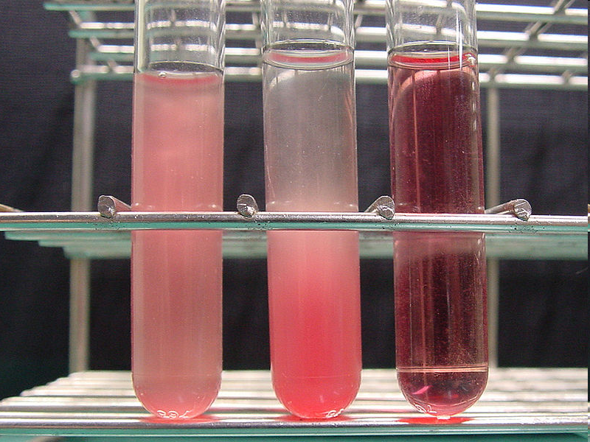
What Is Hemolysis?
(a) without hemolysis: red blood cell suspension seems red and opaque.
(b) without hemolysis: RBCs sedimented spontaneously for 60 min. Note that the supernatant is not colored.
(c) hemolysis: RBC suspension
become transparent by
hemolysis.
(a)
(b)
(c)

Slide 38
RBC Metabolic Pathways
No organelle – no mitochondria
Generate energy through anaerobic breakdown of glucose (2ATP+lactate)
ATP is used as substrate for Na⁺, K⁺ or the Ca²⁺ dependant ATPases that maintain intracellular concentrations of these cations
The glucose uptake by RBC’s through high affinity glucose transporter is independent on insulin

Slide 39
RBC Metabolic Pathways (Cont.)
Four pathways involved in RBC metabolism:
Pentose Phosphate Pathway
Glycolysis pathway
Methemoglobin reductase pathway
2,3 BPG pathway is unique for RBC

Slide 40
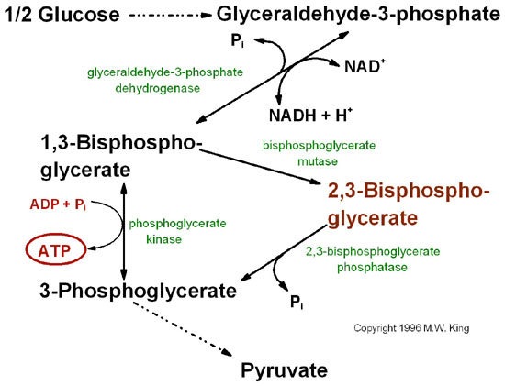
In red cells 1,3 BPG is converted to 2,3BPG which unites with
oxy Hb and helps release of oxygen at tissues.
The rate of synthesis and hydrolysis of 2,3 DPG are very sensitive to pH: a fall of pH inhibits mutase and stimulates phosphatase causing decrease of 2,3 DPG
2,3 BPG pathway
Notes:
Bohr effect
2,3-Bisphosphoglycerate (2,3-BPG; 2,3-diphosphoglycerate) is a highly anionic compound that is concentrated in the concave center of red blood cells and binds to hemoglobin, which makes it possible to transport carbon dioxide in deoxyhemoglobin and stabilizes the union, causing oxygen to become reduced. For oxygen to become attached, the bond between 2,3-BPG and CO₂ must be broken.
The heart constantly contracts, rapidly metabolizes, and has a constant need for oxygen. Heart functions also generate H⁺ ions and CO₂, which are heterotropic effectors of hemoglobin to lower its pH from 7.4 to 7.2, involved in the increased release of oxygen. Thus, oxygen release from hemoglobin is regulated by the acidic environment in the presence of H⁺ ions and CO₂. Hydrogen and CO₂bind to hemoglobin and are also transported freely in blood as HCO₃(bicarbonate) and are carried in the blood back to the lungs as part of the cycle around the body. The hydrogen ions and CO₂ are released from the hemoglobin and oxygen binds.

Slide 41
Metabolism of glutathione
RBC takes up glutathione from circulation.
Liver produces glutathione and releases into circulation.
Glutathione keeps -SH groups of membrane lipids and proteins in reduced form.
RBC may produce some amount of glutathione.

Slide 42
0₂
Pentose Phosphate Pathway
Aerobic respiration
Drugs, fava beans
When erythrocytes are exposed to chemicals that generate high levels of superoxide radicals, GSH (Reduced Glutathione) is required to reduce these damaging compounds
Glutathione Peroxidase catalyzes degradation of organic hydroperoxides by reduction, as two glutathione molecules are oxidized to a disulfide GSSG
The PPP is responsible for maintaining high levels of NADPH in red blood cells for use as a reductant in the glutathione reductase reaction.
0₂⁻
Superoxide radicals
Detoxification
H₂O₂
Hydrogen peroxide
glutathione
peroxidase
2 H₂O
glutathione
reductase
GSSG
The major role of PPP in RBCs is the production of NADPH which protect these cells from oxidative damage by providing GSH for removal of H₂O₂
2 GSH
NADP⁺
NADPH + H⁺
pentose pathway
Notes:
42

Slide 43
Methemoglobin Reductase Pathway
Important in maintaining heme iron in the reduced or ferrous functional state
The metHbFe³⁺ is reduced to deoxyHbFe²⁺ by the flavoprotein, MetHb reductase (MW 185Kda) (NADH cytochrome b₅ reductase).
NADH+H⁺
2 cytob₅Fe³⁺
2 Hb Fe²⁺
(Glycolysis)
NAD⁺
2 cytob₅Fe²⁺
2 met Hb Fe³⁺

Slide 44
Antioxidant enzymes
Superoxide dismutase, catalase, and peroxidase are antioxidant enzymes present in RBC.
They protect erythrocyte membrane lipids and proteins from the deleterious effect of Reactive oxygen species (ROS).

Slide 45
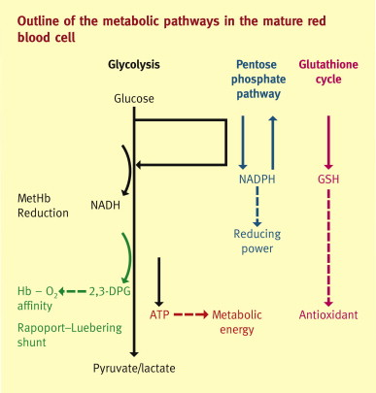
Notes:
Rapoport-Luebering shunt

Slide 46
Salvage pathway synthesis of purine nucleotides
The salvage pathway is a crucial metabolic pathway for recycling purines (like adenine, guanine, and hypoxanthine) and pyrimidines, allowing cells to conserve energy by reusing existing nucleotides instead of synthesizing them from scratch.
It is particularly significant in tissues like erythrocytes (red blood cells) and neurons, where de novo purine synthesis is either inefficient or inactive.
Notes:
References: (Salvage pathway)
Kornberg, A. & Baker, T.A. (1992). DNA Replication. 2nd ed. Freeman.
Becker, M.A., & Seegmiller, J.E. (1975). The salvage pathway of purine nucleotide synthesis in human cells. The Journal of Biological Chemistry, 250(13), 5308-5315.
Lehninger Principles of Biochemistry

Slide 47
Salvage pathway synthesis of purine nucleotides (cont.)
The salvage pathway is particularly important in red blood cells (RBCs) because these cells lack the ability to carry out de novo synthesis of purine nucleotides. Why?
No Nucleus or Mitochondria in Mature RBCs
Energy Efficiency
Maintaining Nucleotide Balance
Avoiding Waste of Purine Bases
In summary, RBCs depend on the salvage pathway to sustain their energy and maintain cellular function efficiently.
Notes:
1-No Nucleus or Mitochondria in Mature RBCs:
Mature RBCs do not have a nucleus or mitochondria, which means they lack the necessary machinery to perform complex metabolic functions, including de novo nucleotide synthesis. As a result, they depend on the salvage pathway to regenerate nucleotides from degraded nucleic acids.
2-Energy Efficiency:
The salvage pathway is more energy-efficient compared to de novo synthesis. Since RBCs primarily rely on glycolysis for energy (due to the absence of mitochondria), conserving energy is critical. The salvage pathway allows RBCs to conserve ATP by reusing existing purines rather than synthesizing them from scratch.
3-Maintaining Nucleotide Balance:
Nucleotides like adenosine triphosphate (ATP) are essential for various functions in RBCs, including maintaining the cell membrane’s shape, ion transport, and overall cell survival. The salvage pathway helps RBCs maintain a steady supply of nucleotides to meet these demands.
4-Avoiding Waste of Purine Bases:
The degradation of purine nucleotides results in free purine bases like adenine and hypoxanthine. The salvage pathway allows RBCs to recycle these bases into nucleotides rather than losing them, ensuring that the necessary building blocks for energy molecules like ATP remain available.

Slide 48
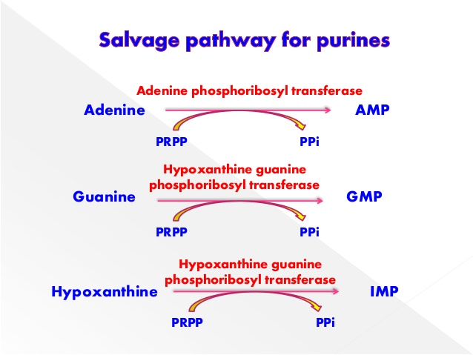
Salvage pathway synthesis of purine nucleotides (cont.) Starting Material and Enzymes Involved
Key Starting Material:
Phosphoribosyl Pyrophosphate (PRPP).
Free purines (such as adenine, guanine, and hypoxanthine) are salvaged and converted into nucleotides.

Slide 49
Salvage pathway synthesis of purine nucleotides (cont.) Starting Material and Enzymes Involved
Two Key Enzymes Involved:
1- Adenine Phosphoribosyltransferase (APRTase): Responsible for converting adenine into adenosine monophosphate (AMP).
2-Hypoxanthine-Guanine Phosphoribosyltransferase (HGPRTase): Converts hypoxanthine and guanine into inosine monophosphate (IMP) and guanosine monophosphate (GMP), respectively.

Slide 50
Salvage pathway synthesis of purine nucleotides (cont.)
Role of PRPP (Phosphoribosyl pyrophosphate)
PRPP is crucial as the donor of the ribose 5-phosphate group in these reactions.
Without PRPP, these salvage reactions could not occur, making it a central molecule in the salvage of purine nucleotides.

Slide 51
Glucose-6-phosphate dehydrogenase deficiency causes hemolytic anemia
Mutations present in some populations causes a deficiency in glucose 6-phosphate dehydrogenase (X-linked), with consequent impairment of NADPH production
Detoxification of H₂O₂ is inhibited, and cellular damage results - lipid peroxidation leads to erythrocyte membrane breakdown (hemolysis) and hemolytic anemia.

Slide 52
Glucose-6-phosphate dehydrogenase deficiency causes hemolytic anemia(cont.)
Most G6PD-deficient individuals are asymptomatic - only in combination with certain environmental factors (sulfa antibiotics, herbicides, antimalarials, *divicine) do clinical manifestations occur.
*toxic ingredient of fava beans

Slide 53
Pyruvate Kinase Deficiency
This deficiency causes the entire glycolysis pathway to cease working so that little to no ATP is produced.
Potassium and water leak from the cell, while calcium concentrations increase.

Slide 54
Pyruvate Kinase Deficiency (cont.)
Consequently, the defective red cells are destroyed in the spleen causing anaemia and the spleen enlarges (splenomegaly) because it is overworked.
The excessive destruction of red blood cells (hemolysis) results in the breakdown of hemoglobin stored in these cells.
Deficiencies are inherited as autosomal recessive traits, so both sexes are affected equally.

Slide 55
Hormonal Control of Erythropoiesis
Erythropoiesis is controlled by a circulating hormone: Erythropoietin (EPO)
EPO release by the kidneys is triggered by:
Hypoxia due to decreased RBCs (low O₂)
Decreased oxygen availability
Increased tissue demand for oxygen
Enhanced erythropoiesis increases the:
RBC count in circulating blood
Oxygen carrying ability of the blood

