Slide 1
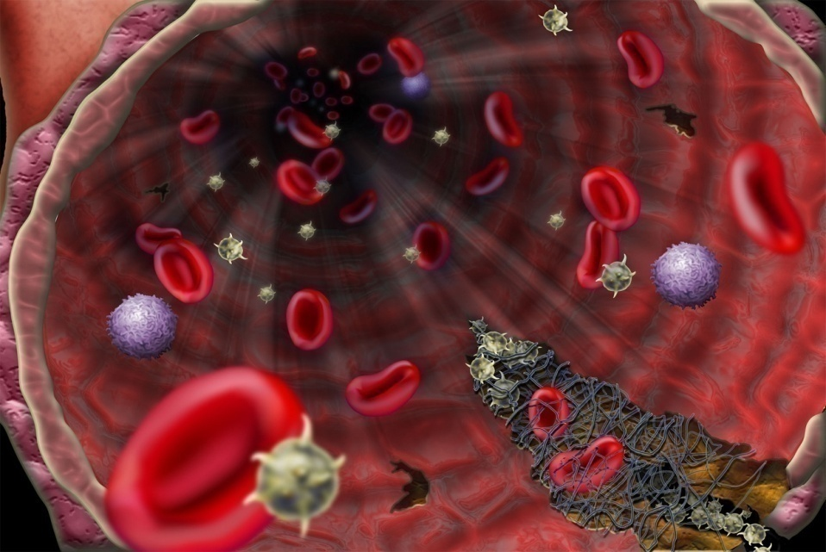
Hemostasis

Slide 2
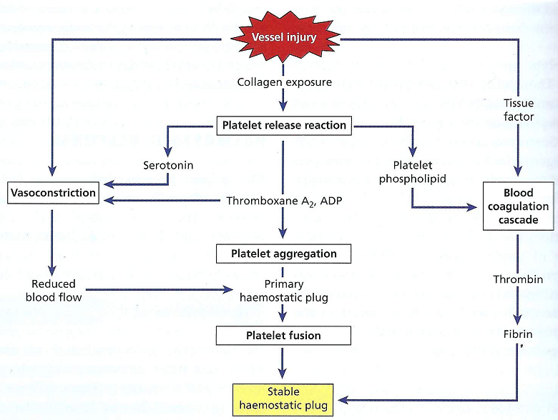
Hemostasis

Slide 3
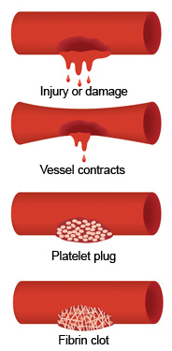
Hemostasis
Arrest of bleeding.
Events preventing excessive blood loss in 3major stages that occur in a set of order following the loss of vascular integrity
Vascular spasm: Vasoconstriction of damaged blood vessels
Platelet plug formation
Coagulation or blood clotting

Slide 4
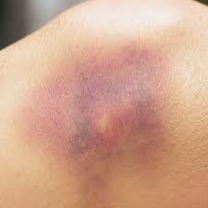
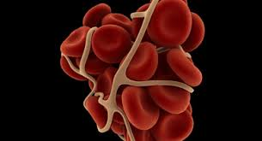
Necessity For Blood Clotting
Prevent excessive blood loss
Prevent entry of micoorganisms through wound
Seals wound
Maintain blood pressure

Slide 5
Hemostasis:
Hemostasis is defined as a property of circulation whereby blood is maintained within a vessel and the ability of the system to prevent excessive blood loss when injured.
Hemostasis is composed of 3 major stages that occur in a set of order following the loss of vascular integrity.

Slide 6
Hemostasis (cont.):
DAMAGE TO BLOOD VESSEL leads to:
Vasoconstriction.
The formation of platelet plug.
The production of a web of fibrin proteins that penetrates and surrounds the platelet plug.

Slide 7
Steps in Hemostasis
*Damage to blood vessel leads to:
Vascular Constriction:
Immediate constriction of blood vessel
Vessel walls pressed together – become “sticky”/adherent to each other
Minimize blood loss

Slide 8
Steps in Hemostasis(Cont.):
2. Platelet Plug formation:
PLATELETS attach to exposed collagen with the presence of von Willebrand factor (vWF) and Glycoprotein IbIX
Aggregation of platelets causes release of chemical mediators (ADP, Thromboxane A₂)
ADP attracts more platelets
Thromboxane A₂ (powerful vasoconstrictor)
* promotes aggregation & more ADP
Leads to formation of platelet plug!

Slide 9
Platelet
In adults, platelets originate in the red bone marrow by fragmentation of the cytoplasm of mature megakaryocytes(Gr. Megas, big, + karyon, nucleus, + kytos), which, in turn, arise by differentiation of megakaryoblasts.
Megakaryoblasts. Megakaryocytes Platelets.
Platelets are repelled from each in absence of blood vessel damage.

Slide 10
Role of platelets in blood clotting:
Platelets (Thrombocytes) have several functions in blood clotting:
 Form platelet plug at the site of injury
 Sites of activation of some clotting factors (II, X)
 Provide the surface on which certain clotting factors bind (Va, Xa, II, Ca²⁺)
 Sources of some clotting factors (XIII, PL)

Slide 11
Role of platelets in blood clotting (cont.):
If platelets are not lysed, blood does not clot
Individuals with thrombocytopenia (low platelets), bleeding for a long time
Platelets deficiency can be due to many agents
(drugs, some infections, ionizing radiation)

Slide 12
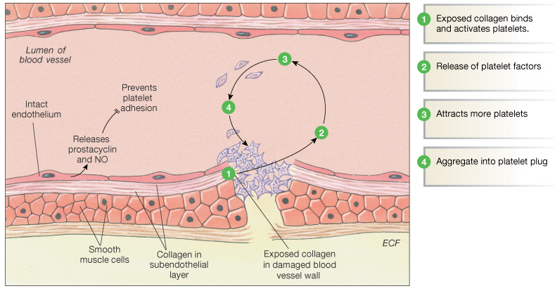
Hemostasis: Vasoconstriction & Plug Formation

Slide 13
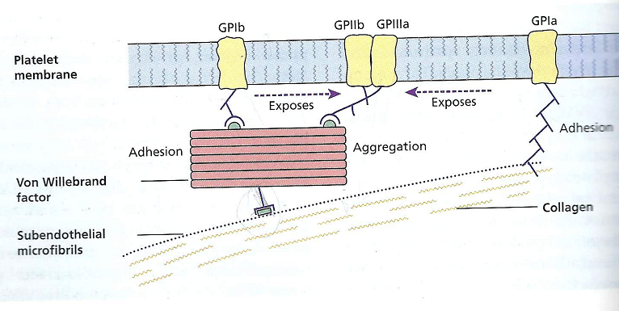
Platelets adhesion

Slide 14
Steps in Hemostasis (cont…)
3- Blood Coagulation (clot formation):
Final Step in Hemostasis:
Transformation of blood from liquid to solid
Clot reinforces the plug
Multiple cascade steps in clot formation
Fibrinogen (soluble) Fibrin
Thrombin

Slide 15
Hemostatic Clot Formation
PRIMARY
PRIMARY
PRIMARY
PRIMARY
AGGREGATION
AGGREGATION
AGGREGATION
AGGREGATION
Platelet Aggregation
Platelet Aggregation
Platelet Aggregation
Platelet Aggregation
Clotting
Clotting
Clotting
Clotting
Hemostatic
clot
Hemostatic
clot
Fibrin
Fibrin
SECONDARY
Fibrin
SECONDARY
SECONDARY
Thrombin
Thrombin
COAGULATION
Thrombin
COAGULATION
COAGULATION
0 min
5 min
10 min

Slide 16
Clotting Cascade
A cascade is a mechanism in which enzymes activate other enzymes sequentially usually leading to an amplification of an initial signal.
Participation of 14 different clotting factors (except for calcium and thromboplastin, clotting factors are proteins)
These factors circulate as inactive zymogens

Slide 17
Coagulation
Stages
Activation of prothrombinase
Conversion of prothrombin to thrombin
Conversion of fibrinogen to fibrin
Pathways
Extrinsic
Intrinsic
Initially independent, then they converge on common pathway leading to the formation of a fibrin clot !

Slide 18
Coagulation Factors
Factors are designated by a Roman numeral (I, II, III, IV, V, VI, VII, VIII, X, IX, XI, XII, XIII).
Active forms are usually designated by the letter “a” after the Roman numeral and may also have a different name for example: Ia/ Fibrin).
Cofactors are needed for many reactions in the cascade example: Calcium, platelet factor 3 (PF3).

Slide 19
Coagulation Factors (Cont.)
The intrinsic and extrinsic coagulation pathways are a series of reactions involve coagulation factors known as
Enzyme precursors (zymogens)
Non-enzymatic (cofactors)
Calcium (Ca ⁺⁺)
Phospholipids (PL).
All coagulation factors normally are present in the plasma, with PL being provided by platelets.

Slide 20
Coagulation Factors (Cont.)
Zymogens:
Factors II, VII, IX, X, XI, XII, and prekallikrein
NO biologic activity until converted by enzymes to active enzymes called serine proteases
Cofactors
Factors V, VIII, tissue factor, and HMWK

Slide 21
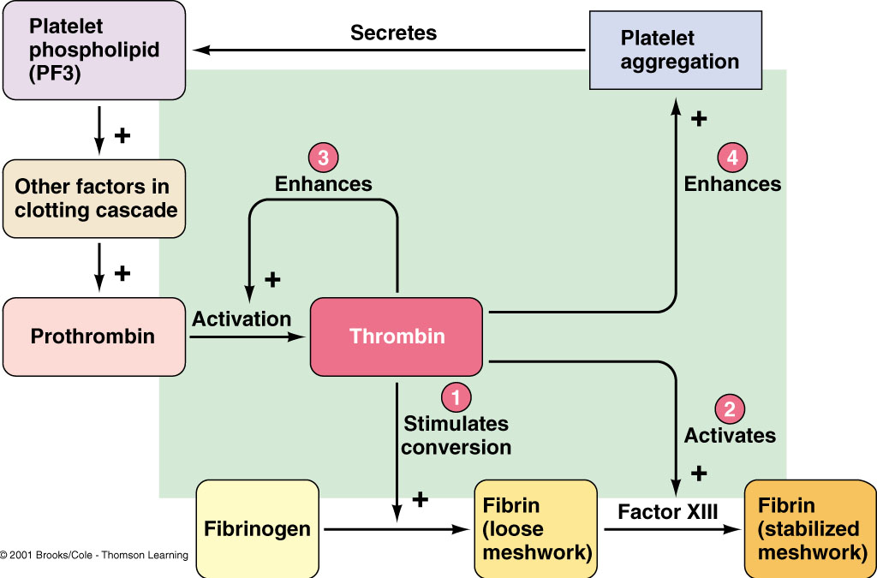
Factor Xa
Thrombin in Hemostasis

Slide 22
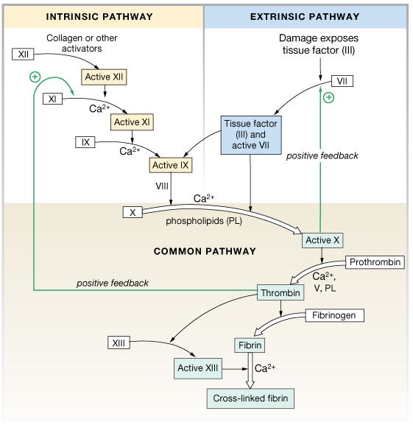
Clotting Cascade
A cascade is a mechanism in which enzymes activate other enzymes sequentially usually leading to an amplification of an initial signal.
Each of these pathways leads to the conversion of factor X (inactive) to factor Xa (active)

Slide 23
Secondary Homeostasis: Clot Formation

Slide 24
What Triggers Intrinsic/Extrinsic Clotting?
Extrinsic—Release of biochemicals from broken blood vessels/damaged tissue.
Intrinsic—No tissue damage, blood contacts damaged endothelial layer of blood vessel walls.

Slide 25
Intrinsic vs. Extrinsic Clotting
Intrinsic clotting—all factors are found in circulating blood.
Extrinsic clotting—Factor III (tissue thromboplastin) is found outside of blood.

Slide 26
Hemostasis: Coagulation & Clot Stabilization
Prothrombin
Ca⁺⁺
Fibrinogen
Fibrin
Polymerization
Stabilize fibrin clot

Slide 27
Activation of Prothrombin into thrombin
Prothrombin is soluble single chain glycoprotein (72kDa) synthesized in liver
Thrombin is produced by the enzymatic cleavage of two sites on prothrombin by activated Factor X (Xa) and generate active 2 chain thrombin molecule which is then released from platelet surface
The A and B chains of thrombin are held together by a dissulfide bond
S
S
S
S
1
2
A
B
1
2
+
A
B
Xa
Xa
Fragment 2 -1
Active thrombin
(34 kDa)
Fragment 2 -1
Prethrombin
Prothrombin (72kDa)
Converts fibrinogen to fibrin

Slide 28
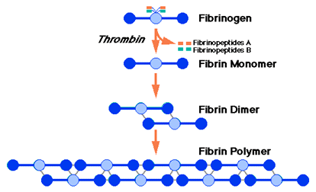
Conversion of Fibrinogen to Fibrin
The A and B portions of the Aα and Bβ chains, termed Fibrinopeptide A (FPA) and Fibrinopeptide B (FPB)
Thrombin
Release of FBs by thrombin generate fibrin monomer (weak)
Aggregate spontaneously forming insoluble fibrin polymer (fibrin clot) (hard, insoluble)

Slide 29
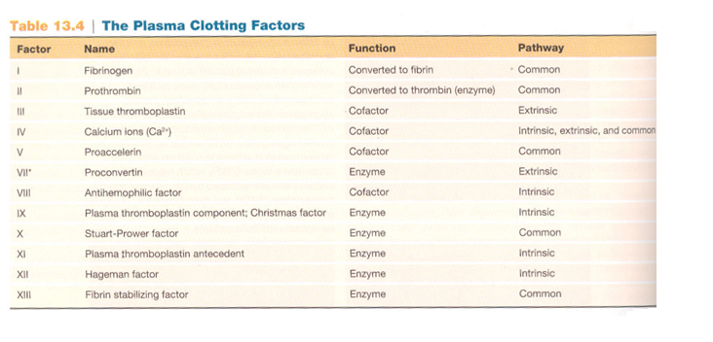

Slide 30
Clot Retraction—Serum
Within a few minutes after a clot is formed, it begins to contract and usually expresses most of the fluid from the clot within 20 to 60 minutes.
The fluid expressed is called serum because all its fibrinogen and most of the other clotting factors have been removed; in this way, serum differs from plasma.
Platelets are necessary for clot retraction to occur.

Slide 31
Dissolution of fibrin clot : fibrinolysis (The removal of fibrin from the blood)
Clot is slowly dissolved by the “fibrin splitting” called Plasmin
Plasmin gets trapped in clot and slowly dissolves it by breaking down the fibrin meshwork at various places, leading to the production of circulating fragments that are cleaved by other proteases or by the kidney and liver

Slide 32
Dissolution of fibrin clot : fibrinolysis (cont.)
Plasminogen is the inactive pre-cursor that is activated by activators in plasma:
Tissue plasminogen activator (t-PA)
Urokinase (to lesser extend)
Is produced as a precursor “prourokinase’’ by epithelial cells
Its main action is probably in the degradation of extracellular matrix

Slide 33
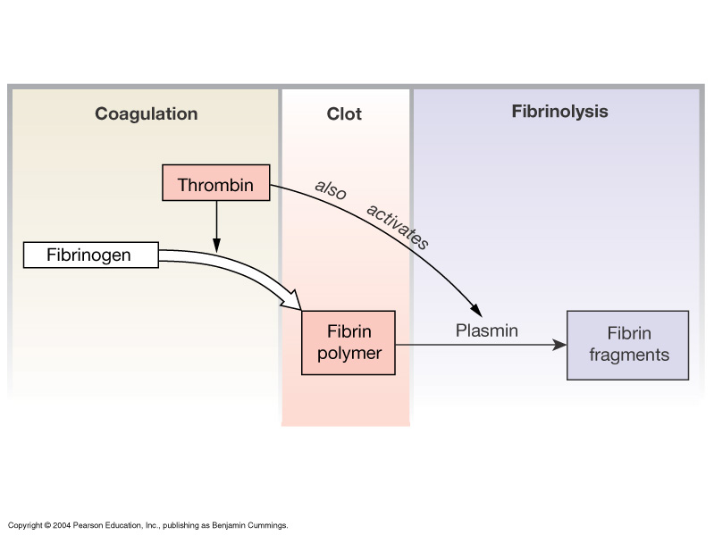
Dissolution of fibrin clot : Fibrinolysis (cont…)
Inactive t-PA is released from vascular endothelial cells following injury.
It binds to fibrin and is consequently activated.
Active t-PA converts plasminogen into plasmin
Dissolves the clot

Slide 34
Coagulation factor disorders
Inherited bleeding disorders
Hemophilia A and B
Von Willebrand disease
Other factor deficiencies
Acquired bleeding disorders
Liver disease
Vitamin K deficiency

Slide 35
Coagulation factor disorders (cont…)
1- Hemophilia A and B
Are the best-known coagulation factor disorders
Hemophilia A Hemophilia B
Coagulation factor deficiency Factor VIII Factor IX
Inheritance X-linked X-linked
Recessive Recessive
Incidence 1/10,000 males 1/50,000 males

Slide 36
Coagulation factor disorders (cont…)
2- Von Willebrand Disease (vWD)
It is the most common hereditary bleeding disorder and is characterized as being inherited autosomal recessive or dominant.
In this disease there is a defect in von Willebrand factor (vWF) which:
a. Acts as a carrier for factor VIII
b. Mediates the binding of glycoprotein Ib (GPIb) to collagen.

Slide 37
Coagulation factor disorders (cont…)
2- Von Willebrand Disease (vWD) (cont.)
c. This binding helps the activation of platelets and formation of primary hemostasis
d. vWD is characterized by excessive bleeding in infants because platelets fail to form hemostatic plug

Slide 38
3- Deficiency of Vitamin K
Coagulation factor disorders (cont…)
Source of vitamin K Green vegetables Synthesized by intestinal flora
Required for synthesis Factors II, VII, IX ,X contribute to bleeding disorders.
Causes of deficiency Malnutrition Biliary obstruction Malabsorption Antibiotic therapy.

Slide 39
Function of Vitamin K
1. Formation of carboxyglutamate
Vitamin K is essential for the functioning of several proteins involved in blood clotting (II, VII, IX and X)
These proteins contain a unique modified glutamate residue, called carboxyglutamate (Gla).
These proteins are synthesized as inactive precursors that are activated by the vitamin K-dependent carboxylase which converts glutamate in these proteins to carboxyglutamate forming mature clotting factors.

Slide 40
Function of Vitamin K (cont…)
1. Formation of carboxyglutamate (cont…)
(mature)
-
(Gla residue)
Dicumarol, Warfarin

Slide 41
Function of Vitamin K (cont…)
2. Interaction of prothombin with platelets
The Gla residue of prothrombin is a natural high affinity binder (chelator) of positively calcium ions, hence the designation of calcium as a co-factor (factor IV) in the schematic.
The prothrombin-calcium complex is then able to bind to PLs essential for blood clotting on the surface of platelets.

Slide 42
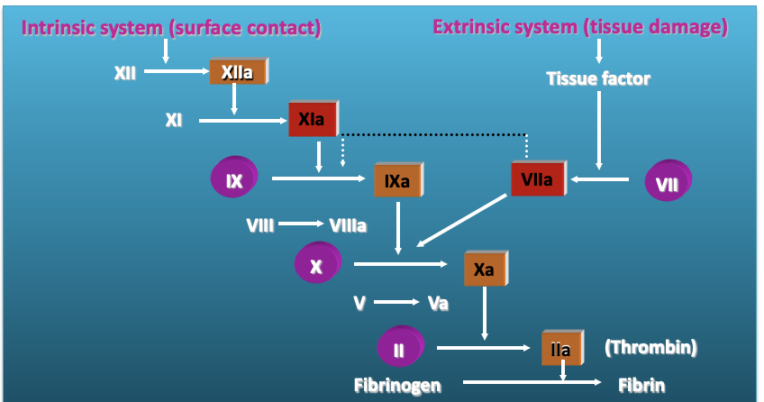
Coagulation Cascade
Vitamin K dependant factors
Notes:
KEY POINT: The efficacy/safety ratio for currently available therapies is less than satisfactory due to their ill-defined, multitargeted activity. New antithrombotic strategies are needed that offer an improved efficacy/safety profile compared with existing antithrombotic agents.^{1,2}
Currently available antithrombotic agents include the heparins (UFH and Enoxaparin), vitamin K antagonists (warfarin), and direct thrombin inhibitors (hirudins).^{3–6}
The most widely used agents, heparins and vitamin K antagonists, have a range of actions on various components of the coagulation cascade. This contributes to the unpredictable clinical responses associated with these agents.^{3–5}
Other limitations of currently available antithrombotics include^{3–7}
High incidence of serious adverse effects, particularly bleeding complications
Routine monitoring of coagulation markers may be needed and represents a substantial
burden in terms of time and costs
Narrow therapeutic margin
Limited effectiveness in preventing VTE
Factor Xa inhibitors are a novel class of antithrombotic agents designed to selectively target only 1 core step in the coagulation cascade, leading to potent and targeted effectiveness.⁸
For training purposes only—Not for distribution

Slide 43
Role of Calcium in Blood Coagulation
Except for the first two steps in the intrinsic pathway, calcium ions are required for the promotion of all the reactions.
Coagulation of blood can be prevented in vitro (e. g. for storage in the blood bank or for separation of plasma) by removal of calcium ions.
The use of oxalates and citrates as in vitro anticoagulants is based on this principle.

Slide 44
Role of Liver and Coagulation
​Liver plays the following significant roles in the coagulation mechanism:
1- Synthesis of procoagulants
It is the site of synthesis of factors V, VII, IX, X, prothrombin and fibrinogen.
2- Removal of activated procoagulants
Liver also removes the activated procoagulants from the blood.
3- Synthesis of anticoagulants
Liver also synthesizes anticoagulants like heparin, antithrombin III and protein C.

