Slide 1
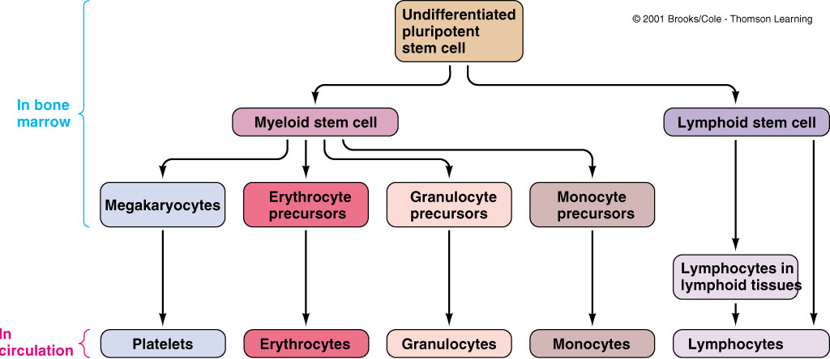
Blood Cell Origin and Production
All new WBCs except for lymphocytes are produced in the bone marrow (that also give rise to erythrocytes and platelets). Most new lymphocytes are produced by colonies of cells in lymphoid tissues, such as lymph nodes
Bone Marrow
Circulation

Slide 2
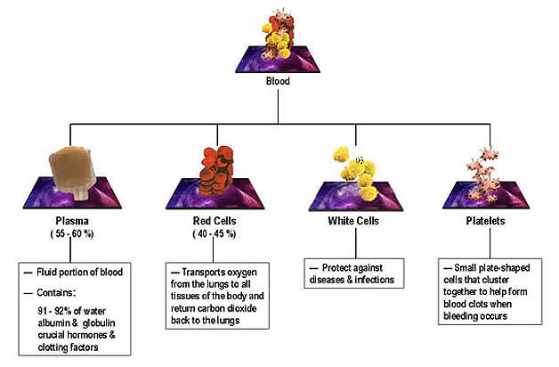
Two major components of blood: liquid phase and formed elements

Slide 3
Leukocytes (WBC’s)

Slide 4
Leukocytes (WBC’s)
Mobile units of body’s defense system:
“Seek and Destroy” Functions:
Destroy invading microorganisms
Destroy abnormal cells (i.e., cancer )
Clean up cellular debris (phagocytosis)
Assist in injury repair
Each WBC has a specific function

Slide 5
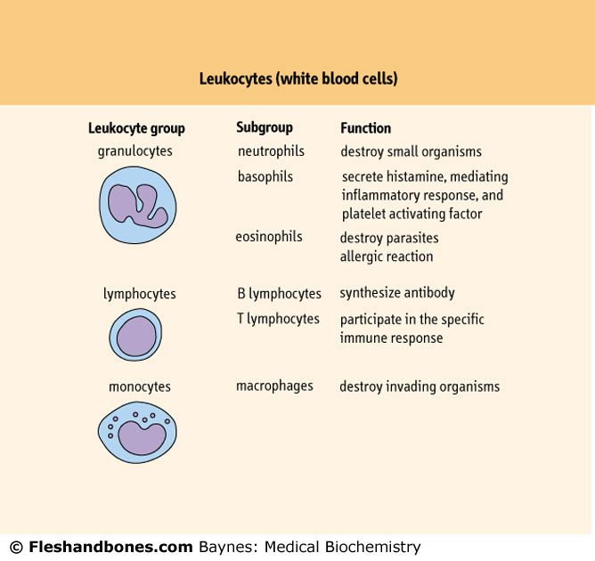
Leukocytes (WBC’s)

Slide 6
Leukocytes (WBC’s)(cont.)
Five Types
Classified according to the presence or absence of granules and the staining characteristics of their cytoplasm.
Leukocytes appear brightly colored in stained preparations, they have a nuclei and are generally larger in size than RBC’s.

Slide 7
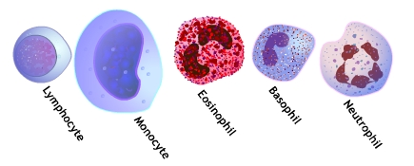
Types of WBC’s
Are classified in 2 main classes
Agranulocytes
Granulocytes

Slide 8
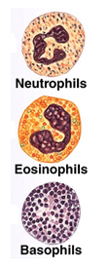
Types of WBC’s (cont.)
Granulocytes (Polymorphonuclear leukocytes): have 2 types of granules in their cytoplasm:
The specific granules (specific functions) and azurophilic granules (lysosomes)
Neutrophils
Eosinophils
Basophils

Slide 9
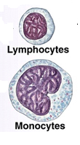
Types of WBC’s (cont.)
Agranulocytes: do not have specific granules, but they do contain azurophilic granules (lysosomes) in their cytoplasm
Lymphocytes
Monocytes

Slide 10
Granulocytes
1. Neutrophils
Constitute 60-70% of circulating WBC’s
Have an average diameter of 12-15 µm
Several lobes in nucleus (2-5 segments) linked by fine threads chromatin
Also contain glycogen (source of energy)
Stain light purple with neutral dyes.

Slide 11
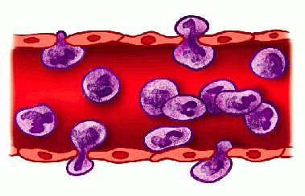
Granulocytes (cont.)
1. Neutrophils (cont.):
Granules are small and numerous
Highly mobile/very active
Diapedesis: Can leave blood vessels and enter tissue space.
Short lived cells: life span of 6-7h in blood and 1-4 days in connective tissues.
Function: Phagocytosis (contain several lysosomes) and play a major role of acute inflammation. (release leukotrienes, prostaglandins, thromboxanes)
Notes:
Prostaglandins, thromboxanes, and leukotrienes are mediators that induce inflammation.

Slide 12
Granulocytes (cont.)
2. Eosinophils
2-4% in normal blood
Large, numerous granules
Typical bilobed nuclei
Are about 12-17 µm in size, pale blue colour
Found in lining of respiratory and digestive tracts

Slide 13
Granulocytes (cont.)
2. Eosinophils (cont.)
Persist in the circulation for 8–12 hours
Functions:
Important functions involve protections against infections caused by parasitic worms and involvement in allergic reactions
Secrete anti-inflammatory substances in allergic reactions.
Notes:
Persist in the circulation الاستمرار في تداول

Slide 14
Granulocytes (cont.)
3. Basophils
Least numerous, less than 1% of blood WBC’s
They are about 12-15 µm diameter
They contain many large, rounded, dark purplish black granules
Their nucleus is divided into irregular lobes
Notes:
Least numerous
أقل عددًا

Slide 15
Granulocytes (cont.)
3. Basophils (cont.)
Diapedesis
Contain histamine and heparin (inflammatory chemical)
Function: Like eosinophils, basophils play a role in both parasitic infections and allergies

Slide 16
Agranulocytes
1. Lymphocytes
Constitute 28% of WBC’s
Small lymphocytes (6-8 µm); medium-sized lymphocytes (small number) and large lymphocytes (18 µm)
Large nuclei/small amount of cytoplasm
Color pale-blue

Slide 17
Agranulocytes (cont.)
1. Lymphocytes (cont.)
Only type of WBC’s that return from the tissue back to blood after diapedesis
Vary in life span: some live only a few days (~3days), others survive in circulating blood for many years (4-5 years)

Slide 18
Agranulocytes (cont.)
1. Lymphocytes (cont.)
Function: immune responses and memory, mainly found in lymph tissue
Two types:
T lymphocytes attack an infect or cancerous cell
B lymphocytes produce antibodies against specific antigens (foreign body)

Slide 19
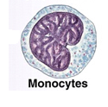
Agranulocytes (cont.):
2. Monocytes
Largest of WBCs (12-20µm)
Dark kidney bean shaped nuclei
Cytoplasm is basophilic and frequently contain very fine azurophilic granules
In tissues differentiate into macrophages

Slide 20
Agranulocytes (cont.):
2. Monocytes (cont.)
Function: phagocytosis
Evident in chronic infections – Tuberculosis
Defense vs. viruses and certain bacteria
Activate lymphocytes
Notes:
Tuberculosis السل
الدرن

Slide 21
WBC Numbers
Doctors look at WBC numbers.
Clinics will count the number of WBC’s in a blood sample, this is called differential count
A decrease in the number of white blood cells is leukopenia
An increase in the number of white blood cells is leukocytosis

Slide 22
Variations in WBC Counts-Leukocytosis
Physiological Causes of Leukocytosis
Age
Exercise
After food intake
Mental stress
Pregnancy
Exposure to low temperature also causes leukocytosis.
Pathological Causes of Leukocytosis
Acute bacterial infections especially by the pyogenic organisms
Acute haemorrhage
Burns
Notes:
Some of the common etiological agents responsible for causing pyogenic infections are bacteria such as Staphylococcus aureus, Streptococcus pyogenes, Escherichia coli, Klebsiella spp., Proteus spp., Pseudomonas spp., and Acinetobacter spp.

Slide 23
Variations in WBC Counts-Leukopenia
​Causes of Leukopenia
Infections by the nonpyogenic bacteria, especially typhoid fever and paratyphoid fever
Viral infections, such as influenza, smallpox and mumps
Protozoal infections
Starvation and malnutrition
Aplasia of bone marrow
Bone marrow depression due to:
Drugs such as chloromycetin and cytotoxic drugs used in malignant diseases
Repeated exposure to X-rays or radiations
Chemical poisons like arsenic, dinitrophenol and antimony
Notes:
malaria

Slide 24
Metabolism of leukocytes
They have aerobic glycolysis and active pentose phosphate pathway (NADPH)
During phagocytosis of bacteria, there is an increase of O₂ consumption (respiratory burst: the rapid release of reactive oxygen species) and superoxide radical O₂⁻ (involved in killing the bacteria) is formed.

Slide 25
Metabolism of leukocytes (cont…)
Phagocytic leukocytes use NADPH as a substrate for the NADPH-oxidase enzyme, which contributes to the killing of ingested microorganisms
NADPH
oxidase
NADPH +A +O₂ NADP⁺ + AH + O₂⁻
Acidic pH
SOD
2H⁺ + 2O₂ ⁻ 2H₂O₂ + AH + O₂⁻
Helps to kill microorganisms

Slide 26
Metabolism of leukocytes (cont…)
Active leukocytes release O₂⁻ ions and H₂O₂ to surrounding tissues in areas of inflammations
Superoxide dismutase, catalase and glutathione peroxidase are normal antioxidant enzymes that help to protect the body against the toxic effect of O₂⁻ ions and H₂O₂

Slide 27
Platelets (Thrombocytes)

Slide 28
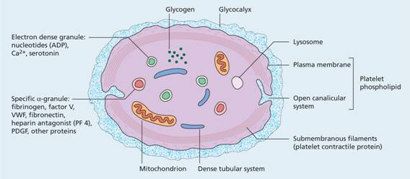
Structure and Composition of Platelets
Also known as thrombocytes (thrombo = clot ; cytes = cells).
Platelets are the smallest blood cells varying in diameter from 2 to 4 µm with an average volume of 5.8 µm³.

Slide 29
Structure and Composition of Platelets (cont.)
Platelets are colourless, spherical, or oval discoid structures.
Leishman staining shows a platelet consisting of faint bluish cytoplasm containing reddish purple granules.
Nucleus is absent in the platelets and therefore these cannot be reproduced.
Notes:
Leishman stain generally shows violet color of the nucleus and neutrophil granules, making the differential count convenient due to better contrast between nucleus and cytoplasm. The contrast depends on two components Azure B and Eosin Y. Azure B is one of the products from oxidation of methylene blue.
Leishman's stain is for the general differentiation of blood cells for malaria and trypanosomes in prepared slides from clinical specimens. Leishman's stain was discovered in 1901 and is used for staining blood smears. It is generally used to differentiate and identify leucocytes, malarial parasites and trypanosomes.

Slide 30
Electron Microscopic Structure
Cell Membrane- ​It consists of lipids (phospholipids, cholesterol and glycolipids), carbohydrates, proteins and glycoproteins.

Slide 31
Electron Microscopic Structure
Microtubules- The microtubules are made up of polymerized proteins called tubulins.
These form a compact bundle, which is present immediately beneath the platelet membrane.
These are responsible for maintenance of the discoid shape of the circulating platelets.
Notes:
قرصي

Slide 32
Electron Microscopic Structure (cont.)
Cytoplasm -The cytoplasm of the platelets contains the following:
Endoplasmic reticulum and Golgi apparatus (synthesize various enzymes and store large quantities of calcium).
Mitochondria are capable of forming ATP and ADP.
Contractile proteins include actin, myosin and thrombosthenin (can cause the platelet to contract and are thus responsible for the clot retraction).

Slide 33
Electron Microscopic Structure (cont.)
Other proteins present in the cytoplasm are as follows:
Fibrin stabilizing factor
Platelet-derived growth factor (PDGF)
von Willebrand factor (VWF)

Slide 34
Electron Microscopic Structure (cont.)
Granules present in the cytoplasm of platelets contain:
Substances like phospholipids
Triglycerides
cholesterol
ATP
ADP
serotonin (5HT).
Enzymes present in the cytoplasm of platelets include:
Adenosine triphosphatase
Enzymes necessary for the synthesis of prostaglandins
Notes:
Serotonin or 5-hydroxytryptamine (5-HT) is a monoamine neurotransmitter. Its biological function is complex and multifaceted, modulating mood, carries messages between nerve cells in your brain (your central nervous system) and throughout your body (your peripheral nervous system).

Slide 35
Properties of Platelets
Adhesiveness:​ Platelets possess the property of adhesiveness, i.e. when they come in contact with any wet surface or rough surface, they get activated and stick to the surface. Factors responsible for adhesiveness are collagen, thrombin, ADP, thromboxane A2, calcium ions and VWF.
Aggregation: ​Platelets have the property to aggregate, i.e. they stick to each other. This is due to ADP and thromboxane A2.
Agglutination: ​Clumping together of platelets is called agglutination. This occurs due to the actions of some platelet agglutinins.
Notes:
gglutinin
Noun
1an antibody, lectin, or other substance that causes agglutination.
In mammalian systems, treatment of cells with the lectin wheat germ agglutinin inhibits nuclear protein import.

Slide 36
Properties of Platelets (cont.)
Notes:
the extracellular matrix (ECM)

Slide 37
Functions of Platelets
When activated, platelets perform the following functions:
Role in Haemostasis
​Haemostasis refers to the spontaneous arrest of bleeding from an injured blood vessel.
Role in Clot Formation
Platelets play an important role in the formation of the intrinsic prothrombine activator, which is responsible for the onset of blood clotting.

Slide 38
Functions of Platelets
Role in Clot Retraction
​Contraction of contractile proteins (actin, myosin and thrombosthenin) present in the platelets plays an important role in clot retraction.
Role in Repair of Injured Blood Vessels.
Role in Defense Mechanism ​Platelets
Due to their property of agglutination, are capable of phagocytosis.
Transport and Storage Function
​The 5HT is stored in the platelets and transported to the site of injury where it is released.

Slide 39
Functions of Platelets (cont.)
​Normal platelet count ranges from 150,000 to 450,000 / mm³, with an average count of 2.5x10⁵ / mm³
Thrombocytosis: ​An increase in the number of platelets more than 4.5 x10⁵ / mm³
Thrombocytopenia: ​A decrease in the number of platelets below 1.5 x10⁵ / mm³
Lifespan of platelets varies from 8-10 days with an average of 10 days.
Destroyed by the tissue macrophage system in the spleen.

