Slide 1
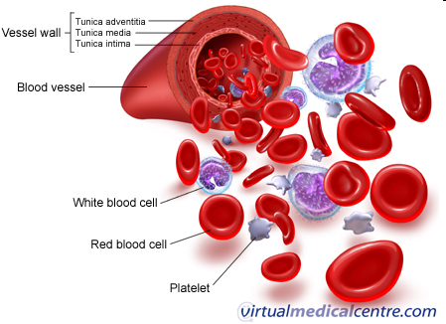
Plasma enzymes

Slide 2
Plasma Enzymes
Plasma derived
Cell Derived:These enzymes have a high activity in cells & overflow into the plasma.
These enzymes act on substrates in plasma & their activity is higher in plasma than cells. E.g., coagulation enzymes.
Secretary enzymes
Metabolic enzymes

Slide 3
Blood plasma contains many enzymes which are classified into:
    Functional plasma enzymes
    Nonfunctional plasma enzyme

Slide 4
Differences between functional and non functional enzymes
 | Functional plasma enzymes | Non functional plasma enzymes
Concentration in plasma | Present in plasma in higher concentrations in comparison to tissue | Normally, Present in plasma in very low concentrations in comparison to tissue
Function | Have known functions | No known functions
Substrate | Their substrates are always present in plasma | Their substrates are absent from plasma
Site of synthesis | liver | Different organs .g. liver heart, skeletal muscles and brain
Effect of disease | Decrease in liver disease | Increase in different organ diseases
Examples | Clotting factors e.g. Prothrombin Lipoprotein lipase, Pseudocholinesterase | ALT, AST, CK, LDH, alkaline phosphatase, acid phosphatase and lipase

Slide 5
Small amounts of intracellular enzymes are present in the blood as a result of normal cell turnover.
'Normal' plasma enzyme levels reflect the balance between the rate of synthesis and release into plasma during cell turnover, and the rate of clearance from the circulation.
The presence of elevated enzyme activity in the plasma may indicate tissue damage that is accompanied by increased release of intracellular enzymes

Slide 6
Source of non functional enzymes
Cell damage with the release of its content of enzymes into blood e.g. Myocardial infarction and viral hepatitis
Obstruction of normal pathways e.g. Obstruction of bile duct increases alkaline phosphatase
Increase of the enzyme synthesis e.g. bilirubin increases the rate of synthesis of alkaline phosphatase in obstructive liver disease
Increased permeability of cell membrane as in hypoxia

Slide 7
Medical importance of non functional enzymes
Measurement of non functional enzymes is important for:
Diagnosis of diseases as disease of different organs cause elevation of different plasma enzymes
Prognosis of the disease we can follow up of the treatment by measuring plasma enzymes before and after treatment

Slide 8
Disadvantages of enzyme assays
A major disadvantage in the use of enzymes for the diagnosis of tissue damage is their lack of specificity to a particular tissue or cell type. Many enzymes are common to more than one tissue.
This problem may be obviated to some extent in 2 ways:
    First, different tissues may contain (and thus release when they are damaged) two or more enzymes in different proportions
    Second, some enzymes exist in different forms (isoforms)

Slide 9
Isoenzymes
Isoenzymes (or isozymes) are a group of enzymes that catalyze the same reaction, but they differ in amino acid sequence
Isoenzymes can be:
  produced by different genes (= true isozymes)
  produced by different posttranslational modification (= isoforms)
found in different compartments of a cell
found in different tissues of an organism
can be oligomers of various subunits (monomers)

Slide 10
Isoenzymes
They differ in:
  electrophoretic mobility
  enzymatic properties
  physical properties (e.g heat stability)
  biochemical properties such as amino acid composition, immunological reactivities
Because isoenzymes are originated from different tissues, their determination give more information than measurement of total enzyme activity in plasma

Slide 11
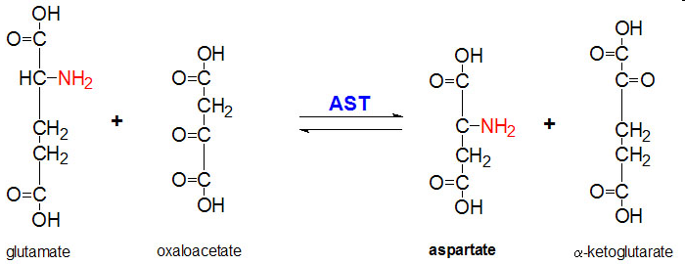
Abnormal plasma enzyme activities
Aspartate Transaminase (AST)/
Serum Glutamate oxaloacetate (SGOT)

Slide 12
Diagnostic Significance
Aspartate Transaminase (AST)/ Serum Glutamate oxaloacetate (SGOT)
The clinical use of AST is limited mainly to the evaluation of hepatocellular disorders and skeletal muscle involvement.
Post AMI (Acute Myocardial Infarction )
  Rises 6 – 8 hours
  Peaks at 24 hours
  Returns to normal by day 5
AST levels are highest in acute hepatocellular disorders, viral hepatitis, cirrhosis.
  Viral hepatitis may reach 100 x ULN (Upper limit of Normal)

Slide 13
Diagnostic Significance (cont.)
Aspartate Transaminase (AST)/ Serum Glutamate oxaloacetate (SGOT)
There are two isoenzyme fractions located in the cell cytoplasm and mitochondria,
  the cytoplasmic isoenzyme is predominant in serum
  while the mitochondrial one may be increased following cell necrosis.
Isoenzyme analysis of AST is not routinely performed in the clinical laboratory.

Slide 14
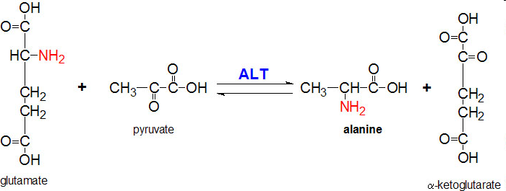
Abnormal plasma enzyme activities
1. Alanine Transaminase (ALT) /
glutamate pyruvate transaminase (GPT)

Slide 15
Alanine aminotransferase (ALT)
Abnormal plasma enzyme activities (Cont.)
Very high values are seen in acute hepatitis, either toxic or viral in origin.
Both ALT and AST are increased in liver diseases, but ALT >AST.
Moderate increase may be seen in chronic liver disease such as cirrhosis, and malignancy in liver.
(AST/ALT) in normal conditions is 1.33 ± 0.42.

Slide 16
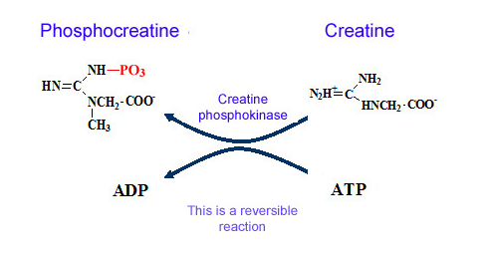
Abnormal plasma enzyme activities (Cont.)
2. Creatine Kinase (CK, CPK)

Slide 17
Creatine Kinase (CK)
Abnormal plasma enzyme activities (Cont.)
High concentrations of CK in:
  skeletal muscle.
  cardiac muscle.
  brain tissue.
Increased plasma CK activity is associated with damage to these tissues
↑ CK is especially useful to diagnose:
    AMI (indicator of muscle injury )
    Skeletal muscle diseases ( Muscular Dystrophy )
Notes:
ضمور العضلاتMuscular Dystrophy

Slide 18
Creatine Kinase isoenzymes
Abnormal plasma enzyme activities (Cont.)
CK occurs in 3 isoenzymes, each is a dimer composed of 2 subunits (B & M): CK1 = BB, CK2 = MB and CK3 = MM
Normal serum consists of:
  Approximately 94% to 100% CK-MM
  Values for the MB isoenzyme range from undetectable to trace (<6% of total CK).
  CK-BB is also present in small quantities
Cardiac muscle CK is 80% , CK-MM and CK-MB is 20%

Slide 19
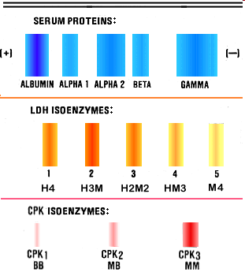
Creatine Kinase isoenzymes
Each CK isozyme shows a characteristic electrophoretic mobility.

Slide 20
Diagnostic Significance
The value of CK isoenzyme separation can be used principally in detection of myocardial damage.
  increased CK – MB ( > 6% of the total CK activity ) is a strong indication of AMI
Post AMI
  CK-MB increases 4 – 8 hours
  Peaks at 12 - 24 hours
  Returns to normal 48 - 72 hours
Notes:
من تلف عضلة القلب myocardial damage
AMI (indicator of muscle injury )

Slide 22
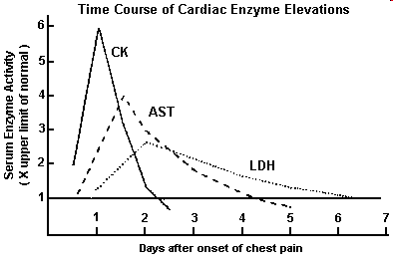
Cardiac Disorders
The CK rise the earliest, the LDH rise is latest
The LDH elevations are present longer than those of CK and AST
Fold elevation
Days post infarction

Slide 23
Abnormal plasma enzyme activities
α-Amylase
  Hydrolyses alpha-bonds of large alpha-linked polysaccharides such as starch and glycogen, yielding glucose and maltose
  It is used as a marker to detect acute pancreatitis and appendicitis
Notes:
Maltoseسكر ثنائي
الكشف عن التهاب البنكرياس الحاد والزائدة الدوديةacute pancreatitis and appendicitis

Slide 24
Abnormal plasma enzyme activities
Gamma-glutamyl-transferase (GGT)
GGT is an enzyme found throughout the body, but it is mostly found in the liver. When the liver is damaged, GGT may leak into the bloodstream.
High levels of GGT in the blood may be a sign of liver disease or damage to the bile ducts.
A GGT test can't diagnose the specific cause of liver disease. So it is usually done along with or after other liver function tests, most often an alkaline phosphatase (ALP) test.
Notes:
التليف الكبدي

Slide 25
Abnormal plasma enzyme activities
Alkaline Phosphatase (ALP)
  Widely distributed throughout the body
  High levels are seen is liver, bone, placenta and intestine
  Physiological increases are been in pregnancy, due to the placental isoenzyme, and in childhood (when bones are growing), due to the bone isoenzyme.

Slide 26
Diagnostic Significance
Alkaline Phosphatase (ALP)
  In hepatobiliary obstruction, hepatocytes lining the biliary ducts induces the ALP synthesis.
  High levels of ALP is indicative of extrahepatic obstruction rather than intrahepatic obstruction
  In bones, the enzyme is derived from osteoblasts. Hence increased in bone diseases like rickets, osteomalacia, neoplastic diseases with bone metastases and healing fractures.
Notes:
تدل المستويات العالية من ALP على انسداد خارج الكبد بدلاً من الانسداد داخل الكبد
في العظام ، يُشتق الإنزيم من بانيات العظم. ومن ثم تزداد أمراض العظام مثل الكساح وتلين العظام وأمراض الأورام مع النقائل العظمية والكسور التي تلتئم.

Slide 27
Abnormal plasma enzyme activities (cont.)
Acid Phosphatase (ACP)
  ACP is secreted by prostate cells, RBC, platelets and WBC.
  The main source of ACP is prostate gland and so can be used as a marker for prostate disease.
  Different forms of acid phosphatase are found in different organs, and their serum levels are used as a diagnostic for disease in the corresponding organs.

Slide 28
Abnormal plasma enzyme activities
LDH
  High activities in heart, liver, muscle, kidney, and RBC
  Lesser amounts: Lung, smooth muscle and brain

Slide 29
Abnormal plasma enzyme activities
LDH
  LDH occurs in 5 isoenzymes: LDH1 (H4), LDH2 (H3M), LDH3 (H2M2), LDH4 (HM3) and LDH5 (M4)

Slide 30
Abnormal plasma enzyme activities
LDH
  LDH occurs in 5 isoenzymes:
    LDH1 (H4): Cardiac , RBCs
    LDH2 (H3M): Cardiac , RBCs
    LDH3 (H2M2): Lung, spleen, pancreas
    LDH4 (HM3): Hepatic
    LDH5 (M4): Skeletal muscle

Slide 31
Diagnostic Significance
LDH is elevated in a variety of disorders:
  in cardiac,
  hepatic,
  skeletal muscle,
  and renal diseases,
  as well as in several hematologic and neoplastic disorders
The highest levels of LD-1 are seen in pernicious anemia and hemolytic disorders
LD-3 with pulmonary involvement
LD-5 predominates with liver & muscle damage

Slide 32
Diagnostic Significance
In healthy individuals
  LD-2 is in highest quantity then LD-1, LD-3, LD-4 and LD-5
Heart problems:
  If problem is not MI, both LD1 and LD2 rise, with LD2 being greater than LD1
  If problem is MI, LD1 is greater than LD2.

Slide 33
Diagnostic Significance
LDH-6 has been present in patients with arteriosclerotic cardiovascular failure
Its appearance signifies a grave prognosis and impending death
It is suggested, that LDH-6 may reflect liver injury secondary to severe circulatory insufficiency
Notes:
تصلب الشرايين, فشل القلب والأوعية الدموية
arteriosclerotic cardiovascular failure
This isoenzyme is heat stable and does not cross-react with any of the im
munoglobulins; hence, it is not an immunoglobulin complex.
An electrophoretic pattern of a liver extract obtained at the time of autopsy of one of these patients disclosed the LD6 band, thus verifying its origin or clearance in the liver.
It was not seen in the heart extract of the same patient.
عكس إصابة الكبد نتيجة لقصور شديد في الدورة الدمويةreflect liver injury secondary to severe circulatory insufficiency
مظهره يدل على التكهن الخطير والموت الوشيكIts appearance signifies a grave prognosis and impending death

Slide 34
Abnormal plasma enzyme activities
Lipase
It is highly elevated in acute pancreatitis, and this persists for 7-14 days. Thus, lipase remains elevated longer than amylase.

Slide 35
Enzymes as Tumor Markers
Enzyme | Disease
Serum acid phosphatase | Prostrate cancer
Serum Alkaline phosphatase | Metastasis in liver, jaundice due to carcinoma head of pancreas, osteoblastic metastasis in bones
Serum LDH | Advanced malignancies and Leukemias
β- Glucuronidase | Cancer of urinary bladder
Leucine Amino Peptidase (LAP) | Liver cell carcinoma
Neuron specific Enolase | Malignancies of nervous tissue and brain

Slide 36
Intracellular Distribution of Diagnostic Enzymes
Liver | Heart | Pancreas | Salivary Glands | Bone | Muscle | Biliary Tract | Prostate
LDH₅ ALT AST | LDH₁ AST CK | LPS AMS | AMS | ALP | CK | ALP GGT | ACP

Slide 37
Major Enzymes of Clinical Significance
Disease | Enzyme
Cardiac Disorders | AST-LDH1-CK
Hepatocellular Disorders Viral hepatitis: Hepatitis B & Hepatitis C. Toxic hepatitis: caused by chemicals & Toxins | ALT-AST-LDH5
Skeletal Muscle Disorders | CK-AST
Biliary tract disorders | ALP- GGT
Bone Disorders | ALP
Acute Pancreatitis | Lipase-AMS
Salivary Gland Inflammation | AMS

Slide 38

THANK YOU !

