Slide 1
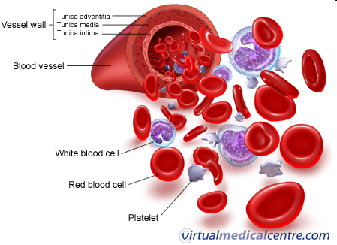
Functions of plasma proteins

Slide 2
Introduction
Most of the diagnostic laboratory tests in biochemistry, hematology, and immunology are performed using blood, plasma, or serum.
The formed elements of blood are suspended in an aqueous solution: the plasma.
Plasma is the supernatant obtained after centrifugation of a blood sample collected into a test tube containing an anticoagulant.

Slide 3
Introduction (Cont.)
Most common anticoagulants - lithium heparinate and EDTA.
Heparinate prevents clotting by binding to thrombin.
EDTA and citrate bind Ca²⁺ and Mg²⁺ ions, thus blocking the calcium- and magnesium-dependent enzymes in the clotting cascade.
Citrate is used as an anticoagulant for coagulation tests and when blood is collected for transfusion.
Notes:
ethylenediaminetetraacetic acid (EDTA).

Slide 4
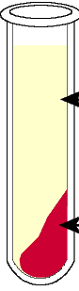
Introduction (Cont.)
Serum is the supernatant obtained after a blood sample has been allowed to clot spontaneously.
During clotting, fibrinogen is converted to fibrin.
Therefore, a major difference between plasma and serum is the absence of fibrinogen in serum.

Slide 5
Plasma protein
Concentration 65 –80 g ⁄ l
Simple or conjugated (glycoproteins, lipoproteins)
Separation:
Salting-out methods
Electrophoresis.

Slide 6
Major Components of globulin bands

Slide 7
Electrophoresis pattern for normal serum proteins
+
-
Albumin α1 α2 β γ

Slide 8
Plasma protein distribution

Slide 9
Fractions of plasma proteins
Fraction
Rel. amount (%)
c (g/l)
Albumins: albumin
pre-albumin (Transthyretin)
52 – 58
34 – 50
α₁-globulins: thyroxin-binding globulin, transcortin, α₁-acid glycoprotein, α₁-antitrypsin, α₁-lipoprotein (HDL), α₁-fetoprotein
2,4 – 4,4
2-4
α₂-globulins: Haptoglobin, macroglobulin, ceruloplasmin.
6,1 – 10,1
5 – 9
β-globulins: transferrin, hemopexin, lipoprotein (LDL), C-reactive protein, C3 and C4 components of the complement system
8,5 – 14,5
6 – 11
γ-globulins: IgG, IgM, IgA, IgD, IgE
10 – 21
8 – 15
Fibrinogens
~ 4
2 - 4.5

Slide 10
Plasma proteins participate in:
Blood coagulation
Maintenance of homeostasis (pH, osmotic pressure)
Defence against infection
Transport of
Nutrient.
Metabolites.
Hormone
Metabolic wastes.
Drug.

Slide 11
General properties of plasma proteins
Most are synthesized in the liver
Exception: γ-globulins – synthesized in plasma cells.
Synthesized as pre-proteins on membrane-bound polyribosomes; then they are subjected to posttranslational modifications in ER and Golgi apparatus

Slide 12
General properties of plasma proteins
Almost all of them are glycoproteins
Exception: albumin
They have characteristic half-life in the circulation (albumin – 20 days)
Many of them exhibit polymorphism (immunoglobulins, transferrin…) ( antitrypsin transferrin, haptoglobin)

Slide 13
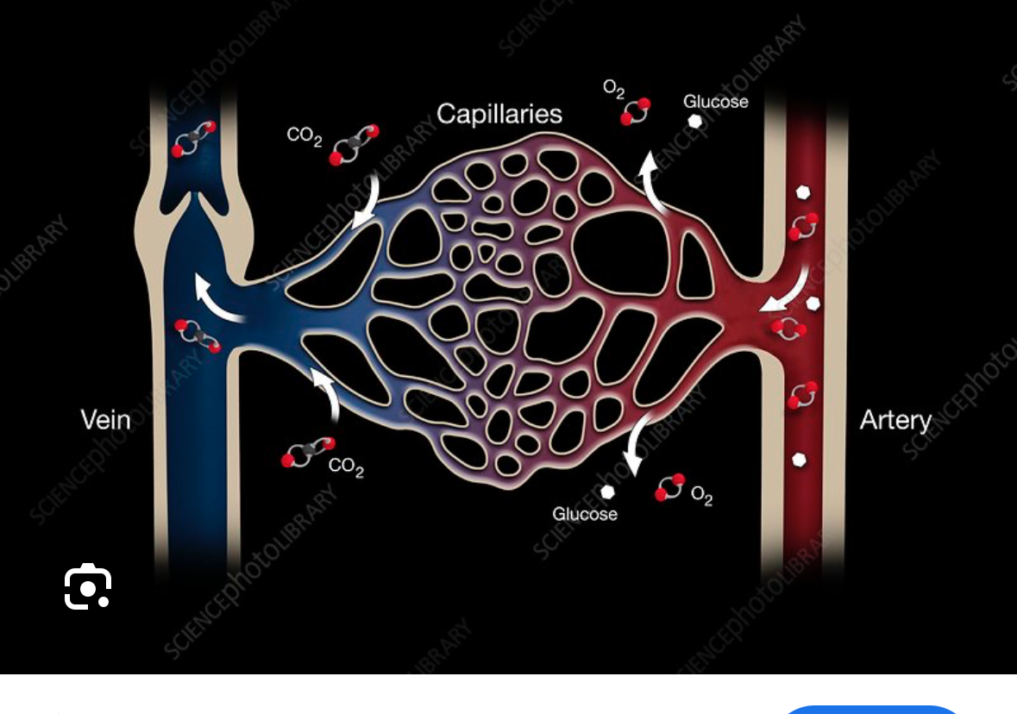
Catabolism of plasma proteins
Plasma proteins circulate not only inside the vascular system but also across the capillary bed into the interstitial fluid and back into the plasma through lymphatic vessels
Notes:
the transport of fluid into a cell by means of local infoldings by the cell membrane so that a tiny vesicle or sac formsaround each droplet, which is then taken into the interior of the cytoplasm

Slide 14
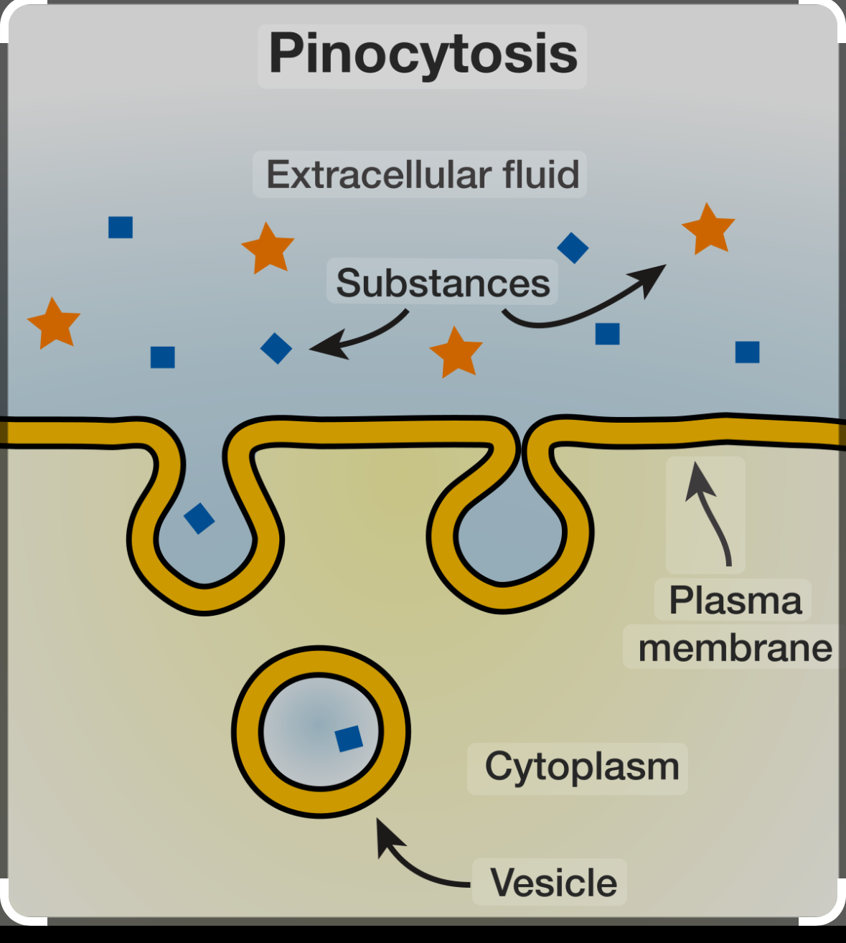
Tissue macrophages take up albumin by pinocytosis
Albumin is broken down within the lysosomes of tissue macrophages to amino acids

Slide 15
Acute phase reactants (APRs)
Class of proteins whose plasma levels change (increase or decrease) during acute inflammatory response
APRs concentration changes in:
infection.
surgery.
injury.
cancer.

Slide 16
Types of APRs
Positive
α1-antitrypsin
C-reactive protein (CRP): ~1000-fold increase!
Fibrinogen
Haptoglobin (HP).
C3, C4.
Negative
Albumin
Transferrin.

Slide 17
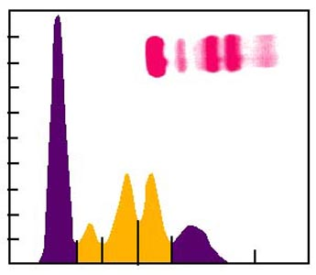
Acute inflammatory response
α1 α2-globulins
Immediate response occurs with stress or inflammation caused by infection, injury or surgical trauma
Normal or ↓ albumin
↑ α1 and α2 globulins

Slide 18
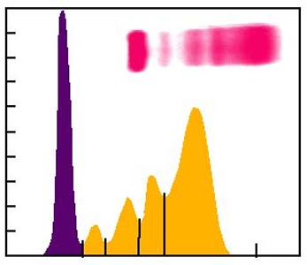
Chronic inflammatory response
α1 α2 γ-globulins
Late response is correlated with chronic infection (autoimmune diseases, chronic liver disease, chronic infection, cancer)
Normal or ↓ albumin
↑α1 or α2 globulins
↑↑ γ globulins

Slide 19
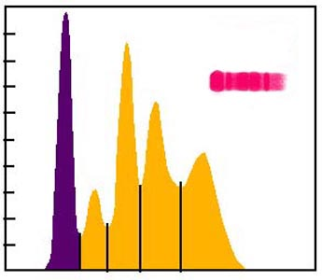
Nephrotic syndrome
The kidney damage illustrates the long-term loss of lower molecular weight proteins
↓ albumin and IgG – they are filtered in kidney.
Retention of higher molecular weight proteins
↑↑ α2-macroglobulin and ↑β-globulin)
α2-globulin β-globulin fractions.

Slide 20
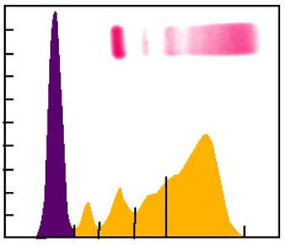
Liver damage - Cirrhosis
γ-globulins
Cirrhosis can be caused by chronic alcohol abuse or viral hepatitis
↓ albumin
↓ α1, α2 and β globulins
↑ Ig A in γ-fraction

Slide 21
Albumin
Not a glycoprotein
It has the lowest molecular weight of almost of plasma proteins
Liver produces about 12g albumin per day (25% of total hepatic protein synthesis and 50% of secreted protein)
Half-life: 20 days
For this reason, measurement of serum albumin concentration is used to assays liver function test

Slide 22
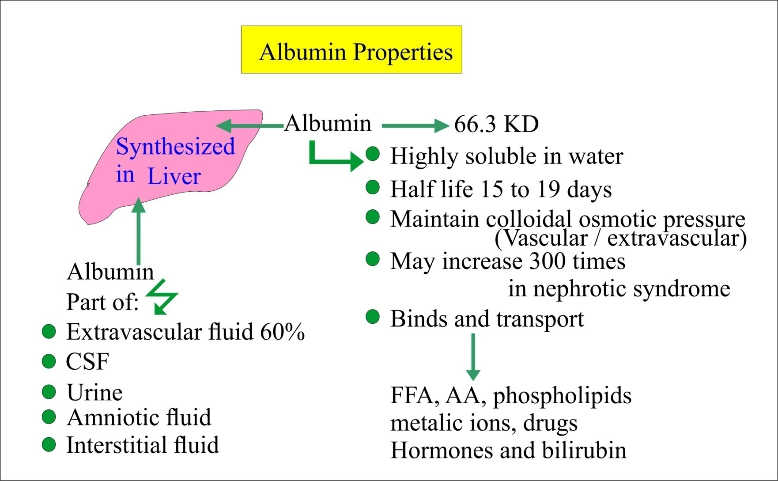

Slide 23
Functions of Albumin
1. Maintenance of the osmotic pressure of plasma
It gives a much greater osmotic effect at the pH 7.4 of
blood
Is responsible for about 75- 80 % of the osmotic effect
of plasma because:
It constitutes slightly> half the plasma proteins by weight
It has the lower molecular weight of the major plasma proteins.

Slide 24
Functions of Albumin
2. Transport It can bind and transport many diverse molecules and serve as low-specificity transport protein, which include:
Free fatty acids
Steroid hormones
Bilirubin
Drugs (Sulphonamides, Aspirin)
Ca²⁺, Cu²⁺

Slide 25
Causes of Albumin Deficiency
Liver diseases (cirrhosis) – decrease in the ratio of albumin to globulins.
Protein malnutrition
Excessive excretion by kidneys (renal disease) (proteinuria)
Mutation causing an Albuminemia (little or no circulating albumin).
There will be a reduction in osmotic pressure, leading to enhanced fluid retention in tissue spaces (edema).

