Slide 1
Transferrin
Beta globulin
Concentration in plasma: 3 g/l
Functions:
      Transport of iron: from catabolism of heme and from food (gut) to the sites where iron is required, i.e. to the bone marrow and other organs (2 moles of Fe³⁺ per 1 mole of transferrin).

Slide 2
Causes of transferrin deficiency
Burns
Infections
Malignancies
Liver and kidney diseases
Pregnancy

Slide 3
Ferritin
Intracellular protein; only small portion in plasma
Function:
  Stores iron that can be called upon for use when needed
Primary hemochromatosis:
  genetic disorder
  characterized by increased absorption of iron from the intestine ⇒ accumulated iron damages organs such as the liver, skin, heart, and pancreas.
  concentration of ferritin is elevated.

Slide 4
Ceruloplasmin
α2-globulins
Concentration in plasma: 300 mg/l
Functions:
  Carries 90% of copper in plasma (copper – cofactor for a variety of enzymes);
  1 molecule binds 6 atoms of copper;

Slide 5
Ceruloplasmin (Cont.)
  It binds copper more tightly than albumin that carries other 10% of copper
  ⇒ Albumin may be more important in copper transport (donates copper to tissues more readily)

Slide 6
Causes of ceruloplasmin decrease
Liver diseases, in particular Wilson´s disease:
  Genetic disease in which copper fails to be excreted into the bile and accumulates in liver, brain, kidney, and red blood cells
  Cause: mutations in the gene encoding for copper-binding ATPase
  Consequences: accumulation of copper in liver, brain, kidneys… ⇒ liver disease, neurologic symptoms

Slide 7
Causes of ceruloplasmin increase
Inflammatory states
Carcinomas, leukaemia
Rheumatoid arthritis

Slide 8
Haptoglobin
α₂- globulin, tetrameric.
Functions:
  Binds free hemoglobin and delivers it to the reticuloendothelial cells
  Complex Hb-Hp is too large to pass through glomerulus
  ⇒ prevention of loss of free Hb in the urine
  ⇒ kidney damage

Slide 9
Causes of Hp increase
Inflammation, infection
Injury
Malignancies

Slide 10
Causes of HP decrease
Haemolytic anaemia
half-life of Hp = 5 days x of complex Hp-Hb = 90 min (the complex is being rapidly removed from plasma)
⇒ Hp levels fall when Hb is constantly being released from red blood cells (as in haemolytic anaemia)

Slide 11
Hemopexin
β-globulins
Binds free heme and transfers it to the liver
⇒ prevent its urinary excretion

Slide 12
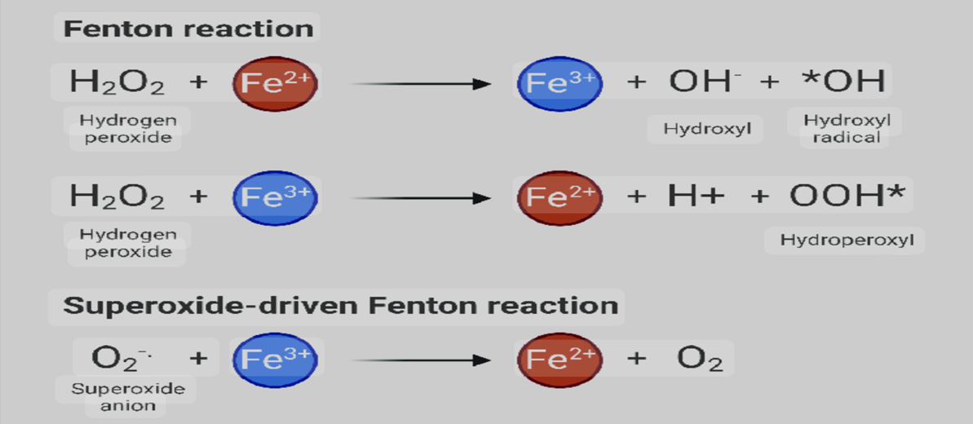
Transferrin
Ferritin
Ceruloplasmin
Haptoglobin
Hemopexin
Act as antioxidants: Remove Fe²⁺ and thus prevent the Fenton reaction:

Slide 13
α₁- Antitrypsin
A glycoprotein with 394 a.a (52 kDa)
Synthesized by hepatocytes and macrophages.
Major component (>90 %) of the α₁-fraction.
Highly polymorphic
Function: Principal plasma inhibitor of serine protease (Inhibits Trypsin, Elastase)

Slide 14
α₁- Antitrypsin (cont.)
Genetic deficiency of α1-Antitrypsin
  Synthesis of the defective α1-Antitrypsin occurs in the liver but it cannot secrete the protein
  α1-Antitrypsin accumulates in hepatocytes and is deficient in plasma

Slide 15
α₁- Antitrypsin (cont.)
Deficiency has a role in emphysema – proteolytic damage of the lung
Methionine involved in antitrypsin (AT) binding to proteases is oxidized by smoking
⇒ AT no longer inhibits proteases
⇒ increased proteolytic damage of the lung, particularly devastating in patients with AT-deficiency

Slide 16
α1 Fetoglobulin(AFP)
Major protein in the human fetal plasma and amniotic fluid (glycoprotein)
AFP levels decrease gradually during intra-uterine life and reach adult levels at birth
Very low amounts in adults
Function is unknown but it may protect fetus from immunologic attack by the mother or has same function of albumin in adult
Sequences of Fetoglobulin and Albumin are homologous.

Slide 17
α1 Fetoglobulin(AFP) (cont.)
Elevated maternal AFP levels are associated with:
    Neural tube defect, anencephaly.
Decreased maternal AFP levels are associated with:
    Increased risk of Down’s syndrome.
AFP is a tumor marker for:
    Hepatoma and testicular cancer

Slide 18
Fibrinogen
Structure
  MW 340 000
  6 polypeptide chains, 2α (67,000), 2β (56,000), 2g (47,000)
α
β
γ
Disulfide bond

Slide 19
Fibrinogen (Factor I):
  Fibrinogen is soluble plasma glycoprotein that consists of 3 non identical pairs of polypeptides chains (Aα, Bβ, γ)₂ covalently linked by disulfide bonds.
  It has a molecular weight of 340kDa .
  Represent the first coagulation factor.

Slide 20
Fibrinogen (cont.)
  Function:
  Blood coagulation (clotting). (The first coagulation factor.)
Thrombin
Fibrinogen
Fibrin
Plasmin
Fibrin
Degradation
Notes:
Coagulation - very important consideration when processing blood outside of the body
Structure must incorporate the ability to be easily broken down after clotting
What is a clot and how does it form from the polymerization of fibrinogen?
Overhead from Brash’s notes next

Slide 21
Lipid transport in blood
The plasma lipoprotein are spherical macromolecular complex of lipids and specific proteins (apolipoproteins )
Lipoprotein's function both to keep their component lipid soluble as they transport them in the plasma (to and from the tissues)

Slide 22
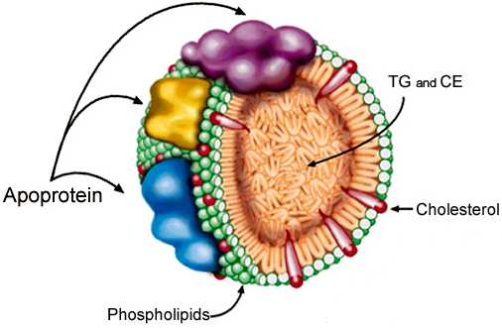
Plasma Lipoproteins Structure
LP core
  Triglycerides
  Cholesterol esters
LP surface
  Phospholipids
  Proteins
  cholesterol

Slide 23
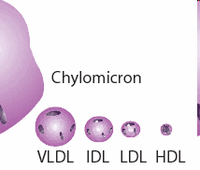
    Lipoprotein Classes
    Chylomicrons
    Very low-density lipoproteins (VLDL)
    Intermediate density lipoproteins (IDL)
    Low density lipoproteins (LDL)
    High density lipoproteins (HDL)

Slide 24
Lipoprotein identified and classified on basis of:
Chemical composition
Physical properties including density and floatation characteristics
Mobility upon electrophoresis

Slide 25
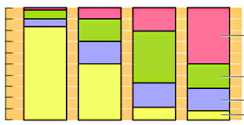
Chemical composition
HDL | LDL | VLDL | Chylomicron | Lipoprotein Chemical %
2 | 10 | 65 | 90 | Triglyceride
18 | 43 | 13 | 5 | Cholesterol
30 | 22 | 12 | 4 | Phospholipid
50 | 25 | 10 | 1 | Protein
100
80
Protein
60
Percent
40
Cholesterol
20
Phospholipid
0
Triglyceride
Chylomicron
VLDL
LDL
HDL

Slide 26
Properties and functions of human lipoproteins
Increasing density

Slide 27
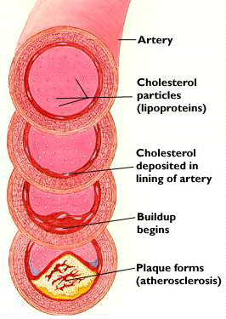
Note that
  LDL values are bad.
  HDL values are good.
High LDL Cholesterol and Low HDL Cholesterol
→Atherosclerosis

Slide 28
Separation of lipoproteins
Plasma lipoproteins are separated by 2 methods (ultracentrifugation, electrophoresis) into different fractions
Comparison between
Ultracentrifugation
Electrophoresis
_
Chylomicrons
VLDL
LDL
HDL
Albumin+FFA
+

Slide 29

THANK YOU !

