Slide 1
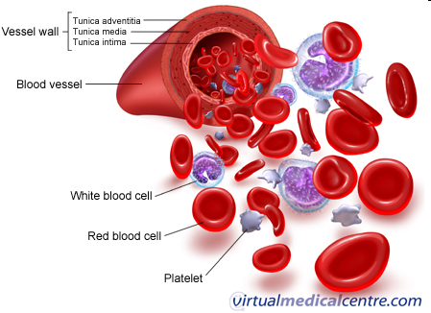
Functions of plasma proteins

Slide 2
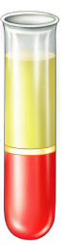
Introduction
Most of the diagnostic laboratory tests in biochemistry, hematology, and immunology are performed using blood, plasma, or serum.
  The formed elements of blood are suspended in an aqueous solution: the plasma.
  Plasma is the supernatant obtained after centrifugation of a blood sample collected into a test tube containing an anticoagulant.

Slide 3
Introduction (Cont.)
Most common anticoagulants - lithium heparinate and EDTA.
  Heparinate prevents clotting by binding to thrombin.
  EDTA and citrate bind Ca²⁺ and Mg²⁺ ions, thus blocking the calcium- and magnesium-dependent enzymes in the clotting cascade.
  Citrate is used as an anticoagulant for coagulation tests and when blood is collected for transfusion.
Notes:
ethylenediaminetetraacetic acid (EDTA).

Slide 4
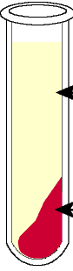
Introduction (Cont.)
Serum is the supernatant obtained after a blood sample has been allowed to clot spontaneously.
During clotting, fibrinogen is converted to fibrin.
  Therefore, a major difference between plasma and serum is the absence of fibrinogen in serum.

Slide 5
        Plasma protein
Concentration 65 –80 g ⁄ l
Simple or conjugated (glycoproteins, lipoproteins)
Separation:
        Salting-out methods
        Electrophoresis.

Slide 6
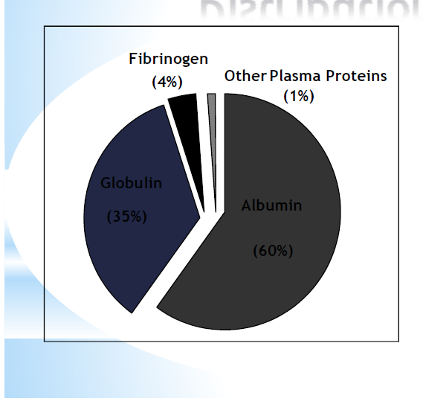
        Plasma protein distribution

Slide 7
Fractions of plasma proteins
Fraction
Rel. amount (%)
c (g/l)
Albumins: albumin
pre-albumin (Transthyretin)
52 – 58
34 – 50
α₁-globulins: thyroxin-binding globulin, transcortin,
α₁-acid glycoprotein, α₁-antitrypsin, α₁-lipoprotein (HDL), α₁-fetoprotein
2,4 – 4,4
2-4
α₂-globulins: Haptoglobin, macroglobulin, ceruloplasmin.
6,1 – 10,1
5 – 9
β-globulins: transferrin, hemopexin, lipoprotein (LDL), C-reactive protein, C3 and C4 components of the complement system
8,5 – 14,5
6 – 11
γ-globulins: IgG, IgM, IgA, IgD, IgE
10 – 21
8 – 15
Fibrinogens
~ 4
2 - 4.5

Slide 8
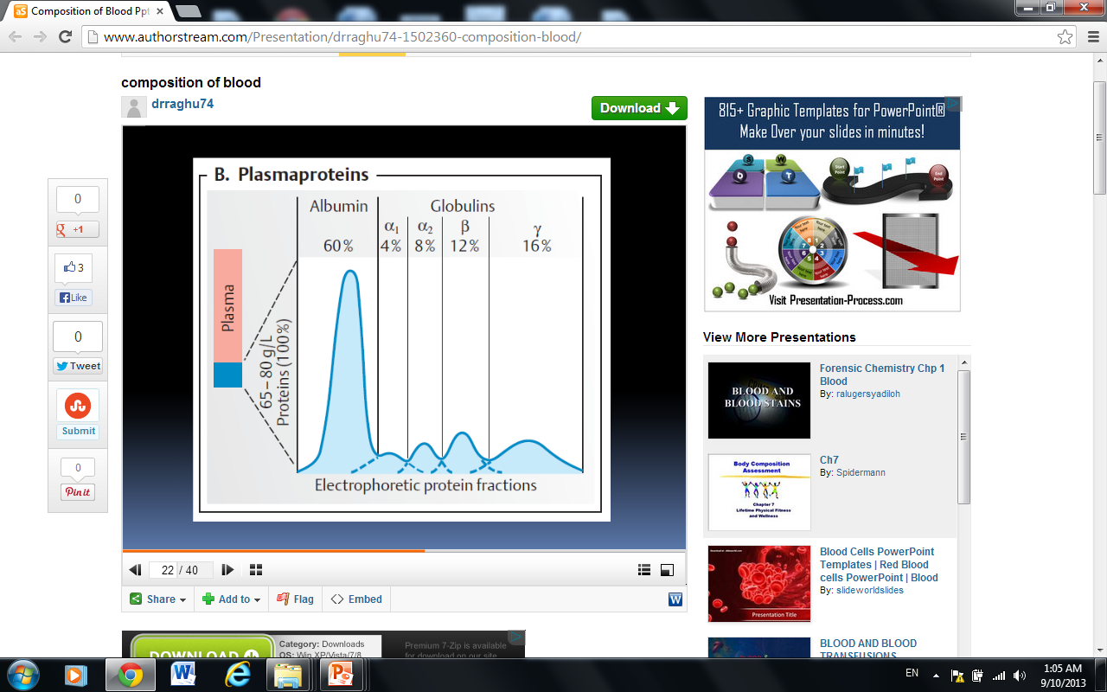
Electrophoresis pattern for normal serum proteins
+
-
Albumin α1 α2 β γ

Slide 9
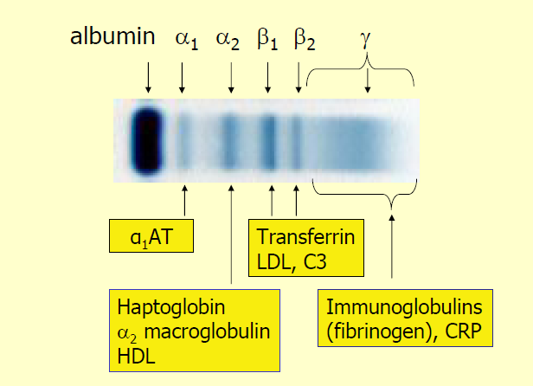
Major Components of globulin bands

Slide 10
Plasma proteins participate in:
Blood coagulation
Maintenance of homeostasis (pH, osmotic pressure)
Defence against infection
Transport of
Nutrient.
Metabolites.
Hormone
Metabolic wastes.
Drug.

Slide 11
General properties of plasma proteins
Most are synthesized in the liver
Exception: γ-globulins – synthesized in plasma cells.
Synthesized as pre-proteins on membrane-bound polyribosomes; then they are subjected to posttranslational modifications in ER and Golgi apparatus

Slide 12
General properties of plasma proteins
Almost all of them are glycoproteins
Exception: albumin
They have characteristic half-life in the circulation (albumin – 20 days)
Many of them exhibit polymorphism (immunoglobulins, transferrin…)

Slide 13
Catabolism of plasma proteins
Plasma proteins circulate not only inside the vascular system but also across the capillary bed into the interstitial fluid and back into the plasma through lymphatic vessels
Tissue macrophages take up albumin by pinocytosis
Albumin is broken down within the lysosomes of tissue macrophages to amino acids
Notes:
the transport of fluid into a cell by means of local infoldings by the cell membrane so that a tiny vesicle or sac formsaround each droplet, which is then taken into the interior of the cytoplasm

Slide 14
Acute phase reactants (APRs)
Class of proteins whose plasma levels change (increase or decrease) during acute inflammatory response
APRs concentration changes in:
        infection.
        surgery.
        injury.
        cancer.

Slide 15
Types of APRs
Positive
α1-antitrypsin
C-reactive protein (CRP): ~1000-fold increase!
Fibrinogen
Haptoglobin (HP).
C3, C4.
Negative
Albumin
Transferrin.

Slide 16
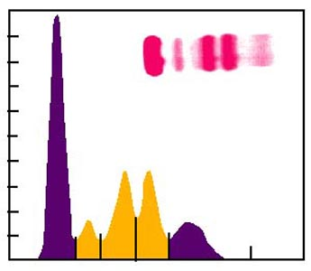
Acute inflammatory response
α1 α2-globulins
Immediate response occurs with stress or inflammation caused by infection, injury or surgical trauma
  Normal or ↓ albumin
  ↑ α1 and α2 globulins

Slide 17
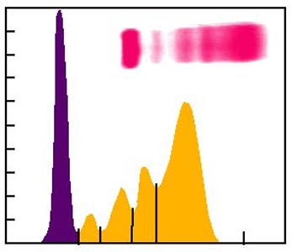
Chronic inflammatory response
α1 α2 γ-globulins
Late response is correlated with chronic infection (autoimmune diseases, chronic liver disease, chronic infection, cancer)
    Normal or ↓ albumin
    ↑α1 or α2 globulins
    ↑↑ γ globulins

Slide 18
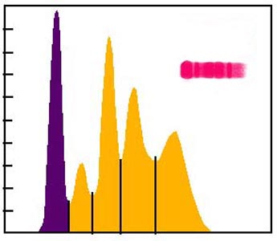
Nephrotic syndrome
The kidney damage illustrates the long-term loss of lower molecular weight proteins
  ↓ albumin and IgG – they are filtered in kidney.
Retention of higher molecular weight proteins
  ↑↑ α2-macroglobulin and ↑β-globulin)
α2-globulin β-globulin fractions.

Slide 19
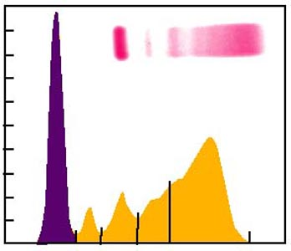
Liver damage - Cirrhosis
γ-globulins
Cirrhosis can be caused by chronic alcohol abuse or viral hepatitis
    ↓ albumin
    ↓ α1, α2 and β globulins
    ↑ Ig A in γ-fraction

Slide 20
Albumin
Not a glycoprotein
It has the lowest molecular weight of almost of plasma proteins
Liver produces about 12g albumin per day (25% of total hepatic protein synthesis and 50% of secreted protein)
Half-life: 20 days
  For this reason, measurement of serum albumin concentration is used to assays liver function test

Slide 21
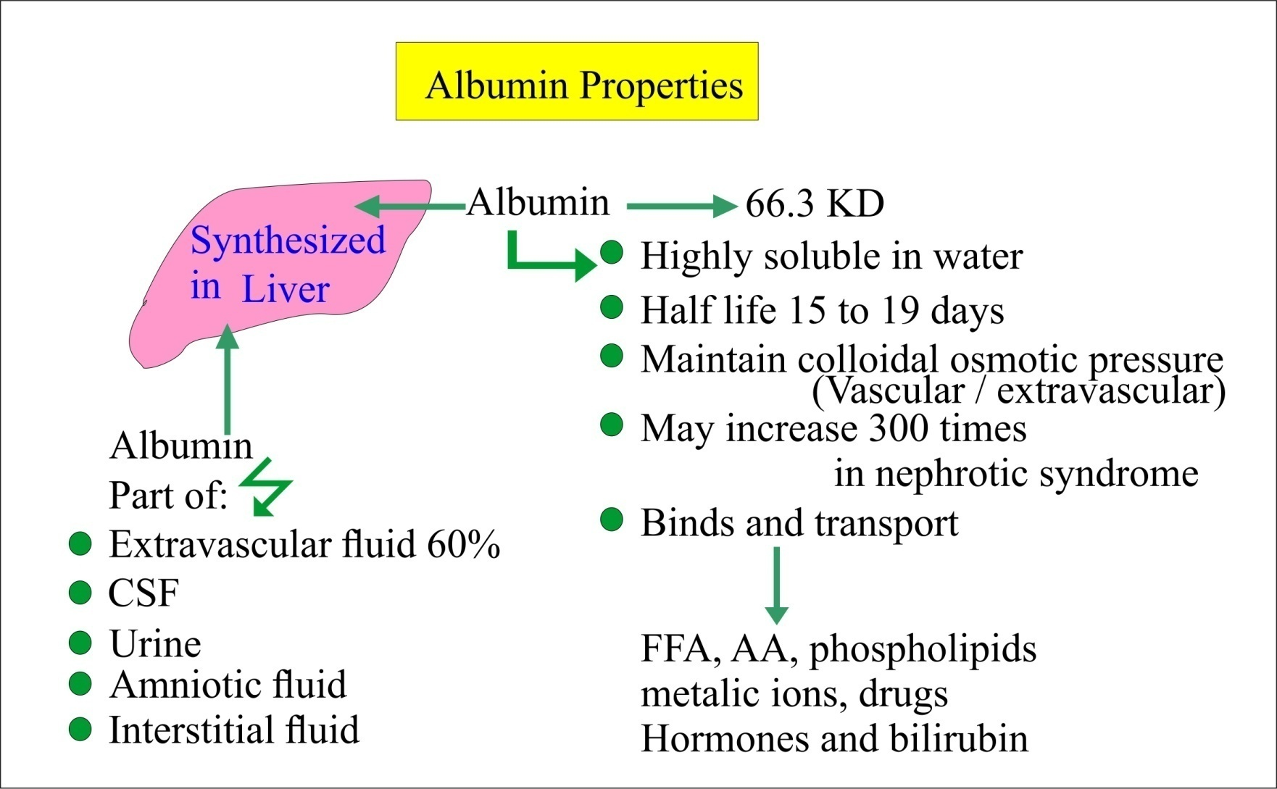

Slide 22
Functions of Albumin
  1. Maintenance of the osmotic pressure of plasma
    It gives a much greater osmotic effect at the pH 7.4 of
    blood
    Is responsible for about 75- 80 % of the osmotic effect
    of plasma because:
      It constitutes slightly> half the plasma proteins by weight
      It has the lower molecular weight of the major plasma proteins.

Slide 23
Functions of Albumin
  2. Transport It can bind and transport many diverse molecules and serve as low-specificity transport protein, which include:
    Free fatty acids
    Steroid hormones
    Bilirubin
    Drugs (Sulphonamides, Aspirin)
    Ca²⁺, Cu²⁺

Slide 24
Causes of Albumin Deficiency
Liver diseases (cirrhosis) – decrease in the ratio of albumin to globulins.
Protein malnutrition
Excessive excretion by kidneys (renal disease) (proteinuria)
Mutation causing an Albuminemia (little or no circulating albumin).
  There will be a reduction in osmotic pressure, leading to enhanced fluid retention in tissue spaces (edema).

Slide 25
Transferrin
Beta globulin
Concentration in plasma: 3 g/l
Functions:
      Transport of iron: from catabolism of heme and from food (gut) to the sites where iron is required, i.e. to the bone marrow and other organs (2 moles of Fe³⁺ per 1 mole of transferrin).

Slide 26
Causes of transferrin deficiency
Burns
Infections
Malignancies
Liver and kidney diseases
Pregnancy

Slide 27
Ferritin
Intracellular protein; only small portion in plasma
Function:
  Stores iron that can be called upon for use when needed
Primary hemochromatosis:
  genetic disorder
  characterized by increased absorption of iron from the intestine ⇒ accumulated iron damages organs such as the liver, skin, heart, and pancreas.
  concentration of ferritin is elevated.

Slide 28
Ceruloplasmin
α2-globulins
Concentration in plasma: 300 mg/l
Functions:
  Carries 90% of copper in plasma (copper – cofactor for a variety of enzymes);
  1 molecule binds 6 atoms of copper;

Slide 29
Ceruloplasmin (Cont.)
  It binds copper more tightly than albumin that carries other 10% of copper
  ⇒ Albumin may be more important in copper transport (donates copper to tissues more readily)

Slide 30
Causes of ceruloplasmin decrease
Liver diseases, in particular Wilson´s disease:
  Genetic disease in which copper fails to be excreted into the bile and accumulates in liver, brain, kidney, and red blood cells
  Cause: mutations in the gene encoding for copper-binding ATPase
  Consequences: accumulation of copper in liver, brain, kidneys… ⇒ liver disease, neurologic symptoms

Slide 31
Causes of ceruloplasmin increase
Inflammatory states
Carcinomas, leukaemia
Rheumatoid arthritis

Slide 32
Haptoglobin
α₂- globulin, tetrameric.
Functions:
  Binds free hemoglobin and delivers it to the reticuloendothelial cells
  Complex Hb-Hp is too large to pass through glomerulus
  ⇒ prevention of loss of free Hb in the urine
  ⇒ kidney damage

Slide 33
Causes of Hp increase
Inflammation, infection
Injury
Malignancies

Slide 34
Causes of HP decrease
Haemolytic anaemia
half-life of Hp = 5 days x of complex Hp-Hb = 90 min (the complex is being rapidly removed from plasma)
⇒ Hp levels fall when Hb is constantly being released from red blood cells (as in haemolytic anaemia)

Slide 35
Hemopexin
β-globulins
Binds free heme and transfers it to the liver
⇒ prevent its urinary excretion

Slide 36
Transferrin
Ferritin
Ceruloplasmin
Haptoglobin
Hemopexin
Act as antioxidants: Remove Fe²⁺ and thus prevent the Fenton reaction:
H₂O₂ + Fe ^{2+ →} Fe ³⁺ + OH· + OH⁻
Free radicals
Oxidative stress cellular damage
eventual cellular death

Slide 37
α₁- Antitrypsin
A glycoprotein with 394 a.a (52 kDa)
Synthesized by hepatocytes and macrophages.
Major component (>90 %) of the α₁-fraction.
Highly polymorphic
Function: Principal plasma inhibitor of serine protease (Inhibits Trypsin, Elastase)

Slide 38
α₁- Antitrypsin (cont.)
Genetic deficiency of α1-Antitrypsin
  Synthesis of the defective α1-Antitrypsin occurs in the liver but it cannot secrete the protein
  α1-Antitrypsin accumulates in hepatocytes and is deficient in plasma

Slide 39
α₁- Antitrypsin (cont.)
Deficiency has a role in emphysema – proteolytic damage of the lung
Methionine involved in antitrypsin (AT) binding to proteases is oxidized by smoking
⇒ AT no longer inhibits proteases
⇒ increased proteolytic damage of the lung, particularly devastating in patients with AT-deficiency

Slide 40
α1 Fetoglobulin(AFP)
Major protein in the human fetal plasma and amniotic fluid (glycoprotein)
AFP levels decrease gradually during intra-uterine life and reach adult levels at birth
Very low amounts in adults
Function is unknown but it may protect fetus from immunologic attack by the mother or has same function of albumin in adult
Sequences of Fetoglobulin and Albumin are homologous.

Slide 41
α1 Fetoglobulin(AFP) (cont.)
Elevated maternal AFP levels are associated with:
    Neural tube defect, anencephaly.
Decreased maternal AFP levels are associated with:
    Increased risk of Down’s syndrome.
AFP is a tumor marker for:
    Hepatoma and testicular cancer

Slide 42
Fibrinogen
Structure
  MW 340 000
  6 polypeptide chains, 2α (67,000), 2β (56,000), 2g (47,000)
α
β
γ
Disulfide bond

Slide 43
Fibrinogen (Factor I):
  Fibrinogen is soluble plasma glycoprotein that consists of 3 non identical pairs of polypeptides chains (Aα, Bβ, γ)₂ covalently linked by disulfide bonds.
  It has a molecular weight of 340kDa .
  Represent the first coagulation factor.

Slide 44
Fibrinogen (cont.)
  Function:
  Blood coagulation (clotting). (The first coagulation factor.)
Thrombin
Fibrinogen
Fibrin
Plasmin
Fibrin
Degradation
Notes:
Coagulation - very important consideration when processing blood outside of the body
Structure must incorporate the ability to be easily broken down after clotting
What is a clot and how does it form from the polymerization of fibrinogen?
Overhead from Brash’s notes next

Slide 45
Lipid transport in blood
The plasma lipoprotein are spherical macromolecular complex of lipids and specific proteins (apolipoproteins )
Lipoprotein's function both to keep their component lipid soluble as they transport them in the plasma (to and from the tissues)

Slide 46
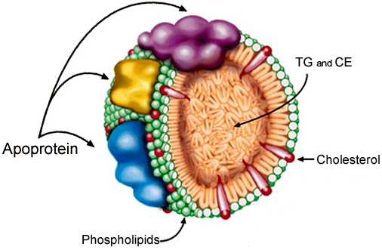
Plasma Lipoproteins Structure
LP core
  Triglycerides
  Cholesterol esters
LP surface
  Phospholipids
  Proteins
  cholesterol

Slide 47
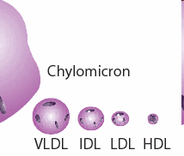
    Lipoprotein Classes
    Chylomicrons
    Very low-density lipoproteins (VLDL)
    Intermediate density lipoproteins (IDL)
    Low density lipoproteins (LDL)
    High density lipoproteins (HDL)

Slide 48
Lipoprotein identified and classified on basis of:
Chemical composition
Physical properties including density and floatation characteristics
Mobility upon electrophoresis

Slide 49
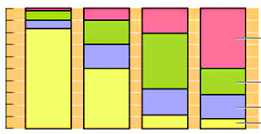
Chemical composition
HDL | LDL | VLDL | Chylomicron | Lipoprotein Chemical %
2 | 10 | 65 | 90 | Triglyceride
18 | 43 | 13 | 5 | Cholesterol
30 | 22 | 12 | 4 | Phospholipid
50 | 25 | 10 | 1 | Protein
100
80
Protein
60
Percent
40
Cholesterol
20
Phospholipid
0
Triglyceride
Chylomicron
VLDL
LDL
HDL

Slide 50
Properties and functions of human lipoproteins
Increasing density

Slide 51
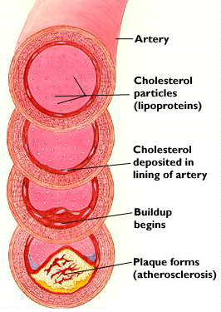
Note that
  LDL values are bad.
  HDL values are good.
High LDL Cholesterol and Low HDL Cholesterol
→Atherosclerosis

Slide 52
Separation of lipoproteins
Plasma lipoproteins are separated by 2 methods (ultracentrifugation, electrophoresis) into different fractions
Comparison between
Ultracentrifugation
Electrophoresis
_
Chylomicrons
VLDL
LDL
HDL
Albumin+FFA
+

