Slide 1
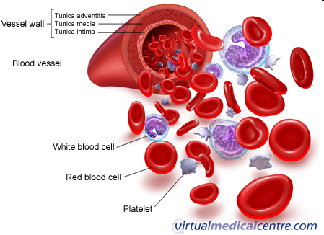
What is blood made up of?

Slide 2
Blood is a fluid tissue made up of water, many types of chemicals and millions of cells.
Blood volume – 4-6 liters depending on sex, size and age (~8% of TBW).
pH – slightly alkaline 7.35 – 7.45; venous blood will have a lower pH because it has a higher concentration of CO₂.

Slide 3
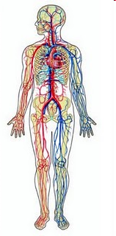
Color – arterial blood is bright red and venous blood is dark red.

Slide 4
Components of Whole Blood
Plasma (55% of whole blood)
Buffy coat: leukocyctes and platelets (<1% of whole blood)
Formed elements
1
Withdraw blood and place in tube with anticoagulant
2
Centrifuge
Erythrocytes (45% of whole blood)

Slide 5
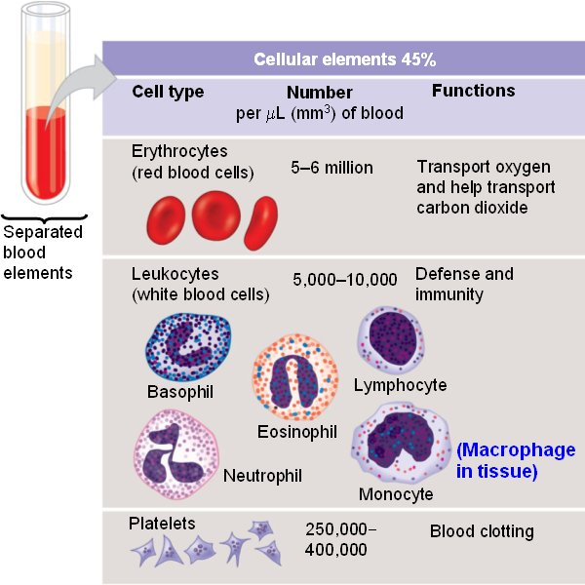
Formed Elements
Notes:
5

Slide 6
Blood plasma
Includes over 100 different dissolved solutes
Notes:
6

Slide 7
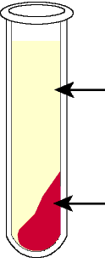
Serum is fluid left when blood clots = plasma – clotting factors
Serum
Blood clot
1
Withdraw blood and
place in tube without anticoagulant
2
Centrifuge

Slide 8
Blood performs three major functions:
Transportation
Gases (O₂, CO₂)
Nutrients (glucose, lipids, amino acids, vitamins, minerals)
Regulation
pH: by using blood proteins and blood solutes alkaline reserve of bicarbonate ions
Water balance
Protection
Immune system Protect against infections by WBCs and antibodies
Clot Formation Preventing blood loss by platelets and Fibrinogen
Waste products (urea, uric acid, creatine, ammonium salts, lactate)
Hormones
Metabolites
Temperature
Electrolytes balance
Ions

Slide 9
Physical properties of blood
Specific gravity:
- Whole blood: 1.055 - 1.065
- Plasma: 1.024 - 1.028
Viscosity: 5-6 times that of water.
Mass: 6-8% of the body weight.

Slide 10
Physical properties of blood (cont…)
Blood volume: ~ 8% of body weight.
~ 86% ml/kg body weight.
5-6L in adults
[Infants have a larger blood volume in proportion to body weight than adults].
Osmotic pressure: 7-8 atmosphere at body temperature.

Slide 11
Functions of plasma
Water (91.5%) | Liquid portion of blood. Acts as solvent and suspending medium for components of blood; absorbs, transports and releases heat.
Plasma Protein (7.0%) | Exert colloid osmotic pressure , which helps maintain water balance between blood and tissues and regulates blood volume
Albumin | Smallest and most numerous blood plasma proteins; produced by liver. Transports proteins for several steroid hormones and for fatty acids.
Globulins | Produced by liver and plasma cells, which develop from B lymphocytes. Antibodies help attack viruses and bacteria. Alpha and beta globulins transport iron, lipids and fat-soluble vitamin.

Slide 12
Functions of plasma
Electrolytes | Inorganic salts. Positively charges ions (cations) include Na⁺,K⁺,Ca+,Mg²⁺; Negatively charged ions (anions) include Cl⁻,HPO₄ ²⁻,SO₄ ²⁻,HCO₃ ⁻. Help maintain osmotic pressure and plays essential roles in function of cells.
Nutrients | Products of digestion pass into blood for distribution to all body cells. Includes amino acids (from proteins), glucose(from carbohydrates), fatty acids and glycerol (from triglycerides), vitamins and minerals.
Gases | Oxygen, Carbon dioxide and Nitrogen. More O₂ is associated with hemoglobin inside red blood cells; more CO₂ is dissolved in plasma. N₂ is present but has no known functions in the body.

Slide 13
Functions of plasma
Regulatory Substances | Enzymes, produces by body cells, catalyze chemical reactions. Hormones, produced by endocrine glands, regulate metabolism, growth and development. Vitamins are cofactors for enzymatic reactions.
Waste Products | Most are breakdown products of protein metabolism and are carried by blood to organs of excretion. Include urea, uric acid, creatine, creatinine, bilirubin and ammonia.

Slide 14
Complete Blood Count (CBC)
Panel of tests that examine different components of the blood.

Slide 15
Complete Blood Count (CBC)
WBC count: Actual number of WBC/ blood volume
WBC differential: Types of WBC present
Platelets (PLT): actual number of PLT/Blood volume
RBC count : Actual number of RBC/ blood volume
Hemoglobin (Hb): Amount of the oxygen carrying protein in the blood

Slide 16
Complete Blood Count (CBC) (cont…)
RBC indices
Mean Corpuscular Volume (MCV ): a measurement of the average size of RBCs
Mean Corpuscular Hemoglobin (MCH ): the average amount of oxygen-carrying hemoglobin inside a RBC.
Mean Corpuscular Hemoglobin Concentration (MCHC): the average concentration of hemoglobin inside a RBC.
Red Cell Distribution Width (RDW): a variation in the size of RBCs

Slide 17
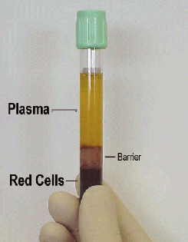
CBC values:
Hematocrit: The fraction of the blood volume comprised of RBCs is termed the hematocrit (volume of RBCs/Total volume of blood x100)
Normal values
Males 47% +/- 5%
Females 42% +/- 5%
Plasma (55% of whole blood)
Buffy coat: leukocytes and platelets (<1% of whole blood)
Formed elements
Erythrocytes (45% of whole blood)

Slide 18
The significance of CBC
Find the cause of symptoms such as fatigue, weakness, fever, bruising, or weight loss
Diagnosis of anemia
Estimation of blood loss
Find an infection
Diagnosis of blood diseases as leukemia
Response to drug or radiation treatment
Screening before surgery
Abnormal count of certain types of cells

Slide 19
TABLE 1: The Complete Blood Cell Count
Parameter | Normal adult range | Indications
Hemoglobin | Male: 14.0 – 17.4 mg/dL Female: 12.0 – 16.0 mg/dL | Low: Anemia High: Polycythemia
Hematocrit | Male: 42% – 52% Female: 35% – 48% | Low: Anemia High: Polycythemia
RBC count | Male: 4.5 – 5.5 x 10⁶/µL Female: 4.0 – 5.0 x 10⁶/µL | Low: Anemia High: Polycythemia
WBC count | 5.0 – 10.0 x 10³/µL | Low: Leukopenia High: Leukocytosis
Platelet count | 140 – 400 x 10³/µL | Low: Thrombocytopenia High: Thrombocytosis
Reticulocyte count (immature RBCs) | 0.5% – 1.5% 25 – 85 x 10³/µL | Low in anemia: Low marrow output High: RBC loss
MCV | 80-100 fL
MCH | 27-31 pg
MCHC | 32-36%
RDW | 11.5-14.5%
Data extracted from: Fischbach FT. A Manual of Laboratory and Diagnostic Tests. Philadelphia, Pa: Lippincott Williams & Wilkins; 2003:47.

