Slide 1
Blood Grouping

Slide 2
Blood group substances
RBC membranes have glycoprotein antigens
These antigens are:
Unique to the individual Human Blood Groups
Recognized as foreign if transfused into another individual
Promoters of agglutination and are referred to as agglutinogens
Presence or absence of these antigens is used to classify blood groups
Humans have 30 varieties of naturally occurring RBC antigens but the important ones are the ABO and the rhesus (Rh) blood systems

Slide 3
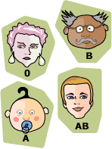
ABO blood grouping system
According to the ABO blood typing system there are four different kinds of blood types depending on the antigen of the RBC membrane: A, B, AB or O

Slide 4
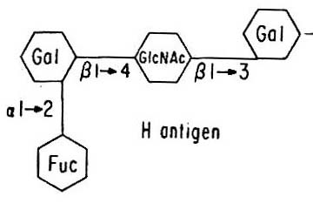
Synthesis of blood group substances 1. H/O substance (H or O antigen)
Is the precursor of both A substance (A antigen) and B substance (B antigen)
Is formed by the action of Fucosyl Transferase that catalyses addition of fucose residue to the terminal galactose residue of H substance precursor
H antigen
Fucose
Added by Fucosyl transferase

Slide 5
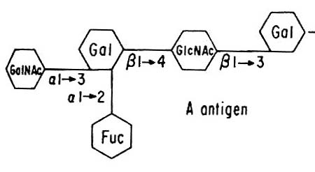
Synthesis of blood group substances 2. A substance
Is formed by the action of N-acetyl-D GalactosamineTransferase (GalNAC transferase) that catalyses addition of GalNAC to the terminal Gal residue of H substance.
GalNAc
(N-Acetyl-
D galactosamine)
A antigen

Slide 6
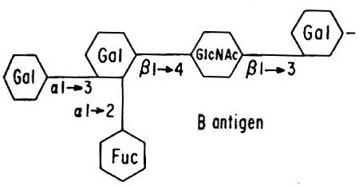
Synthesis of blood group substances 3. B substance
Is formed by the action of Galactosyl Transferase that catalyses the transfer of Gal residue to the terminal galactose residue of H substance
D-Galactose Added by Galactosyl transferase
B antigen

Slide 7
AB0 blood grouping system
Blood group A:
If you belong to the blood group A, you have A antigens on the surface of your RBCs and B antibodies in your blood plasma
Blood group B:
If you belong to the blood group B, you have B antigens on the surface of your RBCs and A antibodies in your blood plasma

Slide 8
AB0 blood grouping system
Blood group AB
If you belong to the blood group AB, you have both A and B antigens on the surface of your RBCs and no A or B antibodies at all in your blood plasma
Blood group O
If you belong to the blood group O (null), you have neither A or B antigens on the surface of your RBCs but you have both A and B antibodies in your blood plasma

Slide 9
How common is your blood type?
46.1%
38.8%
11.1%
3.9%

Slide 10
Rhesus (Rh) Blood Groups
Is the second most significant blood group system in human transfusion
Rh antigens are transmembrane proteins
The D antigen (RhD) is the most important
If it is present, the blood is RhD positive (~80% of the population) , if not it's RhD negative
So, for example, some people in group A will have it, and will therefore be classed as A+ (or A positive), while the ones that don't, are A- (or A negative) and so it goes for groups B, AB and O

Slide 11
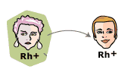
Rhesus (Rh) Blood Groups
A person with Rh+ blood can receive blood from a person with Rh- blood without any problems

Slide 12
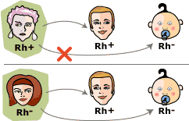
Rhesus (Rh) Blood Groups
A person with Rh⁻ blood can develop Rh antibodies in the blood plasma if he or she receives blood from a person with Rh⁺ blood, whose Rh antigens can trigger the production of Rh antibodies

Slide 13
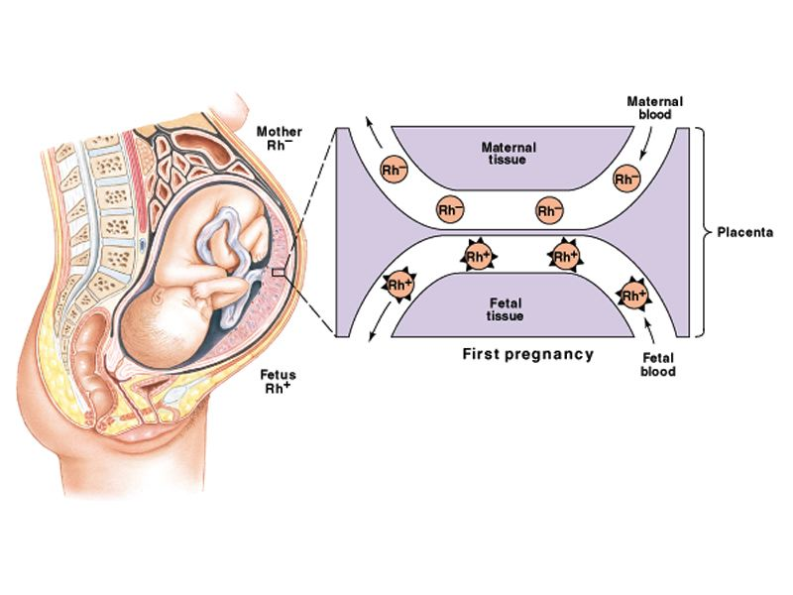
Hemolytic Disease of the Newborn (Erythroblastosis Fetalis)

Slide 14
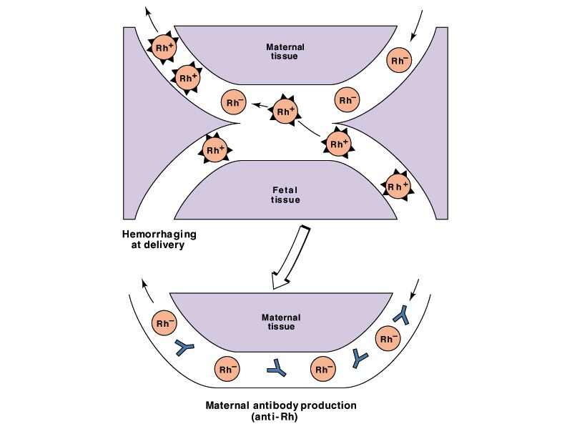
Rh⁺ Fetal cells enter mother’s circulation at delivery

Slide 15
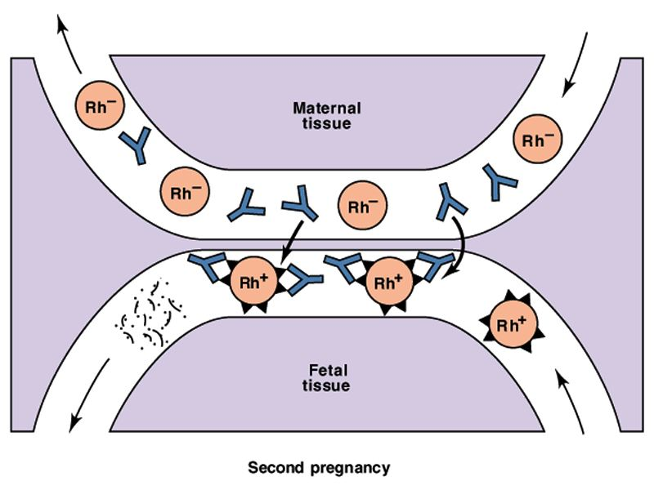
Second pregnancy: Maternal anti-Rh IgG antibodies can cross placenta to attack fetal RBCs
→ Hemolysis
hemolysis

Slide 16
Hemolytic Disease of the Newborn (Erythroblastosis Fetalis)
Mother is Blood type Rh⁻
Father and fetus are Rh⁺
First pregnancy = sensitization at delivery due to hemorrhage
Second pregnancy = Anti-Rh IgG antibodies can cross placenta to attack fetal RBCs → hemolysis

Slide 17
Hemolytic Disease of the Newborn (Erythroblastosis Fetalis)
Rh⁻ mothers who have had a pregnancy with/are pregnant with a Rh⁺ infant are given Rh immune globulin (RhIG) at 28 weeks during pregnancy and within 72 hours after delivery to prevent sensitization to the D antigen.
It works by binding any fetal red cells with the D antigen before the mother is able to produce an immune response and form anti-D IgG

Slide 18
Hemolytic Disease of the Newborn (Erythroblastosis Fetalis)
Maternal antibodies destroy fetal red blood cells
Results in anemia
Anemia limits the ability of the blood to carry oxygen to the baby's organs and tissues.
Baby's responds to the hemolysis by trying to make more red blood cells very quickly in the bone marrow and the liver and spleen.
Organs enlarge - hepatosplenomegaly.
New red blood cells released prematurely from bone marrow and are unable to do the work of mature red blood cells.

Slide 19
Hemolytic Disease of the Newborn (Erythroblastosis Fetalis)
As the red blood cells break down, bilirubin is formed.
Babies unable to get rid of the bilirubin.
Builds up in the blood (hyperbilirubinemia ) and other tissues and fluids of the baby's body resulting in jaundice.
The placenta helps get rid of some of the bilirubin, but not all.

Slide 20
Complications During Pregnancy***
Severe anemia with enlargement of the liver and spleen
When these organs and the bone marrow cannot compensate for the fast destruction of red blood cells, severe anemia results, and other organs are affected
Hydrops Fetalis
This occurs as the baby's organs are unable to handle the anemia. The heart begins to fail, and large amounts of fluid build up in the baby's tissues and organs. A fetus with hydrops is at great risk of being stillborn.

Slide 21
Hemolytic Disease of the Newborn (Hydrops Fetalis)

Slide 22
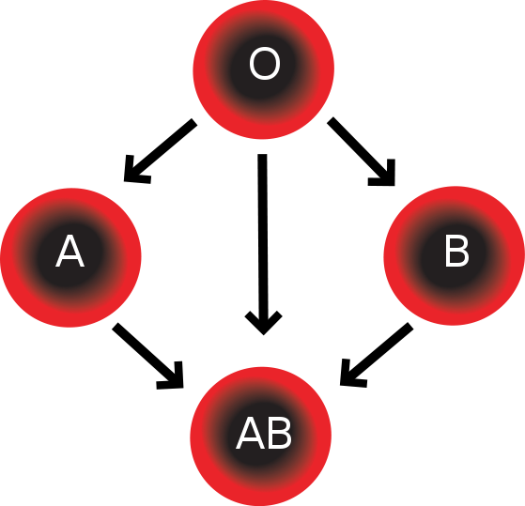
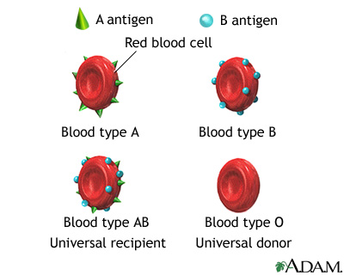
Blood transfusions – who can receive blood from whom?
People with blood group O: "universal donors“
People with blood group AB: "universal receivers"

Slide 23
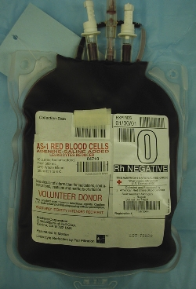
Type of Blood Transfusion
Whole Blood
Blood Component
RBC; PLT(platelets); FFP (Fresh Frozen Plasma); Leukocyte; concentrate.
Using the whole blood is a waste of resources.

Slide 24
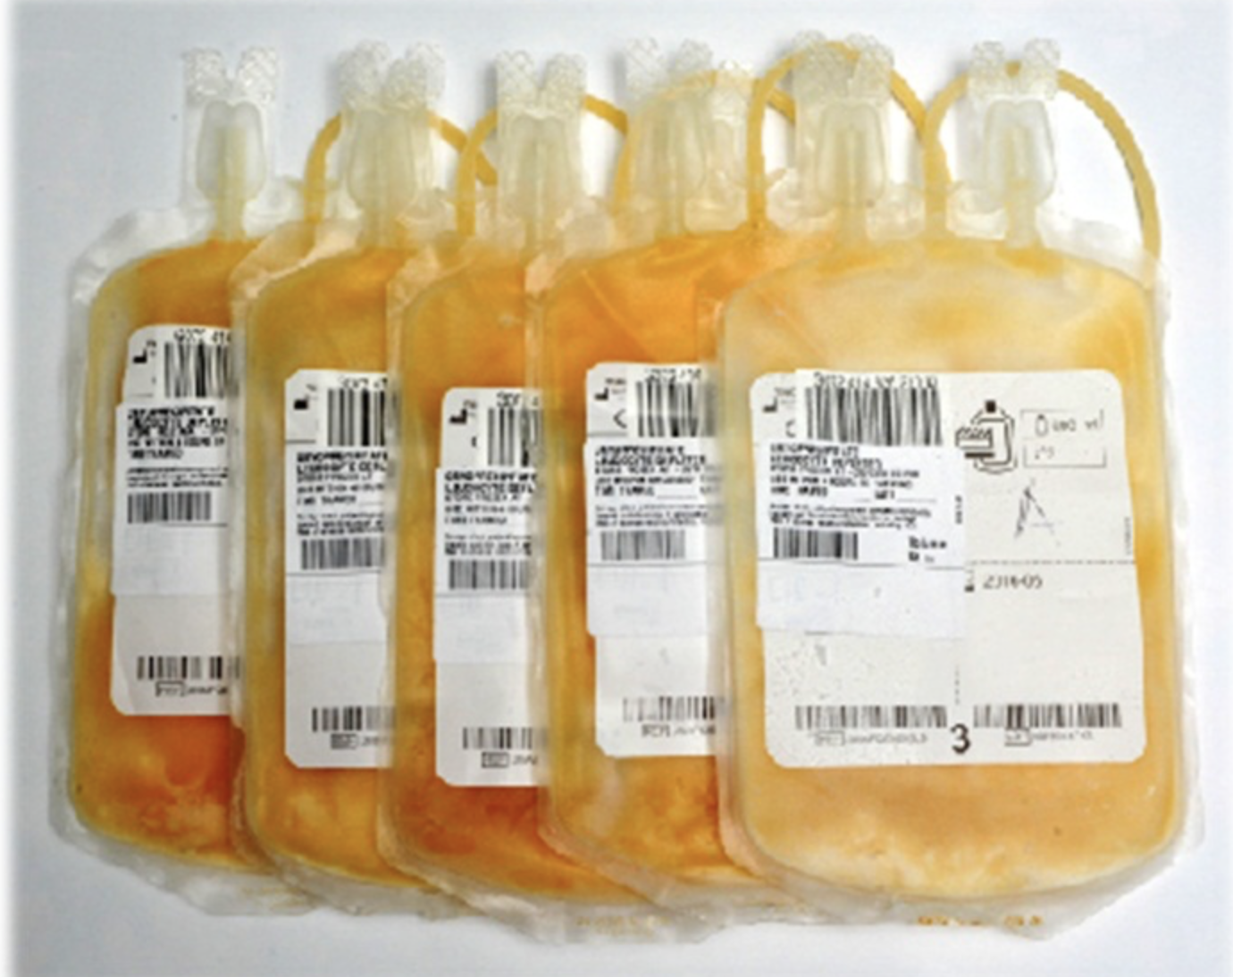
Whole blood
The preparation of blood components from whole blood
Cellular components
Red cells
Platelets
White cells
Fresh plasma
Fresh frozen plasma
Cryoprecipitate Cryosupernatant
Factor VIII Albumin
Concentrate Immunoglobulins
other concentrates
Notes:
Cryoprecipitate is prepared from plasma and contains fibrinogen, factor VIII, von Willebrand factor, factor XIII and fibronectin. It is stored frozen and must be transfused within 6 hours of thawing or 4 hours of pooling.
Cryoprecipitate is the part of plasma that contains a number of clotting proteins (factors) that help control bleeding. It's made by thawing fresh frozen plasma (FFP) between 1 and 6˚C and then collecting the cold-insoluble proteins (precipitate). This is then refrozen for storage and thawed again when someone needs it.
Cryosupernatant the portion of fresh frozen plasma that remains after the removal of cryoprecipitate. It contains very low levels of factor VIII,fibrinogen, and von Willebrand's factor.

Slide 25
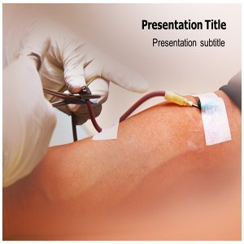
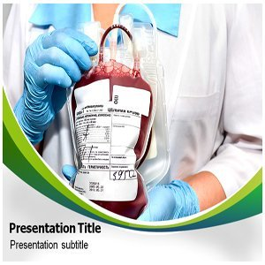
Blood transfusion

Slide 26
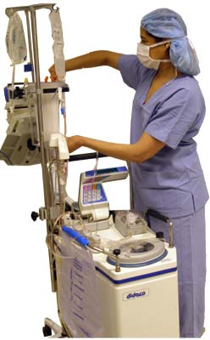
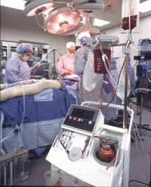

Slide 27
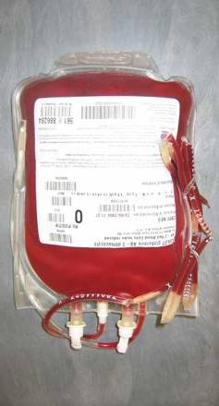
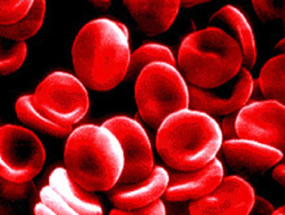
Blood transfusion
Blood transfusion involves the infusion of whole blood or a blood component from one individual (donor) to another(the recipient).
Compatibility between donor red cell antigens and the recipient’s plasma antibodies must be ensured, otherwise potentially fatal haemolytic reactions may occur.

Slide 28
Blood Types
Categorized according to antigens on red blood cells
Type A: A antigens
Type B: B antigens
Type O: no antigens (universal donor)
Type AB: A and B antigens (universal recipient)
D antigen, third antigen; may be present on the red blood cells
a. Rh factor positive: D antigen is present
b. Rh factor negative: D antigen is not present

Slide 29
Blood Donation
In emergencies, there are certain exceptions to the rule that the donor's blood type must match the recipient's exactly: Blood type O negative is the only type of blood that people of all other blood types can receive. This is helpful in emergency situations when the patient needs a transfusion, but their blood type is unknown. Because of this, O negative donors are called "universal donors." People who have type AB blood are called "universal recipients" because they can safely receive any type of blood.

Slide 30
Blood Donation
Blood is mostly donated as whole blood by inserting a catheter into a vein and collecting it in a plastic bag (mixed with anticoagulant) via gravity.
The collected blood is then separated into components to make the best use of it.

Slide 31
Blood Donation
Improvements in the quality of transfused blood, by, for example, the removal of white blood cells, eliminate the theoretical risk that transfusion might lead to cancer recurrence or postoperative infection.
ABOand RhD blood groups, red cell antibody screen and serological tests to exclude syphilis, hepatitis B surface antigen , hepatitis Cvirus (HCV) and HIV.
Blood is stored at 4-6 Cº.

Slide 32
Who Can Donate Blood?
To donate blood, donors should be at least 17 years old and weigh more than 110 pounds (49.8952 kg ). Also, they must be in good health and will be screened for certain medical conditions, such as anemia.
People who meet the eligibility requirements will need to give their medical history and pass a physical exam before donating.

Slide 33
Blood Transfusions:
Blood transfusions can be grouped into two main types depending on their source:
Homologous transfusions, or transfusions using the stored blood of others.
Autologous transfusions, or transfusions using one's own stored blood.

Slide 34
Cross-Matching and Pre-transfusion Tests
A number of steps are taken to ensure that patients receive compatible blood at the time of transfusion:
From the patient :
The ABO and the Rh blood group is determined.
Serum is screened for important antibodies by an indirect antiglobulin test on a large panel of antigenically-typed red cells.
From the donor:
An appropriate ABO and Rh unit is selected.

Slide 35
Cross-Matching and Pre-transfusion Tests(cont.)
At the cross-match:
The patient’s serum is added to donor red cells and spun down to exclude agglutination(the immediate spin). Techniques used in compatibility testing. Donor cells tested against recipient serum and agglutination detected visually or microscopically after mixing and incubation at the appropriate temperature.

Slide 36
Risk associated with blood transfusion:
Transmission of viral infection –hepatitis B, hepatitis C, HIV.
Anaphylactic reactions
Acute hemolytic reactions, acute onset within minutes or 1-2 hours after transfuse incompatible blood ABO-incompatible transfusion).
Volume overload
Iron overload

Slide 37
Acute Hemolytic Transfusion Reaction
Pathophysiology
Ab (in recipient serum) + Ag (on RBC donor)
-Neuroendocrine responses
-Complement Activation
-Coagulation Activation
- Cytokines Effects
Acute hemolytic transfusion reaction

Slide 38
Blood transfusion
If a patientís haemoglobin level is greater than 145 g/l then for most common operations autologous blood should not be collected, as 90% would only be discarded.
Improvements in the quality of transfused blood, by, for example, the removal of white blood cells, leucodepletion, eliminate the theoretical risk that transfusion might lead to cancer recurrence or postoperative infection.

Slide 39
Complications of Blood Transfusion
Bacterial contamination of packed RBCs occurs rarely, possibly due to inadequate aseptic technique during collection or to transient asymptomatic donor bacteremia.
Malaria is transmitted easily through infected RBCs. Many donors are unaware that they have malaria, which may be latent and transmissible for 10 to 15 years.

Slide 40
Complications of Blood Transfusion(cont.)
Massive transfusion is transfusion of a volume of blood greater than or equal to one blood volume in 24 h (eg, 10 units in a 70-kg adult), when a patient receives stored blood in such large volume, the patient's own blood may be, in effect, “washed out.”
Viral transmission hepatitis may be caused by one of the hepatitis viruses, CMV(cytomegalovirus) and EBV (Epstein virus).

Slide 41
Complications of Blood Transfusion(cont.)
Transfusion-related acute lung injury is an infrequent complication caused by anti-HLA and/or anti-granulocyte antibodies in donor plasma that agglutinate and degranulate recipient granulocytes within the lung. Acute respiratory symptoms develop, and chest x-ray has a characteristic pattern of noncardiogenic pulmonary edema.
Post-transfusional iron overload, repeated red cell transfusion over many years in the absent of blood loss, cause deposition of iron.

Slide 42
Transfusion transmitted infections reported to SHOT

