Slide 1
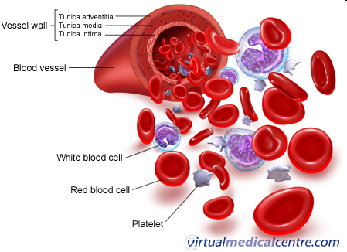
Body Fluids

Slide 2
Body Fluids
Body fluids are liquids originating from inside the bodies of living people. Water makes up approximately 60% of the human body weight (~ 42 L).

Slide 3
Body Water
“Fluid compartments”
Intracellular fluid
Extracellular fluid
Interstitial fluid
Blood plasma
Lymph
transcellular fluid

Slide 4
Total Body Water

Slide 5
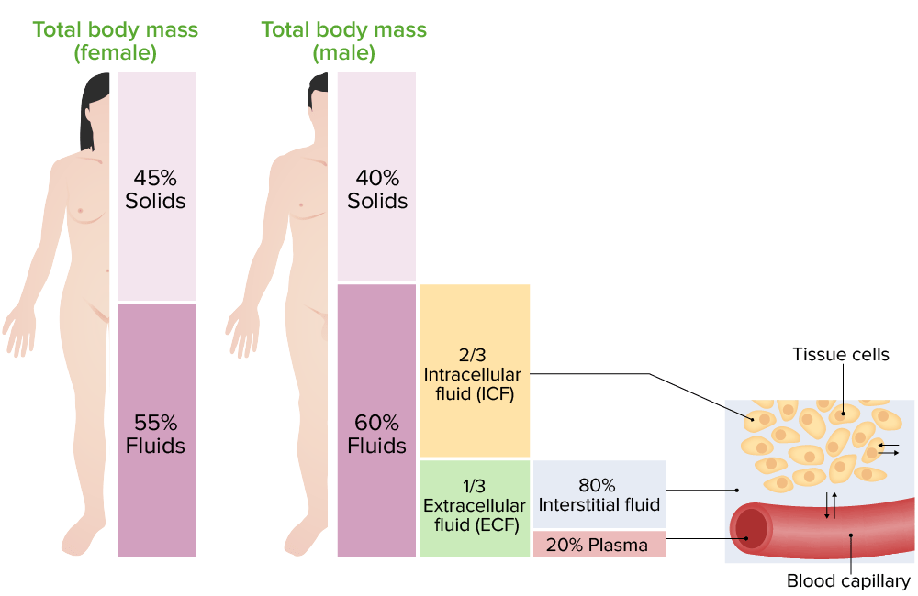
Distribution of body fluids

Slide 6
Distribution of body fluids
ECF include:
Interstitial fluid - the fluid between cells in tissues.
Plasma - the fluid component of blood
Lymph - the fluid in our lymphatic vessels
Transcellular fluids.

Slide 7
Distribution of body fluids(cont.)
Transcellular fluids:
Cerebrospinal Fluid (CSF) - the fluid within the CNS
Synovial fluid - the fluid within most joints
Peritoneal, pericardial, pleural, pancreatic, intraocular, biliary fluids
Fluid compartments are separated by membranes that are freely permeable to water.

Slide 8
Composition of body fluids
Glucose
Amino acids
Fatty acids
Hormones
Enzymes
Sodium
Potassium
Calcium
Magnesium
Chloride
Phosphate
Sulphate
Organic substances
Inorganic substances

Slide 9
Electrolytes in body fluids
Ions form when electrolytes dissolve and dissociate.
4 General functions:
Control osmosis of water between body fluid compartments. (Loss of sodium, at least initially, leads to loss of water and contraction in the extracellular fluid volume).
Help to maintain the acid-base balance
Carry electrical current
Serve as cofactors

Slide 10
Differences between ECF & ICF
ECF
Anions: Cl⁻ (108) HCO₃⁻ (24) | Cations: Na⁺ (142mmol/L) K⁺ (4.2) Mg²⁺ (0.8)
Nutrients: O₂, glucose, fatty acids, & amino acids.
Wastes: CO₂, Urea, uric acid, excess water, & ions.
ICF
Anions: Cl⁻ (4) HCO₃⁻ (10) Phosphate ions | Cations: Na⁺ (14) K⁺ (140) Mg²⁺ (20)
Nutrients: High concentrations of proteins.

Slide 11
Functions of ICF & ECF
ICF: is vital to normal cell function, it contain solutes such as oxygen, electrolytes and glucose. It provides a medium for metabolic processes. (pH = 7).
ECF: it is the transport system that carries nutrients and waste products from the cell. (pH = 7.4)

Slide 12
Significance of body fluids
In Metabolic reactions: water inside the cells forms the medium for various metabolic reactions, which are necessary for growth and functional activities of the cells.
In Transport mechanism: Body water forms the transport medium by which nutrients and other essential substances enter the cells and wastes come out of the cells.

Slide 13
Significance of body fluids (Cont.)
In Temperature regulation : body water plays a vital role in the maintenance of normal body temperature.
In texture of tissues : water inside the cells is necessary for the characteristic form and texture of various tissues.

Slide 14
Significance of body fluids (Cont.)
In Homeostasis: Body cells survive in the fluid medium called internal environment or milieu interior.
Growth and functions of cells: Glucose, amino acids, lipids, vitamins, ions, oxygen etc., in proper quantities in the internal environment.

Slide 15
Examples of Body Fluids
Ocular Fluid (aqueous humour): is a clear, gelatinous fluid similar to plasma, made up mostly of water (99%), hyaluronic acid, sugar, ascorbic acid and inorganic salts.
Bile secreted from the liver into the duodenum to aid in lipid digestion. It is composed of water (85%), bile salts (10%), mucus and pigments (3%), fats (1%).

Slide 16
Examples of Body Fluids (Cont.)
Gastric Juice: Is a fluid formed in the stomach, used to digest proteins. It is composed of hydrochloric acid (0.5%) and large quantities of potassium and sodium chloride.
Saliva: Is produced by salivary glands in the human mouth. Saliva is composed of water (98%) and the remaining 2% is mucus, electrolytes, enzymes and various antibacterial compounds.

Slide 17
Examples of Body Fluids (Cont.)
Semen: Also known as seminal fluid, is the fluid secreted from the male sexual glands.
Sweat: Is the production of fluid by the sweat glands in the skin. It is made up of mainly water and various dissolved solids.

Slide 18
Factors affecting body fluids
Water intake & output.
Age:
% of total body weight.
Infants (80%), late teen and Adults (60%),
old age (40-50%)
Sex:
Adult males: 60%
Adult females: 40-50%

Slide 19
Factors affecting body fluids (Cont.)
Obesity (adipose tissue): The greater the proportion of adipose tissue, the less the % of water.
Climate.
Habits.
Level of physical activity.

Slide 21
Daily intake & output of water

Slide 22
Water may serve as:
Medium of metabolic reactions within cells.
Transporter of nutrients, waste products, and other substances.
A lubricant.
Shock absorber.
Regulates and maintains body temperature.

Slide 23
Disorders of Water Balance

Slide 24
Dehydration
Loss of water from the body,
e.g., vomiting, diarrhea, sweating, & polyuria.
Leads to ↓ in both ECF & ICF volumes.
↑ Osmolarity in both ECF & ICF.

Slide 25
Dehydration(cont.)
General signs:
- Dry tongue.
- loss of skin elasticity.
- soft eyeballs (due to lowering of intraocular tension).
- ↓ blood pressure (if ≥ 4-6L loss).
- ↑ Hb, & ↑ Hct (packed cell volume).
Treated with fluid replacement (orally, or IV).

