Slide 1
Chapter 3 (Unit 1)
Types of Owner

Slide 2
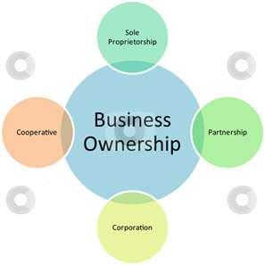
Types of legal structures

Slide 3
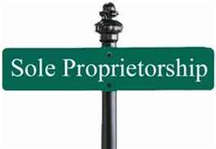
Sole proprietorship
-The simplest form of structure to set up .
A business that falls under this category has my legal existence separate from its owner .
All the profits belong to you as the owner of the business .
Examples :
grocery store , bakeries …..ets .

Slide 4
General partnership
-A business owned by tow or more individuals .
-Personal liable for all transaction proprietors .

Slide 5
Corporation
Exists separately from the people who created it .
-Run by board directors elected by the shareholders.
Have four characteristic :
1- Liability limited to the extent of assets .
2- Continuity of life .
3- Centralization of management .
4- Free transferability of ownership assets .

Slide 6
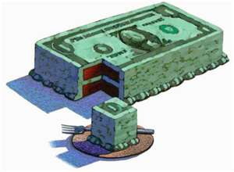
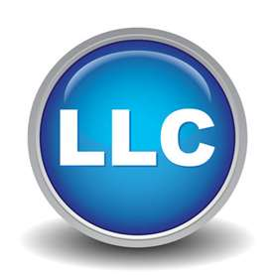
Limited liability company
Limited liability to it owners .
Flexibility in deciding the system of income taxes .
More flexible than a corporation .
It is a form of organization well suited to companies a single owner .

Slide 7
Nonprofit corporation
Provide a service to the community
Cannot be bought or sold like business.

Slide 8
Story from real life ….

