Slide 1
Total RNA Extraction From Tissue

Slide 2
Objectives
Isolation of total RNA from blood sample.

Slide 3
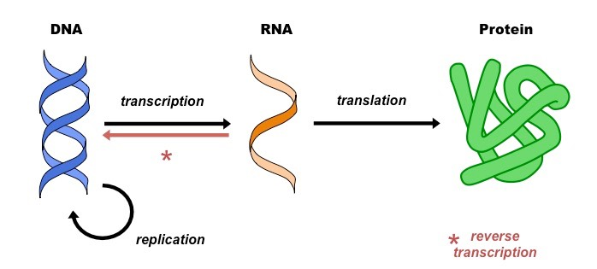
RNA Isolation
RNA (Ribonucleic acid).
RNA, is formed from DNA by a process called transcription.
The three most well-known types of RNA: mRNA, rRNA, and tRNA.
Obtaining pure RNA is an essential step ?
Types of RNA isolation?
Notes:
https://www.biochain.com/blog/types-of-rna-and-how-to-extract-or-purchase-it/

Slide 4
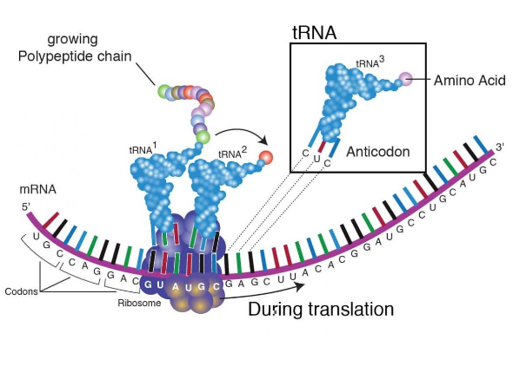
mRNA, tRNA, and rRNA function | Types of RNA :
https://www.youtube.com/watch?v=1THyMOk3WU0
Types of RNA
What are Ribosomes? | Ribosome Function and Structure
https://www.youtube.com/watch?v=WjnUJusSYAo
https://www.biochain.com/blog/types-of-rna-and-how-to-extract-or-purchase-it/

Slide 5
Method of RNA Isolation
The basic procedures used in RNA purification are similar to those of DNA, Why?
However, RNA isolation is more difficult than DNA purification, Why?
Removal of proteins and contaminants
Recovery of RNA
Lysis
Notes:
rapid degradation by ubiquitous ribonuclease enzymes. In addition, relative levels of RNA within a particular cell type can change rapidly with changes to cellular metabolism

Slide 6
Method of RNA Isolation
Organic extraction methods
Filter- based spin basket formats
Magnetic particle methods.
The GOAL is to..
extract pure intact RNA

Slide 7
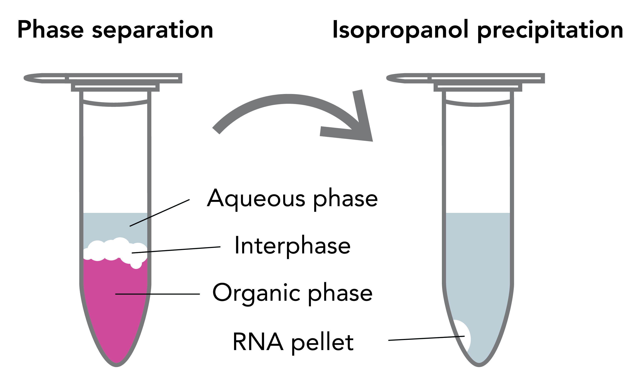
Principles of Organic extraction method
Solubility dependence
lower organic phase
middle phase that contains denatured proteins and gDNA
upper aqueous phase contains RNA
https://www.youtube.com/watch?v=Vz2uu5iyT0I
https://www.youtube.com/watch?v=Vz2uu5iyT0I

Slide 8
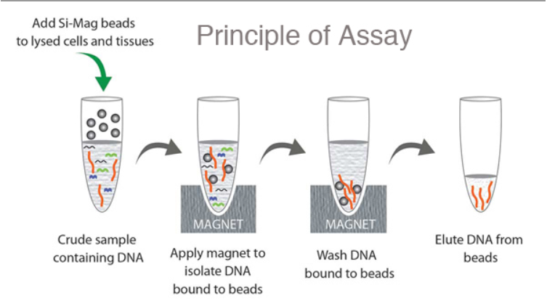
Principles of Magnetic particle method
https://mvspacific.com/REAGENTS/DNA%20Isolation%20Kits.htm
https://www.youtube.com/watch?v=SJ6c40lJuK0

Slide 9
Practical Part

Slide 10
Aim:
To isolate pure and intact total RNA from Rat blood sample using Filter- based spin basket format.
Principle:
In general, Lysing and denaturing cells to liberate total nucleic acids in the presence of RNase inhibitory agents . Additional steps are then required to remove DNA.

Slide 11
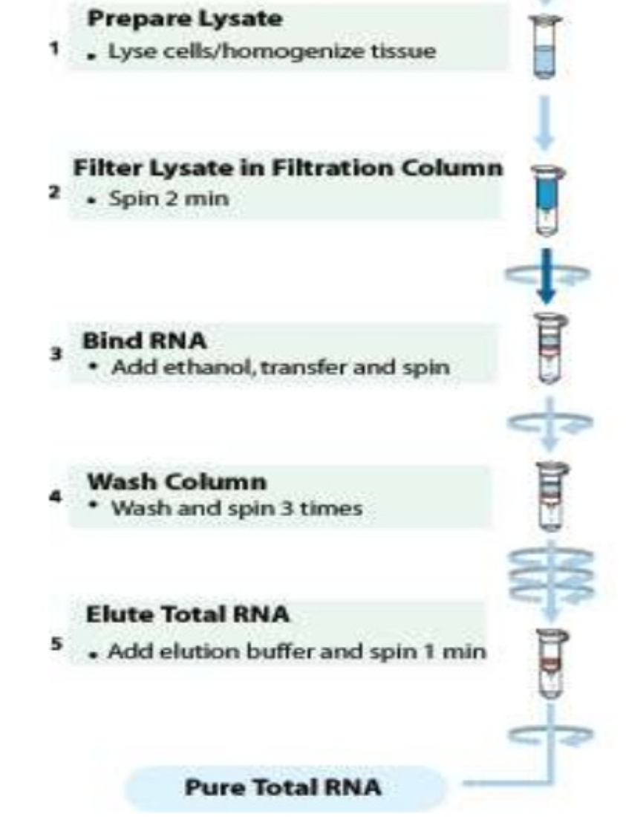
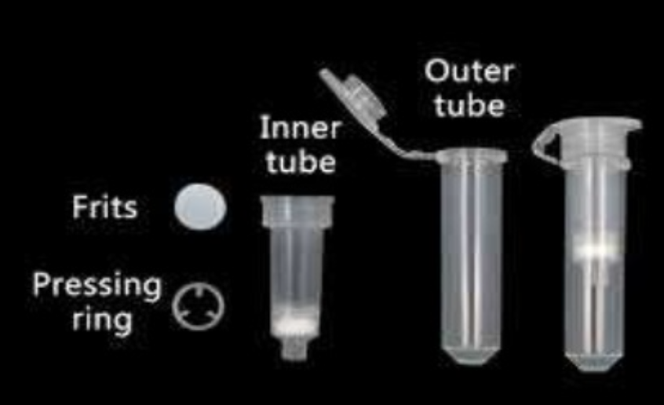
Principle of: Filter-based, spin basket method

Slide 12
Principle of Gene JET RNA Purification Kit:
Samples are lysed in Lysis Buffer, which contains guanidine thiocyanate, a chaotropic salt capable of protecting RNA from endogenous RNases.
The lysate is then mixed with ethanol and loaded on a purification column.
The chaotropic salt and ethanol cause RNA to bind to the silica membrane while the lysate is spun through the column.
Subsequently, impurities are effectively removed from the membrane by washing the column with wash buffers.
Pure RNA is then eluted under low ionic strength conditions with nuclease-free water.

Slide 13
Results:
The concentration, purity, and integrity of the extracted RNA need to be determined.
The A260/A280 ratio is used to assess RNA purity. An A260/A280 ratio of 1.8–2.1 indicates highly purified RNA.

