Slide 1
Tissue Embedding and Sectioning
322 - Histological Techniques

Slide 2
Frozen Sectioning
Embed fresh tissue in OCT compound in cryomolds.
Cut 4-8 μm thick cryostat sections and mount on superfrost plus slides or gelatin coated slides.
Before staining, warm slides at room temperature for 5-10 minutes and fix in ice cold acetone or other alternate fixatives for 5-10 minutes.
Wash in PBS and proceed to standard staining procedure (H & E).
Cover slip with water based mounting media.

Slide 3
http://www.youtube.com/watch?v=VyvyxsNKNOQ

Slide 4
Tissue Embedding

Slide 5
Embedding Steps
Turn the heat block on to melt the paraffin one hour before adding the tissue cassettes.
Place the entire cassettes in up to 65°C paraffin bath for 15 minutes to melt the wax.
Warm metal block molds on the hot plate.
Open cassette to view tissue sample and choose a mold that best corresponds to the size of the tissue.

Slide 6
Embedding Steps con.
Put small amount of molten paraffin in mold, dispensing from paraffin reservoir.
Using warm forceps, transfer tissue into mold, placing cut side down, as it was placed in the cassette.
Transfer mold to cold plate, and gently press tissue flat. Paraffin will solidify in a thin layer which holds the tissue in position.

Slide 7
Embedding Steps con.
If the tissue is in the desired orientation add the labeled tissue cassette on top of the mold as a backing.
Add hot paraffin to the mold from the paraffin dispenser. Be sure there is enough paraffin to cover the face of the plastic cassette.
If necessary, fill cassette with paraffin while cooling, keeping the mold full until solid.

Slide 8
Embedding Steps con.
When the wax is completely cooled and hardened (~20 minutes) the paraffin block can be easily removed out of the mold, the wax blocks should not stick. If the wax cracks or the tissues are not aligned well, simply melt them again and start over.

Slide 9
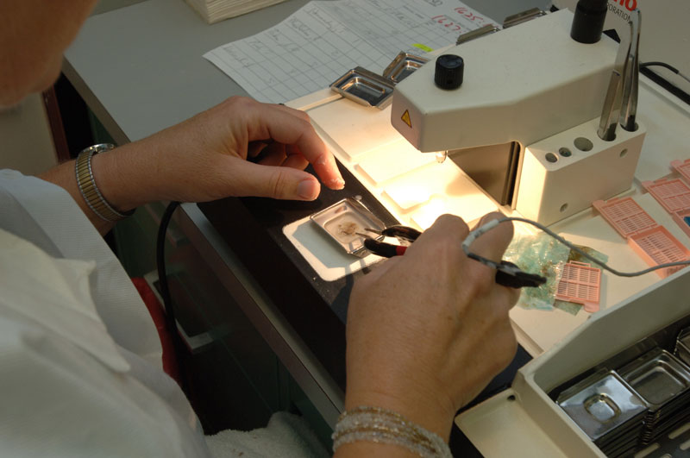

Slide 10
http://www.youtube.com/watch?v=QKvT9KNM0M0
http://www.youtube.com/watch?v=FaOWA-y9UKI

Slide 11
Tissue Sectioning

Slide 12
Tissue Sectioning
Remove wax from surface of the block to expose the tissue (trim blocks at room temperature. Avoid trimming holes by using no greater than 15µm steps)
Chill block on refrigerated plate or covered ice tray for 10 minutes before sectioning at 5µm. Blocks kept on ice for too long will crack and absorb water.
Clean the surface of the water bath by ‘skimming’ with tissue paper .

Slide 13
Tissue Sectioning con
Float sections onto water bath that is hot enough to allow section to flatten completely but not expand too much or disintegrate.
Pick up sections on to cleaned coated slides .
Ensure that sections are clearly labeled and dry properly.
Dry upright at 60⁰C before staining to melt wax and improve adhesion.

Slide 14
http://www.youtube.com/watch?v=KnMdSgd5mts&feature=related

