Slide 1
Thermochemistry
The study of the energy transferred as heat during the course of chemical reactions is called thermochemistry
Thermochemistry is a branch of thermodynamics because a reaction vessel and its contents form a system, and chemical reactions result in the exchange of energy between the system and the surroundings.
The exchange of heat during a chemical reaction between the system and the surroundings measured at constant pressure signifies a change in the enthalpy ΔH
An exothermic reaction is one for which ΔH < 0;
such a reaction is exenthalpic.
An endothermic reaction is one for which ΔH > 0;
such a reaction is endenthalpic.

Slide 2
Standard enthalpy changes
The standard enthalpy change, ΔH ⦵, is the change in enthalpy for a process
in which the initial and final substances are in their standard states
The standard state of a substance at a specified temperature is
its pure form at 1 bar.
The standard enthalpy change for a reaction, or a physical process is the difference in enthalpy between the products in their standard states and the reactants in their standard states, all at the same specified temperature
An example of a standard enthalpy change is the standard enthalpy of vaporization, Δ_{vap}H ⦵, which is the enthalpy change per mole of molecules when a pure liquid water at 1 bar vaporizes to a gas at 1 bar.
H₂O(l) → H₂O(g) Δ_{vap}H ⦵(373 K) = +40.66 kJ mol⁻¹

Slide 3
Enthalpies of physical change
The standard molar enthalpy change that accompanies a change of physical state is called the standard enthalpy of transition and is denoted Δ_{trs}H ⦵.
H₂O(l) → H₂O(g) Δ_{vap}H ⦵(373 K) = +40.66 kJ mol⁻¹
H₂O(s) → H₂O(l) Δ_{fus}H ⦵(273 K) = +6.01 kJ mol⁻¹
Standard enthalpies of fusion and vaporization at the
transition temperature
 | T_{f} /K | Fusion | T_{b}/K | Vaporization
Ar | 83.81 | 1.188 | 87.29 | 6.506
C₆H₆ | 278.61 | 10.59 | 353.2 | 30.8
H₂O | 273.15 | 6.008 | 373.15 | 40.656 (44.016 at 298 K)
He | 3.5 | 0.021 | 4.22 | 0.084

Slide 4
Because enthalpy is a state function, a change in enthalpy is independent of the path between the two states
This feature is very important in thermochemistry, because it implies that the same value of ΔH ⦵ will be obtained, regardless of how the change is brought about between specified initial and final states
For example, the conversion of a solid to a vapour can be pictured either as occurring by sublimation (the direct conversion from solid to vapour),
H₂O(s) → H₂O(g) Δ_{sub}H ⦵
or as occurring in two steps, first fusion (melting) and then vaporization of the resulting liquid:
H₂O(s) → H₂O(l) Δ_{fus}H ⦵
H₂O(l) → H₂O(g) Δ_{vap}H ⦵
Overall: H₂O(s) → H₂O(g) Δ_{fus}H ⦵ + Δ_{vap} H ⦵
g
H
Δ
vap
H
⦵
Enthalpy,
Δ
sub
H
⦵
l
Δ
fus
H
⦵
s
Another consequence of H being a state function is that the standard enthalpy change of a forward process is the negative of its reverse :
ΔH ⦵(A → B) = −ΔH ⦵(A ← B)
B
H
Enthalpy,
Δ
H
⦵
(
A
→
B)
Δ
H
⦵
(
A
←
B)
A

Slide 5
Enthalpies of reaction and transition
Transition | Process | Symbol*
Transition | Phase α → phase β | Δ_{trs}H
Fusion | s → l | Δ_{fus}H
Vaporization | l → g | Δ_{vap}H
Sublimation | s → g | Δ_{sub}H
Mixing | Pure → mixture | Δ_{mix}H
Solution | Solute → solution | Δ_{sol}H
Hydration | X±(g) → X±(aq) | Δ_{hyd}H
Atomization | Species(s, l, g) → atoms(g) | Δ_{at}H
Ionization | X(g) → X⁺(g) + e⁻(g) | Δ_{ion}H
Electron gain | X(g) + e⁻(g) → X⁻(g) | Δ_{eg}H
Reaction | Reactants → products | Δ_{r}H
Combustion | Compound(s, l, g) + O₂(g) → CO₂(g) + H₂O(l, g) | Δ_{c}H
Formation | Elements → compound | Δ_{f}H
Activation | Reactants → activated complex | Δ‡H

Slide 6
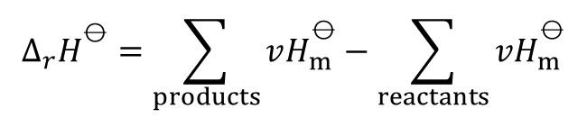
Enthalpies of chemical change
There are two ways of reporting the change in enthalpy that accompanies a chemical reaction
One is to write the thermochemical equation, a combination of a chemical equation and the corresponding change in standard enthalpy
CH₄(g) + 2O₂(g) → CO₂(g) + 2H₂O(g) ΔH ⦵ = −890 kJ
ΔH ⦵ is the change in enthalpy when reactants in their standard states change to products in their standard states:
Pure, separate reactants in their standard states → pure, separate products in their standard states
Alternatively, the chemical equation is written and the standard reaction enthalpy, Δ_{r}H ⦵ (or ‘standard enthalpy of reaction’), is reported. Thus, for the combustion of methane at
298 K, write
CH₄(g) + 2O₂(g) → CO₂(g) + 2H₂O(l) Δ_{r}H ⦵ = −890 kJ mol⁻¹
For a reaction of the form 2A + B → 3C + D, the standard reaction enthalpy would be
Δ_{r}H ⦵ = {3H_{m} ⦵ (C) + H_{m}⦵ (D)} − {2H_{m}⦵(A) + H_{m}⦵(B)}
And in general,
$$∆_{r}H^{\text{⦵}}=\sum_{products}{vH_{m}^{\text{⦵}}}−\sum_{reactants}{vH_{m}^{\text{⦵}}}$$

Slide 7
Standard enthalpies of formation and combustion of organic compounds at 298 K
 | Δ_{f} H ⦵/(kJ mol⁻¹) | Δ_{c} H ⦵/(kJ mol⁻¹)
Benzene, C₆H₆(l) | +49.0 | −3268
Ethane, C₂H₆(g) | −84.7 | −1560
Glucose, C₆H₁₂O₆(s) | −1274 | −2808
Methane, CH₄(g) | −74.8 | −890
Methanol, CH₃OH(l) | −238.7 | −721

Slide 8
Hess’s law
Standard reaction enthalpies can be combined to obtain the value for another reaction
This application of the First Law is called Hess’s law
The standard reaction enthalpy is the sum of the values for the individual reactions into which the overall reaction may be divided
The importance of Hess’s law is that information abouta reaction of interest, which may be difficult to determine directly,can be assembled from information on other reactions
For example, Let’s say we are interested in the standard enthalpy of formation of carbon monoxide (CO).
However, burning graphite also produces some carbon dioxide (CO₂), so we cannot measure the enthalpy change for CO directly. We must employ an indirect route, based on Hess’s law. It is possible to carry out the following two separate reactions:
First, we reverse Equation (b) to get
we carry out the operation (a) + (c) and obtain

Slide 9
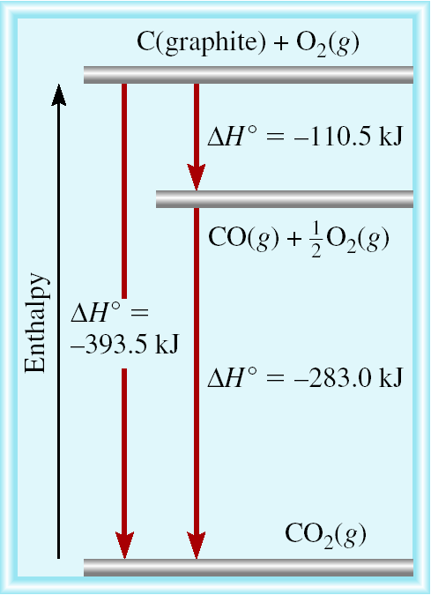
C (graphite) + 1/2O₂ (g) CO (g)
CO (g) + 1/2O₂ (g) CO₂ (g)
C (graphite) + O₂ (g) CO₂ (g)

Slide 10
Example: using the following reactions
1- C₃H₆ (g) + H₂(g) → C₃H₈ (g) Δ_{r}H⦵= −124 kJ
2- C₃H₈ (g) + 5O₂(g) → 3CO₂(g) + 4H₂O(l) Δ_{r}H⦵= −2220 kJ
3- H₂(g) + 1/2O₂(g) → H₂O(l) Δ_{r}H⦵= −286 kJ
Find Δ_{r}H⦵ for the reaction
C₃H₆(g) + 9/2O₂(g) → 3CO₂ (g) + 3H₂O(l)
Soln.
Manipulate the given reactions to get the desired reaction with its own Δ_{r}H⦵.
By leaving reactions 1 and 2 as they are, reversing reaction 3 and summing the results, we get
 | Δ_{r}H ⦵/kJ
C₃H₆(g) + H₂(g) → C₃H₈(g) | −124
C₃H₈(g) + 5 O₂(g) → 3 CO₂(g) + 4 H₂O(l) | −2220
H₂O(l) → H₂(g) + ¹₂ O₂(g) | +286
C₃H₆(g) + ⁹₂ O₂(g) → 3 CO₂ (g) + 3 H₂O(l) | −2058

Slide 11
Standard enthalpies of formation
The standard enthalpy of formation, Δ_{f}H ⦵, of a substance is the standard reaction enthalpy for the formation of the compound from its elements in their reference states
The reference state of an element is its moststable state at the specified temperature and1 bar.
The standard enthalpy of formation of liquid benzene at 298 K, for example, refers to the reaction
s,graphite) + 3H₂(g) → C₆H₆(l) Δ_{f}H ⦵ = +49.0 kJ mol⁻¹
Each substance has its own reaction of formation and Δ_{f}H ⦵
The standard enthalpies of formation of elements in their reference states are zero at all temperatures
Δ_{f}H ⦵ (O₂ (g)) = 0 kJ mol⁻¹
Δ_{f}H ⦵ (O (g)) ≠ 0 kJ mol⁻¹
Δ_{f}H ⦵ (O₃ (g)) ≠ 0 kJ mol⁻¹
Δ_{f}H ⦵ (C (graphite) = 0 kJ mol⁻¹
Δ_{f}H ⦵ (C (diamond)) ≠ 0 kJ mol⁻¹

Slide 12
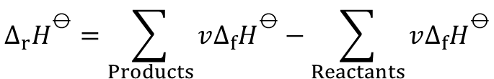
Standard enthalpies of formation of inorganic compounds at 298 K
Standard enthalpies of formation of organic compounds at 298 K
 | Δ_{f}H⦵/(kJ mol⁻¹)
H₂O(l) | −285.83
H₂O(g) | −241.82
NH₃(g) | −46.11
N₂H₄(l) | +50.63
NO₂(g) | +33.18
N₂O₄(g) | +9.16
NaCl(s) | −411.15
KCl(s) | −436.75
 | Δ_{f}H⦵/(kJ mol⁻¹)
CH₄(g) | −74.81
C₆H₆(l) | +49.0
C6H12(l) | −156
CH₃OH(l) | −238.66
CH₃CH₂OH(l) | −277.69
The standard enthalpy of formation of ions in solution poses a special problem because it is not possible to prepare a solution of either cations or anions alone
This problem is overcome by defining one ion, conventionally the hydrogen ion, to have zero standard enthalpy of formation at all temperatures
Δ_{f}H ⦵(H⁺,aq) = 0 Ions in solution [convention]
For any reaction
$$∆_{r}H^{\text{⦵}}=\sum_{Products}{v∆_{f}H^{\text{⦵}}}−\sum_{Reactants}{v∆_{f}H^{\text{⦵}}}$$

Slide 13
Example: The standard enthalpy of formation of phenol is −165.0 kJ mol−1. Calculate its standard enthalpy of combustion.
Solution:
The reaction equation for the combustion of one mole of phenol is
Δ_{r}H ^{Ө} = Δ_{c}H ^{Ө}
Δ_{c}H ^{Ө} for this reaction is given by

Slide 14
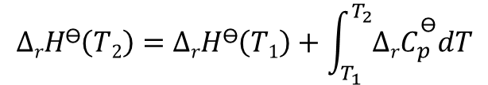
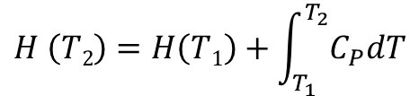

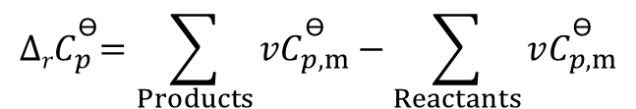
The temperature dependence of reaction enthalpies
Since (dH = C_{p}dT)
Then for each substance Heated
Δ
H
⦵
(
T
)
$$H \left(T2\right)=H\left(T1\right)+\int_{T_{1}}^{T_{2}}{C_{P}dT}$$
H
Products
r
2
Enthalpy,
Δ
H
⦵
(
T
)
Reactants
And for a reaction
r
1
$$∆rH\text{Ө}\left(T2\right)=∆rH\text{Ө}\left(T1\right)+\int_{T_{1}}^{T_{2}}{∆rC_{p}^{\text{Ө}}dT}$$
T
Temperature,
T
This equation is known as Kirchhoff’s law
1
T
2
When the temperature is increased, the enthalpy of the products and the reactants both increase, but may do so to different extents. In each case, the change in enthalpy depends on the heat capacities of the substances. The change in reaction enthalpy reflects the difference in the changes of the enthalpies of the products and reactants
$${∆rC}_{p}^{\text{Ө}}=\sum_{Products}{vC_{p,m}^{\text{Ө}}}−\sum_{Reactants}{vC_{p,m}^{\text{Ө}}}$$
And the integrated form of Kirchhoff’s law is
$∆rH\text{Ө}\left(T2\right)=∆rH\text{Ө}\left(T1\right)+$ $∆rC_{p}^{\text{Ө}}(T2−T1)$

Slide 15
Example: The standard enthalpy of formation of H₂O(g) at 298 K is −241.82 kJ mol⁻¹. Estimate its value at 100 °C given the following values of the molar heat capacities at constant pressure: H₂O(g): 33.58 J K⁻¹ mol⁻¹; H₂(g): 28.84 J K⁻¹ mol⁻¹; O₂(g): 29.37 J K⁻¹ mol⁻¹. Assume that the heat capacities are independent of temperature.
Solution:
The reaction is
H₂(g) + 1/2 O₂(g) → H₂O(g)
so
Δ_{r}C_{p}⦵ = C ⦵_{p,m}(H₂O,g) − {C ⦵_{p,m}(H₂,g) + 1/2 C ⦵_{p,m}(O₂,g)}
= −9.94 J K⁻¹ mol⁻¹
It then follows that
Δ_{r}H ⦵ (373 K) = −241.82 kJ mol⁻¹ + (75 K) × (−9.94 J K⁻¹ mol⁻¹) = −242.6 kJ mol⁻¹

Slide 16

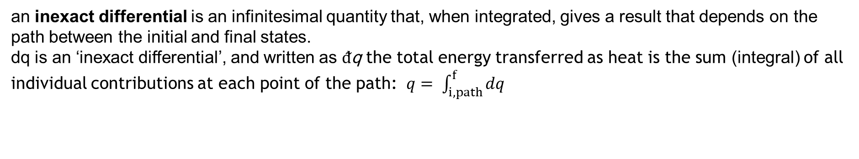
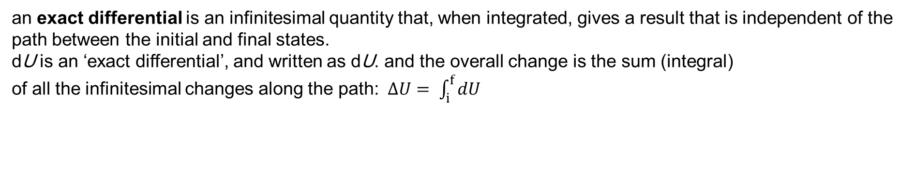
State functions and exact differentials
A state function is a property that depends only on the current state of a system and is independent of its history
For example, The internal energy (U ) and enthalpy (H )
A path function is a property that depends on the path between two states.
For example, The heat (q ) and work (w )
U
As the volume and temperature of a system are changed, the internal energy changes. An adiabatic and a nonadiabatic path are shown as Path 1 and Path 2, respectively: they correspond to different values of q and w but to the same value
of ΔU.
i
Internal energy,
Path 1
(
w
≠
0
,
q
= 0)
Path 2
(
w
≠
0
,
q
≠
0)
f
Temperature,
T
Volume,
V
an exact differential is an infinitesimal quantity that, when integrated, gives a result that is independent of the path between the initial and final states.
dU is an ‘exact differential’, and written as dU. and the overall change is the sum (integral)
of all the infinitesimal changes along the path:$∆U= \int_{i}^{f}{dU}$
an inexact differential is an infinitesimal quantity that, when integrated, gives a result that depends on the path between the initial and final states.
dq is an ‘inexact differential’, and written as $ᵭ$q the total energy transferred as heat is the sum (integral) of all individual contributions at each point of the path: $q= \int_{i, path}^{f}{dq}$

Slide 17

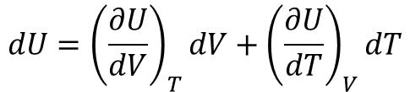

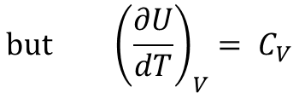
Changes in internal energy
It is possible to write U in terms of just two independent variables: V and T, p and T, or p and V.
Expressing U as a function of volume and temperature turns out to result in the simplest expressions.
$$dU={\left(\frac{∂U}{dV}\right)}_{T}dV+{\left(\frac{∂U}{dT}\right)}_{V}dT$$
This is the general expression for a change in U with T and V
U
Internal energy,
An overall change in U, which is denoted dU, arises when both V and T are allowed to change. If second-order infinitesimals are ignored, the overall change is the sum of changes for each variable separately.
U
U
(
∂
U
)
(
∂
U
)
+
∂
V
T
d
V
+
∂
T
V
d
T
d
T
Temperature,
T
Volume,
d
V
V
$$but {\left(\frac{∂U}{dT}\right)}_{V}= C_{V}$$
and ${\left(\frac{∂U}{dV}\right)}_{T}$is known as the internal pressure and denotet $π_{T}$
$$dU=π_{T }dV+C_{V} dT$$

Slide 18
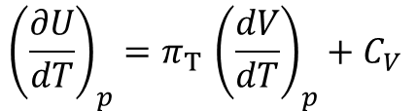
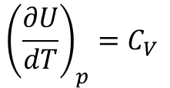
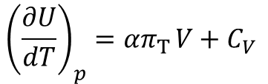
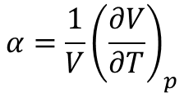
Changes in internal energy at constant pressure
When the equation $dU=π_{T }dV+C_{V} dT is devided by dT\text{, }\text{and} \text{impose} \text{the} \text{condition} \text{of} \text{constant} \text{pressure} \text{we} \text{get}$
$${\left(\frac{∂U}{dT}\right)}_{p}=π_{T }{\left(\frac{dV}{dT}\right)}_{p}+C_{V}$$
The partial derivative on the right in this expression is the slope of the plot of volume against temperature (at constant pressure). This property is normally tabulated as the expansion coefficient, α, of a substance, which is defined as
$$α=\frac{1}{V}{\left(\frac{∂V}{∂T}\right)}_{p}$$
Therefore
$${\left(\frac{∂U}{dT}\right)}_{p}={απ}_{T }V+C_{V}$$
For a perfect gas, π_{T} = 0, so then
$${\left(\frac{∂U}{dT}\right)}_{p}=C_{V}$$
That is, although the constant-volume heat capacity of a perfect gas is defined as the slope of a plot of internal energy against temperature at constant volume, for a perfect gas C_{V} is also the slope of a plot of internal energy against temperature at constant pressure.

Slide 19
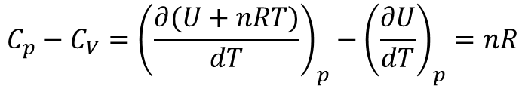
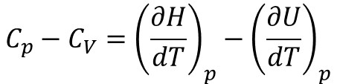
The last equation provides an easy way to derive the relation between C_{p} and C_{V} for a perfect gas
$${C_{p}−C}_{V}={\left(\frac{∂H}{dT}\right)}_{p}−{\left(\frac{∂U}{dT}\right)}_{p}$$
Since
H = U + pV = U + nRT
$${C_{p}−C}_{V}={\left(\frac{∂(U+nRT)}{dT}\right)}_{p}−{\left(\frac{∂U}{dT}\right)}_{p}=nR$$

Slide 20
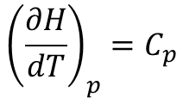

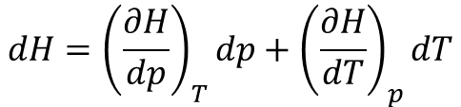
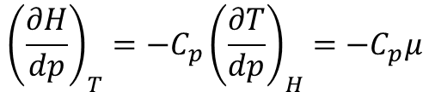
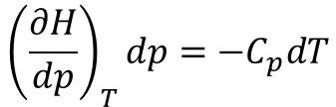
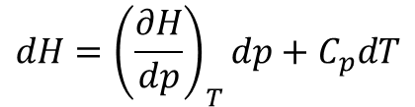
Changes in enthalpy
An expression for the variation of enthalpy with pressure and temperature can be expressed as
$$dH={\left(\frac{∂H}{dp}\right)}_{T}dp+{\left(\frac{∂H}{dT}\right)}_{p}dT$$
Since
$${\left(\frac{∂H}{dT}\right)}_{p}=C_{p}$$
Then
$$dH={\left(\frac{∂H}{dp}\right)}_{T}dp+C_{p}dT$$
Now if we set dH = 0, the
$${\left(\frac{∂H}{dp}\right)}_{T}dp=−C_{p}dT$$
$${\left(\frac{∂H}{dp}\right)}_{T}=−C_{p}{\left(\frac{∂T}{dp}\right)}_{H}=−C_{p}μ$$
Or
where μ (mu) is known as the Joule–Thomson coefficient.
Substitution into the equation of dH gives
$$dH=C_{p}dT−μC_{p}dp$$
For a perfect gas, μ = 0, but real gases have non-zero Joule–Thomson coefficients which might be either positive or negative depending on the identity of the gas, the pressure, the relative magnitudes of the attractive and repulsive intermolecular forces, and the temperature.

Slide 21
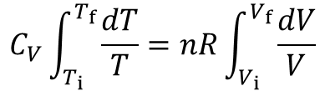

Adiabatic changes
The change in temperature
ΔU = (T_{f} − T_{i})C_{V} = C_{V} ΔT
When the expansion is adiabatic, q = 0; then because ΔU = q + w, it follows that ΔU = w_{ad}
The subscript ‘ad’ denotes an adiabatic process
w_{ad} = C_{V} ΔT
Work of adiabatic change [perfect gas]
Deriving an expression for the temperature change in a reversible adiabatic expansion
The work done when the perfect gas expands reversibly and adiabatically by dV against a constant pressure of p is
dw_{ad} = −p dV
Therefore
C_{V} dT = −p dV
Since the gas is perfect, p can be replaced by nRT /V to give C_{V} dT = −(nRT/V) dV and therefore
$$\frac{C_{V}dT}{T}=\frac{nRdV}{V}$$
By integration, we get
$$C_{V}\int_{T_{i}}^{T_{f}}{\frac{dT}{T}=nR\int_{V_{i}}^{V_{f}}{\frac{dV}{V}}}$$

Slide 22
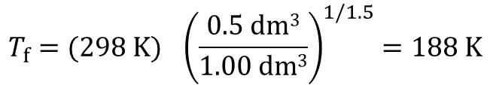

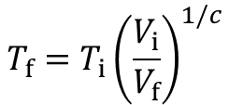


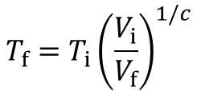
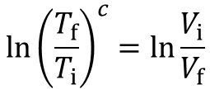
$$C_{V} ln\frac{T_{f}}{T_{i}}=nRln\frac{V_{f}}{V_{i}}$$
$$\frac{C_{V}}{nR}ln\frac{T_{f}}{T_{i}}=ln\frac{V_{i}}{V_{f}}$$
note that C_{V} /nR = C_{V,m}/R = c and use ln x ª = a ln x to obtain
$$ln{\left(\frac{T_{f}}{T_{i}}\right)}^{c}=ln\frac{V_{i}}{V_{f}}$$
This relation implies that (T_{f} /T_{i})^{c} = (V_{i} /V_{f}) and, upon rearrangement,
$$T_{f}=T_{i}{\left(\frac{V_{i}}{V_{f}}\right)}^{1/c}$$
Where c = C_{V,m} /R
reversible adiabatic expansion of a perfect gas
Or
$$V_{i}T_{i}^{c}=V_{f}T_{f}^{c}$$
Where c = C_{V,m} /R
reversible adiabatic expansion of a perfect gas
Example: 0.020 mol of Ar undergoes an adiabatic, reversible expansion from an initial temperature of 25 °C, from 0.50 dm³ to 1.00 dm³. The molar heat capacity of argon at constant volume is 12.47 J K⁻¹ mol⁻¹. Calculate the final temperature and the adiabatic work of this sample.
Solution:
$$T_{f}=T_{i}{\left(\frac{V_{i}}{V_{f}}\right)}^{1/c}$$
c = C_{V,m} /R = 12.47 J K⁻¹ mol⁻¹ /8.314 J K⁻¹ mol⁻¹ = 1.5
$$T_{f}={(298 K)}_{}{\left(\frac{0.5 dm3}{1.00 dm3}\right)}^{1/1.5}=188 K$$
w_{ad} = C_{V} ΔT = n C_{V,m} ΔT
= (0.020 mol) x (12.47 J K⁻¹ mol⁻¹) x (-110 K) = -27 J

Slide 23
The change in pressure
The perfect gas law pV = nRT can be used to write
However, we found earlier that T_{i}/T_{f} = (V_{f}/V_{i})^{1/c}. Therefore,
For a perfect gas C_{p,m} − C_{V,m} = R. It follows that
and therefore that
which can be rearranged to
reversible adiabatic expansion, perfect gas
For a monatomic perfect gas, C_{V,m} = 3/2 R , and C_{p,m} = 5/2 R (from C_{p,m} − C_{V,m} = R), so γ = 5/3 .
For a gas of nonlinear, C_{V,m} = 3R and C_{p,m} = 4R, so γ = 4/3.

Slide 24
The curves of pressure versus volume for adiabatic change are known as adiabats
An adiabat depicts the variation of pressure with volume when a gas expands adiabatically and, in this case, reversibly. Note that the pressure declines more steeply for an
adiabat than it does for an isotherm because in an adiabatic change, the temperature falls.
Example: What is the final pressure when a sample of argon (for which γ = 5/3 ) at 100 kPa expands reversibly and adiabatically to twice its initial volume?
Solution:

