Slide 1
The Liver
&
The Testis

Slide 2
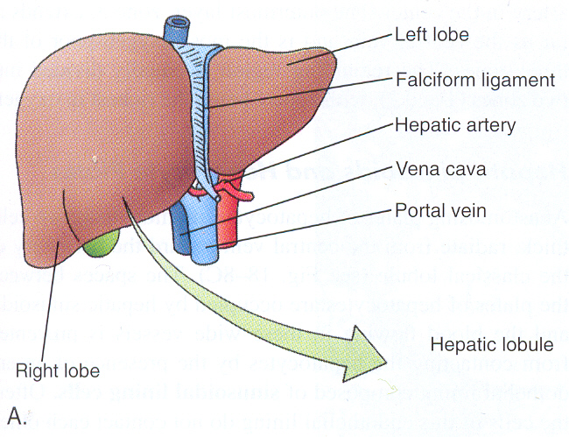
The liver
The liver is the largest gland associated with the alimentary tract.
In the liver, transformation of the metabolites and detoxification of toxic substances take place.
It is situated in the abdominal cavity beneath the diaphragm.
It receives blood from 2 sources:
The portal vein that carries oxygen-poor, nutrient-rich blood from the abdominal viscera.
The hepatic artery that supplies oxygen- rich blood.

Slide 3
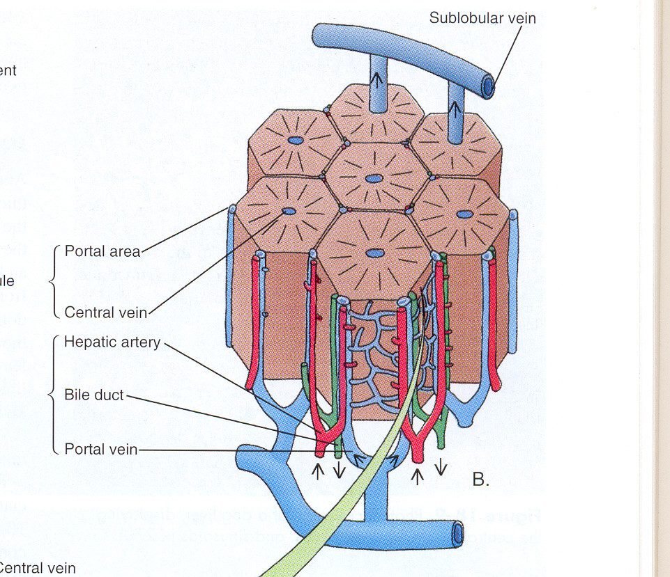
The liver is covered by a thin connective tissue capsule.
The portal vein and the hepatic artery enter the liver, and the right and the left hepatic (bile) ducts and lymphatics exit from it. These vessels and ducts terminate in the portal spaces between the liver lobules.
The liver consists of compartments known as the hepatic lobules.

Slide 4
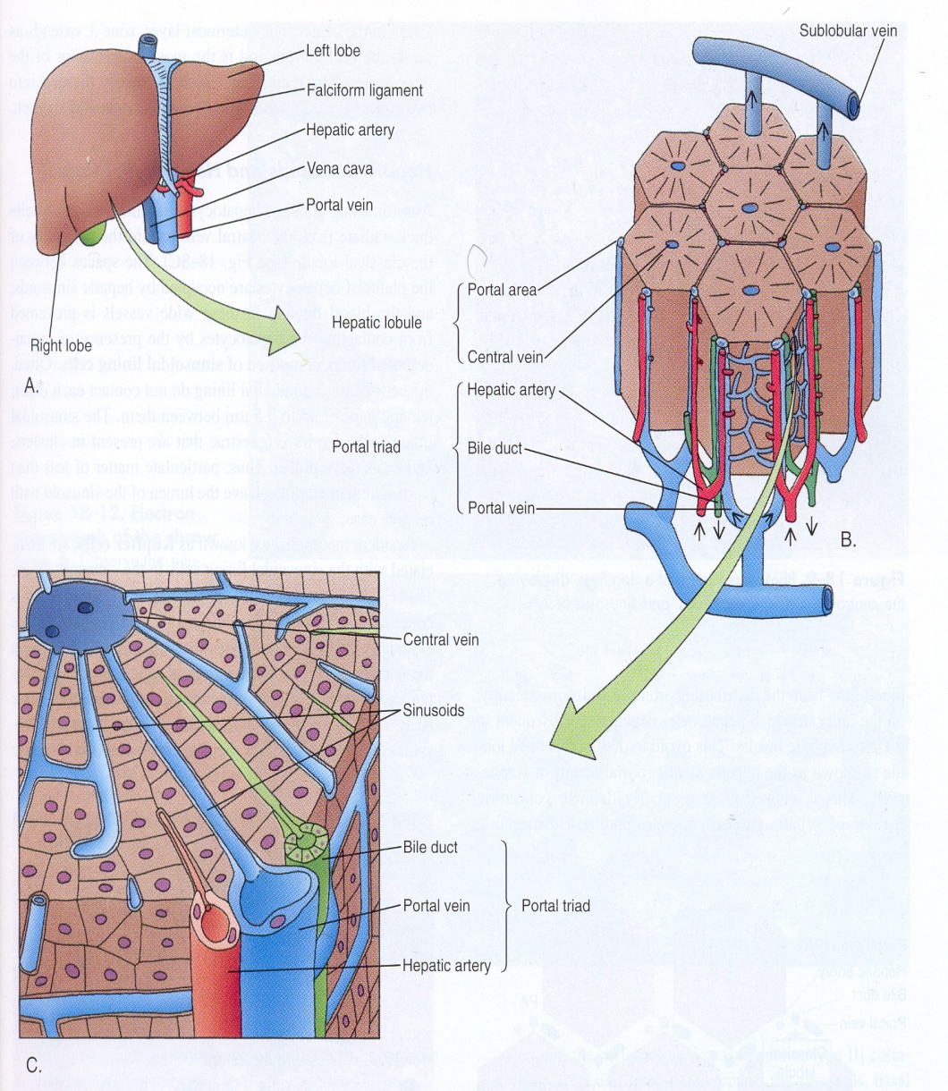
The Classic Hepatic Lobule:
The lobule is formed of a polygonal mass of tissue.
The main cellular components of the hepatic lobule are the hepatocytes. Which form cords radially arranged around the central vein. The spaces between these cords are known as the liver sinusoids.
The hepatocytes are large polygonal cells with one or two rounded nuclei, each containing a large nucleolus.
The liver sinusoids are irregularly-dilated vessels the wall of which is composed only of a discontinuous layer of fenestrated (with opening for exchange of macromolecules) endothelial cells, with no basal lamina.

Slide 5
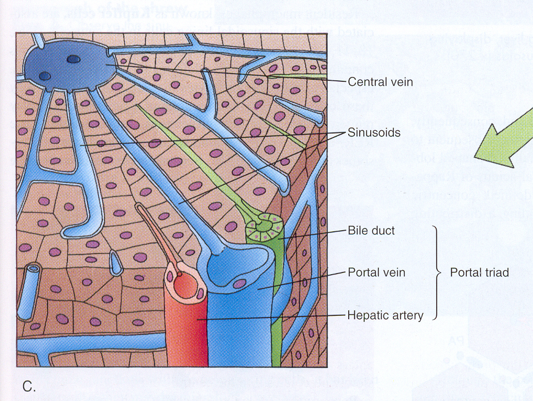
The lobules are separated from each other by a layer of connective tissue which contains the bile ducts, lymphatics, blood vessels and nerves. The region containing these structures in the connective tissue layer is called the portal area or portal space (the venule is usually the largest of the structures in this space).
The bile ducts is lined by cuboidal epithelium and carries bile from the hepatocytes and empties it eventually into the hepatic duct.
Portal veins and hepatic arterioles deliver blood into the sinusoids at the periphery of the lobule. This mixed blood in the sinusoids run toward the lobule center where they drain into the central vein.

Slide 6
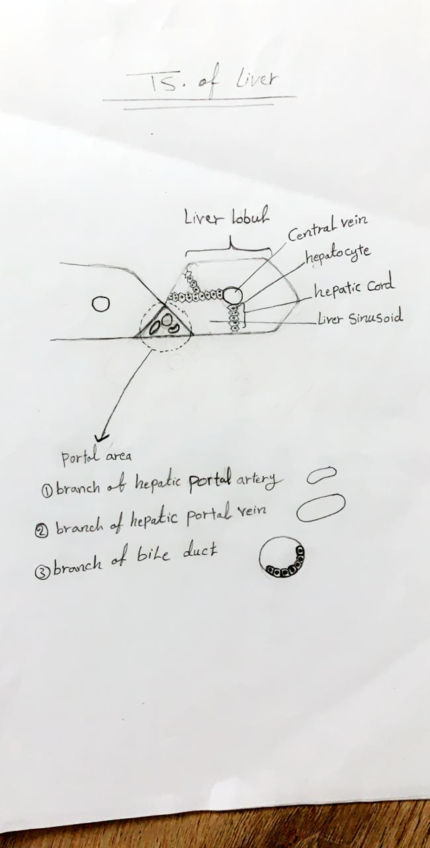

Slide 7
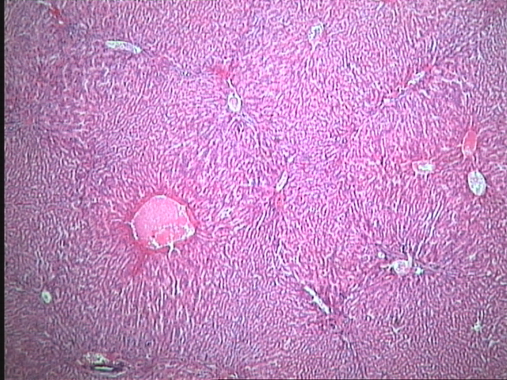

Slide 8
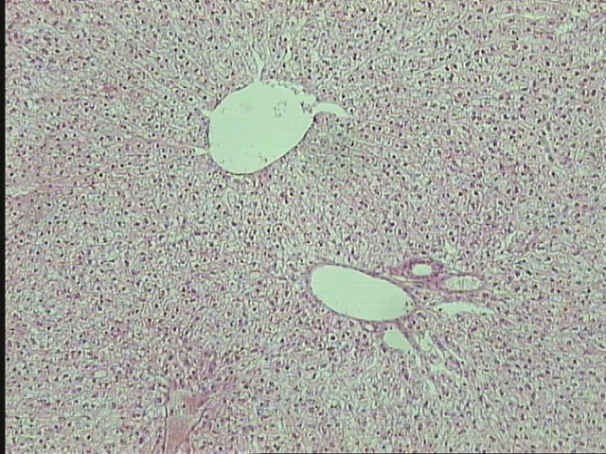
T. S. of The Liver

Slide 9
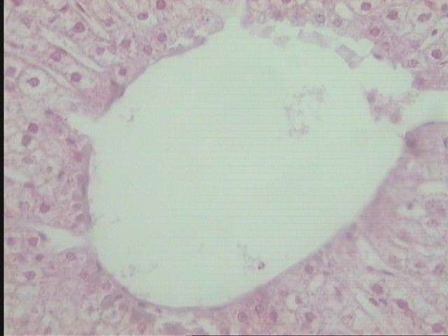
The central vein of The Liver
Hepatocyte
Hepatic cords
Central vein

Slide 10
T. S. of The Liver

Slide 11
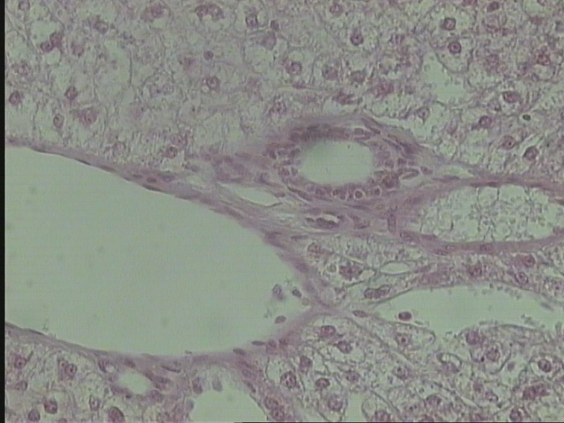
The portal area of The Liver
Branch of hepatic portal artery
Branch of bile duct
Branch of hepatic portal vein

Slide 12
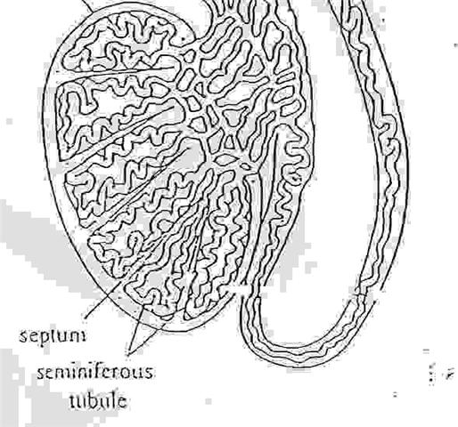
The Testis
The male reproductive system is composed of two testis, the genital ducts, the accessory glands and the penis.
The testis are primary sex organs forming the sperm.
The Structure of The Testis:
Each testis is surrounded by collagenous connective tissue known as tunica albugenia.
Each testis is sub-divided by fibrous septa into about 250 compartments called testicular lobule.
Each testicular lobule consists of 1-4 tightly coiled seminiferous tubules.

Slide 13
The seminiferous tubules:
In cross section, it appears to consist of spermatogenic cells arranged in 4-8 layers.
These cells consist of the following types:
Cel type | Description | Chromosomes no.
Type-A spermatogonia | lightly stained cytoplasm and a large darkly stained nucleus. | diploid cells. | divide mitotically and are a continuous source of spermatogonia
Type-B spermatogonia | lightly stained cytoplasm and nucleus. | diploid cells. | They grow large in size and give rise to primary spermatocytes.

Slide 14
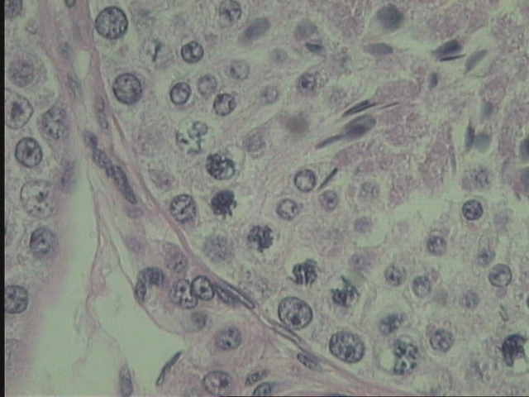

Slide 15
Cel type | Description | Chromosomes no. | Note
Primary spermatocytes | the largest cells in the seminiferous tubule. arranged in 2-3 layers. rounded shape. extensive cytoplasm. clear chromatin in the nucleus. | diploid cells. | They undergo the first meiotic division and each produces two small cells known as the secondary spermatocytes.

Slide 17
Cel type | Description | Chromosomes no. | Note
Secondary spermatocytes | small rounded cells. | haploid cells | undergo the second meiotic division and give rise to spermatids.
Spermatids | small cells. condensed chromatin. | haploid cells | the nearest to the tubule lumen. They undergo a process of differentiation known as spermeiogenesis and give rise to mature spermatozoa.

Slide 18
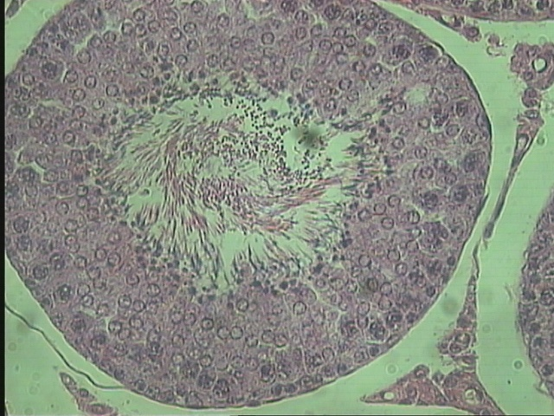

Slide 20
Cel type | Description | Chromosomes no. | Note
Mature spermatozoa | They have head and tail. | haploid cells | found in the lumen of the seminiferous tubule.

Slide 22
Cel type | Description | Chromosomes no. | Note
Sertoli cells | elongated pyramidal cells. found between the spermatogonial cells. Their basal lamina and their tip extent to the tubule lumen. | diploid cells. | They acts as “nurse cells” by providing structural and metabolic support for the developing spermatozoa. They also secrete a peptide hormone called inhibin which suppresses the synthesis and release of FSH by the anterior pituitary gland. They also phagocytize excess cytoplasm shed by spermatids during spermeiogensis.

Slide 23
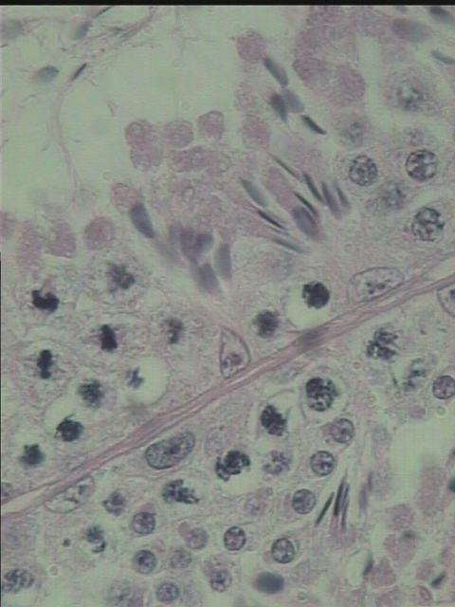

Slide 24
Cel type | Description | Chromosomes no. | Note
Interstitial cells (Lydig cells) | rounded or polygonal cells with a central nucleus. rich in lipid droplets. |  | found embedded in the connective tissue filling the spaces between the seminiferous tubules. The cells secrete the male hormone testosterone.

Slide 25
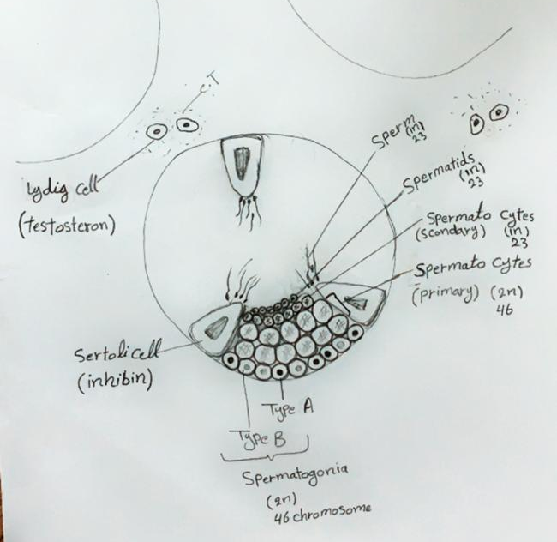

Slide 26
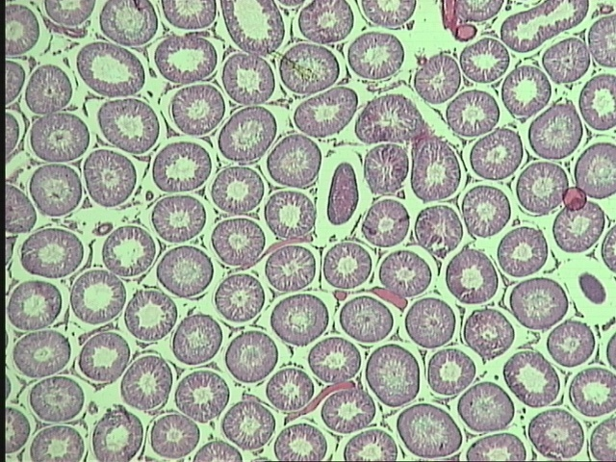

Slide 27
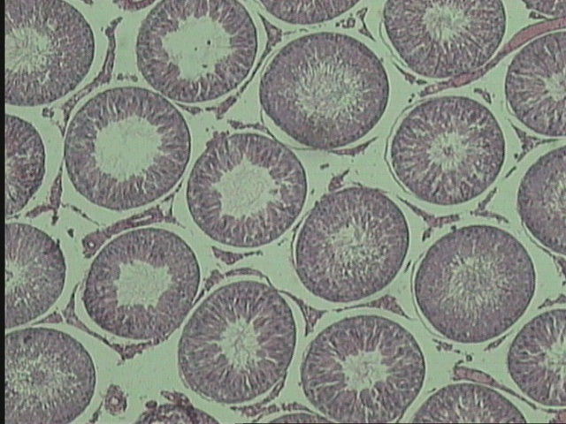

Slide 31
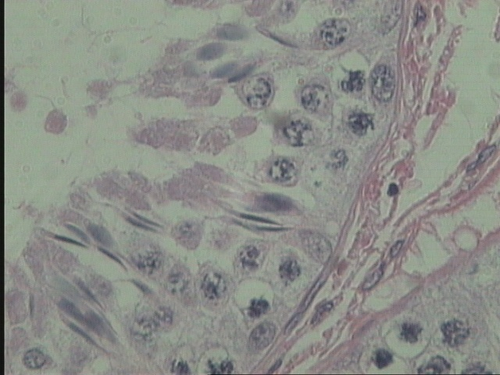

Slide 32


