Slide 1

22 The chemical potential

Slide 2



Slide 3
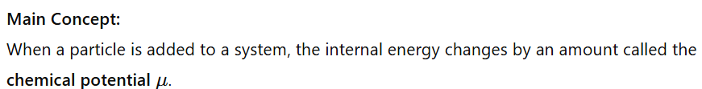





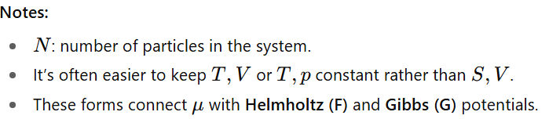

22.1 A definition of the chemical potential
Takeaway:
The chemical potential represents how the energy of a system changes when particles are added.
It links thermodynamics and particle exchange in a unified way.
Alternative Forms (More Practical):

Slide 4
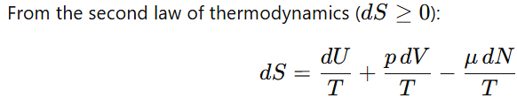

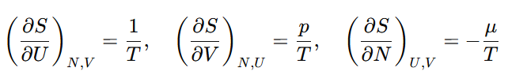

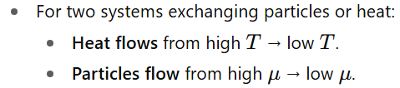

22.2 The meaning of the chemical potential
Core Idea:
Takeaway:
Thus,
Temperature equalizes energy.
Chemical potential equalizes
particles.
Both drive systems toward:
maximum entropy (equilibrium).
Concepts to Remember:

Slide 5
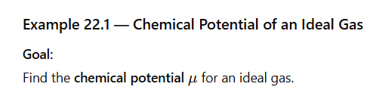




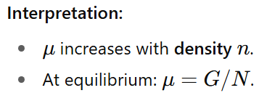

and for an ideal gas:
Differentiate $F$w.r.t. $N$:

Slide 6
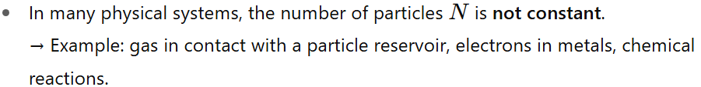
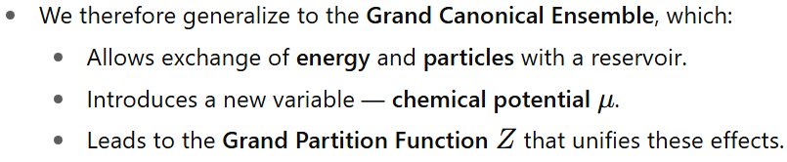
Section 22.3: Grand Partition Function
Objective:
To understand how to describe systems that exchange both energy and particles with a large reservoir.
Why do we need the Grand Partition Function?
So, What is the difference
Between:
Canonical Ensemble vs.
Grand Canonical Ensemble ?

Slide 7
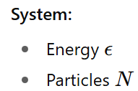
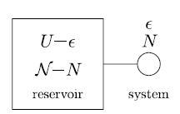
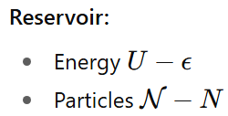


System–Reservoir Setup
The entropy of the reservoir changes as:
(Eq. 22.17)

Slide 8




Probability of a Microstate
The probability that the system is in a state with energy $E_{i}$and $N_{i}$particles is:
After normalization:
This is known as the Gibbs Distribution for the Grand Canonical Ensemble.
Definition of the Grand Partition Function
The normalization constant is the grand partition function:
(Eq. 22.20)

Slide 9



Deriving Mean Quantities
Mean particle number:
(Eq. 22.21)
Mean energy:
(Eq. 22.22)
This connects
microscopic probabilities with
macroscopic thermodynamic quantities.
Entropy Expression
(Eq. 22.23)

Slide 10
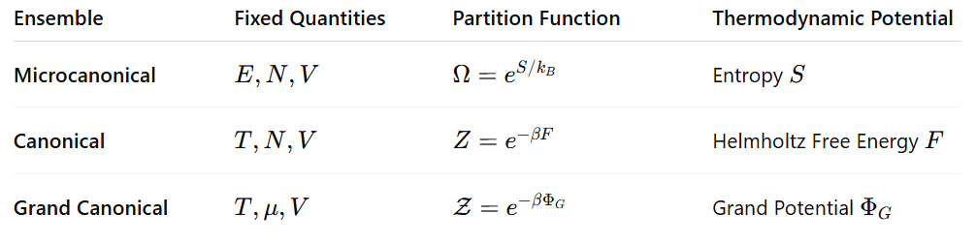
The Three Statistical Ensembles

Slide 11
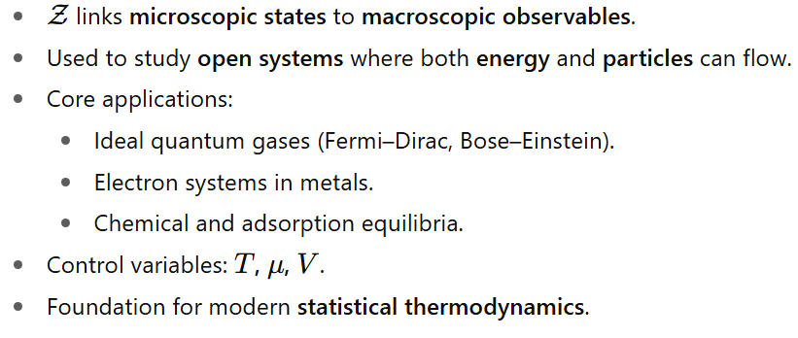
Physical Interpretation

Slide 12



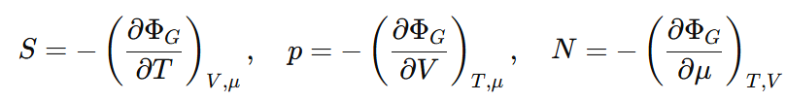
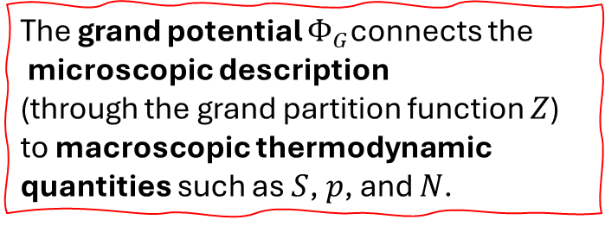
where Z is the grand partition function.
Relation to Other Potentials
Key Idea
The grand potential $Φ_{G}$connects the
microscopic description
(through the grand partition function $Z$)
to macroscopic thermodynamic
quantities such as $S$, $p$, and $N$.
Differential Form

Slide 13
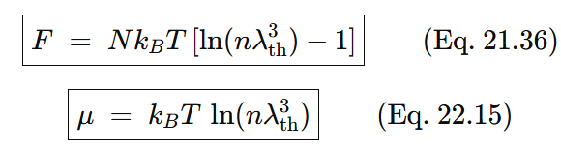













Example22.2
Find the grand potential for an ideal gas, and show that eqns. 22.33 and 22.34 lead to the correct expressions for p and N.
Step 3 – Verifying 𝑁
Step 1 – Starting Equations
So,
Or
But
Step 2 – Using the Ideal Gas Law

Slide 14



Step 4 – Verifying 𝑝
we get:
which is the ideal-gas law.

Slide 15






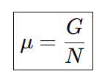

22.5 Chemical potential as Gibbs function per particle
Extensive variables ( $U,S,V,N$) scale linearly with the size of the system.
Intensive variables ( $T,p,μ$) remain unchanged when the system is scaled.
If we scale the system by a factor λ:
Entropy as a Homogeneous Function :
“All extensive quantities scale linearly with λ.”
Differentiate w.r.t. λ and set λ = 1 to find a thermodynamic relation:
But
Chemical potential
is the Gibbs free energy
per particle.
So,
This identifies the Gibbs function:
Since $G=μN$, we have:

Slide 16




Implication for the Grand Potential
Using $F=U−TS$:
If entropy is extensive, the relation
holds exactly, validating the thermodynamic consistency.
What it means physically ?
The grand potential $Φ_{G}$is the thermodynamic potential appropriate when T, V, and μ are fixed**.
The relation $Φ_{G}=−pV$means that the pressure is directly determined by the grand potential:
This connects the macroscopic mechanical quantity (pressure) with a thermodynamic potential that is often used in statistical mechanics, where:

Slide 17
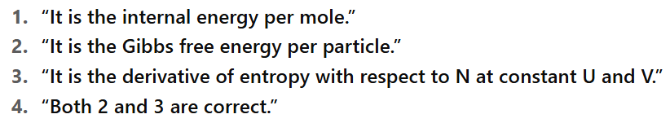
Quiz — Interpretation of μ
Which of the following best describes the physical meaning of the chemical potential $μ$?

Slide 18







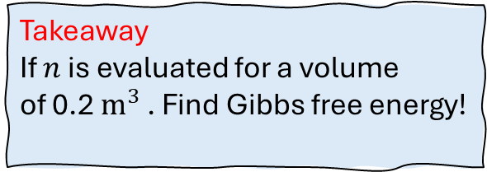
For an ideal gas at temperature $T=300K$, $p=1.0×{10}^{5}Pa$, and particle density $n=N/V=2.45×{10}^{25} m^{−3}$, for argon with $m=6.63×{10}^{−26} kg$ . Evaluating the Chemical Potential.
Takeaway
If $n$ is evaluated for a volume
of 0.2 $m^{3}$ . Find Gibbs free energy!

Slide 19


For the same system as in the previous problem for a volume of 0.2 m³, find the grand potential .

Slide 20


22.7 Particle number conservation laws
General idea
This section discusses the connection between particle number conservation and the chemical potential (μ).
First: When particle number is not conserved
That means particles can be created or destroyed freely (like photons).
The system chooses the number $N$that minimizes the Helmholtz free energy $F$, with the equilibrium condition:
and since
So, for particles with no number-conservation law, the chemical potential equals zero.
Example: photons, because they can be created or annihilated without violating conservation laws.

Slide 21

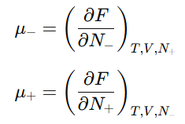


Second: When particle number is conserved
Example: electrons (e⁻) and positrons (e⁺).
An electron cannot disappear unless it annihilates with a positron in a reaction like:
and the conservation of charge requires that the difference between the number of positrons and electrons remain constant:
The system minimizes $F$while respecting this constraint, so:
Since $F$is the sum of contributions from electrons and positrons, we have:

Slide 22



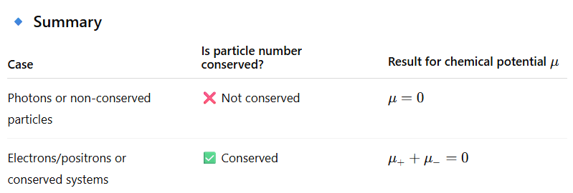
and since
we obtain
Thus, the chemical potentials of the electron and positron are equal in magnitude but opposite in sign:

Slide 23
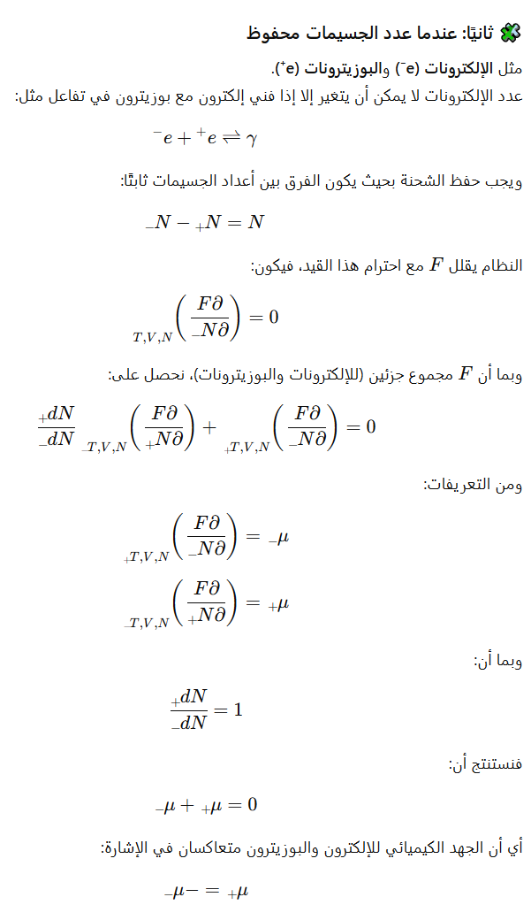
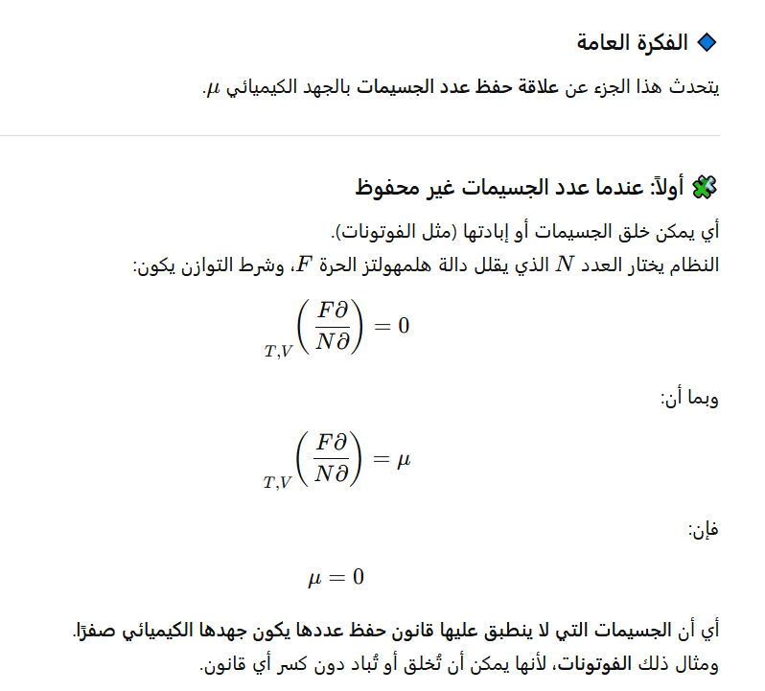

Slide 24
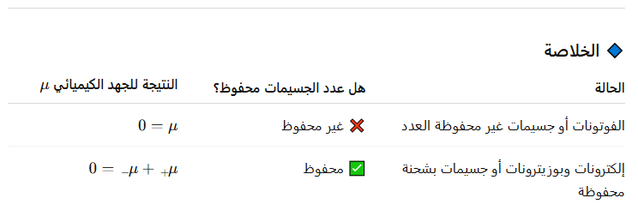

Slide 25






23.4 Radiation pressure
Blackbody Radiation
Collimated Beam of Light
Pressure on surface:
Power radiated per unit area:
Power on surface:
Conclusion
Electromagnetic radiation exerts real pressure on surfaces.
Pressure depends on whether photons move in all directions or in a single direction (beam).
These relations connect power, energy density, and pressure for blackbody radiation.
Modified relations
Energy density in radiation:
Power radiated per unit area:
Pressure on cavity walls:
Energy density:
Pressure:

Slide 26
