Slide 1
The blood vessels

Slide 2
The circulatory system consists of
the blood vascular system
the lymphatic vascular system
composed of
The heart
The arteries
The veins
The capillaries
pumps
the blood
carry oxygenated blood and nutrients to the tissues
carry deoxygenated blood, rich in carbon dioxide and other metabolic products from the tissues to the heart
consists of a diffuse network of thin tubules through which gas exchange between blood and tissues takes place
They becomes thinner as they branch forming arterioles

Slide 3
Structure of the blood vessels
All blood vessels have a number of structural features in common. They are composed of three layers called
1- tunica intima
2- tunica media
3- tunica adventitia

Slide 4
Structure of the blood vessels
Tunica intima
Tunica media
Tunica adventitia
It is an areolar connective tissue layer consisting of longitudinally collagen and elastic fibers
Consists of 2 components
Consists of layers of circular smooth muscle cells with elastic and collagen fibers interposed among them
A layer of squamous endothelial cells lining the vessel interior surface, and rest on a basement membrane called the basal lamina
gradually becomes continuous with the enveloping connective tissue of the organ through which the vessel is running
A subendothelial layer of loose connective tissue that may contain some smooth muscle cells, which tend to be arranged longitudinally

Slide 5
Layer | The artery
Tunica intima | -Consists of 2 components: a) A layer of squamous endothelial cells lining the vessel interior surface, and rest on a basement membrane called the basal lamina. b) A subendothelial layer of loose connective tissue that may contain some smooth muscle cells, which tend to be arranged longitudinally. -Is separated from the media by a well developed layer of elastic connective tissues, called the internal elastic lamina.
Tunica media | -Consists of layers of circular smooth muscle cells with elastic and collagen fibers interposed among them. - The thickest layer of the vessel wall.
Tunica adventitia | -It is an areolar connective tissue layer consisting of longitudinally collagen and elastic fibers. -This layer gradually becomes continuous with the enveloping connective tissue of the organ through which the vessel is running. -Rich in elastic fibers.

Slide 6
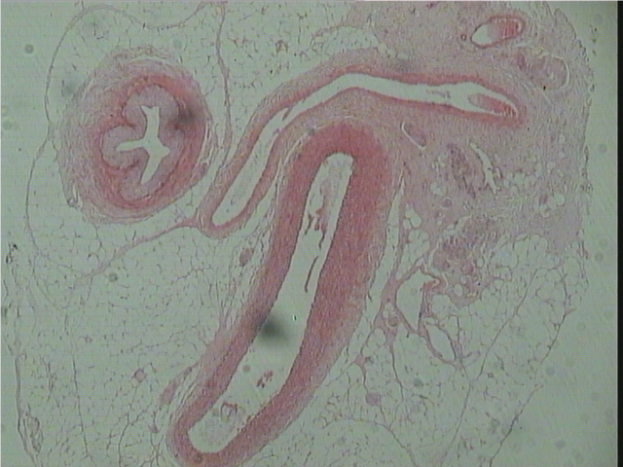
T.S of different Blood Vessels
(Artery and Vein)
Vein
Artery

Slide 7
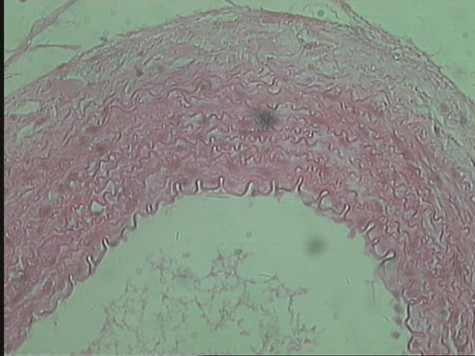
Sector of the wall of an artery
Tunica adventitia
Tunica media
Tunica intima
Lumen

Slide 8
Layer | The vein
Tunica intima | -Consists of 2 components: a) A layer of squamous endothelial cells lining the vessel interior surface, and rest on a basement membrane called the basal lamina. b) A subendothelial layer of loose connective tissue that may contain some smooth muscle cells, which tend to be arranged longitudinally. -Is not separated from the media by the internal elastic lamina.
Tunica media | Consists of layers of circular smooth muscle cells with elastic and collagen fibers interposed among them. -Much thinner than that of the artery.
Tunica adventitia | -It is a connective tissue layer consisting of longitudinally collagen and elastic fibers. -This layer gradually becomes continuous with the enveloping connective tissue of the organ through which the vessel is running. - Rich in collagenous fibers. - The thickest layer of the vessel wall.

Slide 9
T.S of different Blood Vessels
(Artery and Vein)
Vein
Artery

Slide 10
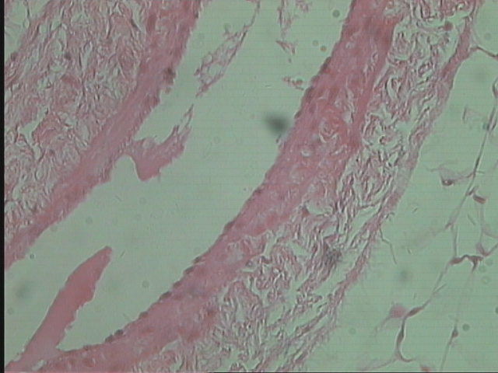
Sector of the wall of a vein
Tunica adventitia
Tunica intima
Tunica media
Lumen

Slide 11
Sector of the wall of an artery
Sector of the wall of a vein

Slide 12
Layer | The artery | The vein
Tunica intima | -Consists of 2 components: a) A layer of squamous endothelial cells lining the vessel interior surface, and rest on a basement membrane called the basal lamina. b) A subendothelial layer of loose connective tissue that may contain some smooth muscle cells, which tend to be arranged longitudinally. -Is separated from the media by a well developed layer of elastic connective tissues, called the internal elastic lamina. | -Consists of 2 components: a) A layer of squamous endothelial cells lining the vessel interior surface, and rest on a basement membrane called the basal lamina. b) A subendothelial layer of loose connective tissue that may contain some smooth muscle cells, which tend to be arranged longitudinally. -Is not separated from the media by the internal elastic lamina.
Tunica media | -Consists of layers of circular smooth muscle cells with elastic and collagen fibers interposed among them. - The thickest layer of the vessel wall. | Consists of layers of circular smooth muscle cells with elastic and collagen fibers interposed among them. -Much thinner than that of the artery.
Tunica adventitia | -It is an areolar connective tissue layer consisting of longitudinally collagen and elastic fibers. -This layer gradually becomes continuous with the enveloping connective tissue of the organ through which the vessel is running. -Rich in elastic fibers. | -It is a connective tissue layer consisting of longitudinally collagen and elastic fibers. -This layer gradually becomes continuous with the enveloping connective tissue of the organ through which the vessel is running. - Rich in collagenous fibers. - The thickest layer of the vessel wall.

Slide 13


