Slide 1
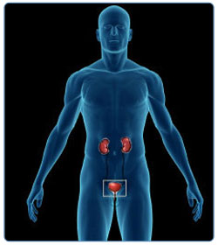
THE URINARY SYSTEM

Slide 2
Objectives:
Components of Urinary system.
The kidneys
Sectional Anatomy of the kidney
The Nephron
Principles of Renal Physiology

Slide 3
Components of Urinary system
The urinary system has three major functions:
1-Excretion: the removal of organic waste products from body fluids.
2-Elimination: the discharge of these waste products into the environment.
3-Homeostatic regulation: of the volume and solute concentration of blood plasma.

Slide 4
Components of cont…
The excretory functions of urinary system are performed by the two kidneys - organs that produce urine - a fluid containing water, ions, and small soluble compounds .
Urine leaving the kidneys flows along the urinary tract, which consists of paired tubes called ureters to the urinary bladder, a muscular sac for temporary storage of urine.
On leaving the urinary bladder, urine passes through the urethra, which conducts the urine to the exterior.
The urinary bladder and the urethra are responsible for the elimination of urine, a process called urination, in this process contraction of the muscular urinary bladder forces urine through the urethra and out of the body.

Slide 5
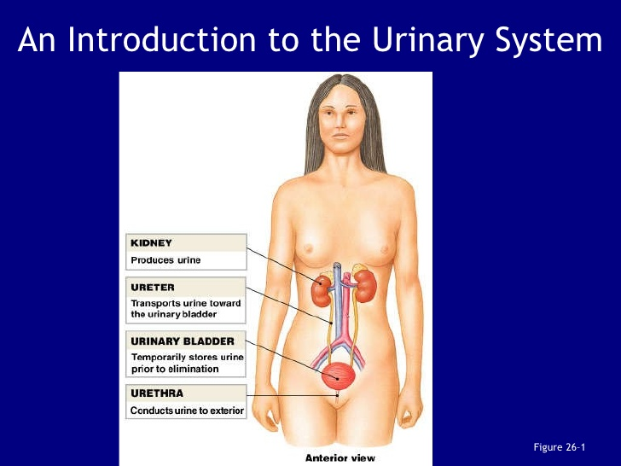

Slide 6
Functions of urinary system
1- Regulation of blood volume and blood pressure.
2- Regulating of plasma concentration of sodium, potassium , chloride and other ions.
3- Helping to stabilize blood pH.
4- Conserving valuable nutrients.
5- Assisting the liver in detoxifying poisons.

Slide 7
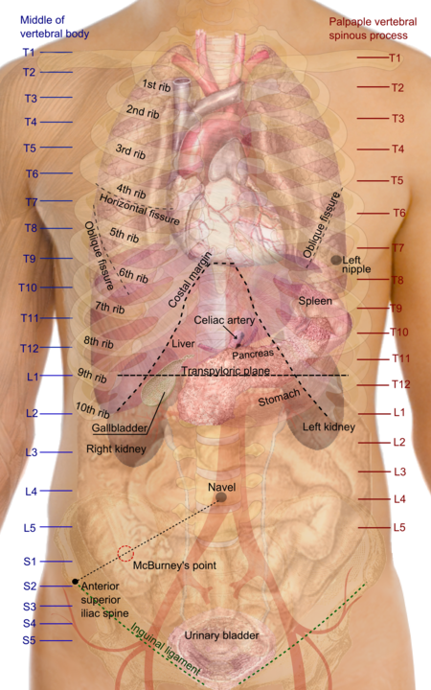
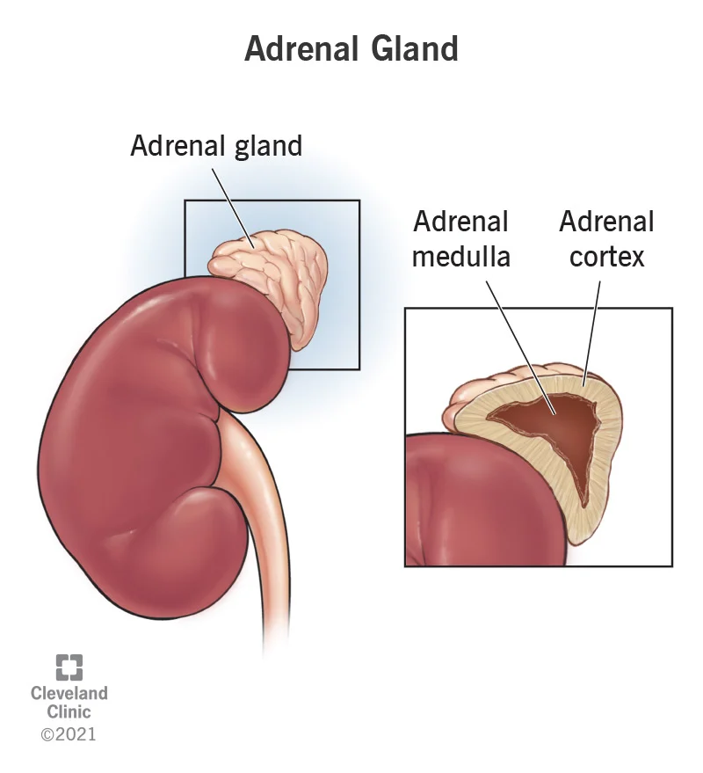
The Kidneys
The kidneys are located on either side of the vertebral column, between vertebrae T₁₂ and L₃ .
The left kidney lies slightly superior to the right kidney.
The superior surface of each kidney is capped by an adrenal gland .
Each kidney is protected and stabilized by three concentric layers of connective tissue:
1- The renal capsule, a layer of collagen fibers that covers the outer surface of entire organ.

Slide 8
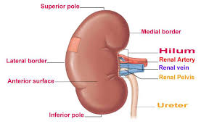
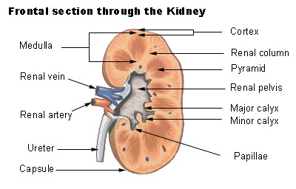
The Kidneys cont…
2- The a dispose capsule, a thick layer of adipose tissue surrounds the renal capsule.
3- The renal fascia, a dense fibrous outer layer that anchors the kidney to surrounding structures .
A typical adult kidney is reddish-brown .
The hilum, a prominent media indentation, is the point of entry for the renal artery and renal nerves and the point of exit for the renal vein and ureter.

Slide 9
Sectional Anatomy of the kidney
The fibrous renal capsule covering the outer surface of the kidney also lines the renal sinus, an internal cavity within the kidney.
The renal capsule is bound to the outer surfaces of the structures within the renal sinus, stabilizing the positions of the ureter and the renal blood vessels and nerves.
The kidney itself has an outer cortex and inner medulla.
The renal cortex is the superficial portion of the kidney, in contact with the renal capsule.

Slide 10
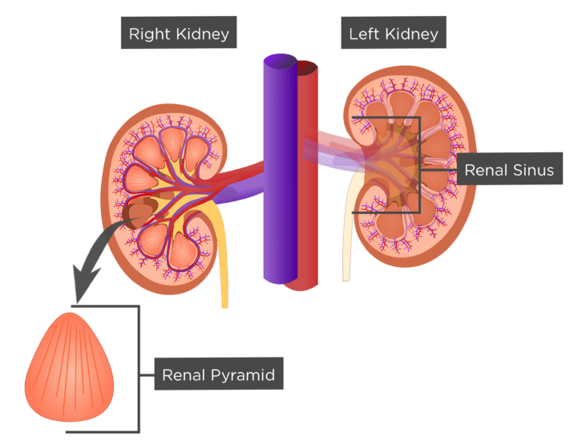
Sectional Anatomy
The cortex is reddish brown and granular.
The renal medulla consists of 6 to 18 distinct conical or triangular structures called renal pyramids.
The base of each pyramid abuts the cortex, and the tip of each pyramid - a region known as the renal papilla - projects into the renal sinus.
Each pyramid has a series of fine grooves that converge at the papilla .
Adjacent renal pyramids are separated by bands of cortical tissue called renal columns, which extend into the medulla
The columns have a distinctly granular texture, similar to that of the cortex.

Slide 11
Sectional Anatomy…
A renal lobe consists of a renal pyramid, the overlying area of renal cortex, and adjacent tissues of the renal columns.
Urine production occurs in the renal lobes.
Ducts within each renal papilla discharge urine into a cup-shaped drain called a minor calyx .
Four or five minor calyces merge to form a major calyx, and two or three major calyces combine to form the renal pelvis, a large funnel shaped chamber .
The renal pelvis which fills most of the renal sinus, is connected to the ureter, which drains the kidney .

Slide 12
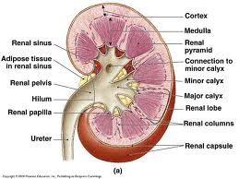
Sectional Anatomy…
Urine production begins in microscopic, tubular structures called nephrons in the cortex of each renal lobe.
Each kidney has roughly 1.25 million nephrons, with a combined length of about 145 km .

Slide 13
The Nephron:
Each nephron consist of renal tubule and a renal corpuscle.
A. Renal corpuscle:
The nephron begins at the renal corpuscle, a spherical structure consisting of:
Bowman’s capsule, a cup-shaped chamber.
and a capillary network known as the glomerulus.
Blood arrives at the renal corpuscle by way of an afferent arteriole.
This arteriole delivers blood to the glomerulus, which consist of about 50 intertwining capillaries.
The glomerulus projects into bowman’s capsule.

Slide 14
Renal corpuscle:
Blood leaves the glomerulus in an efferent arteriole and flows into a network of capillary, the peritubular capillaries, that surround the renal tubule.
These capillaries in turn drain into small venules that return the blood to the venous system (see figure 26-5).
The renal corpuscle is the site where the process of filtration occurs.
In this process, blood pressure forces water and dissolved solutes out of the glomerular capillaries and into a chamber -the capsular space- that is continuous with the lumen of the renal tubule .

Slide 15
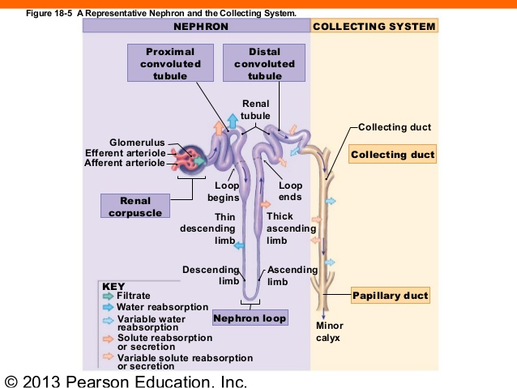

Slide 16
Filtration produces an essentially protein –free solution, known as a filtrate that is otherwise similar to blood plasma.
B. Renal tubule
From the renal corpuscle, filtrate enters the renal tubule, which is responsible for three crucial functions:
reabsorbing all the useful organic nutrients that enter the filtrate.
2) reabsorbing more than 90% of the water in the filtrate .
3) secreting into the tubule any waste products that failed to enter the renal corpuscle through filtration at the glomerulus.

Slide 17
Renal tubule
Renal tubule is along tubular passageway.
It has two convoluted (coiled or twisted) segments - the proximal convoluted tubule (PCT) and the distal convoluted tubule (DCT)- separated by a simple U-shaped tube called the loop of henle.
The convoluted segments are in the cortex, and the loop of the henle extends at lest partially into the medulla.
For clarity, the nephron shown in figure 26-6 has been shortened and straightened.
The regions of the nephron vary by structure and function.
As it travels along the tubule, the filtrate, now called tubular fluid, gradually changes in composition.
The changes that occur and the characteristics of the urine that results vary with the activities in each segment of the nephron.

Slide 18
Renal tubule
Each nephron empties into the collecting system, a series of tubes that carry tubular fluid away from the nephron.
Collecting ducts receives this fluid from many nephrons.
Each collecting duct begins in the cortex and descends into the medulla carrying fluid to a papillary duct that drains into a minor calyx.

Slide 19
The Nephron:
Nephrons from different locations differ slightly in structure.
Roughly 85% of all nephrons are cortical nephrons, located almost entirely within the superficial cortex of the kidney (figure 26-7a,b).
In a cortical nephron, the loop of the henle is relatively short, and the efferent arteriole delivers blood to a network of peritubular capillaries, which surround the entire renal tubule.
These capillaries drain into small venules that carry blood to the interlobular veins.

Slide 20
The Nephron:
The remaining 15% of nephrons, termed juxtamedullary nephron, have long loops of henle that extend deep into the medulla (figure 26-7a,c).
In these nephrons, the peritubular capillaries are connected to the vasa recta, long straight capillaries that paralle the loop of henle.
Because they are more numerous than juxtamedullary nephron, cortical nephrons perform most of the reabsorptive and secretory functions of the kidneys.

Slide 21
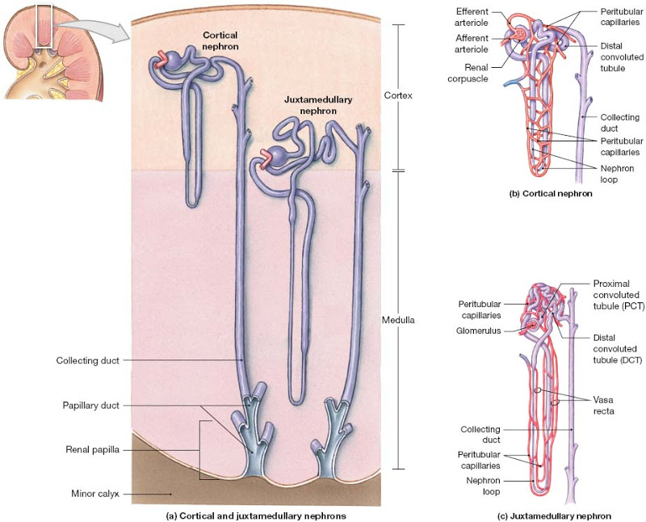
Cortical and Juxtamedullary Nephrons

Slide 22
Basic processes of urine formation
1- Filtration:
Blood pressure forces water and solutes across the wall of the glomerular capillaries and into the capsular space.
Solute molecules small enough to pass through the filtration membrane are carried by the surrounding water molecules.
2- Reabsorption:
Removal of water and solutes from the filtrate, and their movement across the tubular epithelium and into the peritubular fluid.
Reabsorption occurs after filtrate has left the renal corpuscle .

Slide 23
Basic processes of …
Most of the reabsorbed materials are nutrients the body can use.
Whereas filtration occurs solely based on size, reabsorption is a selective process involving either simple diffusion or the activity of carrier proteins in the tubular epithelium.
The reabsorbed substance in the peritubular fluid eventually re-enter the blood.
Water reabsorption occurs passively through osmosis.

Slide 24
Basic processes of …
3- secretion :
It is the transport of the solutes from the peritubular fluid, across the tubular epithelium, and into the tubular fluid .
Secretion is necessary because filtration dose not force all the the dissolved materials out of the plasma.
Tubular secretion, which provides a backup process for filtration, can further lower the plasma concentration of undesirable materials.
Secretion is often the primary method of excretion for some compounds, including many drugs .

Slide 25
Basic processes of … cont…
The juxtamedullary nephron enable the kidneys to produce concentrated urine.
Three organic waste products are noteworthy:
Urea
Creatinine
Uric acid

