Slide 1
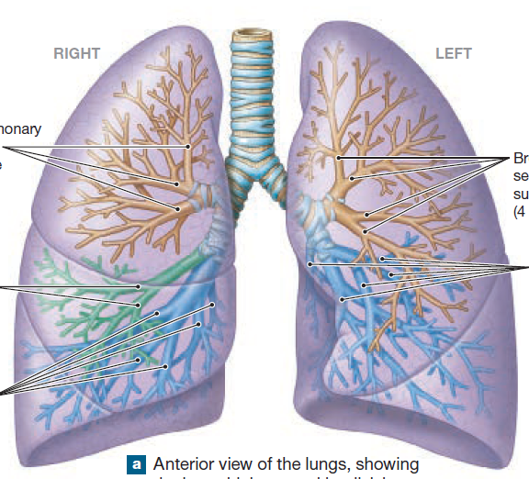
RESPIRATORY SYSTEM

Slide 2
Introduction
Functions of respiratory system:
  Move air in and out of lungs (ventilation)
  Providing an extensive surface area for gas exchange between air and circulating blood.
  Protecting respiratory surfaces from dehydration, temperature changes, and defending respiratory system from invasion by pathogen.
  Producing sounds.
  Facilitating the detection of olfactory stimuli by olfactory receptors.
Notes:
2

Slide 3
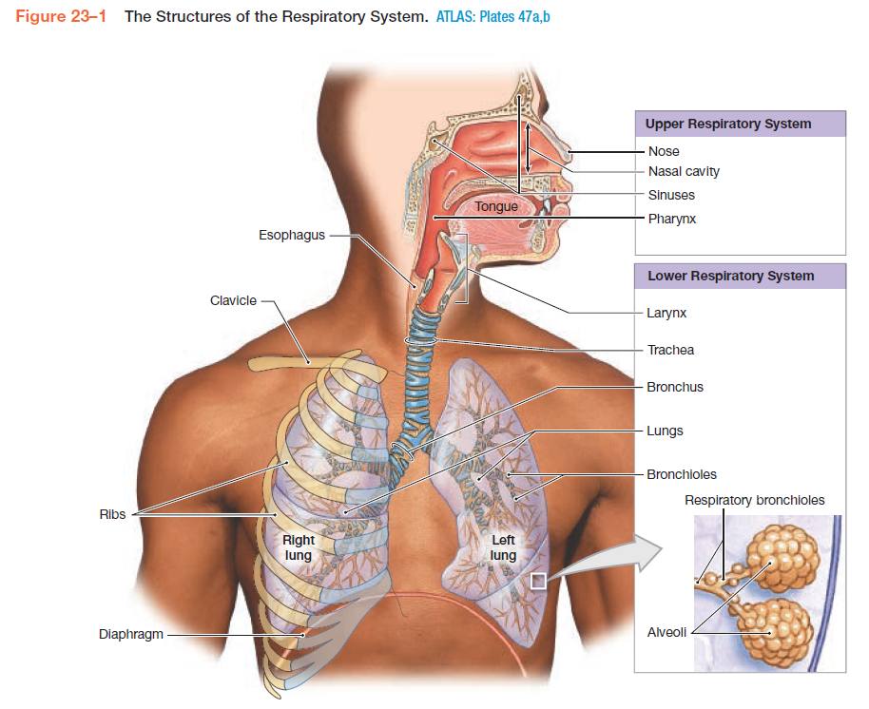
The Structures of the Respiratory System

Slide 4
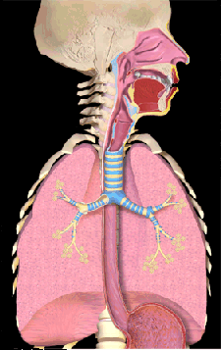
Organs of the Respiratory System
Nose
Pharynx
Larynx
Trachea
Bronchial tree
Alveoli of the Lungs
Notes:
4

Slide 5
Organs of the Respiratory System
Upper respiratory system consist of:
nose- nasal cavity- paranasal sinuses and pharynx.
1. Nose
It is the primary passageway for air entering the respiratory system.
    Nares openings of the nose.
    Nasal vestibule space contained within the flexible tissues of the nose
    Nasal septum divide the nasal cavity into left and right portions.
Notes:
5

Slide 6
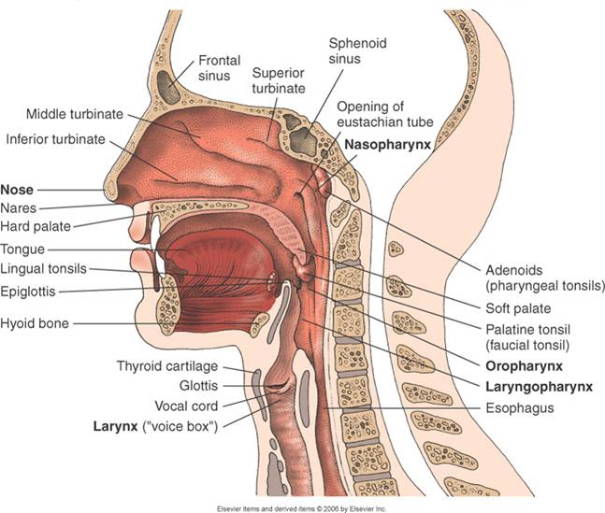
Upper respiratory system
Notes:
6

Slide 7
Organs of the Respiratory … cont..
  2. Nasal cavity
  the maxillary, nasal, frontal, ethmoid, and sphenoid bones form the lateral and superior walls of nasal cavity.
  The mucous secretion produced in the associated paranasal sinuses, help keep the surfaces of the cavity moist and clean.
  The nasal cavity opens into the nasopharynx through a connection known as the internal nares.
  Nasal mucosa: the mucosa of nasal cavity prepares inhaled air for arrival at lower respiratory system.
Notes:
7

Slide 8
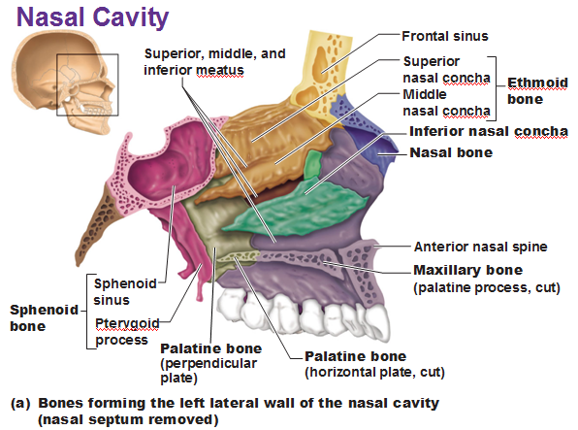
Nasal Cavity

Slide 9
Organs of the Respiratory System (cont.)
3. Pharynx
  Serves both the respiratory and digestive system.
  It extends between the internal nares and the entrances to the larynx and esophagus.
  It is divided into the nasopharynx, the oropharynx, and the laryngopharynx.
  The lower respiratory system includes:
  the larynx, trachea, bronchi, bronchioles, and alveoli of lungs.
1. Larynx
  Also called the “voice box”.
  Moves air in and out of the trachea and produces voice.
  Composed of three cartilages:
  Thyroid cartilage, Epiglottic cartilage, and Cricoid cartilage
Notes:
9

Slide 10
The lower respiratory system cont…
2. Lungs
  Cone-shaped organs
  Right lung – three lobes
  Left lung – two lobes
  Pleura – membranes surrounding the lungs.
  The lungs contain connective tissue, the bronchial tree, nerves, lymphatic vessels, and blood vessels.
Notes:
10

Slide 11
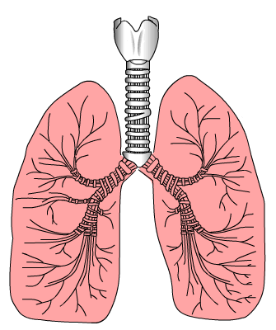
The lower respiratory system cont…
3. Trachea
  Referred to as the windpipe.
  Extends from the larynx to the bronchi.
  Tubular organ made of rings of cartilage and smooth muscle.
  15-20 tracheal cartilages, which serve to stiffen the tracheal walls and protect the airway.
  Each tracheal cartilage is C-shaped.
  An elastic ligament and the trachealis muscle, a band of smooth muscle, connect the ends of each tracheal cartilage.
  Contraction of trachealis muscle reduces the diameter of trachea.
Trachea
Notes:
11

Slide 12
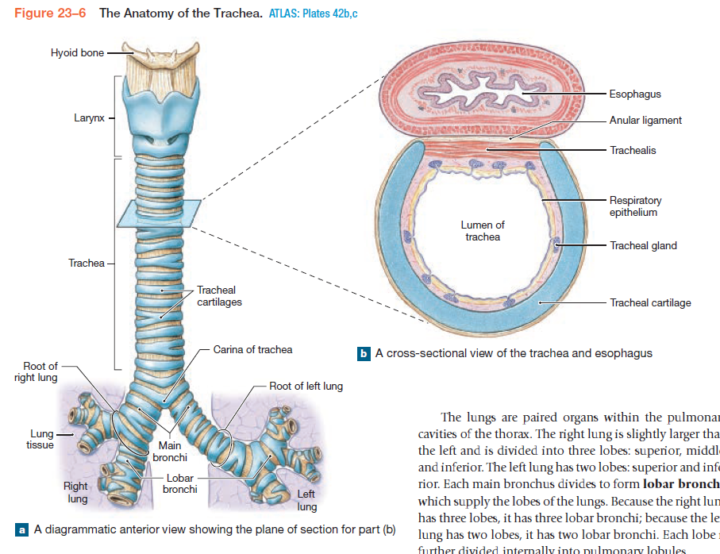
Trachea
Notes:
12

Slide 13
The lower respiratory system cont…
4. Bronchial tree
  The trachea branches within the mediastinum, giving rise to right and left primary bronchi.
  The right primary bronchus is larger in diameter than the left.
  The primary bronchi and their branches form the bronchial tree.
  Each primary bronchus divides to form secondary bronchi.
  The right lung has three secondary bronchi, and the left lung has two.
  In each lung, the secondary bronchi branch to form tertiary bronchi.
Notes:
13

Slide 14
Bronchial tree cont…
  Each tertiary bronchus ultimately supplies air to single bronchopulmonary segment.
  Each tertiary bronchus branches several times within bronchopulmonary segment, giving rise to multiple bronchioles
  Bronchioles further branch into terminal bronchioles.
  Each terminal bronchiole delivers air to single pulmonary lobule.
  Within lobule the terminal bronchiole branches to form respiratory bronchioles, which deliver air to gas exchange surfaces of lungs.

Slide 15
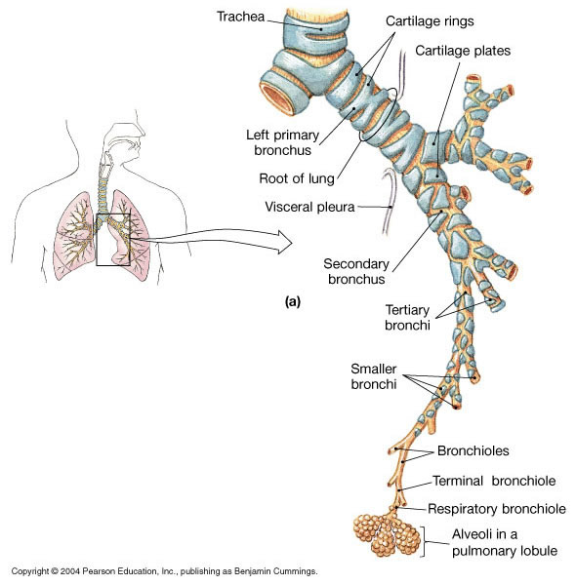
The branching pattern of bronchi in the left lung
Notes:
15

Slide 16
Bronchial tree cont…
  5. Alveolar ducts and alveoli
  Respiratory bronchioles are connected to individual alveoli and to multiple alveoli along regions called alveolar ducts.
  Alveolar ducts end at alveolar sacs, common chambers connected to multiple individual alveoli.
  Each lung contains about 150 million alveoli.
  An extensive network of capillaries is associated with each alveolus.
  The alveolar epithelium consists primarily of simple squamous epithelium.
  Septal cells are scattered among the squamous cells.
Notes:
16

Slide 17
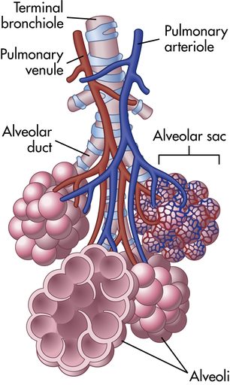
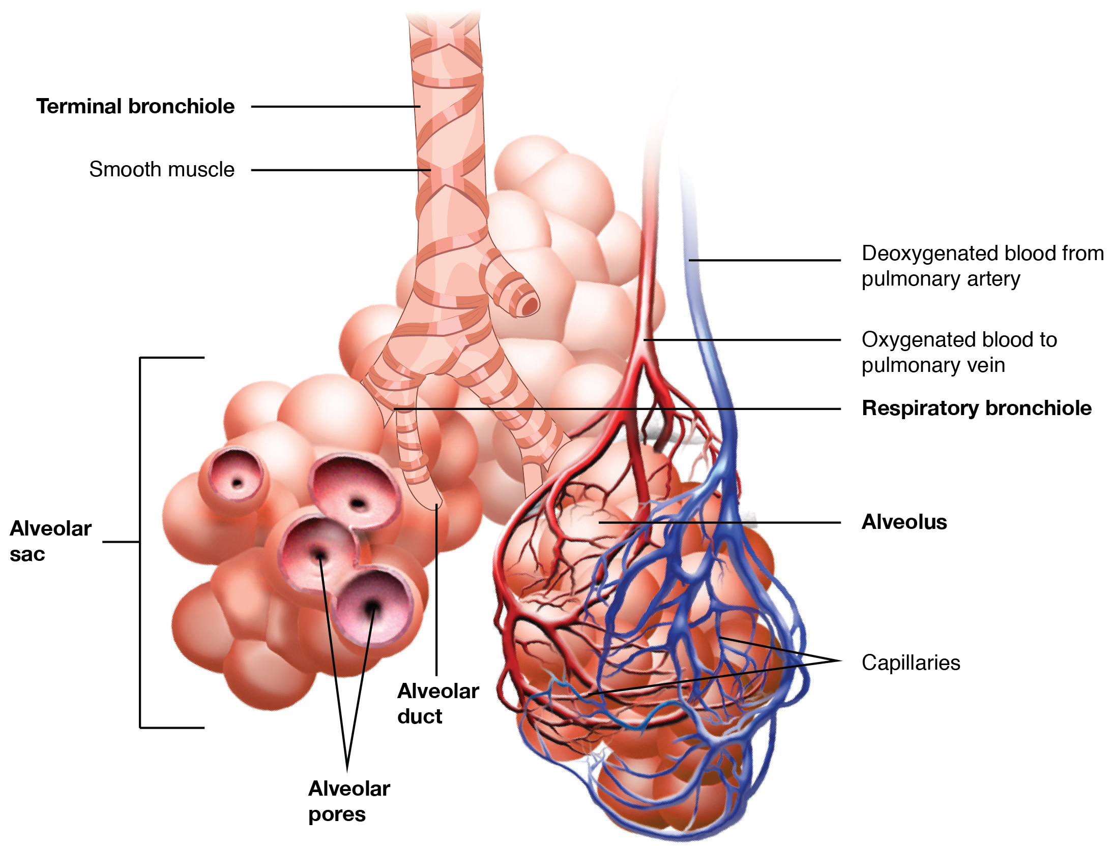
The Structure of a single Pulmonary Lobule
Notes:
17

Slide 18
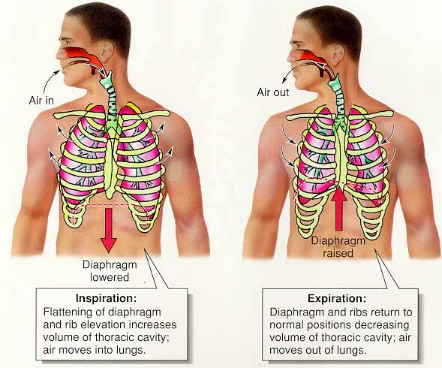
Mechanisms of pulmonary ventilation
Notes:
18

Slide 19
External respiration and internal respiration
Respiration allow gas exchange within the body.
The general term respiration includes two integrated processes:
  external respiration and internal respiration.
  The definitions of these terms vary among references.
  External respiration includes all the processes involved in the exchange of oxygen and carbon dioxide between the body’s interstitial fluids and the external environment.
  The purpose of external respiration and the primary function of the respiratory system is to meet the respiratory demands of cells.

Slide 20
External respiration and internal cont…
  Internal respiration is the absorption of oxygen and the release of carbon dioxide by the cells.
  The biochemical pathways responsible for oxygen consumption and for the generation of carbon dioxide by mitochondria pathways known collectively as cellular respiration.
  External respiration includes three integrated steps:
  1- Pulmonary ventilation, or breathing, which physically moves air into and out of the lungs.
2- Gas diffusion across the blood air barrier between alveolar air spaces and alveolar capillaries, and across capillary walls between blood and other tissues.
3- Transport of oxygen and carbon dioxide between alveolar capillaries and capillary beds in other tissues.

Slide 21
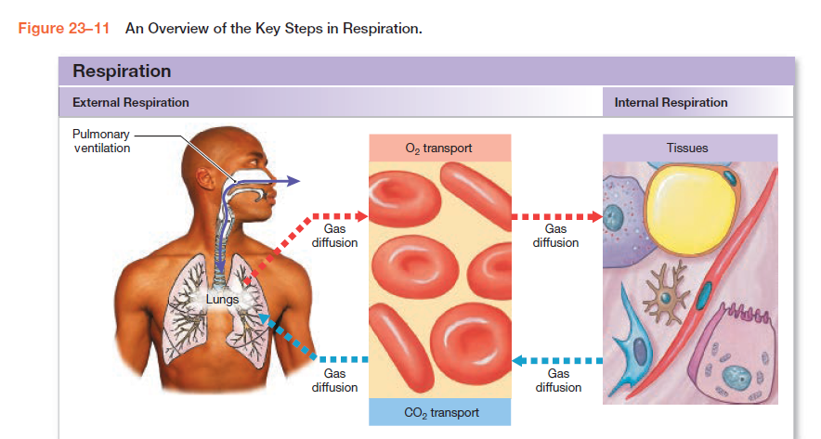
External respiration and internal Respiration

Slide 22
REGULATION OF BREATHING
The motor neurons that stimulate the respiratory muscles are controlled by two major descending pathways: one that controls voluntary breathing and another that controls involuntary breathing.
- Inspiration and expiration are produced by the contraction and relaxation of skeletal muscles in response to activity in somatic motor neurons in the spinal cord. The activity of these motor neurons is controlled, in turn, by descending tracts from neurons in the respiratory control centers in the medulla oblongata and from neurons in the cerebral cortex.

Slide 23
🧠 Control Centers in the Brain
Breathing is mainly controlled by the respiratory centers in the brainstem, specifically:
Medulla oblongata – sets the basic rhythm of breathing.
Pons – helps smooth out the breathing pattern (coordinates inspiration and expiration).
These centers send signals to the respiratory muscles (like the diaphragm and intercostal muscles) to contract and relax rhythmically.

Slide 24
2. 🩸Chemical Regulation
The most important factor regulating breathing is the level of carbon dioxide (CO₂) in the blood.
High CO₂ → increases acidity (lowers pH) → stimulates chemoreceptors → breathing rate increases.
Low CO₂ → decreases acidity (raises pH) → breathing rate slows down.
Chemoreceptors:
Central chemoreceptors (in the medulla): sensitive to CO₂ and pH changes in cerebrospinal fluid.
Peripheral chemoreceptors (in carotid and aortic bodies): respond to changes in O₂, CO₂, and pH in the blood.

Slide 25
3. 💪 Neural Regulation
Inspiratory neurons in the medulla trigger muscle contraction (inhalation).
Expiratory neurons inhibit these signals to allow relaxation (exhalation).
Higher brain centers (like the cerebral cortex) can voluntarily control breathing (e.g., holding your breath, speaking, or singing).

Slide 27



