Slide 1
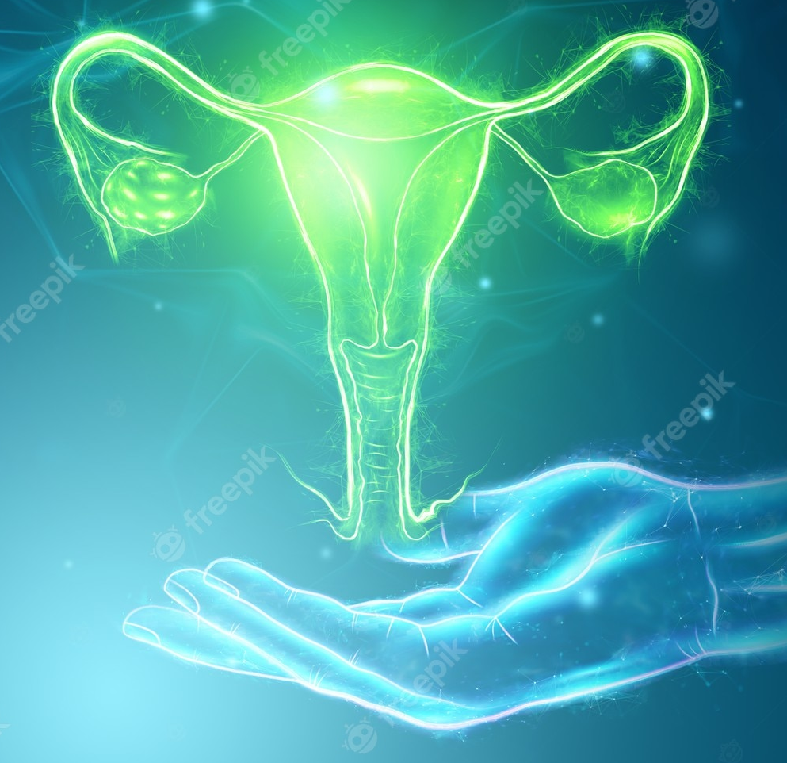
Regulation of the Female Reproductive System
531 Zoo Advanced Physiology
Lecture 12
Presented by..
Dr. Jamilah Alshammari

Slide 2

Objectives
Female Reproductive System
Oogenesis
Hormonal regulation of female reproductive system
Ovarian Cycle/ Menstrual cycle
- Follicular phase
- Ovulation
- Luteal phase
- Menstrual (period) phase
Menopause
Common menstrual problems

Slide 3
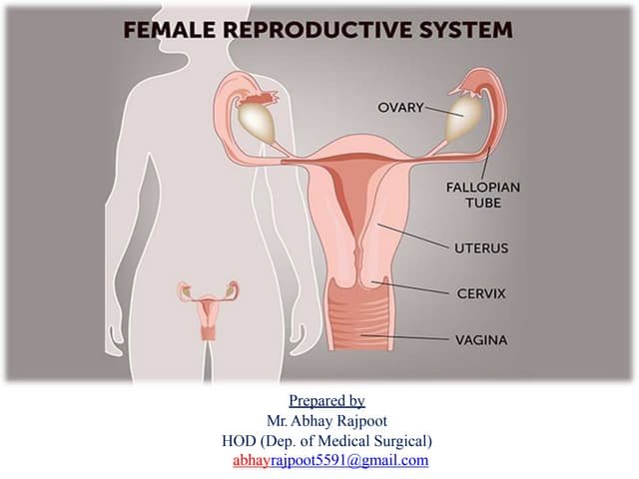
Female Reproductive System
Ovaries.
Fallopian tubes.
Uterus.
Cervix and vagina.
Clitoris.
External genital organs

Slide 4
The main functions of the female reproductive system
The female reproductive system consists of internal and external organs.
It creates hormones
Produce the female gametes (ova)
It is responsible for fertility
Menstruation and sexual activity

Slide 5
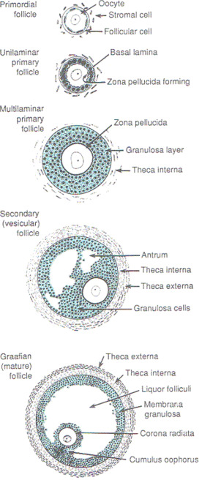
Oogenesis
Oogenesis is a series of developmental steps that enable the oocyte to mature and become competent for fertilization.
During the embryogenesis
Most primordial germ cells (PGCs) migrate to
gonads from their extragonadal origin and
replicate by mitosis.
A female fetus has a finite number of egg

Slide 6
In the female fetus, replicated PGCs (oogonia) differentiate into oocytes and enter meiosis to become primary oocytes.
All primary oocytes become arrested at the prophase stage of the first meiotic, until the female reaches reproductive maturity.
Primary oocytes are surrounded by a single layer of squamous granulosa cells forming primordial follicles

Slide 7
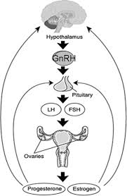
Regulation of the Female Reproductive System
Hormonal interaction between the hypothalamus, anterior pituitary gland and ovaries regulates the female reproductive system.
The hypothalamus secretes a peptide, gonadotropin-releasing hormone (GnRH).

Slide 8
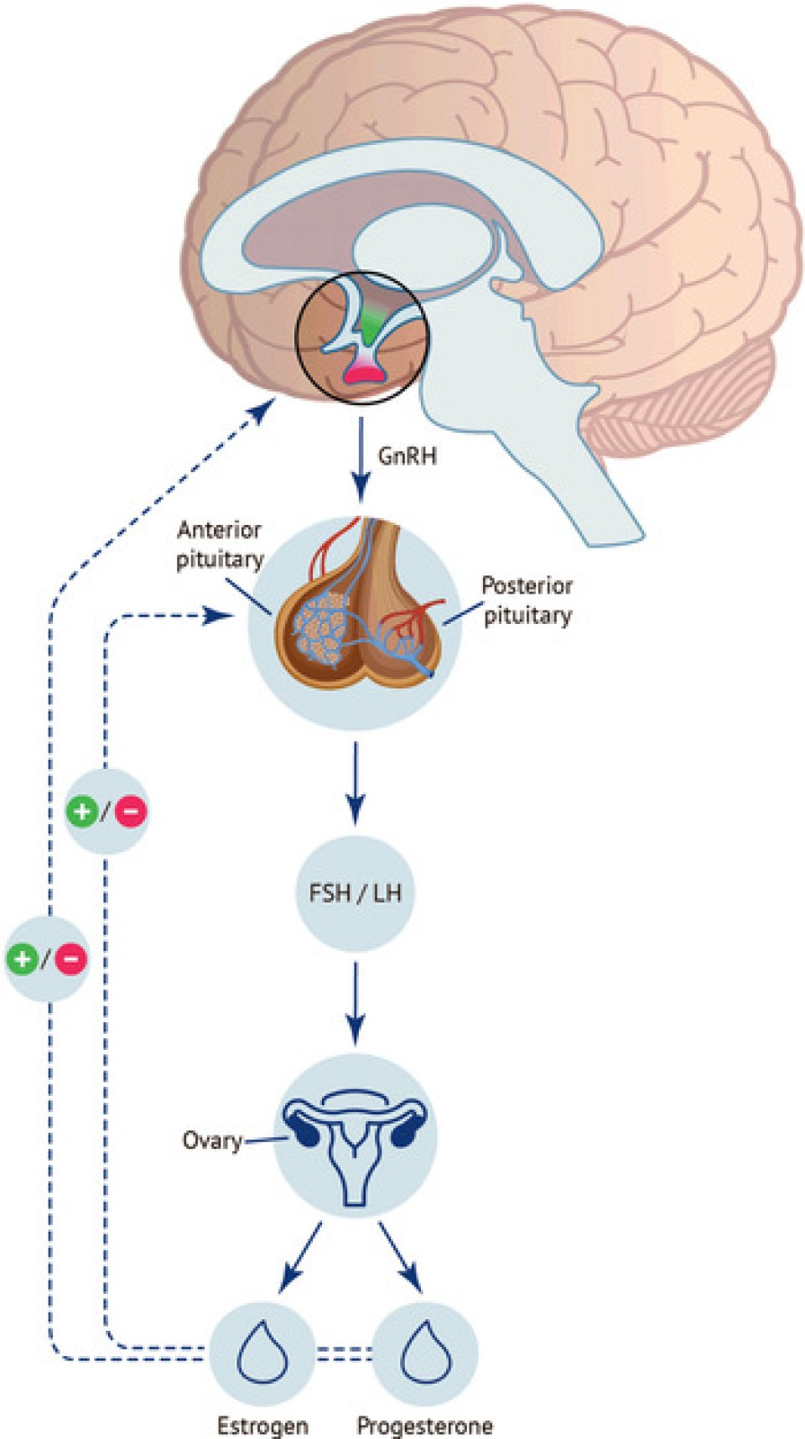
Hormones regulate female reproductive system
1- FSH stimulates development of egg cells (ova), which develop in follicles.
Follicle cells produce the hormone inhibin, which inhibits FSH production.
2- LH also plays a role in the development of ova, induction of ovulation, and stimulation of estrogen and progesterone production by the ovaries.

Slide 9
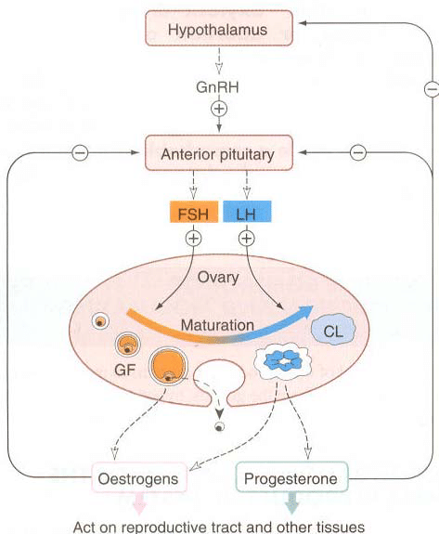
3/4- Estrogen and progesterone are steroid hormones that prepare the body for pregnancy.
Estrogen produces secondary sex characteristics in females, while both estrogen and progesterone regulate the menstrual cycle.

Slide 10
Ovarian cycle ( Menstrual Cycle)
The ovarian cycle refers to the growth and maturation of an oocyte in preparation for fertilization and reproduction.
The ovarian cycle repeats every 28 days from puberty until menopause, as long as the female is not pregnant.
The ovarian cycle consists of the
Follicular phase. B. Ovulation
C. Luteal phase D. Menstruation

Slide 11
The menstrual cycle
The ovarian cycle describes changes that occur in the follicles of the ovary, whereas the uterine cycle describes changes in the endometrial lining of the uterus.
Both cycles can be divided into phases
The menstrual cycle is regulated by hormones.
A menstrual cycle is measured from the first day of your period to the first day of your next period.

Slide 12
The menstrual cycle
The average length of a menstrual cycle is 28 to 29 days, but every woman’s cycle is different. For example, teenagers might have cycles that last 45 days, whereas women in their 20s to 30s might have cycles that last 21 to 38 days.
Your first period is called menarche.
In Western countries, the average age for a first period is 12 to 13, but it can start as early as nine and as late as 16.
Your last period is called menopause. In Australia, the average age for women to reach menopause is 51 to 52. Some women might reach menopause as late as 60

Slide 13
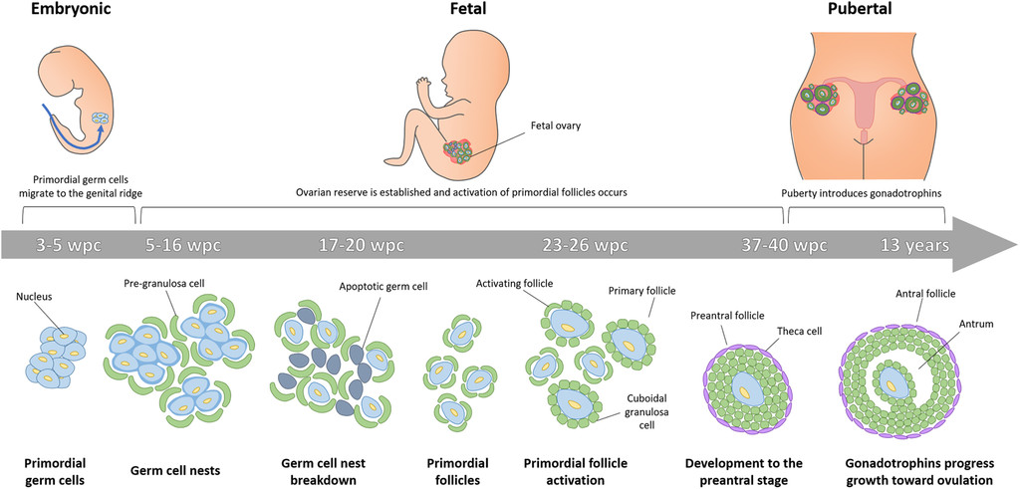
Ovarian Follicular Development
Oogonia differentiate into primary oocytes and proliferate by mitosis resulting in about 7 million oocytes by the 5th month of gestation.
During the 3rd month of gestation, some oogonia begin meiosis and arrest in the prophase of meiosis I until puberty.

Slide 14
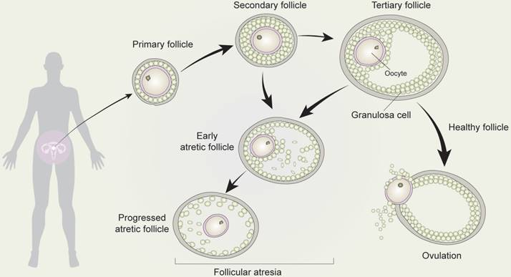
By the 7th month of gestation, a layer of granulosa cells develops around all viable germ cells and forms a primordial follicle.
After the 4th month of gestation, oogonia (and later oocytes) start to be lost spontaneously in a process called atresia; eventually, 99.9% are lost.

Slide 15
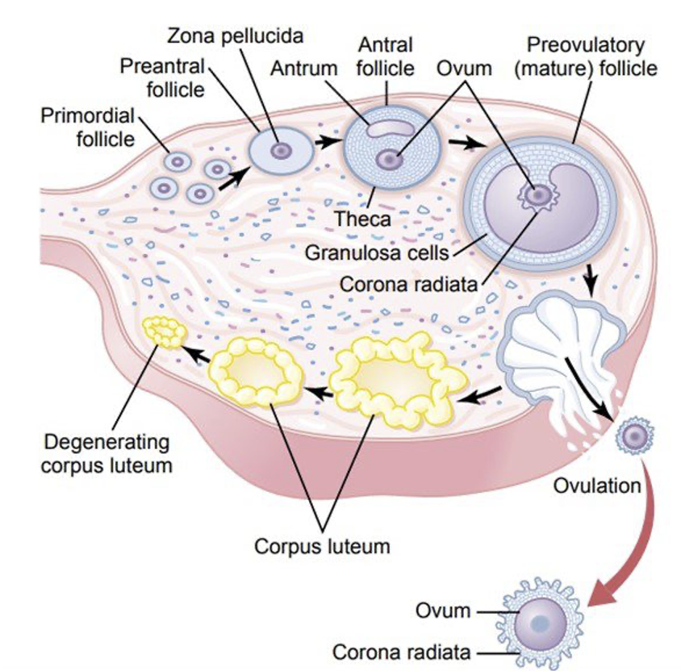
A. The follicular phase
The follicular phase starts on the first day of your period and lasts for 13 to 14 days, ending in ovulation.
The pituitary gland in the brain releases a hormone to stimulate the production of follicles in the ovary. Usually, only one follicle will mature into an egg.
This happen from day 10 of your cycle. During this phase, your uterus lining also thickens in preparation for pregnancy.

Slide 16
After the early proliferative phase of growth, lasting for a few days, the mass of granulosa cells secretes a follicular fluid that contains a high concentration of estrogen.
Accumulation of this fluid causes an antrum to appear within the mass of granulosa cells.
The early growth of the primary follicle up to the antral stage is stimulated mainly by FSH alone.
Then greatly accelerated growth occurs, leading to still larger follicles called vesicular follicles.

Slide 17
During the first few days of each monthly female sexual cycle, the concentrations of both FSH and LH increase slightly to moderately.
FSH greater than LH and preceding it by a few days.
These hormones, especially FSH, cause accelerated growth of 6 to 12 primary follicles each month.
The initial effect is rapid proliferation (granulosa cells) > rise to many more layers of these cells.
spindle cells collect in several layers outside the granulosa cells> the theca
  In the theca interna, the cells take on epithelioid characteristics similar to those of the granulosa cells and develop the ability to secrete additional steroid sex hormones (estrogen and progesterone).
  The outer layer, the theca externa, develops into a highly vascular connective tissue capsule that becomes the capsule of the developing follicle.

Slide 18
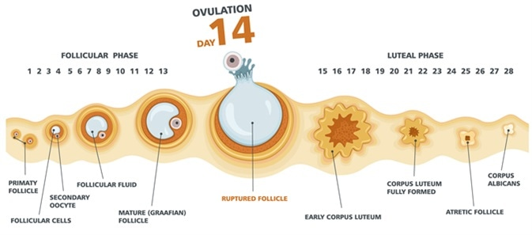
3. Ovulation
When a mature egg is released from an ovary and moves along a fallopian tube towards your uterus.
It happens once each month, about two weeks before your next period. It can last from 16 to 32 hours.
It is possible to get pregnant in the five days before ovulation and on the day of ovulation, but it’s more likely in the three days leading up to and including ovulation.
Once the egg is released, it will survive up to 24hr.

Slide 20
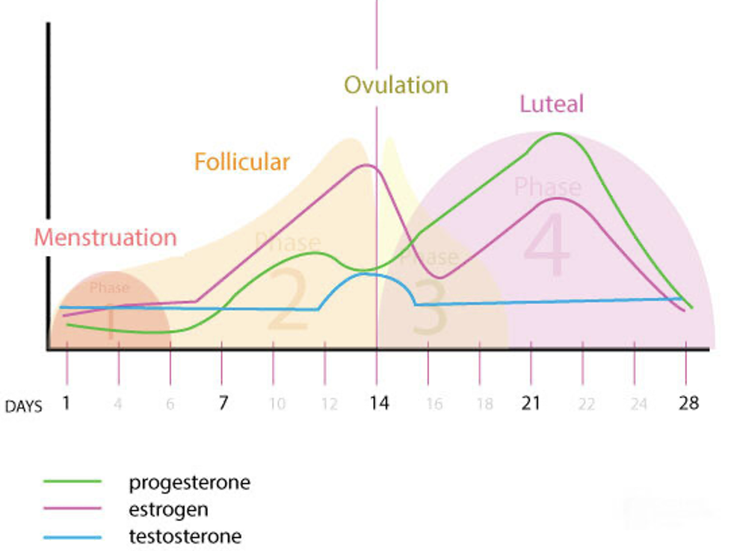
4. The luteal phase
After ovulation, cells in the ovary (the corpus luteum), release progesterone and a small amount of estrogen.
The lining of the uterus to thicken in preparation for pregnancy.
If a fertilized egg implants in the lining of the uterus, the corpus luteum continues to produce progesterone.
If pregnancy does not occur, the corpus luteum dies, progesterone levels drop, the uterus lining sheds and the period begins again.

Slide 21
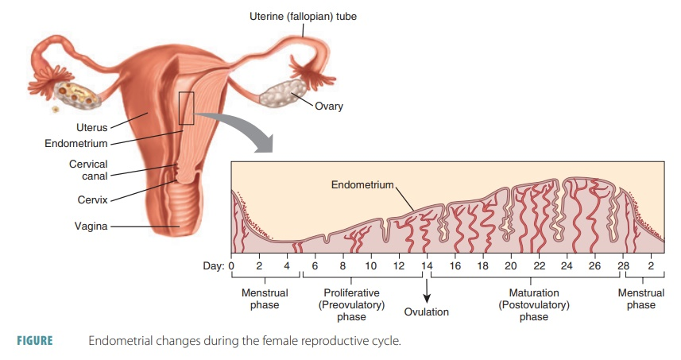
4. Menstruation
Menstruation is commonly known as a period.
When you menstruate, your uterus lining sheds and flows out of your vagina.
Your period contains blood, mucus and some cells from the lining of your uterus.
The average length of a period is three to seven days.

Slide 22
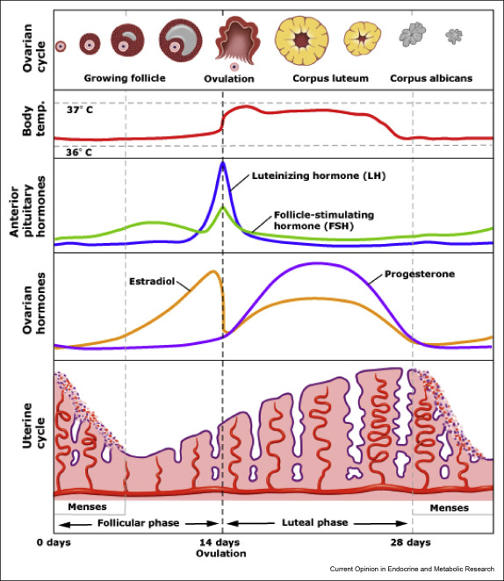
Estrogen levels rise and fall twice during the menstrual cycle
Estrogen levels rise during the mid-follicular phase and then drop precipitously after ovulation.
This is followed by a secondary rise in estrogen levels during the mid-luteal phase with a decrease at the end of the menstrual cycle.

Slide 23
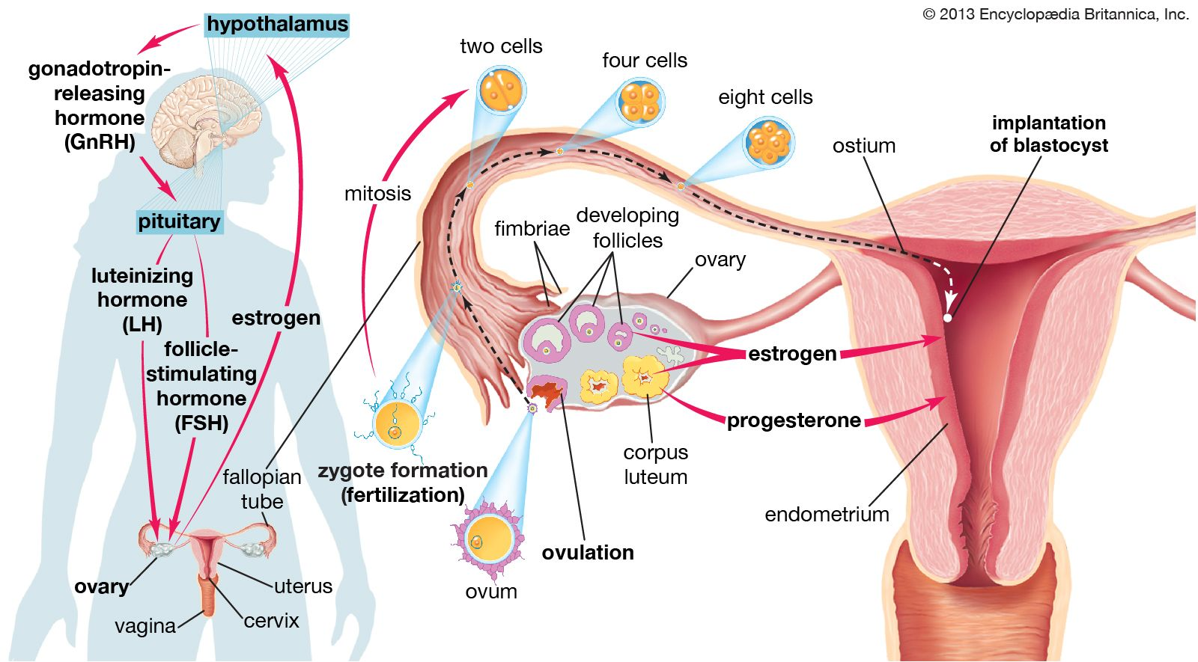

Slide 24
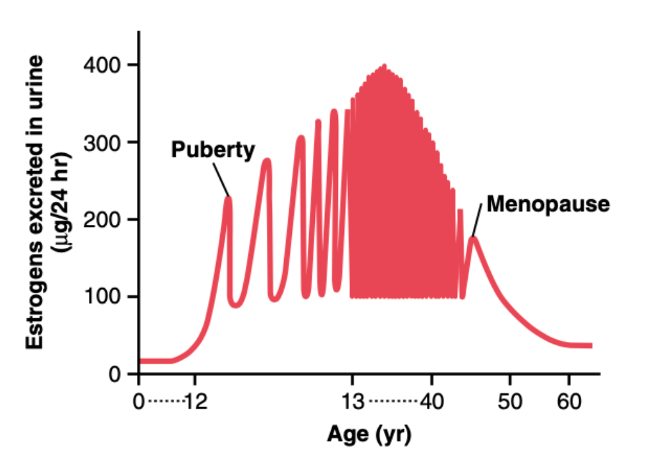
Menopause
• At age 40 to 50 years, the sexual cycle usually becomes irregular and ovulation often fails to occur. After a few months to a few years, the cycle ceases altogether.
The period during which the cycle ceases and the female sex hormones diminish to almost none is called menopause.

Slide 25

Common menstrual problems
premenstrual syndrome (PMS) – hormonal events before a period can trigger a range of side effects in women at risk, including fluid retention, headaches, fatigue and irritability.
Treatment options include exercise and dietary changes
dysmenorrhoea – or painful periods. It is thought that the uterus is prompted by certain hormones to squeeze harder than necessary to dislodge its lining.
Treatment options include pain-relieving medication and the oral contraceptive pill

Slide 26
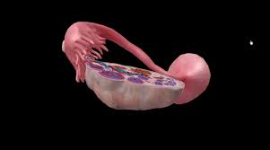
https://youtu.be/42WIByexiXc?si=t9jBQgGuD94Da-W0
Summary

Slide 27

Activity
Fatimah and her husband want to have a baby, but she has problem in fallopian tubes (block). What is the suitable treatment for them?
If she and her husband do not have any problem but the Sperm unable to penetrate or survive in the cervical mucus, What is the treatment they should to asked?

Slide 28

Activity
Answer these questions and send it by email on the end of this week. (Jalshammary@ksu.edu.sa)
What triggers the shedding of the uterine lining during menses?
Which hormone is responsible for the development of new follicles in the proliferative phase?
What hormone causes the multiple ovarian follicles to develop during the follicular phase of the ovarian cycle?
What causes the corpus luteum to degenerate by apoptosis if fertilization does not occur?
Which hormone produced by the granulosa cells lowers FSH levels in the ovarian cycle?

Slide 29
References
https://youtu.be/42WIByexiXc?si=t9jBQgGuD94Da-W0
https://doi.org/10.1016/B978-0-12-813570-9.00010-3
Human physiology, Stuart Ira Fox.
Fundamentals of anatomy and physiology, Martini.

Slide 30


