Slide 1

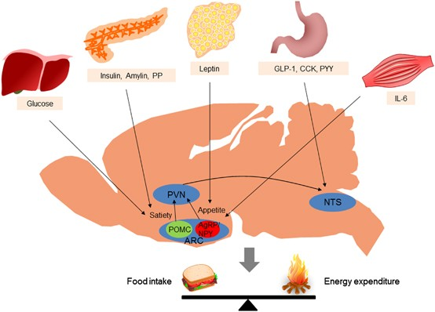



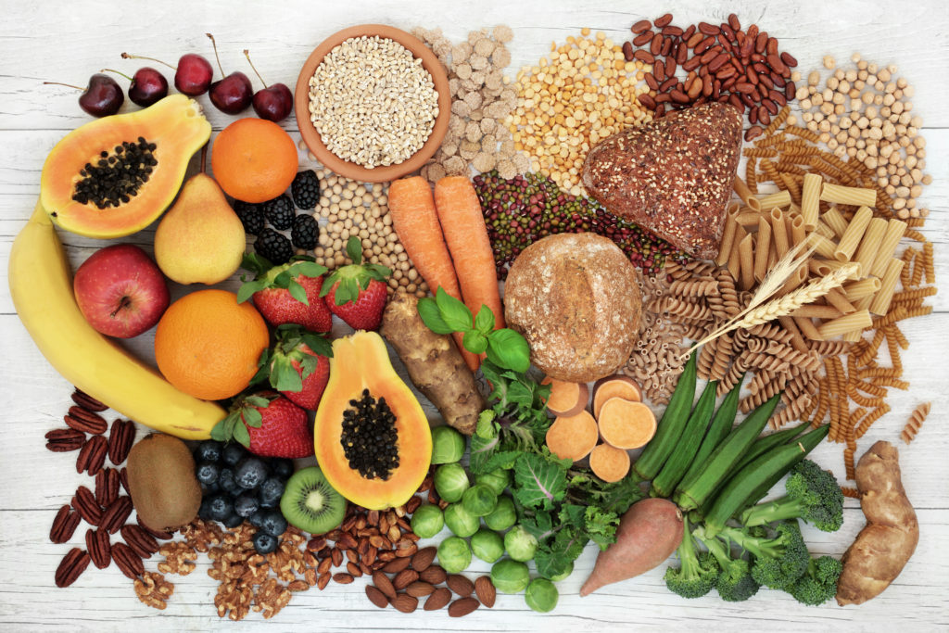
Regulation of digestion
Zoo 531 Advanced Animal Physiology

Slide 2
Learning Objectives
By the end of this lecture, you will be able to:
Discuss the role of neural regulation in digestive processes.
Explain how hormones regulate digestion.

Slide 4
What is the digestive system?
The digestive system is made up of the gastrointestinal tract (GI tract) or digestive tract—and the liver, pancreas, and gallbladder.
The GI tract is a series of hollow organs joined in a long, twisting tube from the mouth to the anus.
The hollow organs that make up the GI tract are the mouth, esophagus, stomach, small intestine, large intestine, and anus.
The liver, pancreas, and gallbladder are the solid organs of the digestive system.

Slide 5
The small intestine has three parts.
The first part is called the duodenum.
The jejunum is in the middle and
The ileum is at the end.
The large intestine includes the appendix, cecum, colon, and rectum. The appendix is a finger-shaped pouch attached to the cecum. The cecum is the first part of the large intestine. The colon is next. The rectum is the end of the large intestine.

Slide 6
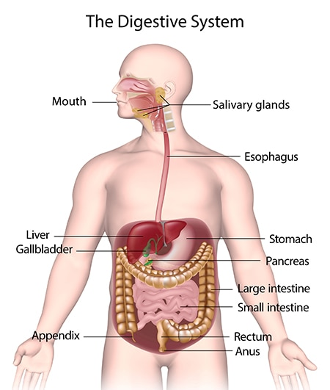

Slide 7
Functions of the Digestive System
Ingestion takes place when materials enter the digestive tract through the mouth .
Mechanical processing is crushing and shearing that makes materials easier to propel along the digestive tract.
Digestion refers to the chemical breakdown of food into small organic fragments suitable for absorption by the digestive epithelium.
Secretion is the release of water, acids, enzymes, buffers, and salts by the epithelium of the digestive tract and by glandular organs.

Slide 8
Functions of the Digestive System
5. Absorption is the movement of organic molecules, electrolytes(inorganic ions), vitamins, and water across the digestive epithelium and into the interstitial fluid of the digestive tract.
6. Excretion is the removal of waste products from body fluids. The process called defecation, or egestion, ejects materials from the digestive tract, eliminating them as feces.

Slide 9
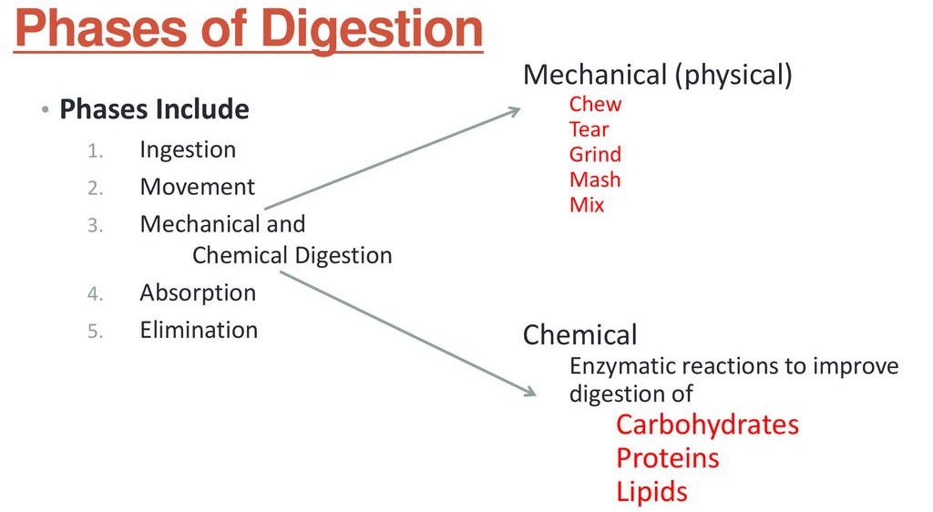

Slide 10
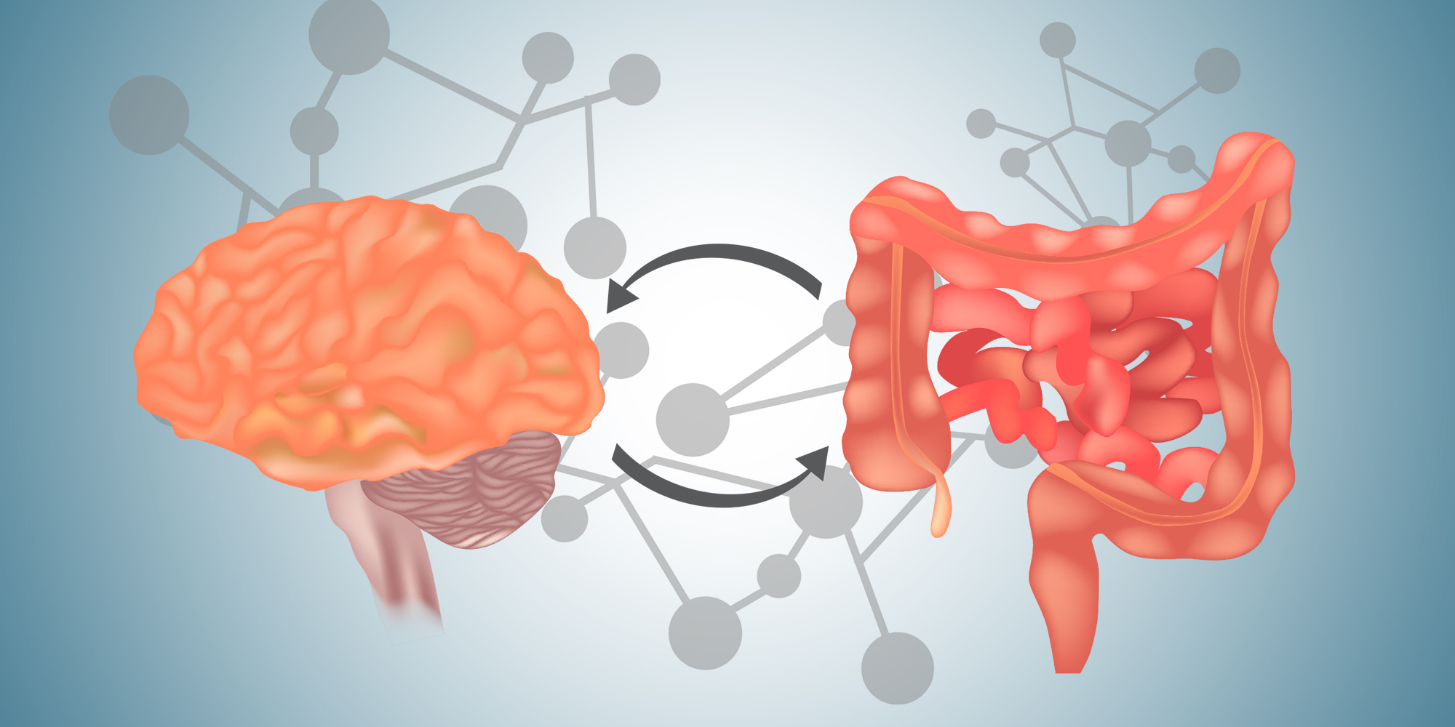
What regulates and controls the digestive system?

Slide 11
Your hormones and nerves work together to help control the digestive process. Signals flow within your GI tract and back and forth from your GI tract to your brain. The brain controls the responses of hunger and satiety. The endocrine system controls the release of hormones and enzymes required for digestion of food in the digestive tract.

Slide 12
Hormones
Cells lining your stomach and small intestine make and release hormones that control how your digestive system works.
These hormones tell your body when to make digestive juices and send signals to your brain that you are hungry or full.
Your pancreas also makes hormones that are important to digestion.

Slide 13
Nerves
You have nerves that connect your central nervous system—your brain and spinal cord—to your digestive system and control some digestive functions.
For example, when you see or smell food, your brain sends a signal that causes your salivary glands to "make your mouth water" to prepare you to eat.
You also have an enteric nervous system (ENS)—nerves within the walls of your GI tract.
When food stretches the walls of your GI tract, the nerves of your ENS release many different substances that speed up or delay the movement of food and the production of digestive juices.
The nerves send signals to control the actions of your gut muscles to contract and relax to push food through your intestines.

Slide 14
Neural Responses to Food
In reaction to the smell, sight, or thought of food, the first hormonal response is that of salivation.
The salivary glands secrete more saliva in response to the stimulus presented by food in preparation for digestion.
Simultaneously, the stomach begins to produce hydrochloric acid to digest the food. Recall that the peristaltic movements of the esophagus and other organs of the digestive tract are under the control of the brain.
The brain prepares these muscles for movement as well.
When the stomach is full, the part of the brain that detects satiety signals fullness.

Slide 15
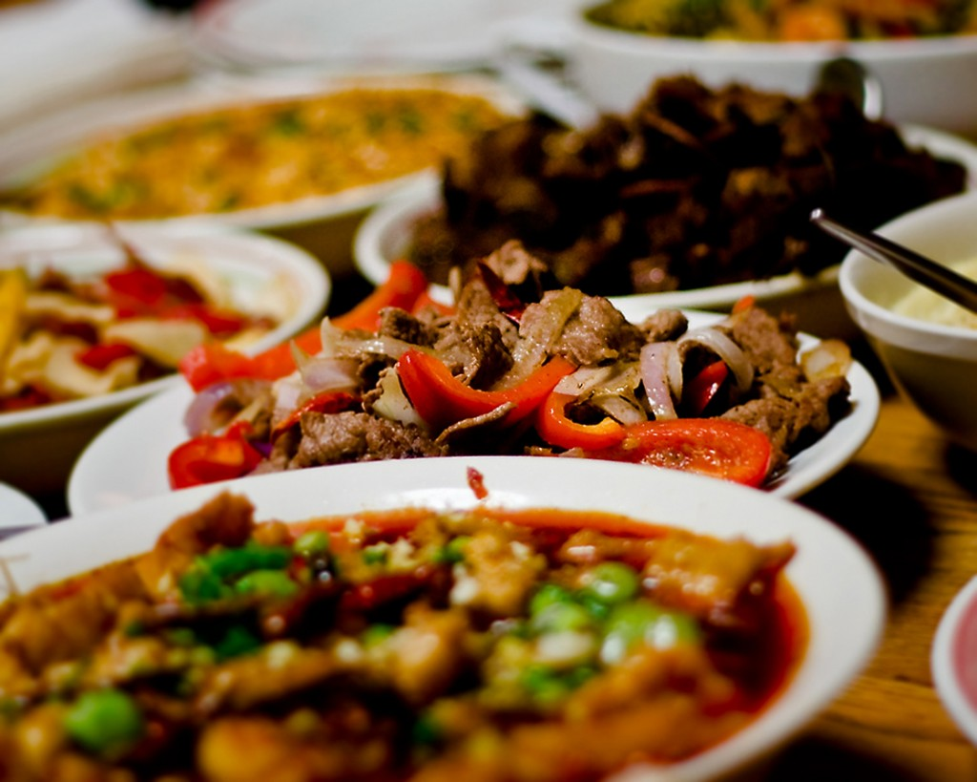
Figure 15.20. Seeing a plate of food triggers the secretion of saliva in the mouth and the production of HCL in the stomach. (credit: Kelly Bailey

Slide 16
There are three overlapping phases of gastric control:
1. The cephalic phase
2. The gastric phase
3. Intestinal phase
each requires many enzymes and is under neural control as well.

Slide 17
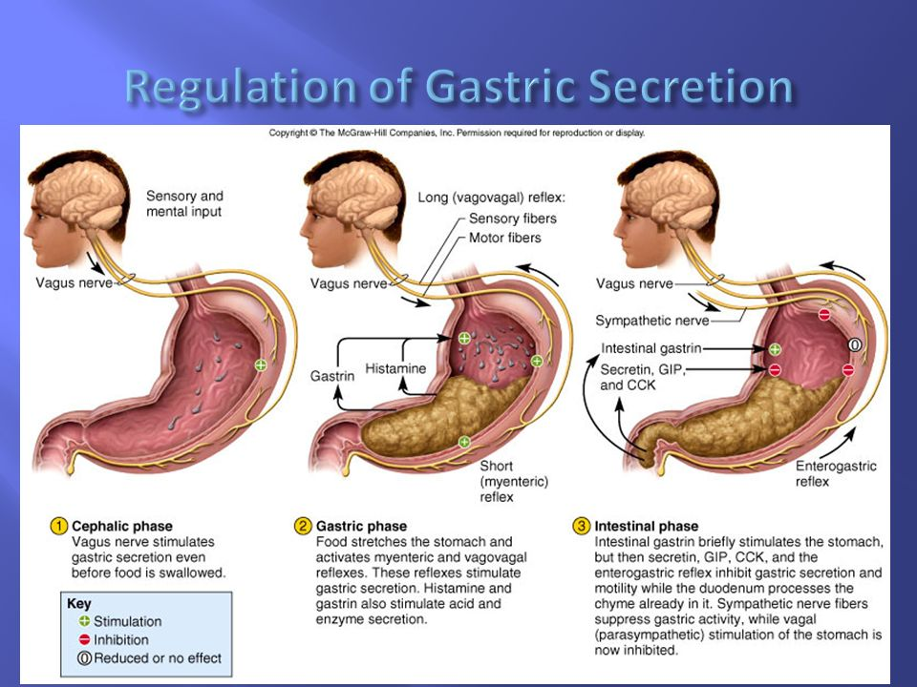
Digestive Phases

Slide 18
Cephalic phase
The response to food begins even before food enters the mouth.
The first phase of ingestion, called the cephalic phase, is controlled by the neural response to the stimulus provided by food.
All aspects—such as sight, sense, and smell—trigger the neural responses resulting in salivation and secretion of gastric juices.
The gastric and salivary secretion in the cephalic phase can also take place due to the thought of food.
Right now, if you think about a piece of chocolate or a crispy potato chip, the increase in salivation is a cephalic phase response to the thought.
The central nervous system prepares the stomach to receive food.

Slide 19
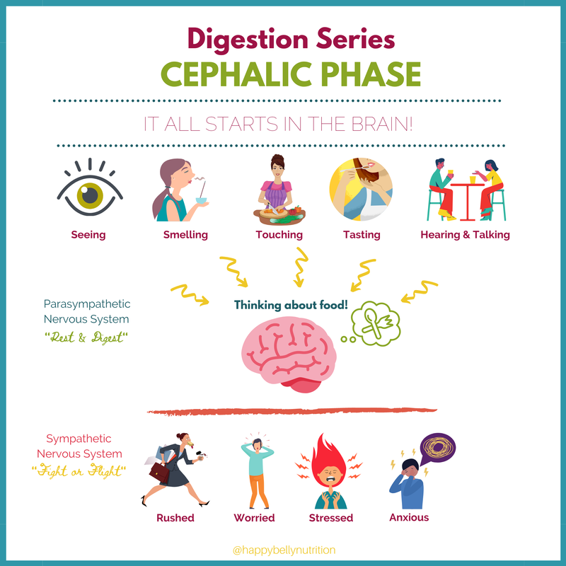

Slide 20
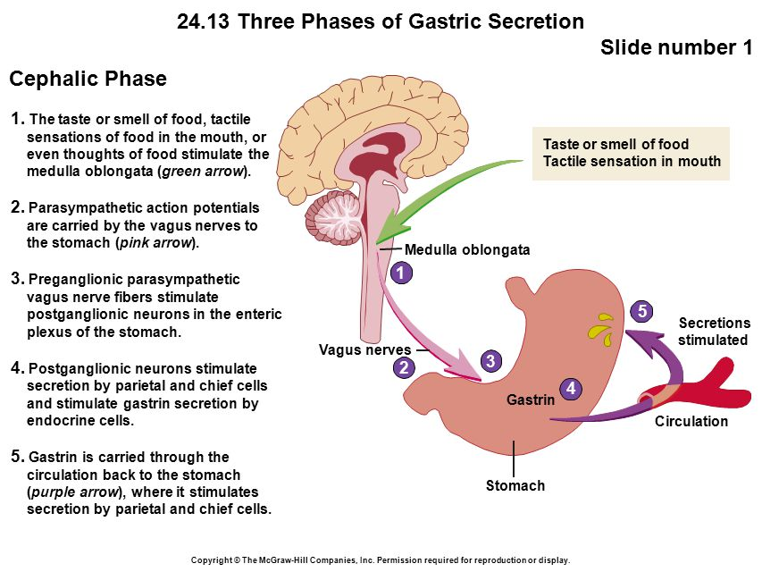

Slide 21
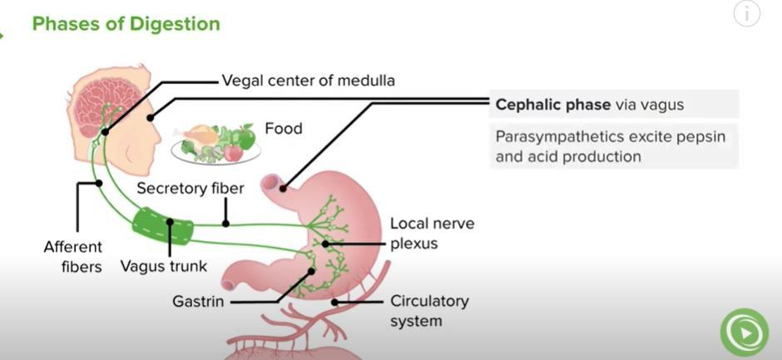
Digestive Phases

Slide 22
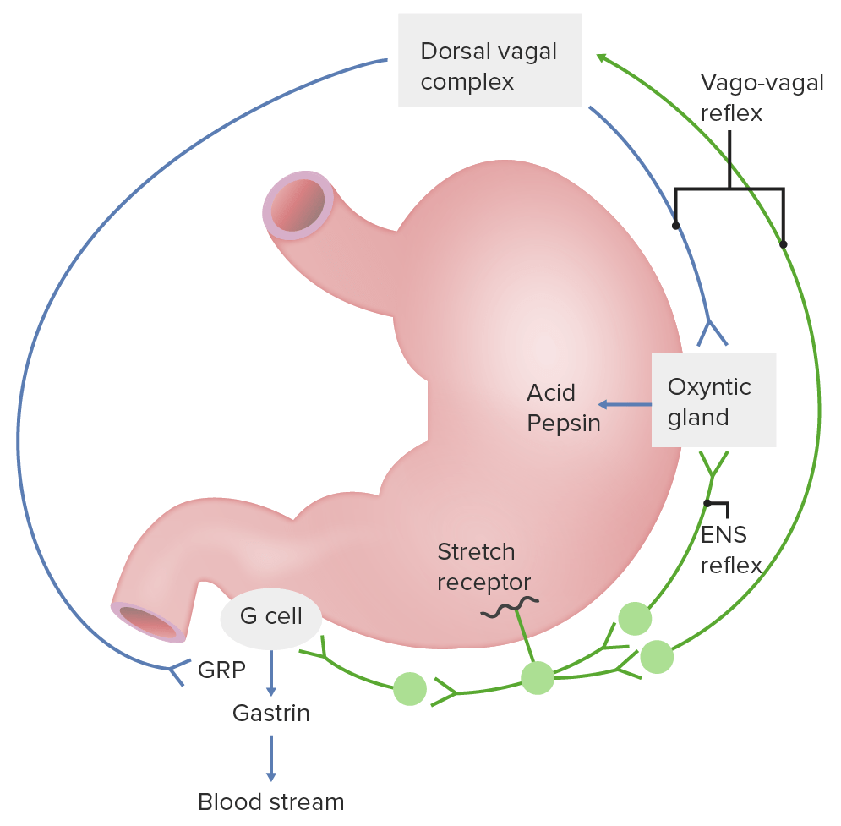

Slide 23
Gastric phase
The gastric phase begins once the food arrives in the stomach.
It builds on the stimulation provided during the cephalic phase. Gastric acids and enzymes process the ingested materials.
The gastric phase is stimulated by (1) distension of the stomach, (2) a decrease in the pH of the gastric contents, and (3) the presence of undigested material.
This phase consists of local, hormonal, and neural responses.
These responses stimulate secretions and powerful contractions.

Slide 24
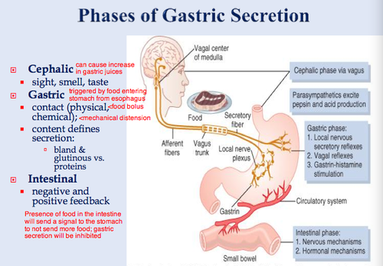

Slide 25
intestinal phase
The begins when chyme enters the small intestine triggering digestive secretions.
This phase controls the rate of gastric emptying.
In addition to gastrin emptying, when chyme enters the small intestine, it triggers other hormonal and neural events that coordinate the activities of the intestinal tract, pancreas, liver, and gallbladder.

Slide 26
Hormonal Responses to Food
The endocrine system controls the response of the various glands in the body and the release of hormones at the appropriate times.
One of the important factors under hormonal control is the stomach acid environment.
During the gastric phase, the hormone gastrin is secreted by G cells in the stomach in response to the presence of proteins.
Gastrin stimulates the release of stomach acid, or hydrochloric acid (HCl) which aids in the digestion of the proteins.
However, when the stomach is emptied, the acidic environment need not be maintained and a hormone called somatostatin stops the release of hydrochloric acid.
This is controlled by a negative feedback mechanism.

Slide 27
In the duodenum, digestive secretions from the liver, pancreas, and gallbladder play an important role in digesting chyme during the intestinal phase.
In order to neutralize the acidic chyme, a hormone called secretin stimulates the pancreas to produce alkaline bicarbonate solution and deliver it to the duodenum.
Secretin acts in tandem with another hormone called cholecystokinin (CCK).
Not only does CCK stimulate the pancreas to produce the requisite pancreatic juices, it also stimulates the gallbladder to release bile into the duodenum.

Slide 28
Understanding the hormonal control of the digestive system is an important area of ongoing research.
Scientists are exploring the role of each hormone in the digestive process and developing ways to target these hormones.
Advances could lead to knowledge that may help to battle the obesity epidemic.

Slide 29
Another level of hormonal control occurs in response to the composition of food.
Foods high in lipids take a long time to digest.
A hormone called gastric inhibitory peptide is secreted by the small intestine to slow down the peristaltic movements of the intestine to allow fatty foods more time to be digested and absorbed.

Slide 30
Summery The Enteric Endocrine System
The second of the two systems that control digestive function is the endocrine system, which regulates function by secreting hormones.
Recall that hormones are chemical messengers secreted into blood that modify the physiology of target cells.
A target cell for a particular hormone is a cell that has receptors for that hormone and can thus respond to it.

Slide 31
Digestive function is affected by hormones produced in many endocrine glands, but the most profound control is exerted by hormones produced within the gastrointestinal tract.
The gastrointestinal tract is the largest endocrine organ in the body and the endocrine cells within it are referred to collectively as the enteric endocrine system. Three of the best-studied enteric hormones are:
Gastrin: Secreted from the stomach and plays an important role in control of gastric acid secretion.
Cholecystokinin: A small intestinal hormone that stimulates secretion of pancreatic enzymes and bile.
Secretin: Another hormone secreted from small intestinal epithelial cells; stimulates secretion of a bicarbonate-rich fluids from the pancreas and liver.

Slide 32
In contrast to endocrine glands like the anterior pituitary gland, in which essentially all cells produce hormones, the enteric endocrine system is:
1.diffuse: single hormone-secreting cells are scattered among other types of epithelial cells in the mucosa of the stomach and small intestine.
For example, most of the epithelial cells in the stomach are dedicated to secreting mucus, hydrochloric acid or a proenzyme called pepsinogen into the lumen of the stomach.
Scattered among these secretory epithelial cells are G cells, which are endocrine cells that synthesize and secrete the hormone gastrin. Being a hormone, gastrin is secreted into blood, not into the lumen of the stomach.

Slide 33
Similarly, other hormones produced by the enteric endocrine system are synthesized and secreted by cells within the epithelium of the small intestine.
Like all endocrine cells, cells in enteric endocrine system do not simply secrete their hormone continuously, which would not be very useful as a control system.
Rather, they secrete hormones in response to fairly specific stimuli and stop secreting their hormone when those stimuli are no longer present.

Slide 34
What stimulates the endocrinocytes in the enteric endocrine system?
As you might deduce, in most cases these endocrine cells respond to changes in the environment within the lumen of the digestive tube.
Because these cells are part of the epithelium, their apical border is in contact with the contents of the lumen, which allows them to continually "taste" or sample the lumenal environment and respond appropriately.

Slide 35
What stimulates the endocrinocytes in the enteric endocrine system?
To illustrate how control is implemented through the enteric endocrine system, consider the important example of preventing stomach acid from burning the epithelium of the small intestine:
Acid-laden ingesta flows out of the stomach, into the small intestine.
Acid in the small intestine stimulates secretion of the hormone secretin from endocrine cells in the intestinal epithelium.
Secretin stimulates the pancreas to dump a bicarbonate-rich fluid into the lumen of the intestine.
The bicarbonate neutralizes acid, which removes the stimulus for secretion of additional secretion.
In the absence of a secretin stimulus, the pancreas stops secreting bicarbonate.

Slide 36
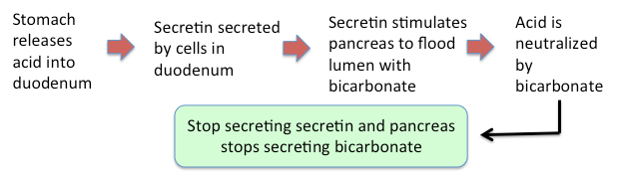

Slide 37


