Slide 1
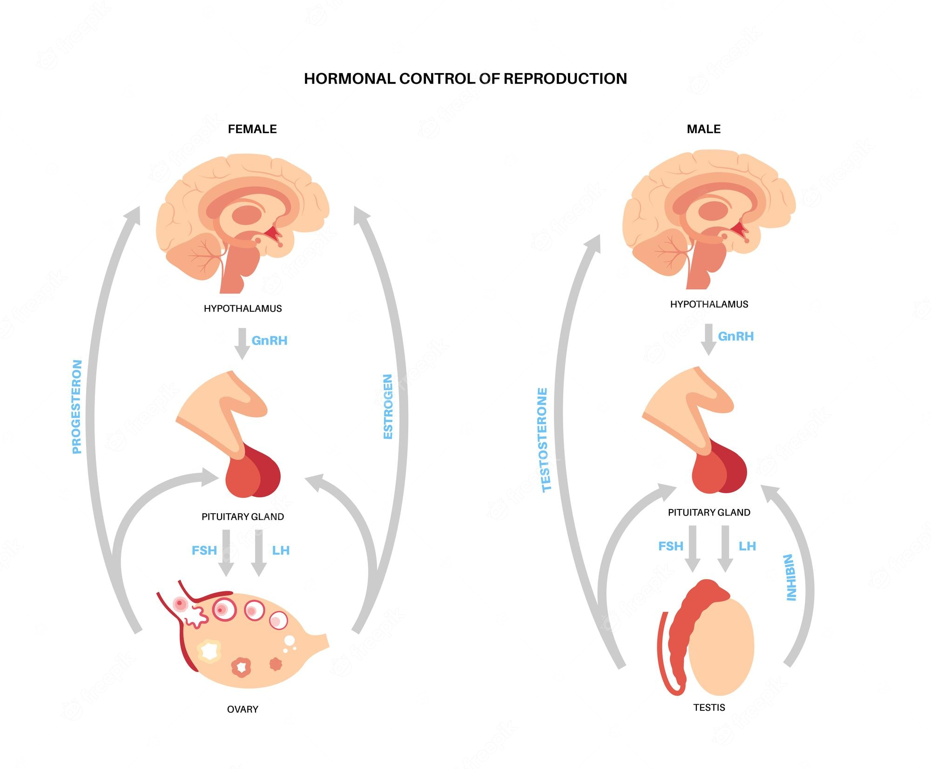
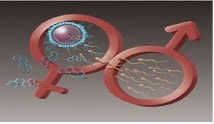
Regulation of reproduction
Ninth lecture
Zoo 531 Advanced Animal Physiology
Second semester 2025

Slide 2
Reproduction
Reproduction is the production of offspring.
There are two main forms:
sexual and
A sexual reproduction.
-In sexual reproduction, an organism combines the genetic information from each of its parents and is genetically unique.
-In a sexual reproduction, one parent copies itself

Slide 3
Reproduction Definition
Reproduction is a biological process by which an organism reproduces an offspring that is biologically similar to the organism.
Reproduction enables and ensures the continuity of species, generation after generation.

Slide 4
Endocrine Regulation of Reproduction
The functions of the testes and ovaries are regulated by gonadotropic
hormones secreted by the anterior pituitary.
The gonadotropic hormones stimulate the gonads to secrete their sex steroid hormones, and these steroid hormones, in turn, have an inhibitory effect on the secretion of the gonadotropic hormones.
This interaction between the anterior pituitary and the gonads forms a
negative feedback loop.

Slide 5
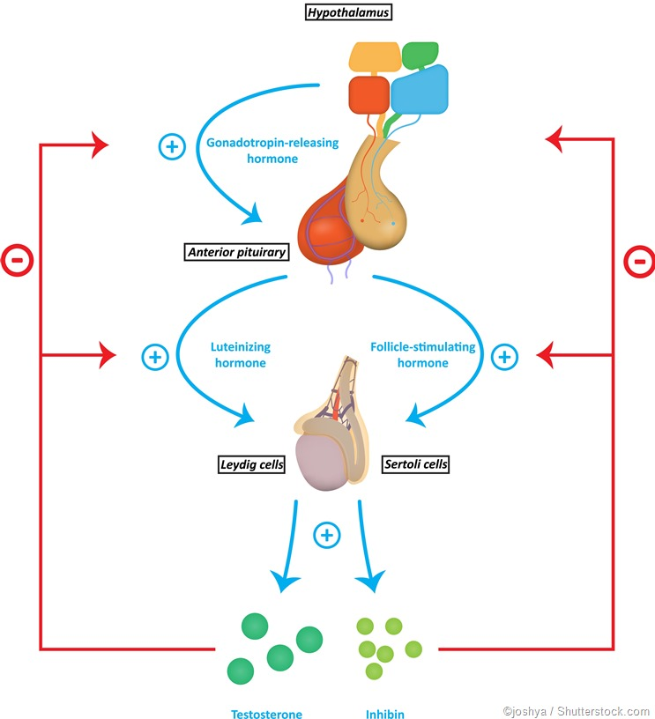

Slide 6
Interactions Between the Hypothalamus,
Pituitary Gland, and Gonads
The anterior pituitary produces & secretes two gonadotropic Hormones:
FSH (follicle-stimulating hormone).
LH (luteinizing hormone).
Although these two hormones are named according to their actions in the female, the same hormones are secreted by the male’s pituitary gland.
The gonadotropic hormones have three primary effects on the gonads:
1) stimulation of spermatogenesis or oogenesis (formation of sperm or ova)
2) stimulation of gonadal hormone secretion
3) maintenance of the structure of the gonads (the gonads atrophy if the pituitary gland is removed).

Slide 7
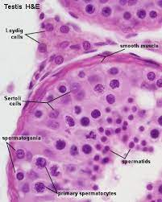
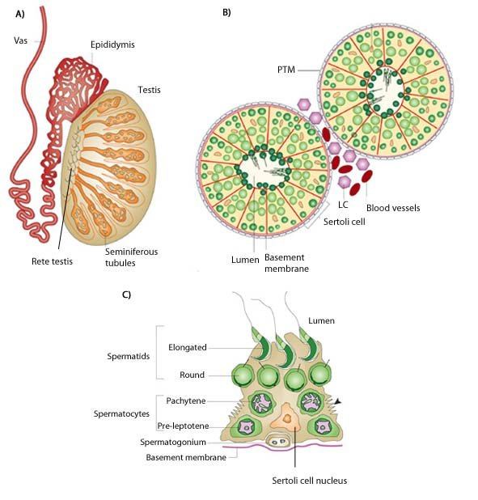
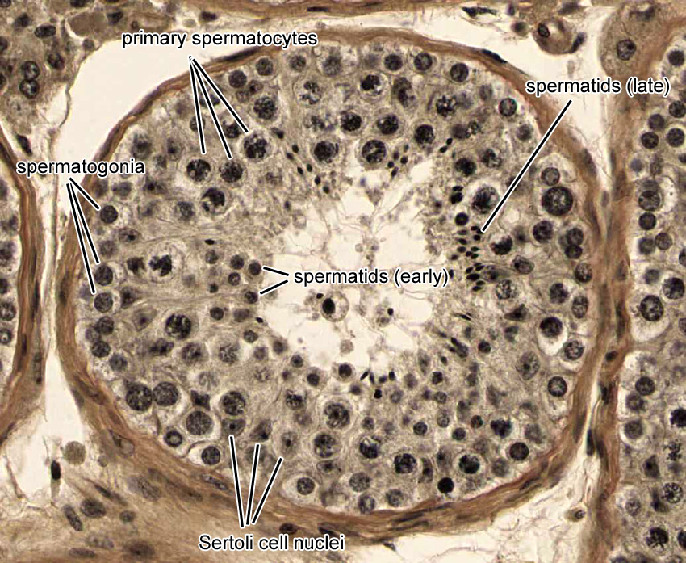

Slide 8
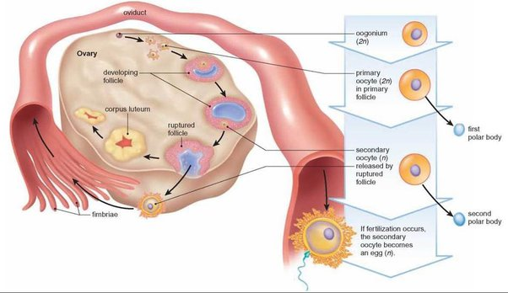
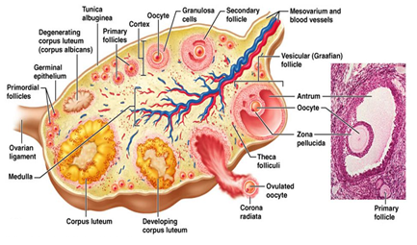
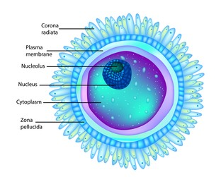

Slide 9
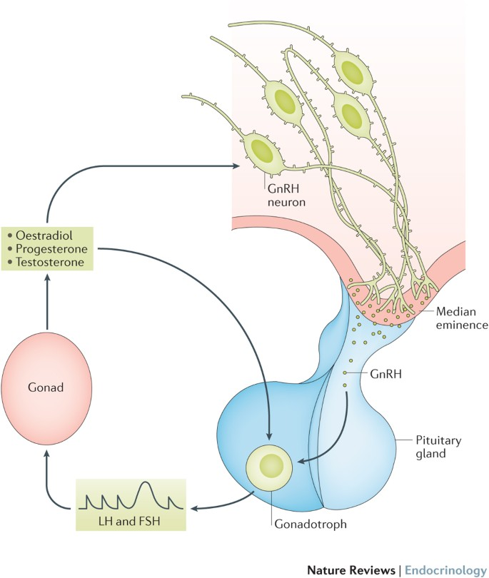
The secretion of both LH and FSH from the anterior pituitary is stimulated by a hormone produced by the hypothalamus and secreted into the hypothalamo-hypophyseal portal vessels.
This releasing hormone is sometimes called LHRH (luteinizing hormone-releasing hormone).
Since attempts to find a separate FSH-releasing hormone have thus far failed, and since LHRH stimulates FSH as well as LH secretion, LHRH is often referred to as gonadotropin releasing hormone (GnRH).
Gonadotrophin-releasing hormone (GnRH) is
a type of hormone that is produced from cells that are present in the hypothalamus. Afterward, they are then secreted into small blood vessels that finally are transmitted towards the pituitary gland. As a consequence, the pituitary gland forms the luteinizing hormone and follicle-stimulating hormones.

Slide 10
The negative feedback effects of steroid hormones occurs by means of two mechanisms:
(1) inhibition of GnRH secretion from the hypothalamus and
(2) inhibition of the pituitary’s response to a given amount of GnRH.
In addition to steroid hormones, the testes and ovaries secrete a polypeptide hormone called inhibin:
- Inhibin is secreted by the Sertoli cells of the seminiferous tubules in males and by the granulosa cells of the ovarian follicles in females.
- This hormone specifically inhibits the anterior pituitary’s secretion of FSH without affecting the secretion of LH.

Slide 11
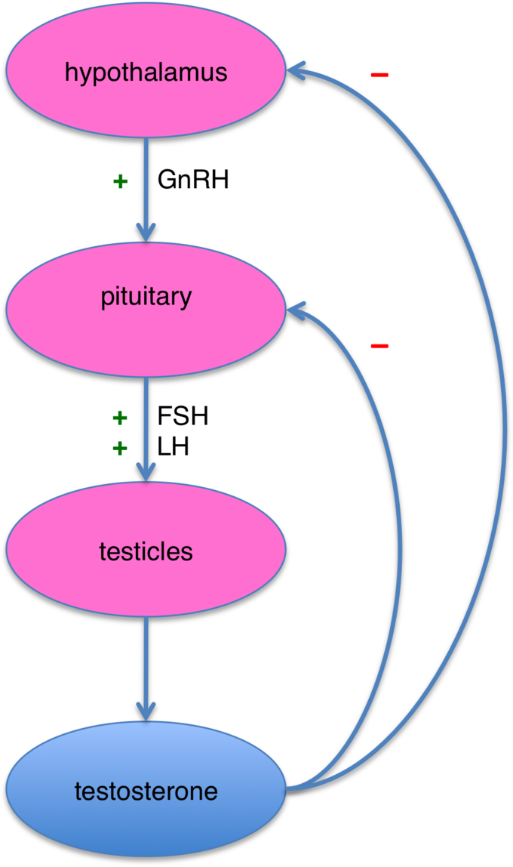

Slide 12
HORMONAL REGULATION OF THE REPRODUCTIVE SYSTEM
The reproductive system is controlled by the gonadotropins follicle-stimulating hormone (FSH) and luteinizing hormone (LH), which are produced by the pituitary gland.
Gonadotropin release is controlled by the hypothalamic hormone gonadotropin-releasing hormone (GnRH).
FSH stimulates the maturation of sperm cells in males and is inhibited by the hormone inhibin, while LH stimulates the production of the androgen testosterone.
FSH stimulates egg maturation in females, while LH stimulates the production of estrogens and progesterone.
Estrogens are a group of steroid hormones produced by the ovaries that trigger the development of secondary sex characteristics in females as well as control the maturation of the ova. In females, the pituitary also produces prolactin, which stimulates milk production after childbirth, and oxytocin, which stimulates uterine contraction during childbirth and milk let-down during suckling.

Slide 13
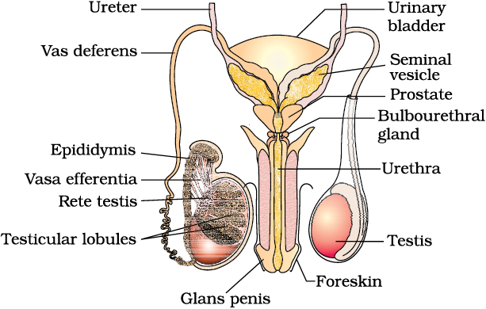
Male Reproductive System

Slide 14
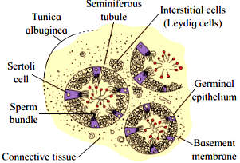
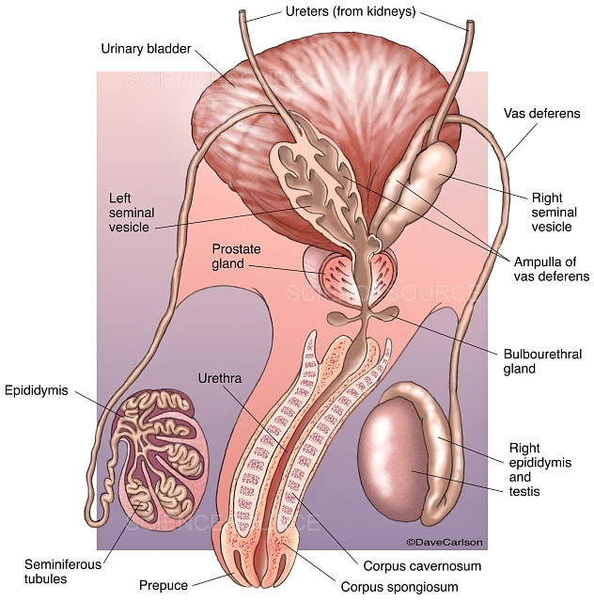
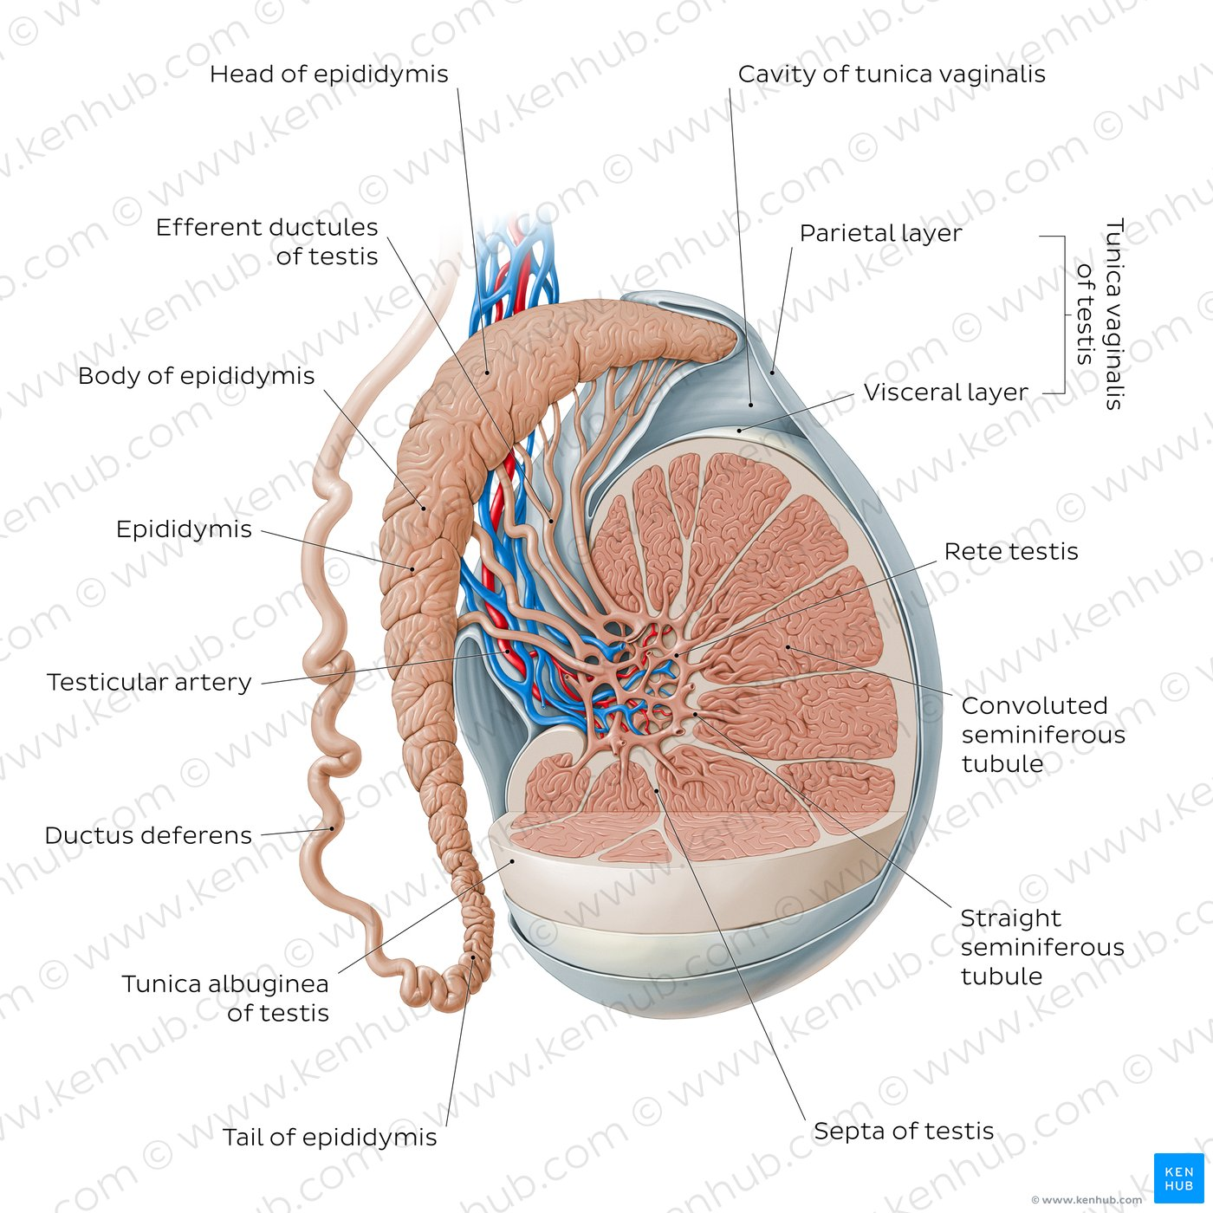
Anatomy and histology of the testis

Slide 15
The Leydig cells
The Leydig cells in the interstitial tissue of the testes are stimulated by
LH to secrete testosterone, a potent androgen that acts to maintain
the structure and function of the male accessory sex organs and to
promote the development of male secondary sex characteristics.
The Sertoli cells in the seminiferous tubules of the testes are stimulated by FSH.
The cooperative actions of FSH and testosterone are required
to initiate spermatogenesis.

Slide 16
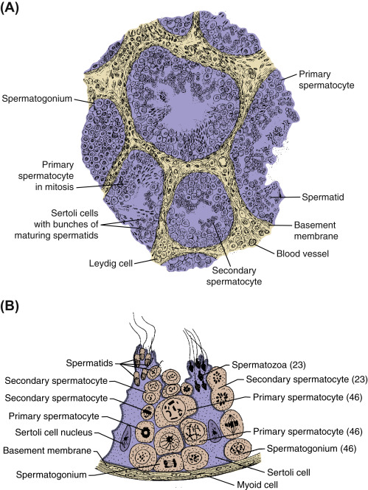

Slide 17

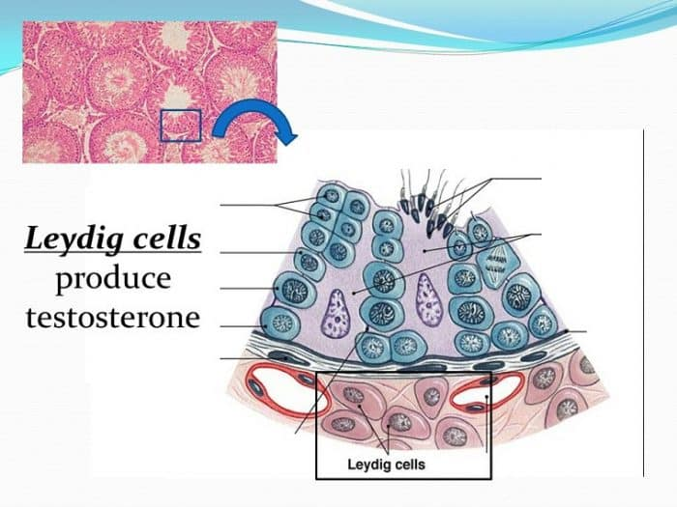
The testes
The testes consist of two parts, or “compartments”—the
seminiferous tubules, where spermatogenesis occurs, and the
interstitial tissue, which contains the testosterone-secreting Leydig cells .The seminiferous tubules account for about 90% of the weight of an adult testis. The interstitial tissue is a thin web of connective tissue (containing Leydig cells) that fills the spaces between the tubules.

Slide 18
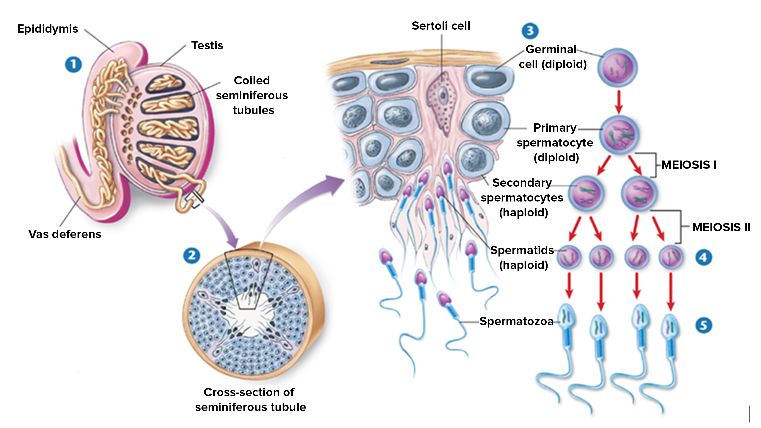
With regard to gonadotropin action, the testes are strictly
compartmentalized. Cellular receptor proteins for FSH are
located exclusively in the seminiferous tubules, where they are
confined to the Sertoli cells. LH receptor proteins are located
exclusively in the interstitial Leydig cells. Secretion of
Testosterone by the Leydig cells is stimulated by LH but not by
FSH.

Slide 19
Spermatogenesis occurs in the testes, and hormones from the hypothalamus, pituitary gland, and testes control male reproductive functions
Mitosis and Meiosis
Mitosis: the production of genetically identical cells.
Meiosis: the production of gametes.
Mitosis and Meiosis differ significantly in terms of the events of that take place in the nucleus.
Human somatic cells contain 23 pairs of chromosomes, or 46 chromosomes altogether.
Each pair consists of one chromosome provided by the father, and another provided by the mother, at the time of fertilization.

Slide 20
Mitosis and Meiosis cont….
The two members of each of the 22 pairs have similar sizes and genes and are known as homologous chromosomes.
Mitosis is part of the process of somatic cell division, producing two daughter cells each containing identical numbers and pairs of chromosomes (Figure 28–8a).
Because somatic cells contain both members of each chromosome pair, they are called diploid (2n = 46) cells.
Meiosis involves two cycles of cell division (meiosis I and meiosis II) Figure 28–8b.
It produces four cells, each containing 23 individual chromosomes.
These cells are called haploid (n = 23) cells and contain only one member of each homologous pair of chromosomes.

Slide 21
Mitosis and Meiosis cont….
Because gametes contain half the number of chromosomes found in somatic cells, the fusion of the nuclei of a male gamete and a female gamete produces a cell that has the normal (double) number of chromosomes.
The events in the nucleus shown in Figure 28–8b are the same for the formation of sperm in males or oocytes in females.
As a cell prepares to begin meiosis, DNA replication occurs within the nucleus just as it does in a cell preparing for mitosis.
The duplicated chromosomes condense and become visible with a light microscope.
As in mitosis, each chromosome now consists of two duplicate chromatids.
At this point, the close similarities between meiosis and mitosis end.

Slide 22
Mitosis and Meiosis cont….
In meiosis, the corresponding maternal and paternal chromosomes now come together in an event known as synapsis.
Synapsis involves 23 pairs of chromosomes, and each member of each pair consists of two chromatids.
A matched set of four chromatids is called a tetrad (four) (Figure 28–8b).
Some genetic material can be exchanged between the maternal and paternal chromatids of a chromosome pair at this stage of meiosis.
Such an exchange, called crossing over, increases genetic variation among offspring.

Slide 23
Meiosis I
Meiosis I begins with prophase I; the nuclear envelope disappears at the end of prophase I.
As metaphase I begins, the tetrads line up along the metaphase plate.
As anaphase I begins, the tetrads break up—the maternal and paternal chromosomes separate; this is a major difference between mitosis and meiosis.
As anaphase I proceeds, the maternal and paternal components are randomly and independently distributed.
As a result, telophase I ends with the formation of two daughter cells containing unique combinations of maternal and paternal chromosomes.
Both cells contain 23 chromosomes.
The first meiotic division is called a reductional division because it reduces the number of chromosomes from the diploid number (2n = 46) to the haploid number (n = 23).
Each of these chromosomes still consists of two chromatids.
The two chromatids will separate during meiosis II.

Slide 24
Meiosis II
The interphase between meiosis I and meiosis II is very brief.
No DNA is replicated during that period.
Each cell then proceeds through prophase II, metaphase II, and anaphase II. During anaphase II, the chromatids separate.
Telophase II yields four haploid cells, each containing 23 chromosomes.
The chromosomes are evenly distributed among the four cells, but the cytoplasm may not be.
In males, in the process of spermatogenesis, meiosis produces four immature gametes that are identical in size.
Each will develop into a functional sperm.
In females, meiosis produces one relatively huge oocyte and three tiny, nonfunctional polar bodies. (If fertilization takes place, the oocyte completes meiosis II, yielding an ovum.)

Slide 25
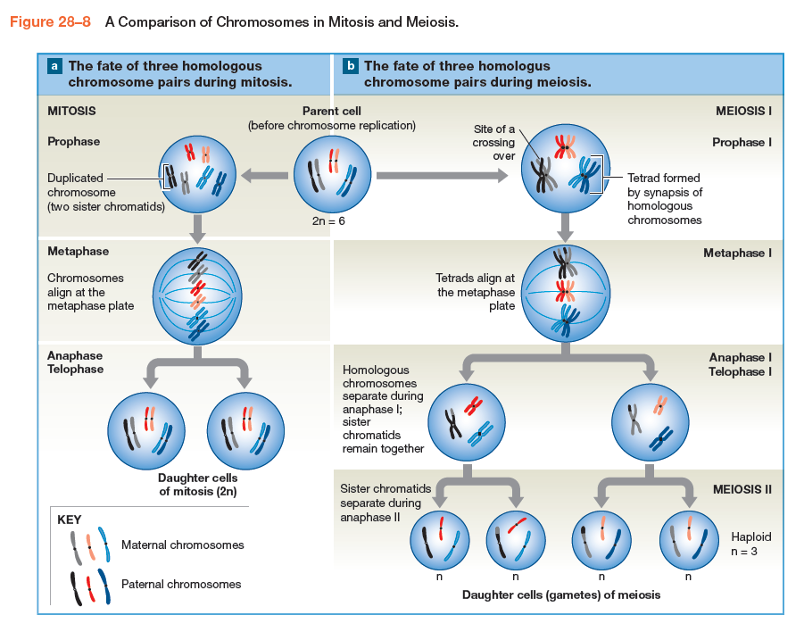

Slide 26
Spermatogenesis
As we have indicated, spermatogenesis is the process of sperm formation (Figure 28–9).
Spermatogenesis begins at puberty (sexual maturation) and continues until relatively late in life.
The complete process of spermatogenesis takes about 64 days.
It involves three steps:
  1. Mitosis. Spermatogonia are stem cells in the seminiferous tubules that undergo cell divisions throughout adult life.
  Some of these cells differentiate into primary spermatocytes, which prepare to begin meiosis.

Slide 27
Spermatogenesis cont…
2. Meiosis. Primary spermatocytes then undergo meiotic divisions that produce spermatids, undifferentiated male gametes.
3. Spermiogenesis: spermatids differentiate into physically mature sperm.
Spermatogenesis is a continuous process, so all stages of meiosis are seen within the seminiferous tubules.
Each seminiferous tubule contains spermatogonia, spermatocytes at various
stages of meiosis, spermatids, and sperm.
They also contain large nurse cells (Sertoli cells), which provide a microenvironment that supports spermatogenesis.
The sperm eventually lose contact with the nurse cells of the seminiferous tubule and enter the fluid in the lumen.

Slide 28
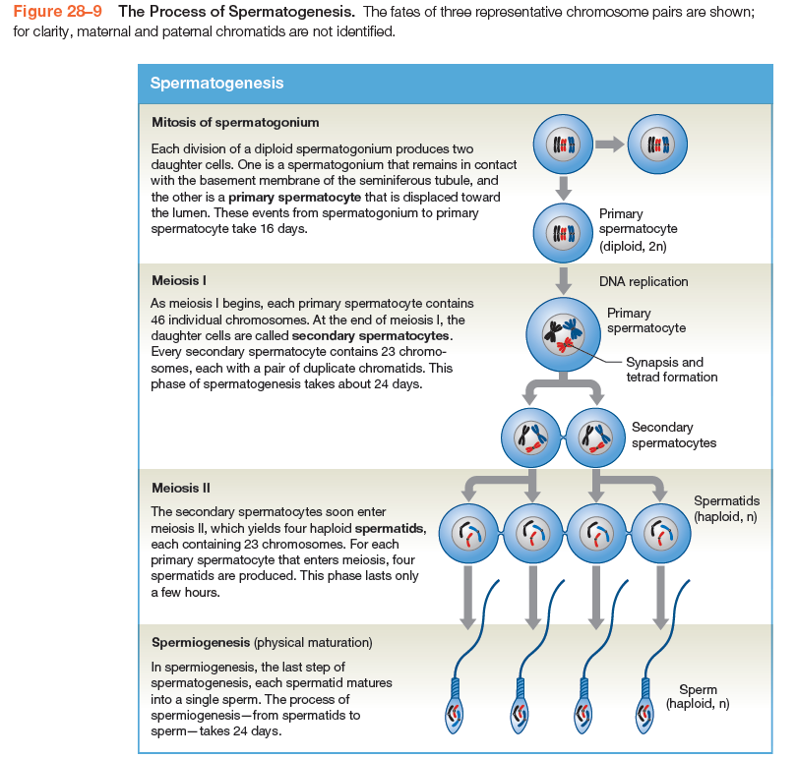

Slide 29
Spermatogenesis cont…
The four spermatids initially remain interconnected by bridges of cytoplasm because cytokinesis (cytoplasmic division) is not completed in meiosis I or meiosis II.
These connections assist in transferring nutrients and hormones between the cells, helping ensure that the cells develop together.
The bridges are not broken until the last stages of physical maturation.
In spermiogenesis, the last step of spermatogenesis, the spermatids gradually develop into mature sperm (Figures 28–9, 28–11).
At spermiation, a sperm loses its attachment to the nurse cell and enters the lumen of the seminiferous tubule.

Slide 30
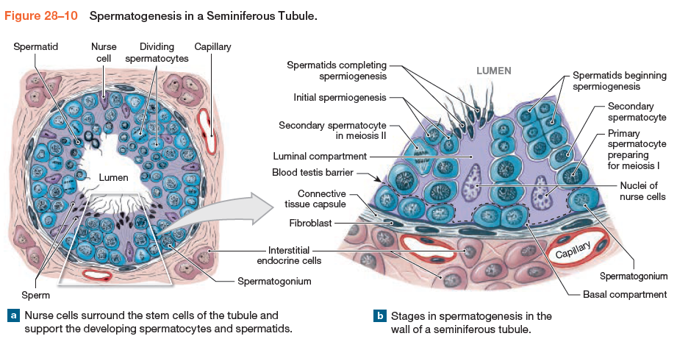

Slide 31
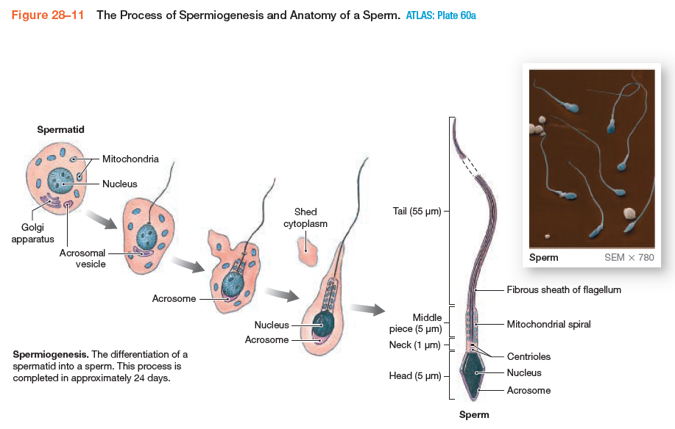

Slide 32

Any Questions?

