Slide 1
Zoo 651

Slide 2
- Content -
Cell culture.
ELISA.
Comet assay.
MTT assay.
Flow cytometry.
PCR.
Real-Time PCR.
Gel electrophoresis.
Western blotting.
Primers.
DNA sequencing.
SNP.
Immunohistochemistry.
Cell proliferation, migration and invasion assays.

Slide 3
Cell culture

Slide 4
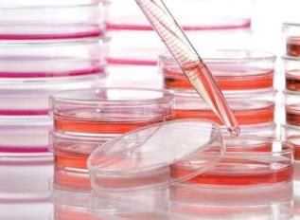
Cell culture
Cell culture is the process by which cells are grown under controlled artificial environment conditions, generally outside their natural environment, which stimulates the in vivo conditions such as temperature, nutrition and protection from microorganisms.
After the interest cells have been isolated from living tissue, then this cells can be maintained in vitro under carefully controlled conditions.

Slide 5
Cell culture
The cells may be removed directly or by mechanical or enzymatic action.
Examples of cells used to culture are fibroblast, lymphocytes, cells from cardiac and skeletal tissues, cells from liver, breast, skin, and kidney and different types of tumor cells.

Slide 6
- Types of animal cell culture-
Cell culture
Based on the number of cell division, cell culture can be classified as:
A
Primary cell culture.
B
Secondary cell culture and cell line.

Slide 7
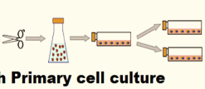
Cell culture
Primary cell culture
A. Primary cell culture:
Refers to the stage (primary step) of the culture after the cells are isolated straight from the host tissue, which can grow and proliferate on a suitable container under the appropriate conditions, thus the culture obtained is called primary cell culture.
Primary culture contains a very heterogeneous population of cells and most of the cells divide only for a limited life span.
Depending on their origin, primary cells grow either as an adherent monolayer or in a suspension.

Slide 8
- Primary cell culture is further classified based on the type of cell:
Cell culture
1
Adherent cells.
2
Suspension cells.

Slide 9
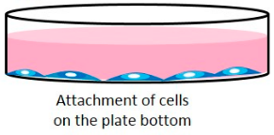
Cell culture
Adherent cells:
Also referred to as anchorage dependent cells, these are the type of cells that require attachment to a solid or semi-solid substrate for proliferation and growth, and this growth is limited to surface area.
These cells are propagate and forms as a monolayer.
Adherent cells are immobile.
Fibroblasts and epithelial cells are of such types.

Slide 10
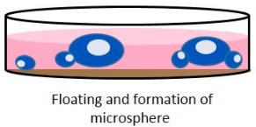
Cell culture
Suspension cells:
Suspension cells are also called anchorage independent or non-adherent cells which can be grown as free floating cells in the culture medium.
Suspension cells do not attach to the surface of the culture flasks.
Some example of cells that can be grown in suspension such as hematopoietic stem cells (derived from blood, spleen and bone marrow) and tumor cells.
These cells grow much faster which do not require the frequent replacement of the medium and can be easily maintained.

Slide 11
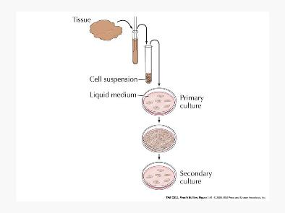
Cell culture
Secondary cell culture and cell line:
When primary cells is sub-cultured, then it called secondary cells or cell line or sub-clone.
Sub-culture:
Which is transfer of cell from one culture vessel to another by remove growth medium and detach adherent cells.

Slide 12
- Secondary cell culture or cell line is further divided based on the life span of culture into two types:
Cell culture
1
Finite cell lines.
2
Continuous cell lines.

Slide 13
Cell culture
Finite cell lines:
Go through a limited number of cell generation.
Limited life span.
Lose their ability to proliferate.
Less growth rate.
Properties:
Contact inhibition.
Density limitation.
Anchorage dependence.

Slide 14
Cell culture
Continuous cell lines:
The ability to divide and grow indefinitely.
This cells grow more in suspension.
They also have a tendency to grow on top of each other in multilayers on culture-vessel surfaces.
High growth rate.
Properties:
Absence Contact inhibition.
Absence Anchorage dependence.

Slide 15
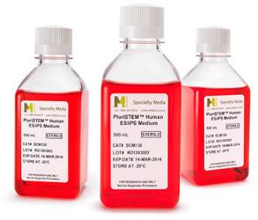
- Types of culture media-
Cell culture
There are two major types of culture media, these include:
A
Natural media.
B
Artificial media.

Slide 16
Cell culture
Natural media:
Natural culture media is composed of biological fluids that are naturally occurring.
Although this type of media can be used for a range of cells, but its biggest disadvantage is that it may lack the exact components required by given cells, which can greatly affect reproducibility.

Slide 17
Cell culture
Artificial media:
Also referred to as synthetic media, is the type of media that is produced by adding such nutrients as vitamins, gases (oxygen and carbon dioxide) and protein among others.

Slide 18
- Applications of cell culture-
Cell culture
Cell culture have many applications such as:
Cellular and molecular biology.
Providing excellent model systems for studying the normal physiology and biochemistry of cells.
Mutagenesis.
Toxicity Testing:
Animal cell culture is used to study the effects of new drugs on survival and growth of a number of types of cells.

Slide 19
- Applications of cell culture-
Cell culture
Cell culture have many applications such as:
Cancer Research:
The basic difference between normal cell and cancer cell can be studied using animal cell culture technique.
Normal cells can be converted into cancer cells by using radiation, chemicals and viruses. Thus, the mechanism and cause of cancer can be studied.
Cell culture can be used to determine the effective drugs for selectively destroy only cancer cells.

Slide 20
ELISA

Slide 21
ELISA
Enzyme linked immunoabsorbent assay (ELISA) is a specific type of biochemical test, an immunological assay commonly used to detect and measure the presence or concentration of antibodies, antigens, proteins and glycoproteins present in biological samples.
Enzyme label:
In ELISA it is necessary to use any marker to know the antigen-antibody binding.
For such purpose we label either antigen or antibody with some materials that do not interfere with the binding.

Slide 22
ELISA
- Types of ELISA-
- There are four different types of ELISA based on the basis of binding structure between the antibody and antigen, include:
Direct ELISA.
1
Indirect ELISA.
2
Sandwich ELISA.
3
4
Competitive ELISA.

Slide 23
ELISA
Direct ELISA:
Only an enzyme-labeled primary antibody is used, meaning that secondary antibodies are not needed.
The enzyme-labeled primary antibody "directly" binds to the target (antigen) that is immobilized to the plate solid surface.
Next, the enzyme linked to the primary antibody reacts with its substrate to produce a visible signal that can be measured.
- In this way, the antigen of interest is detected.

Slide 24
ELISA
Indirect ELISA:
Both a primary antibody and a secondary antibody are used.
But in this case, the primary antibody is not labeled with an enzyme.
Instead, the secondary antibody is labeled with an enzyme.
The primary antibody binds to the antigen immobilized to the plate, and then the enzyme-labeled secondary antibody binds to the primary antibody.
Finally, the enzyme linked to the secondary antibody reacts with its substrate to produce a visible signal that can be measured.

Slide 25
ELISA
Sandwich ELISA:
The antibody that is immobilized to the plate, and this antibody is called capture antibody.
In addition to capture antibody, sandwich ELISA also involves the use of detection antibodies, which generally include the unlabeled primary detection antibody and the enzyme-labeled secondary detection antibody.

Slide 26
ELISA
Sandwich ELISA:
Firstly, the antigen of interest binds to the capture antibody immobilized to the plate.
Secondly, the primary detection antibody binds to the antigen.
Thirdly, the secondary detection antibody binds to the primary detection antibody, and then the enzyme reacts with its substrate to produce a visible signal that can be measured.

Slide 27
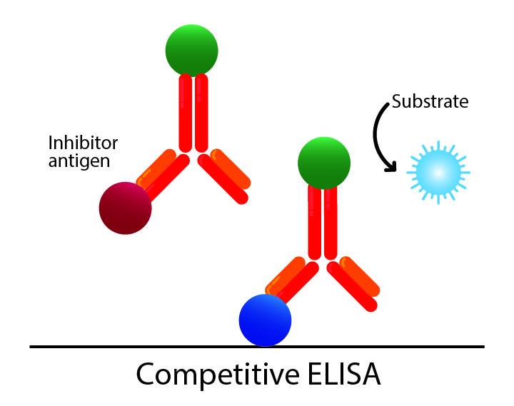
ELISA
Competitive ELISA:
Is relatively complex because it involves the use of inhibitor antigen, so competitive ELISA is also known as inhibition ELISA.
In competitive ELISA, the inhibitor antigen and the antigen of interest compete for binding to the primary antibody.
Firstly, the unlabeled primary antibody is incubated with the sample containing the antigen of interest, leading to the formation of antigen-antibody complex (Ag-Ab).
In this step, the antibody is excessive compared with the antigen, so there are free antibodies left.

Slide 28
ELISA
Competitive ELISA:
Secondly, the Ag-Ab mixture is added to the plate coated with inhibitor antigen that can also bind to the primary antibody.
The free primary antibody in the mixture binds to the inhibitor antigen on the plate, while the Ag-Ab complexes in the mixture do not and are therefore washed off.
Thirdly, the enzyme-labeled secondary antibody is added to the plate and binds to the primary antibody bound to the inhibitor antigen on the plate.
Finally, a substrate is added to react with the enzyme and emit a visible signal for detection.

Slide 29
- Applications of ELISA -
ELISA
Determination of serum antibody concentrations in a virus test.
Used in food industry when detecting potential food allergens.
Tracking the spread of disease in disease outbreaks.
Detecting infections.
Measuring toxins in contaminated food.
Used in tumor tests.
Presence of antigen or the presence of antibody in a sample can be evaluated.
Detection and measurement of antigen.
Detection and measurement of antibodies to past exposure to disease.

Slide 30
Comet assay

Slide 31
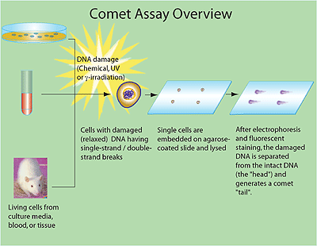
Comet assay
Also known as single cell gel electrophoresis (SCRE), is a simple method for measuring and determining whether there has been deoxyribonucleic acid (DNA) damage to a single cell from apoptosis (cell death) or cytotoxicity (toxicity to cells) and the extent of this damage.
In this case, damage is defined as single or double-stranded breaks in the DNA and this damage can be caused by chemicals or UV radiation.

Slide 32
- Applications of comet assay -
Comet assay
The assay has applications, such as:
Used in oncology to screen for genotoxicity (damage to genetic materials).
Used in testing novel chemicals for genotoxicity.
Monitoring environmental contamination with genotoxins.
Human bio-monitoring and molecular epidemiology.
Fundamental research in DNA damage and repair.

Slide 33
MTT assay

Slide 34
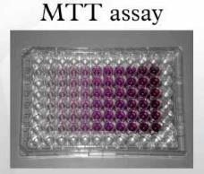
MTT assay
The MTT assay is a colorimetric assay system and is used to measure cellular metabolic activity as an indicator of cell viability, proliferation and cytotoxicity.
The MTT assay is consider to be important, because is:
Measuring cellular proliferation (cell growth) in response to external factors.
Allows to assess the viability (cell counting).

Slide 35
- Applications of MTT assay -
MTT assay
Used to determine cytotoxicity of potential medicinal agents and toxic materials, since those agents would stimulate or inhibit cell viability and growth.
Apoptosis screening.
Drug sensitivity.
Response to growth factors.
Cell activation.

Slide 36
Flow cytometry

Slide 37
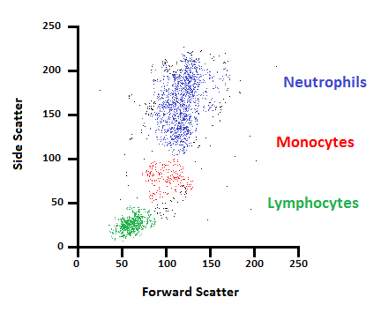
Flow cytometry
Flow cytometry (FC) is a technique used to detect and measure physical and chemical characteristics of a population of cells or particles.
Uses for flow cytometry include:
Cell counting.
Cell sorting.
Determining cell characteristics and function.
Detecting microorganisms.
Biomarker detection.
Protein engineering detection.
Diagnosis of health disorders such as blood cancers.

Slide 38
- Applications of flow cytometry -
Flow cytometry
It is used in clinical labs for the detection of malignancy in body fluids.
Cytometers like cell sorters can be used to separate the cells of interest.
It can be used for the detection of the content of DNA.
Flow cytometers allow the analysis of replication cells.
The different stages of cell death, apoptosis, and necrosis can be detected by flow cytometers based on the differences in the morphological and biochemical changes.

Slide 39
PCR

Slide 40
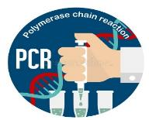
PCR
Polymerase chain reaction (PCR) is a technique used in molecular biology to amplify a single copy or a few copies of a segment of DNA, generating thousands to millions of copies of a particular DNA sequence to be then used for further testing.

Slide 41
- Components of PCR -
PCR
The key components of a PCR reaction are:
DNA template (that contains the DNA region (target) to amplify).
Primers (which are short single strand DNA fragments that are a complementary sequence to the target DNA region).
Taq polymerase (DNA polymerase enzyme that makes new strands of DNA, using existing strands as templates).
Nucleotides (DNA building blocks).

Slide 42
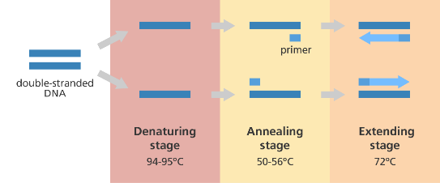
PCR
The basic steps are:
Denaturation (96°C):
Heating the reaction strongly to separate or denature the DNA strands.
This provides single-stranded template for the next step.

Slide 43
PCR
The basic steps are:
2- Annealing (55-65°C):
Cooling the reaction so the primers can bind to their complementary sequences on the single-stranded template DNA.

Slide 44
PCR
The basic steps are:
3- Extension (72°C):
Raising the reaction temperatures so Taq polymerase extends the primers, synthesizing new strands of DNA.

Slide 45
- Applications of PCR -
PCR
PCR is used to amplify genes associated with genetic disorders from the DNA of patients.
PCR can also be used to test for a bacterium or DNA virus in a patient's body.
Used to obtaining DNA for cloning genes.
DNA for sequencing purposes because the gene of interest can easily be amplified if flanking sequences are known.
Phylogenetic studies to amplify genes from various environmental sources.
Diagnostic microbiology.

Slide 46
Real-Time PCR

Slide 47
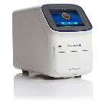
Real-time PCR
Real-time polymerase chain reaction (real-time PCR), is a laboratory technique of molecular biology based on the polymerase chain reaction (PCR), that allows the detection of PCR products as a targeted DNA molecule accumulate in "real-time" during the PCR amplification process.
Real-time PCR is commonly used to measure gene expression.
Its one major shortcoming is that the sequence of the specific target gene of interest must be known, hence real-time PCR can only be used for studying known genes.

Slide 48
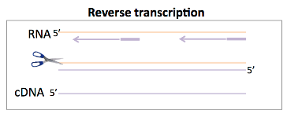
Real-time PCR
Real-time PCR steps:
The first step in a real-time PCR reaction is the conversion of RNA to cDNA this process is known as reverse transcription.
Complementary DNA (cDNA): is DNA synthesized from a single-stranded RNA (e.g., messenger RNA (mRNA) or microRNA (miRNA)) template in a reaction catalyzed by the enzyme reverse transcriptase.
The next step uses fluorescent reporters and a PCR reaction to amplify and detect specific genes.

Slide 49
- Applications of real-time PCR -
Real-time PCR
Applications that would have been less effective with traditional PCR.
Viral quantitation.
Quantitation of gene expression.
Drug-therapy efficacy.
DNA damage measurement.
Pathogen detection.
Genotyping.

Slide 50
Difference between PCR and RT-PCR
RT-PCR | PCR
is a variant of PCR used in the detection of gene expression in molecular biology. | is a technique used in molecular biology to amplify a segment of DNA generating millions of copies of a DNA sequence. | Definition
reverse transcription is followed by PCR | Denaturation, annealing, and extension are the three steps in PCR. | Steps
- A single-stranded RNA molecule serves as the template for the reverse transcription. - A single strand DNA molecule serves as the template for the PCR. | A double-stranded DNA molecule serves as the template for PCR. | Template

Slide 51
Difference between PCR and RT-PCR
RT-PCR | PCR
Reverse transcriptase and DNA polymerase are used as enzymes in RT-PCR. | DNA polymerase is used as the enzyme in PCR. | Enzymes Used
Only the reverse primer is used for the reverse transcription and both forward and reverse primers are used in the PCR. | Forward and reverse primers are used in the PCR. | Primers
is more sensitive than PCR. | is a sensitive method. | Sensitivity
is used in the detection of gene expression. | is used in functional analysis of genes, diagnosis, monitoring of hereditary diseases, DNA cloning, DNA sequencing and ancient DNA amplification. | Applications

Slide 52
Gel electrophoresis

Slide 53
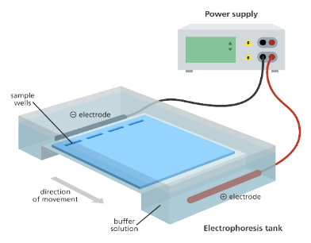
Gel electrophoresis
Gel electrophoresis is a technique commonly used for separation and analysis of macromolecules (DNA, RNA and proteins) and their fragments, according to their size and charge.

Slide 54
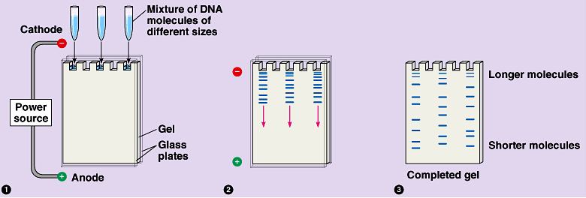
Gel electrophoresis
According to charge:
Charged molecules move through a gel when an electric current is passed across it.
An electric current is applied across the gel so that one end of the gel has a positive charge and the other end has a negative charge.
The movement of charged molecules is called migration.
Molecules migrate towards the opposite charge.
A molecule with a negative charge will therefore be pulled towards the positive end.

Slide 55
Gel electrophoresis
According to size:
Smaller molecules migrate through the gel more quickly and therefore travel further than larger fragments that migrate more slowly and therefore will travel a shorter distance.
As a result the molecules are separated by size.

Slide 56
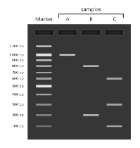
Gel electrophoresis
Gel electrophoresis and DNA:
Electrophoresis enables to distinguish DNA fragments of different lengths.
Gels for DNA separation are often made out of a polysaccharide called agarose.
DNA is negatively charged, therefore, when an electric current is applied to the gel, DNA will migrate towards the positively charged electrode.
Shorter strands of DNA move more quickly through the gel than longer strands resulting in the fragments being arranged in order of size.
The use of dyes, fluorescent, tags or radioactive labels enables the DNA on the gel to be seen after they have been separated.
They will appear as bands on the gel.

Slide 57
- Applications of gel electrophoresis -
Gel electrophoresis
Gel electrophoresis is widely used in the molecular biology and biochemistry labs, and some key applications of the technique are:
In the separation of DNA fragments for DNA fingerprinting to investigate crime scenes.
To analyze results of polymerase chain reaction (PCR).
To analyze genes associated with a particular illness.
In DNA profiling for taxonomy studies to distinguish different species.
In paternity testing using DNA fingerprinting.
In the study of structure and function of proteins.
In the analysis of antibiotic resistance.
In blotting techniques for analysis of macromolecules.

Slide 58
Western blotting

Slide 59
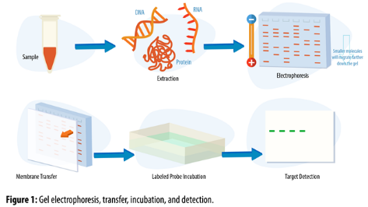
Western blotting
Western blotting (also called immunoblotting, because an antibody is used to specifically detect its antigen) is technique for protein analysis.
The term “blotting” refers to the transfer of biological samples from a gel to a membrane and their subsequent detection on the surface of the membrane.

Slide 60
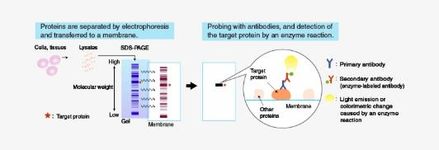
Western blotting
The steps of western blotting technique:
In this technique, a mixture of proteins is separated based on molecular weight, and thus by type, through gel electrophoresis.
In order to make the proteins accessible to antibody detection, These results are then transferred from within the gel onto a membrane.

Slide 61
Western blotting
The steps of western blotting technique:
After transferring, the membrane has the ability to bind to proteins.
In this case, both the target and antibodies are proteins and so there could be some unwanted binding.
Blocking of non-specific binding is achieved by placing the membrane in a dilute solution of protein. Then, the protein in the dilute solution attaches to the membrane in all places where the target proteins have not attached.
Thus, when the antibody is added, there is no place on the membrane for it to attach other than on the binding sites of the specific target protein.

Slide 62
Western blotting
The steps of western blotting technique:
The detection of the target protein, there are two steps:
Primary antibody:
After blocking, a dilute solution of primary antibody is incubated with the membrane.

Slide 63
Western blotting
The steps of western blotting technique:
Secondary antibody:
After rinsing the membrane to remove unbound primary antibody, the membrane is exposed to another antibody, directed at a species-specific portion of the primary antibody.
Several secondary antibodies will bind to one primary antibody and enhance the signal.

Slide 64
- Applications of western blotting -
Western blotting
To determine the size and amount of protein in given sample.
Disease diagnosis: detects antibody against virus or bacteria in serum.
Western blotting technique is the confirmatory test for HIV. It detects anti HIV antibody in patient’s serum.
Definitive test for Lyme disease, Hepatitis B and Herpes.
Useful to detect defective proteins.
Western blotting test is used in the analysis of biomarkers such as hormones, growth factors and cytokines.
This technique is also employed in the gene expression studies.

Slide 65
Primers

Slide 66
Primers
A primer is a short single-stranded nucleic acid, 18-20 base pair in length, utilized by all living organisms in the initiation of DNA synthesis.
Living organisms use solely RNA primers, while laboratory techniques in biochemistry and molecular biology that require in vitro DNA synthesis (such as DNA sequencing and polymerase chain reaction) usually use DNA primers, since they are more temperature stable.
A primer must be synthesized by an enzyme called primase, which is a type of RNA polymerase, before DNA replication can occur.

Slide 67
Primers
The synthesis of a primer is necessary because the enzymes that responsible for DNA replication, which are called DNA polymerases, can only attach new DNA nucleotides to an existing strand of nucleotides, and requiring a primer be bound to the template before DNA polymerase can begin a complementary strand.
The primer therefore serves to prime and lay a foundation for DNA synthesis.
The primers are removed before DNA replication is complete, and the gaps in the sequence are filled in with DNA by DNA polymerases.

Slide 68
Primers
Two type of primers:
Two primers are utilized, one for each of the complementary single strands of DNA:
The forward primer attaches to the start codon of the template DNA.
The reverse primer attaches to the stop codon of the complementary strand of DNA.
- The 5' ends of both primers bind to the 3' end of each DNA strand.

Slide 69
- Applications of primers -
Primers
These DNA primers are commonly used to perform the polymerase chain reaction to copy pieces of DNA or for DNA sequencing (in vitro).
These RNA primers are used in DNA replication (in vivo).

Slide 70
DNA sequencing

Slide 71
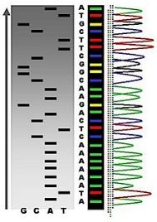
DNA sequencing
The process of determining the order of bases adenine (A), thymine (T), cytosine (C), and guanine (G) along a DNA strand.
All the information required for the growth and development of an organism is encoded in the DNA of its genome.
DNA sequencing is fundamental to genome analysis and understanding the biological processes in general.

Slide 72
- Applications of DNA sequencing -
DNA sequencing
There are a wide variety of medical applications for DNA sequencing, some examples include:
Targeted sequencing:
Sequencing of select variants or areas within a gene's exons or full exons (the segments of DNA that code for proteins).
Single gene sequencing:
Sequencing all exons of a gene, often including parts of the non-coding areas.

Slide 73
- Applications of DNA sequencing -
DNA sequencing
There are a wide variety of medical applications for DNA sequencing, some examples include:
Multi-gene panel sequencing:
Sequencing parts or all of several genes to detect mutations (disease-causing variants) that can cause a genetic disorder.
Whole genome sequencing.
Whole genome sequencing of microbes.

Slide 74
SNP

Slide 75
SNP
A single-nucleotide polymorphism (SNP):
The most common type of change in DNA.
SNPs occur when a single nucleotide (building block of DNA) at a specific position in the genome is replaced with another.
For example, at a specific base position in the human genome, the C nucleotide may appear in most individuals, but in a minority of individuals, the position is occupied by an A.
This means that there is a SNP at this specific position, and the two possible nucleotide variations (C or A ) are said to be the alleles for this specific position.

Slide 76
- Applications of SNP -
SNP
Some of these genetic differences, have proven to be very important in the study of human health:
SNPs may help predict an individual’s response to certain drugs, susceptibility to environmental factors such as toxins, and risk of developing particular diseases.
SNPs can also be used to track the inheritance of disease genes within families.

Slide 77
Immunohistochemistry

Slide 78
Immunohistochemistry
Immunohistochemistry (IHC) is the most common application of immunostaining.
It involves the process which is combines histological, immunological and biochemical techniques for selectively identifying antigens (proteins) in cells of a tissue section by exploiting the principle of antibodies binding specifically to certain antigens (markers) in biological tissues.
The antibodies are usually linked to an enzyme or a fluorescent dye.

Slide 79
Immunohistochemistry
After the antibodies bind to the antigen in the tissue sample, the enzyme is activated, and the antigen can then be seen under a microscope.
Immunohistochemistry makes it possible to visualize the distribution and localization of specific cellular components within a cell or tissue.

Slide 80
- Applications of immunohistochemistry -
Immunohistochemistry
Immunohistochemical staining is widely used in the diagnosis of abnormal cells such as those found in cancerous tumors.
It may also be used to help tell the difference between different types of cancer.
Specific molecular markers are characteristic of particular cellular events such as proliferation or cell death (apoptosis).
If cellular events associated with cancerous tumors (such as an increase in cell death) are evident in the tissue, then the abnormal activity will be highlighted by the stained tissue sample.
Immunohistochemistry cannot only help in the identification of a tumor, but it can also distinguish whether or not a tumor is benign or malignant.

Slide 81
- Applications of immunohistochemistry -
Immunohistochemistry
So, the applications of Immunohistochemistry can be include:
Prognostic markers in cancer.
Tumors of uncertain histogenesis.
Metastasis.
Responses to treatments.
Infections.
Neurodegenerative diseases.
Muscle diseases.
Brain trauma.

Slide 82
Cell proliferation, migration and invasion assays

Slide 83
Cell proliferation, migration and invasion assays
These assays can be perform in a label-free real-time settings using the xCELLigence real-time cell-based analysis (RTCA) technology.
The xCELLigence CIM assay:
The xCELLigence® real-time cell analysis (RTCA) DP Instrument in combination with CIM-plate® 16 devices (ACEA Biosciences) allows label-free, automated quantification of cell migration and invasion in real time under physiological conditions.
The xCELLigence CIM assay can be used to examine potential therapeutics and study the basic biology of migratory processes.
This CIM assay can track migration in real-time (at second or minute intervals) automatically without exogenous labels.

Slide 84
- Applications of cell proliferation, migration and invasion assays -
Cell proliferation, migration and invasion assays
Cell proliferation, migration and invasion assays is a key procedure involved in many biological processes including embryological development, tissue formation, immune defense or inflammation, and cancer progression.

Slide 85
Thanks

