Slide 1
Water Treatment 4. Softening
Water Softening
Hard water
Hard water is usually defined as water which contains a high concentration of Ca++ and Mg++ ions.
Water Softening
Softening is the removal of hardness from water.
Types of Hardness
Carbonate hardness (Temporary Hardness)
Calcium bicarbonate Ca(HCO₃)₂
Magnesium bicarbonate Mg(HCO₃)₂
Non-carbonate hardness (Permanent Hardness)
Calcium sulfate and chloride
Magnesium sulfate and chloride
Classification of water according to its hardness:
s
Soft | < 50 mg/L as CaCO₃
Moderately Soft | 50 – 150 mg/L as CaCO₃
Hard | > 150 – 300 mg/L as CaCO₃
Very Hard | >300 mg/L as CaCO₃

Slide 2
Water Treatment 4. Softening
Hardness Impact
Case water to form scales and resist to soap.
Clog pipes
Causes excessive use of soaps and detergents.
Hard water harms many industrial processes.
Ruin water heaters and boilers.
Reduce heating efficiency.

Slide 3
Water Treatment 4. Softening (Chemical Precipitation)
Water Softening Methods
Chemical precipitation: [lime – soda ash softening]. By using lime Ca(OH)₂ and soda ash Na₂CO₃
Advantages:
Aids in coagulation
Aids in disinfection
Help precipitates heavy metals.
Disadvantages
Large quantities of sludge

Slide 4
Water Treatment 4. Softening (Chemical Precipitation)
Chemistry of Precipitation Softening
Lime is added to remove carbonate hardness
Soda ash is added to remove non-carbonate hardness
CO₂ is applied after lime treatment to lower pH (re-carbonation).
Lime softening consists of raising the waters pH to produce calcium carbonate and magnesium hydroxide which settle out of the water.
Lime Softening
Ca(HCO₃)₂ + Ca(OH)₂ → 2 CaCO₃ ↓ + H₂O (pH=9.25)
Mg(HCO₃)₂ + Ca(OH)₂ → 2 CaCO₃ ↓ + Mg(OH)₂ ↓ + 2H₂O
Soda Ash Softening
CaSO₄ + Na₂CO₃ → CaCO₃ ↓ + Na₂SO₄
CaCl₂ + Na₂CO₃ → CaCO₃ ↓ + 2 NaCl
Lime-Soda Ash Softening
MgSO₄ + Ca(OH)₂ + Na₂CO₃ → CaCO₃ ↓ + Mg(OH)₂ ↓ + NaCO₃
Re-carbonation
Ca(OH)₂ + CO₂ → CaCO₃ ↓ + H₂O
CaCO₃ + CO₂ +H₂O → Ca(HCO₃)₂

Slide 5
Water Treatment 4. Softening (Cation-Exchange)
Hard water is passed through a filter bed containing cation-exchange media (resins) where Ca⁺⁺ and Mg⁺⁺ are absorbed on the media and an equivalent amount of Na⁺ is released into solution.
Note:
Resin: insoluble polymers containing fixed cations or anions capable of reversible exchange with mobile ions in the solution with which they are brought into contact.
When the media is exhausted, a strong sodium chloride solution (NaCl) is passed through the bed to regenerate the media with Na⁺.
Softening
Ca⁺⁺ CaR
+ Na R (Resin) → + Na⁺
Mg⁺⁺ MgR
Regeneration
Ca R Ca⁺⁺
+ NaCl → Na R +
Mg R Mg⁺⁺

Slide 6
Water Treatment 4. Softening (Cation-Exchange)
Example
For the water with the following chemical analysis to be softened by the cation-exchange process to zero hardness, sketch the meq/L bar graph of the softened water.
s
0
4
6
7.5
Ca⁺⁺ | Mg⁺⁺ | Na⁺
HCO₃⁻ | SO₄⁻⁻ | Cl⁻
0
5.3
6.2
7.5
0
7.5
Na⁺
HCO₃⁻ | SO₄⁻⁻ | Cl⁻
0
5.3
6.2
7.5

Slide 7
Water Treatment 4. Softening (Cation-Exchange)
Comparison between Chemical and Ion-Exchange Treatment
Large quantities of chemical sludge | Brine product
Hardness cannot be reduced to zero | Hardness can be reduced to zero
Economical | Alkalinity is not consumed
 | The softened water contains high level of Na+
 | Water must be free of turbidity, Fe, and Mn

Slide 8
Water Treatment Iron and Manganese Removal
Aeration, sedimentation and filtration
Aeration oxidize the soluble ferrous iron (Fe++) to insoluble ferric iron (Fe+++)
High removal of Mn++ is not possible by this technique because manganese cannot be oxidized as easily as iron with plain aeration.
Aerator: tray type aerator, water is distributed on top of a series of trays from which it drips down the stack.
Other types of aerators: spray nozzles, diffused air.

Slide 9
Water Treatment Iron and Manganese Removal
Aeration, Chemical Oxidation, Sedimentation and filtration.
The common method for the removal of Fe and Mn from well water without softening.
Aeration: to initiate oxidation of Fe⁺⁺ and Mn⁺⁺.
Chemical oxidation (e.g. potassium permanganate KMnO4, chlorine): to oxide Fe⁺⁺ and Mn⁺⁺:
Fe(HCO₃)₂ + KMnO₄ → Fe(OH)₃ ↓ + MnO₂ ↓
Ferrous bicarbonate Ferric hydroxide Manganese dioxide
Mn(HCO₃)₂ + KMnO₄ → MnO₂ ↓
Manganous bicarbonate Manganese dioxide
Theoretically, 1 mg/L of potassium permanganate oxidizes 1.06 mg/L of iron and 0.52 mg/L of manganese

Slide 10
Water Treatment Iron and Manganese Removal
Example
A well water supply contains 3.2 mg/L of iron and 0.8 mg/L of manganese. Estimate the dosage of potassium permanganate required for the iron and manganese oxidation.
KMnO₄ required = 3.2 x (1.0/1.06) + 0.8 x (1.0/0.52) = 3.02 + 1.54 = 4.6 mg/L

Slide 11
Water Treatment Taste and Odor Control
Causes of Taste and Odor
Ground water: dissolved gases (e.g. H₂S, volatile organics, salts, metals such as Fe)
Surface water: decayed vegetation (organics), algae, industrial wastes.
Measures for the control of taste and odor
Prevention measures:
Use of algicide to control of algae in surface water (e.g. copper sulfate).
Maintain a proper pH (not less than 6.5) in water distribution systems to control the dissolution of copper and iron in water.
Control discharges of industrial wastewater.
Treatment measures:
Aeration: to remove dissolved gases and volatile compounds.
Oxidation methods: use of oxidants (e.g. chlorine, KMnO₄, ozone)
Carbon adsorption: use of activated carbon (expensive).

Slide 12
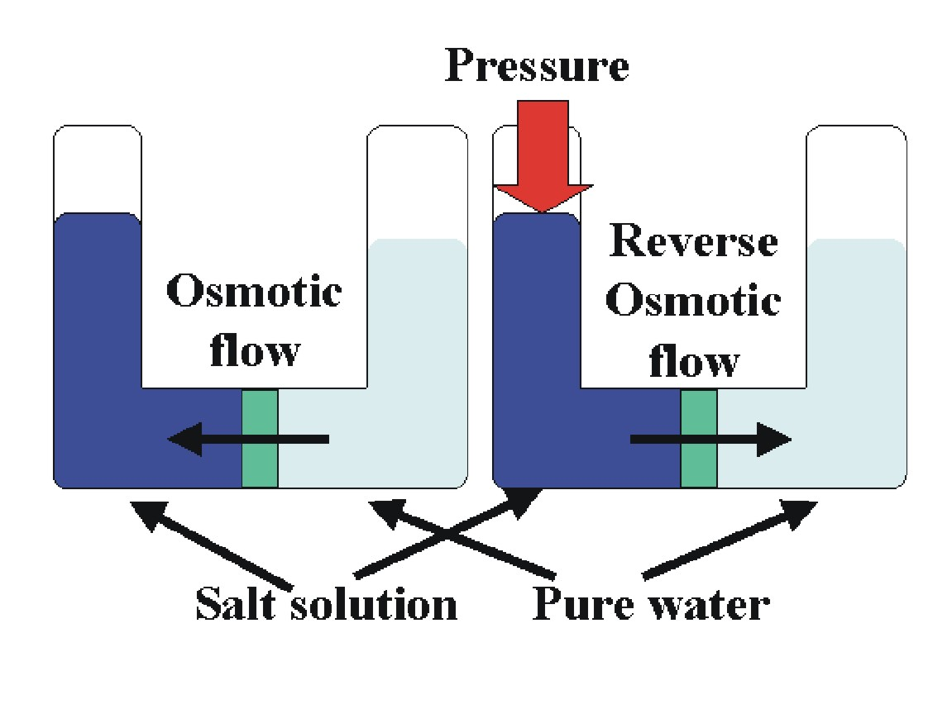
Water Treatment Removal of Dissolved Salts (Desalinization)
Processes used for desalinization/demineralization:
Distillation – Reverse Osmosis – Ion Exchange – Electrodialysis
Salinity of seawater = 35000 mg/L (mostly sodium chloride)
Salinity of brackish groundwater > 1000 mg/L
Reverse Osmosis
Osmosis: the process of diffusion/transfer of solvent (water) through a semi-permeable membrane from a solution of a lower to one of a higher concentration.
Reverse Osmosis: the forced passage of water through a semi-permeable membrane against the natural osmotic pressure to accomplish separation of water and ions.

Slide 13
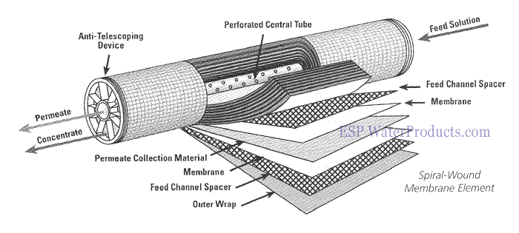
Water Treatment Removal of Dissolved Salts (Desalinization)
Membranes:
100 – 150 microns (skin layer < 1 micron + porous support structure)
Size of pores : 0.001 microns (theoretical).
Membrane material: cellulose acetate, polyamide.
Membrane configuration/modules:
Spiral-wound module
d

Slide 14
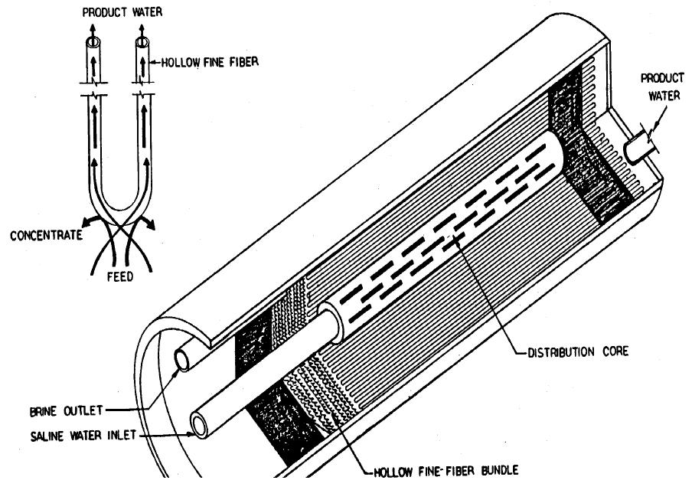
Water Treatment Removal of Dissolved Salts (Desalinization)
Membranes:
Membrane configuration/modules:
Hollow fiber module
Outside diameter of hollow fibers = 80 – 100 microns
Inside diameter = 40 microns

Slide 15
Water Treatment Removal of Dissolved Salts (Desalinization)
Operation pressure of RO systems: 350 – 1500 psi (24 – 1200 bar)
Note: Osmotic pressure of seawater = 350 psi
Osmotic pressure of groundwater is much less (because TDS is low)
Pretreatment
Saline water fed to RO system must be free of SS, organic matter, excessive hardness, and Fe and Mn to prevent fouling and scaling of membranes.
Pre-treatment Methods:
Coagulation and filtration: to remove turbidity, Fe and Mn.
Softening: to remove hardness
Adsorption (by AC): to remove organics.
Acidification (addition of H₂SO₄): to reduce pH to less than 6 to convert HCO₃⁻ to CO₂ gas in order to reduce CaCO₃ scale and oxidation of Fe and Mn.
Addition of scale inhibitors (e.g. hexametaphosphate): to prevent chemical scaling.

Slide 16
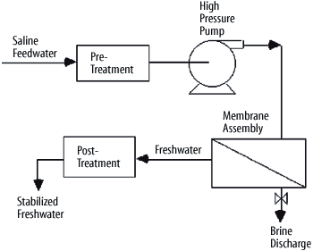
Water Treatment Removal of Dissolved Salts (Desalinization)
Post-treatment
Ro product (permeate) must be stabilized.
Post-treatment methods:
Aeration: to remove CO2.
Addition of lime and soda ash: to adjust pH to about 8.0.
Membrane Cleaning
Flushing with acid rinses and cleaning agents to remove buildup of salts, metal ions, organic matter, or biological growths.
Reject Brine
Reject Brine = 10 % to 30 % of the feed water.
s

Slide 17
Water Treatment Disinfection
Purpose of disinfecting drinking water: to kill micro-organisms that cause diseases in humans (pathogens).
Disinfectants:
Chlorine, Cl₂ → Chlorination
Calcium hypochlorite, Ca(OCl)₂ → Chlorination
Sodium hypochlorite, NaOCl → Chlorination
Chlorine dioxide, ClO₂ → Chlorination
Ozone, O₃ → Ozonation.
Ultraviolet radiation (UV) → Disinfection with UV.
Treatment processes assist in removing pathogens
Coagulation, settling, and filtration (over 90% removal is achieved).
Excess-lime softening (due to high pH involved).

Slide 18
Water Treatment Disinfection (1. Chlorination)
Chlorine is added to water in form of:
Chlorine gas (Cl₂): a greenish-yellow-colored, toxic gas. (supplied as liquefied gas in cylinder)
Salts:
Calcium hypochlorite, Ca(OCl)₂ (available in powdered, granular, pellet, or tablet forms used in swimming pool and small treatment plants, that contain about 70 % chlorine)
Sodium hypochlorite, NaOCl (available in liquid form at concentrations between 12 % and 15 % chlorine)

Slide 19
Water Treatment Disinfection (1. Chlorination)
Chemistry of Chlorine
Chlorine Reactions in Water
Cl₂ combines with water forming hypochlorous acid (HOCl):
Cl₂ + H₂O → HOCl + H⁺ + Cl⁻
HOCl ionizes into H+ and hypochlorite ion (OCl⁻) in a reversible reaction:
------- pH > 7.5 ------>
HOCl OCl⁻ + H⁺
<----- pH < 7.5 -------
Also calcium/sodium hypochlorites hydrolyze forming the hypochlorite ion (OCl⁻)
Ca(OCl)₂ + H₂O → 2 OCl⁻ + Ca⁺⁺ + H₂O
The killing efficiency of HOCl is about 40 to 80 times more than that of OCl-.
Therefore, chlorination is more effective at low pH because HOCl is more dominant.
Chlorine existing in water as HOCl and OCl- is called “free available chlorine”

Slide 20
Water Treatment Disinfection (1. Chlorination)
Chlorine reactions with Ammonia
Chlorine reacts with ammonia in water to form chloramines:
HOCl + NH₃ → H₂O + NH₂Cl (mono-chloramine) at a pH 4.5 – 8.5 and > 8.5
HOCl + NH₂Cl → H₂O + NHCl₂ (di-chloramine) at pH 4.5 – 8.5
HOCl + NHCl₂ → H₂O + NCl₃ (tri-chloramine) at pH < 4.4
Chlorine in the form chloramines is called “combined available chlorine”.
The addition of ammonia to chlorinated water to produce chloramines is called “chloramination”.
Chloramines are effective for disinfection but to a lesser degree than free available chlorine.

Slide 21
Water Treatment Disinfection (1. Chlorination)
Chlorine reactions with substances in water
When chlorine is added to water (dosages up to 1 mg/L according to the Figure shown below), it oxidizes any present compounds (reducing compounds: inorganic such as Fe⁺⁺, Mn⁺⁺, H₂S and NH₃ and organics) and is converted to chloride ion. And thus, it is totally consumed and no residual appears (point A).
If the initial dosage is higher (1 mg/L < dosage < 5 mg/L), chlorine reacts with ammonia to form chloramines, and reacts with organics to form chloro-organics. These products are called “combined chlorine residual” (points A and B).
As the chlorine dosage is increased further (point B to point C) some of the chloramines and chloro-organics are destroyed (to form N₂, nitrous N₂O) and thus the combined residual is reduced.
At point C, the combined residual reaches its lowest point (Point C is called the breakpoint).
Dosages in excess of point C, produce “free chlorine residuals” [“free” in the sense that it has not reacted with anything, and “available” in the sense that it can react if necessary].
The addition of chlorine to reach the breakpoint is called “breakpoint chlorination”.

Slide 22
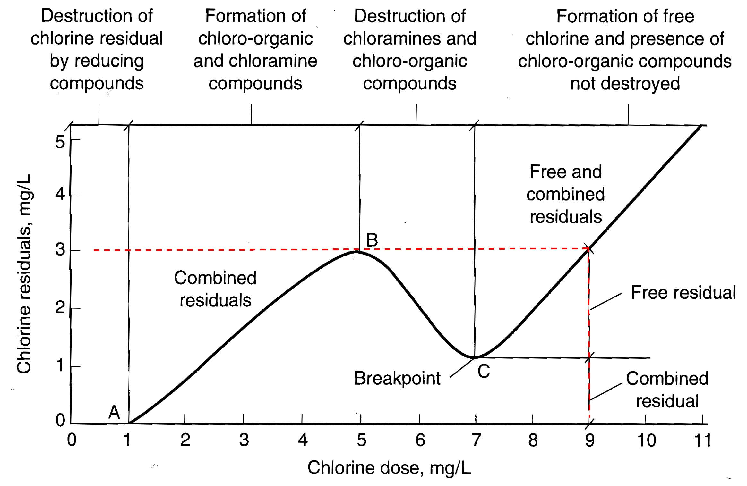
Water Treatment Disinfection (1. Chlorination)

Slide 23
Water Treatment Disinfection (1. Chlorination)
Disinfection By-Products (DBPs)
Chlorination of water containing natural humic organic substances produces toxic, carcinogenic chlorinated by-products:
Trihalomethanes, THMs (e.g. chloroform, CHCl₃, and bromodi-chloromethanes, CHBrCl₂).
Haloacetic acids, HAAs.
Control of Disinfection By-Products
Reduce the formation of DBPs by applying chlorine to later stages of treatment (e.g. after filtration) in order to remove humic organics before chlorination.
Application of activated carbon to absorb organics prior to chlorination.
Use of alternative disinfectants that do not form these DBPs (e.g. chloramines, ozone).

Slide 24
Water Treatment Disinfection (1. Chlorination)
Factors affecting the action of Chlorination
Dosage and contact time.
Tests must be done to determine the proper dosage of chlorine.
Sufficient contact time must be ensured to kill microorganisms (at least 30 minutes) depending on the temperature and pH.
Examples

Slide 25
Water Treatment Disinfection (2. Ozonation)
O₃ decomposes in water to produce oxygen and free hydroxyl radicals (HO and HO₂).
Very strong oxidant (more effective than chlorine)
Leaves no taste or odor
No residual is produced to protect water during distribution and transfer.
Must be generated on site because it decays rapidly.
More costly than chlorination.
Ozone forms carcinogenic and toxic DBPs such as aldehydes (e.g. formaldehyde), various acids (e.g. acetic acid), and brominated byproducts in the presence of bromide (e.g. bromate ion, bromoform, brominated acetic acids), and others.

Slide 26
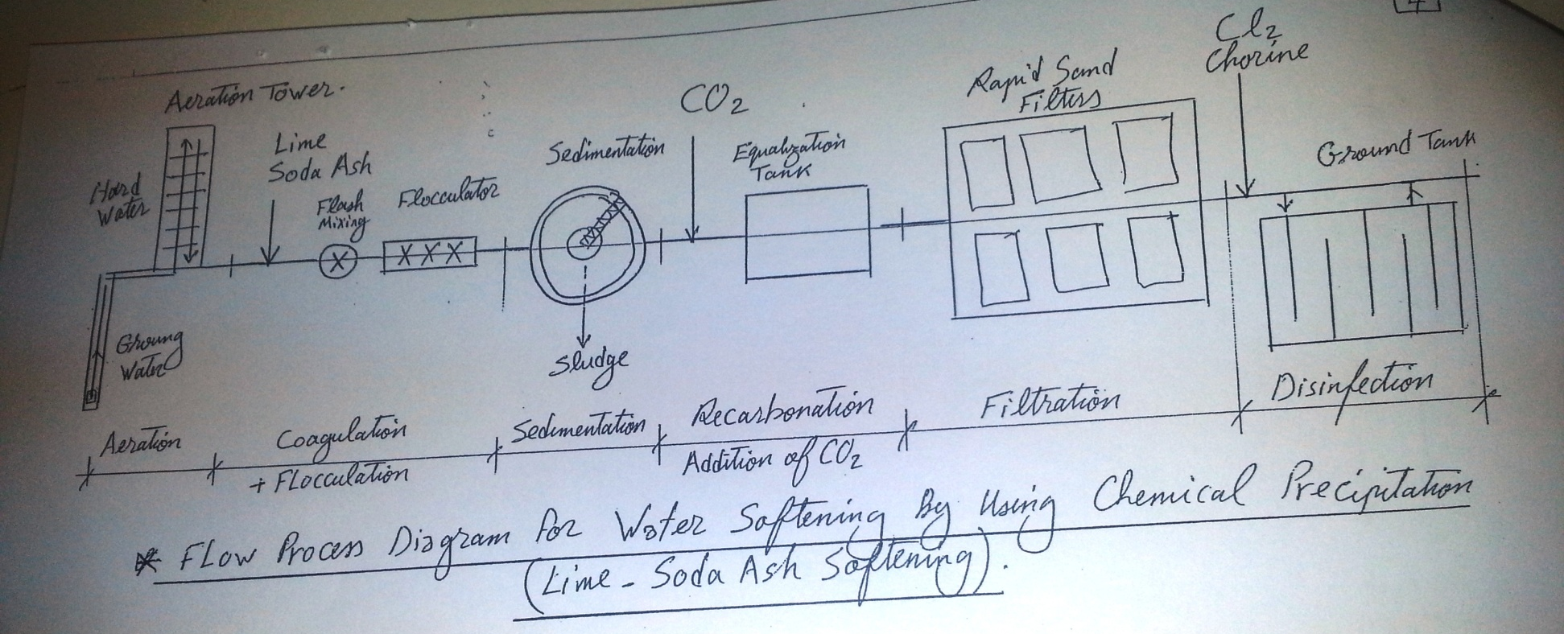

Slide 27
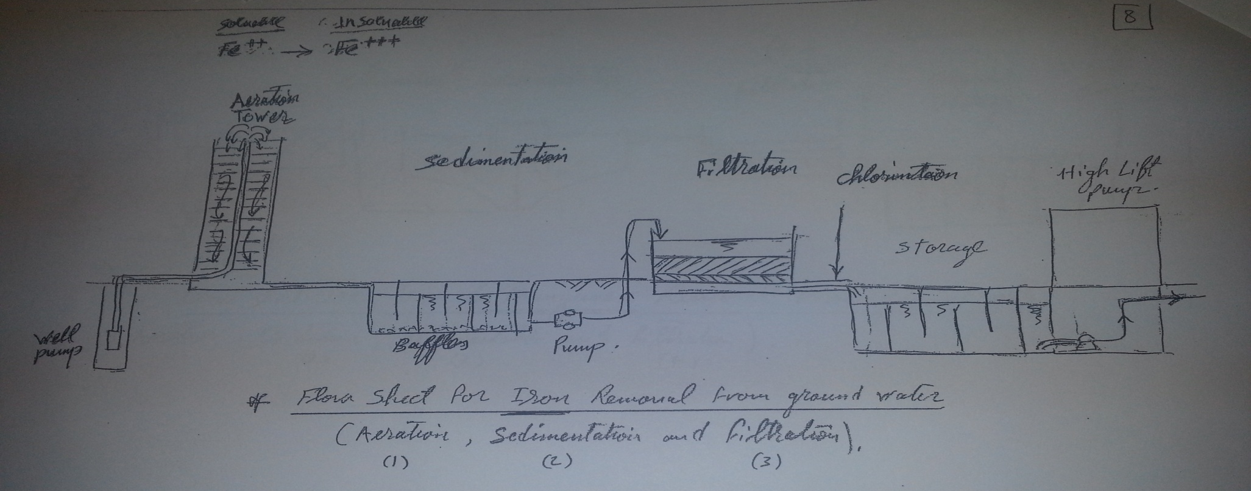

Slide 28
