Slide 1
Influences of Poly(Vinyl Alcohol) Molecular Weight and Carbon Nanotubes on Radiation-Crosslinking Shape Memory Polymers
Aamer A. M. Alfayyadh

Slide 2
Introduction
Overview of Shape Memory Polymers (SMPs):
Ability to return to original shape upon external stimulus.
Applications in various fields like aerospace and dynamic molds.

Slide 3
Objectives of the Study
To prepare and characterize chemically and radiation-crosslinked PVA/CEA nanocomposites.
To investigate the effects of molecular weight and carbon nanotubes (CNTs) on properties.

Slide 4
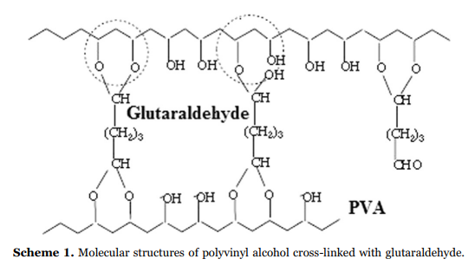
Materials and Methods
Materials Used:
PVA of two molecular weights (16,000 g/mol and 146,000 g/mol).
2-Carboxyethyl Acrylate (CEA), MWCNT, and MWCNT-NH2.
Methods:
Chemical crosslinking with glutaraldehyde.
Radiation crosslinking using gamma irradiation.

Slide 5
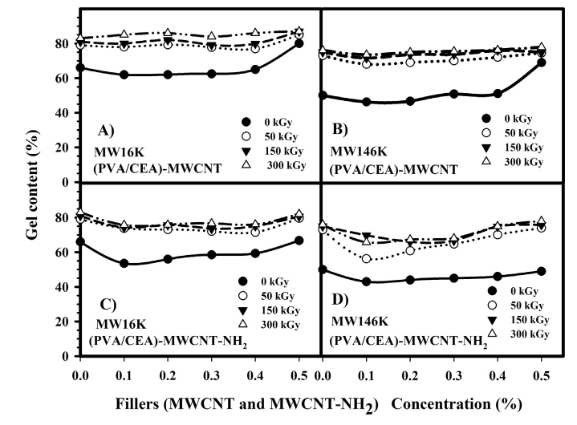
Gel Content Analysis
Gel content increases with irradiation dose and filler concentration.
Higher molecular weight PVA yields lower gel content compared to lower molecular weight.

Slide 6
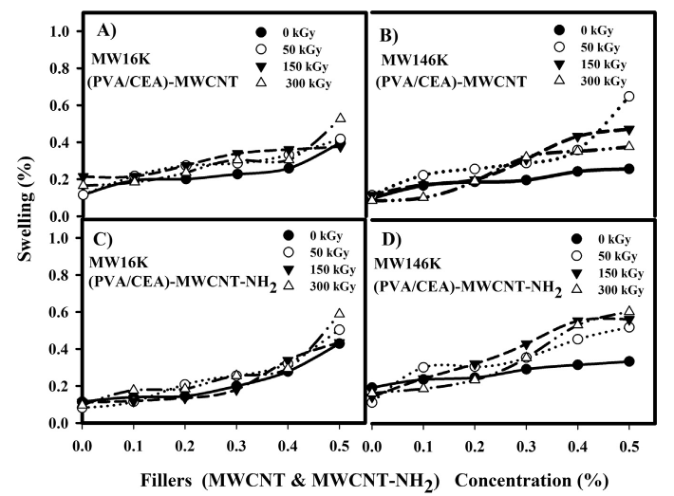
Swelling Behaviour
Swelling remains below 1%, indicating effective crosslinking.
Minimal swelling attributed to bound water and increased filler concentration.

Slide 7
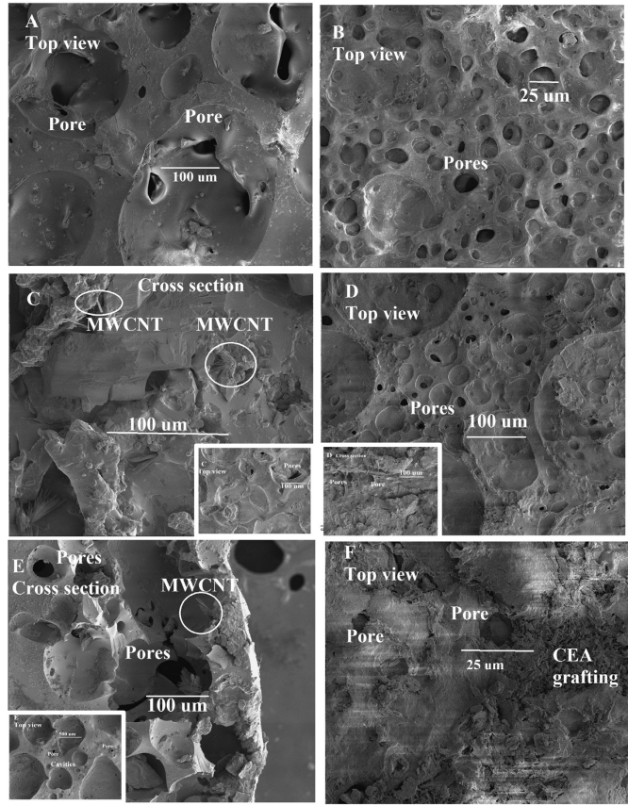
Morphology Observation
Homogeneous distribution of fillers in the polymer matrix.
Presence of pores and surface texture variations due to fillers.

Slide 8
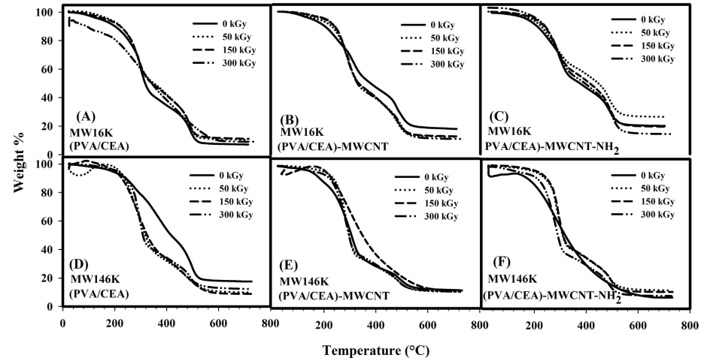
Thermogravimetric Analysis (TGA)
Three weight loss stages indicate degradation processes.
Higher molecular weight PVA shows decreased thermal stability with increased irradiation.

Slide 9
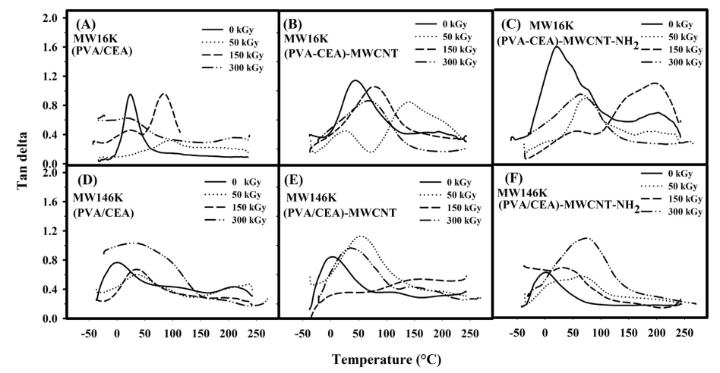
Dynamic Mechanical Analysis (DMA) - Tan Delta
Tan δ increases with the addition of MWCNT and MWCNT-NH2, indicating enhanced material response to thermal changes.

Slide 10
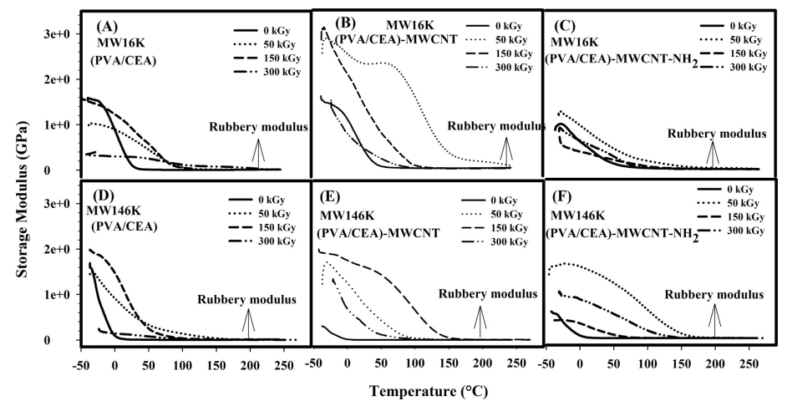
Storage and Rubbery Moduli
Storage modulus decreases with increased irradiation.
MWCNT-filled composites exhibit better mechanical properties than those without fillers.

Slide 11
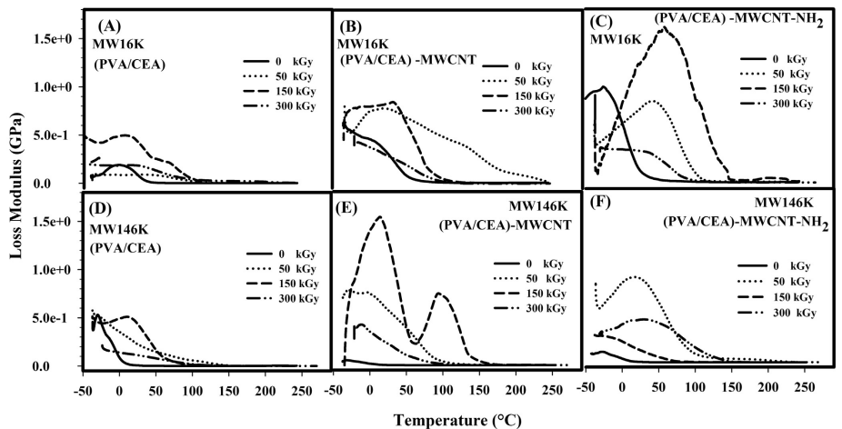
Loss Modulus
Higher loss modulus values for irradiated samples, indicating improved energy dissipation.

Slide 12
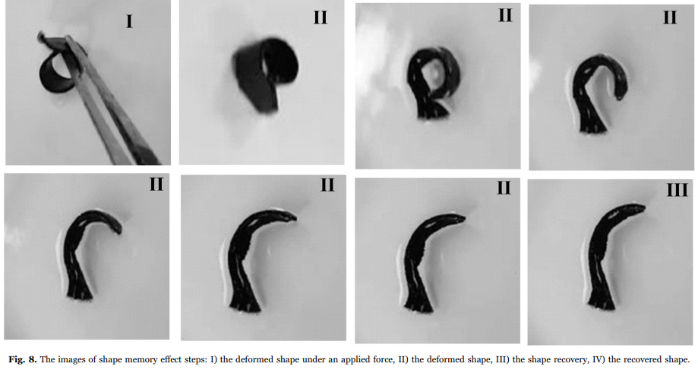
Shape Memory Effect
Demonstrates the ability of the material to recover its original shape after deformation.

Slide 13
Conclusions
Successful preparation of PVA nanocomposites with enhanced properties.
The addition of MWCNT and MWCNT-NH2 improves mechanical and thermal properties.

